Slide 1
Do Nows

Slide 2
Do Now 08/24/17
In July 2013, the FDA approved a new version of a drug used to treat opium dependence. The old version of the drug had received complaints about a bitter taste, an aftertaste, and that it took a long time to dissolve. The goal of the new version was to get more patients to take the drug as prescribed by addressing these issues. In addition to these improvements, experimenters monitored the existence and types of side effects of the drug.
Describe the W’s and variables (indicate type).

Slide 3
Answer:
Who: Patients being treated for opium addiction
What: Taste, aftertaste, time to dissolve, patient compliance, types of side effects
When: Prior to July 2013
Where: United States
How: Clinical trials
Why: To determine whether patients would comply with treatment better with the new version of the drug.
Categorical: taste, aftertaste, compliance, side effects
Quantitative: time to dissolve (minutes?)

Slide 4
Do Now 09/12/17
Business analysts hoping to provide information helpful to American grape growers compiled these data about vineyards: size (acres), number of years in existence, state, varieties of grapes grown, average case price, gross sales, and percent profit.
Describe the W’s and variables (indicate type).

Slide 5
Answer:
Who: Vineyards
What: Size of vineyard (in acres), number of years in existence, state, varieties of grapes grown, average case price (in dollars), gross sales (in dollars), and percent profit
When: Not specified
Where: United States
How: Not specified
Why: To provide information helpful to American grape growers
Categorical: State and variety of grapes grown
Quantitative: Size of vineyard, number of years in existence, average case price, gross sales, and percent profit

Slide 6
Do Now 09/13/17
In 2012, Consumer Reports rated bottomfreezer refrigerators. It listed 102 models, giving the brand, cost, size (cu ft), temperature performance, noise (poor, fair, etc.), ease of use, energy efficiency, estimated annual energy cost, an overall rating (good, excellent, etc.), and the exterior dimensions.
Describe the 1.) Population of Interest 2.) Who and What 3.) Identify variables and classify

Slide 7
Answer:
1. Population of Interest: All available bottomfreezer refrigerators of the 102 models in the market.
2. Who: 102 refrigerators
What: Brand, cost (probably in dollars), size (in cu. ft.), temperature performance, noise, ease of use, energy efficiency, estimated annual energy cost (probably in dollars), overall rating, exterior height, exterior length, and exterior width (all dimensions probably measured in inches).
3. Categorical: Brand, temperature performance, overall rating, noise, ease
of use, and energy efficiency
Quantitative: Cost, size, estimated energy cost, exterior height, exterior length, and exterior width

Slide 8
Do Now 09/14/17
1. What percent of females are brown-eyed?
2. What percent of brown-eyed students are female?
3. What percent of students are brown-eyed females?
4. What’s the distribution of Eye Color?

Slide 9
Do Now 09/15/17 The following table is consistent with the results from “Beverage Choices of Young Females: Changes and Impact on Nutrient Intakes”
a. What % of the young girls reported that they drink milk?
b. What % of the young girls were in the 1989-1991 survey?
c. What % of the young girls who reported that they drink milk were in the
1989-1991 survey?
d. What % of the young girls in 1989-1991 reported that they drink milk?

Slide 10
Do Now 09/18/17
a. What percent of the survivors were in second class?
b. What percent were second-class passengers who
survived?
c. What percent of the second-class passengers survived?”

Slide 11
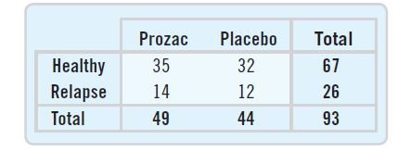
Do Now 09/19/17
Table above shows the result of 93 women treated for anorexia. Do these results provide evidence that Prozac might be helpful in treating anorexia? Explain.

Slide 12
Answer:
Data provide no evidence that Prozac might be helpful in treating anorexia. About 71% of the patients who took Prozac were diagnosed as “Healthy”, while about 73% of the patients who took a placebo were diagnosed as “Healthy”. Even though the percentage was higher for the placebo patients, this does not mean that Prozac is hurting patients. The difference between 71% and 73% is not likely to be statistically significant.

Slide 13
Do Now 09/20/17
Compare the percent who are female among the blue-eyed students to the percent of all students who are female.
Does it seem that Eye Color and Sex are independent? Explain.

Slide 14
Answer:
40% of the blue-eyed students are female, while 50% of all students are female.
Since blue-eyed students appear less likely to be female, it seems that Sex and Eye Color may not be independent. (But the numbers are small.)

Slide 15
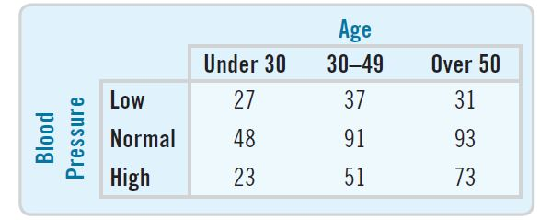
Do Now 09/21/17 A company held a blood pressure screening clinic for its employees. The results are summarized in the table below by age group and blood pressure level:
a) Write a brief description of the association between age and blood pressure among these employees.
b) Does this prove that people’s blood pressure increases as they age? Explain.

Slide 16
Answer:
In this company, as age increases, the percentage of employees with low blood pressure decreases, and the percentage of employees with high blood pressure increases.
b) No, this does not prove that people’s blood pressure increases as they age.
Generally, an association between two variables does not imply a cause-and – effect relationship. Specifically, these data come from only one company and cannot be applied to all people. Furthermore, there may be some other variable that is linked to both age and blood pressure. Only a controlled experiment can isolate the relationship between age and blood pressure

Slide 17
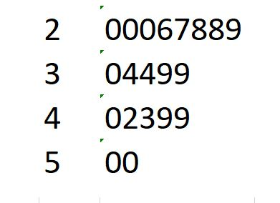
Do Now 09/22/17 Find the number of data values represented and the median for the stem plot below:

Slide 18
Answer:
n = 20 and median = 34

