Slide 1
15 School Days Left!

Slide 2
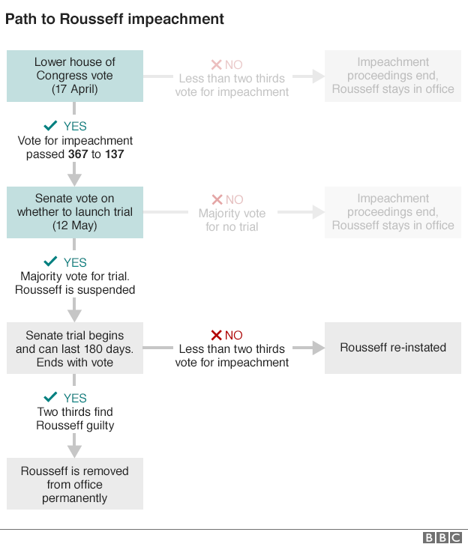

Slide 3
Current Events Quiz: 5/23
Panama Papers (what it is, significance)
Brussels attack (March 2016)
2016 election—who is left?
Houston floods (April 2016)
Political turmoil in Brazil

Slide 4
History of Australia/Oceania

Slide 5
Early Migrations
Settled the region more than 40,000 years ago
How??
Land bridge to Australia
Possible use of canoes & rafts…may have regarded exploration as a part of life

Slide 6
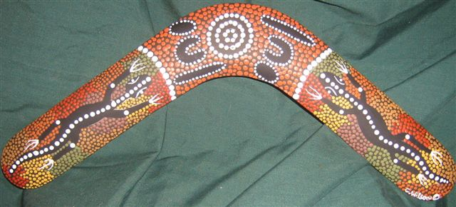
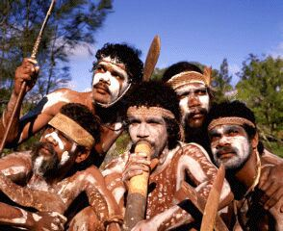
Indigenous Lifestyles: Australian Aborigines
Australian Aborigines
Natives living in desert areas (Outback)
Used routes to find water; were also able to trade & meet with other cultures
Used boomerangs to hunt animals

Slide 7
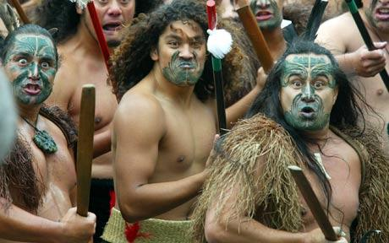
Meanwhile, in Oceania
Relied on fish, turtles and shrimp for food
Made voyages on canoes → trade between islands
Shell pieces = $$ (still used today in New Britain)
900s: Maori people of Polynesia settle in New Zealand

Slide 8
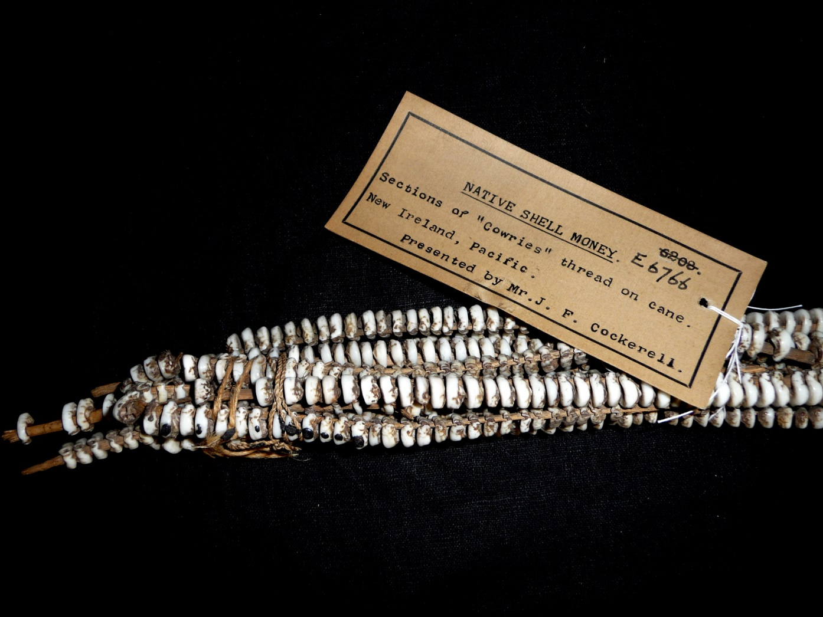
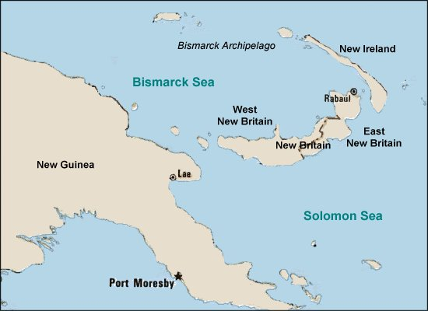

Slide 9
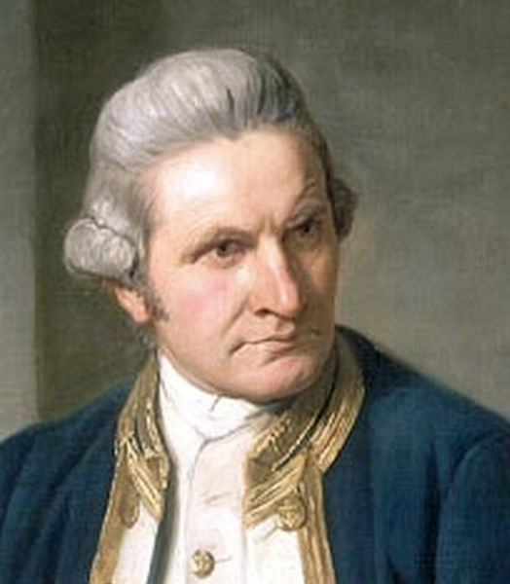
James Cook
British sailor who took three voyages to the South Pacific from 1768-1779
Claimed eastern Australia for the British
Circled Antarctica
Made accurate records & maps about this region

Slide 10
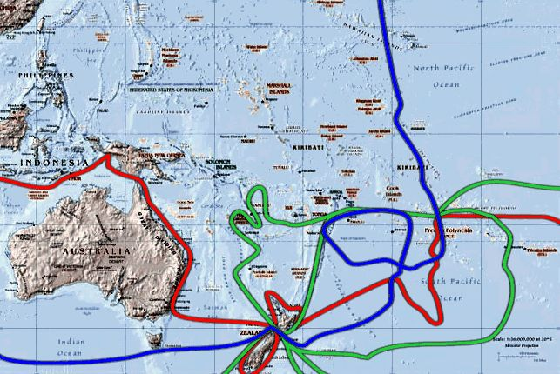
From ducksters.com
1st voyage = red 2nd = green 3rd = blue

Slide 11
British Australia
Eventually, Australia used as a convict colony
Housed convicts who were sent from overcrowded British prisons
Sydney, 1788
Fun fact: couldn’t use Georgia anymore because of the American Revolution!
By 1850: imprisonment ended!
People begin to establish farms and settlement → livestock
Gold discovered in 1850s → growing population, increase in mining

Slide 12
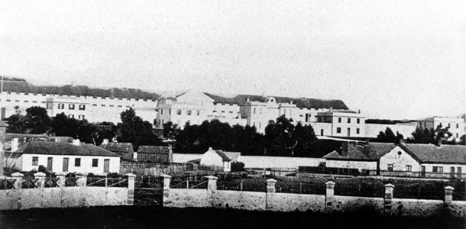
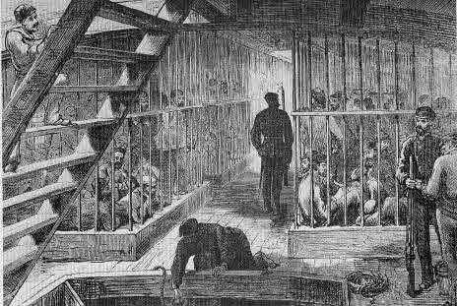
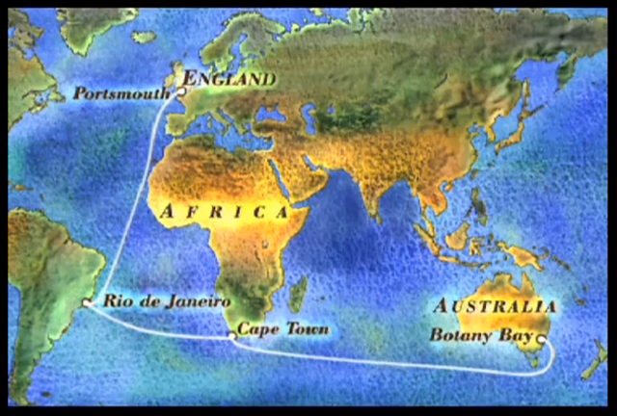

Slide 13
Oceania
Europeans also settling in various islands of Oceania
Why?
Excellent fishing waters
Fertile soil
Great climate (in the tropics)
Commercial plantations set up in Oceania
Sugarcane, pineapples among the crops grown
Introduced livestock → livestock becoming major part of New Zealand economy

Slide 14
Effect on Aborigines
More and more European settlements → Aborigines pushed from their homes
Denied basic human rights
Spread of disease → reduced Aborigine population
Couldn’t defend themselves against disease & weapons from Europeans
1910-1970: Aboriginal children removed from their homes, placed in “European” homes and/or boarding schools
Purpose—eradicate Aboriginal culture once and for all
100,000 children relocated, known as “Stolen Generation”

Slide 15
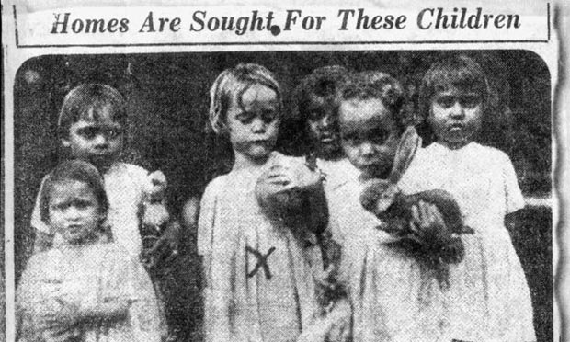
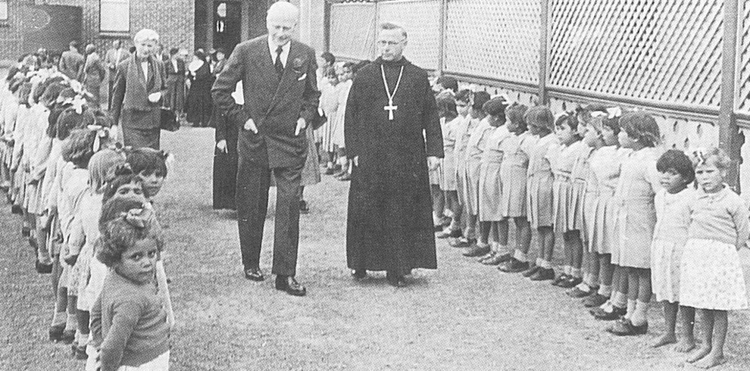
https://www.buzzfeed.com/allanclarke/do-you-know-what-sorry-day-is-about?utm_term=.peVyp13zWK#.oojQqWD4M6

Slide 16
Treaty of Waitangi (1840)
Placed Maori under British monarchy
British insisted this gave the Maori full rights
Maori didn’t believe the British would stay true to their word; wasn’t actually signed by many Maori chiefs
Disagreements → armed Maori resistance vs. British for 15 years
Oceania
Diseases → need for workers from other countries
Led to weakening of indigenous cultures in Oceania
Europeans continued to spread THEIR culture

Slide 17
World Wars
Many European powers struggling for control over Pacific islands before WW1 & WW2
Effect:
Japan lost their territories in Micronesia; turned over to USA as trust territories
Trust territories: dependent areas that the UN placed under temporary control of a foreign country
Most have now become independent countries

Slide 18
Independence
Most of the region gained independence in the 1900s
Australia & New Zealand were peaceful; became dominions (self rule under British Empire)
1901: Australia
1907: New Zealand
Modern-day:
Looks to US for more trade & military protection
Developed national characteristics
Aborigines & Maori have greater rights

Slide 19
Independence
1962: Samoa was first small Oceania island to win independence (from New Zealand)
Most Oceania islands today are independent
Some have been met with ethnic conflict stemming from colonial rule
Fiji & Solomon Islands

Slide 20
Antarctica
Europeans first saw it in 1800s, but thought it had no value
1900s: Amundsen (Norway) & Scott (UK)
Dramatic race to South Pole→ opened Antarctica for exploration
Wanted new trading routes, seal-hunting areas & mineral resources
Antarctic Treaty: 1959
Signed by 12 countries to encourage peaceful scientific research
1991: additional agreement to ban mining and to protect environment in Antarctica

Slide 21
