Slide 1
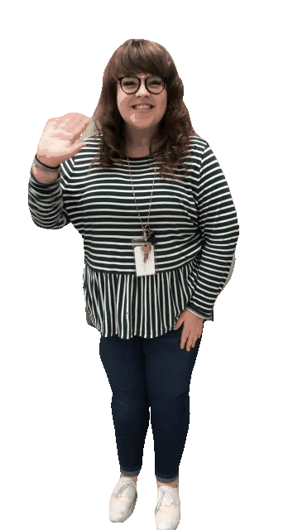

Slide 3
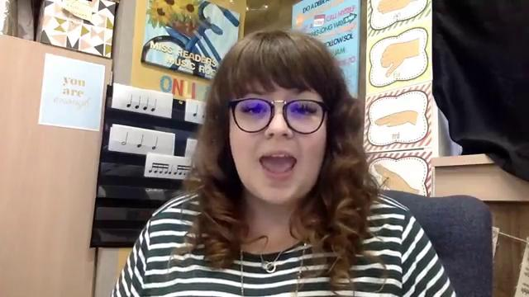

Slide 4
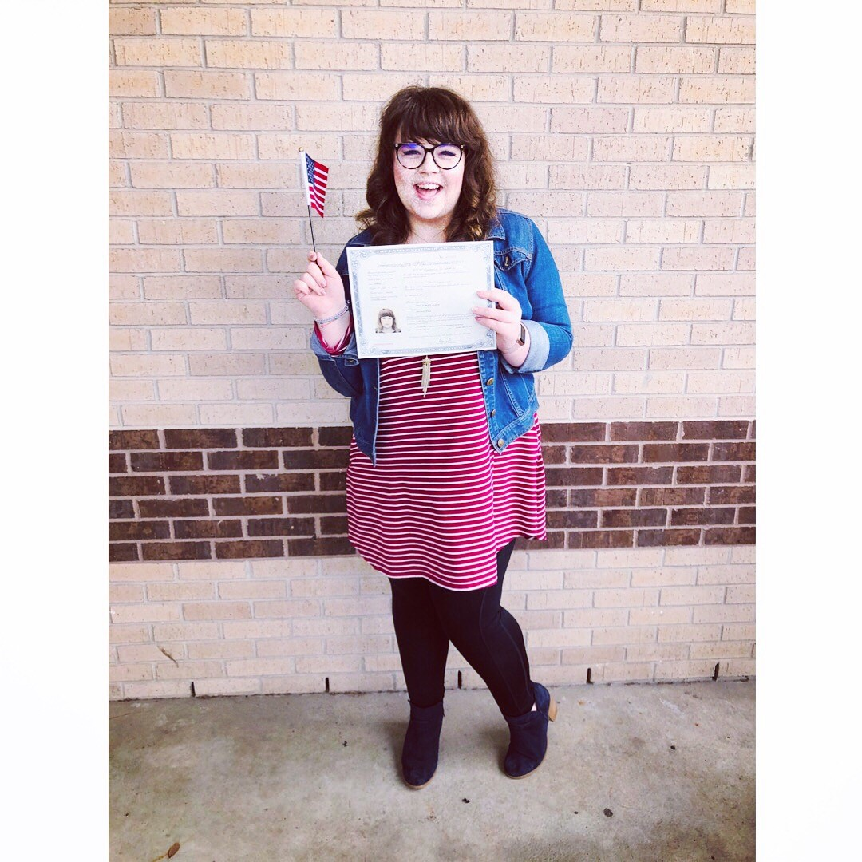
This is my 4th Year at scanlan oaks
I became a u.s citizen in february
My favourite movie is the sound of music
I’m a gryffindor
I root root root for the astros!!

Slide 5
I have one cat
My favorite food is pickles
I sang for the queen of england

Slide 6
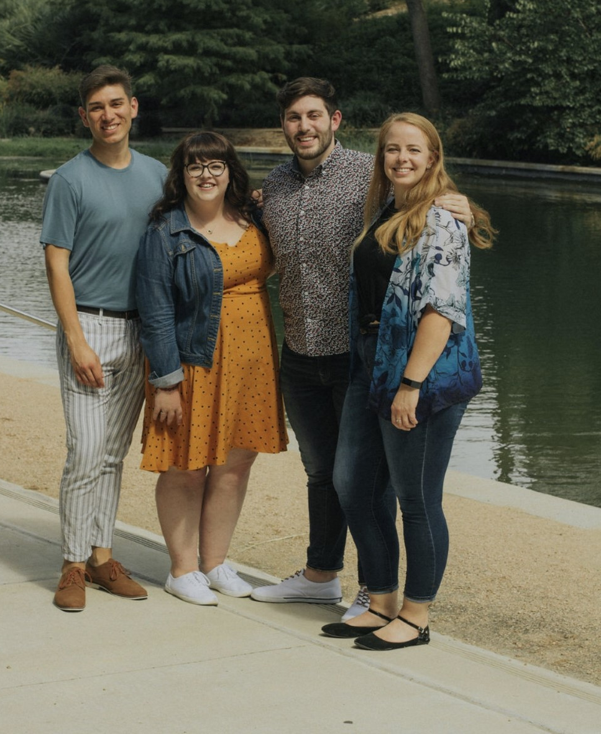
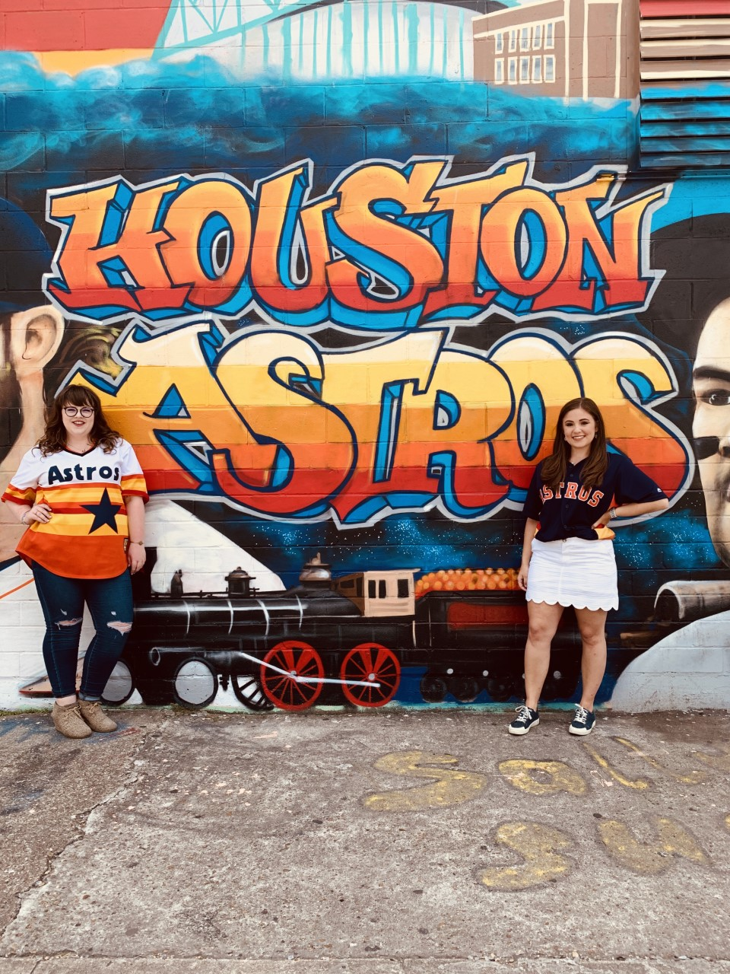
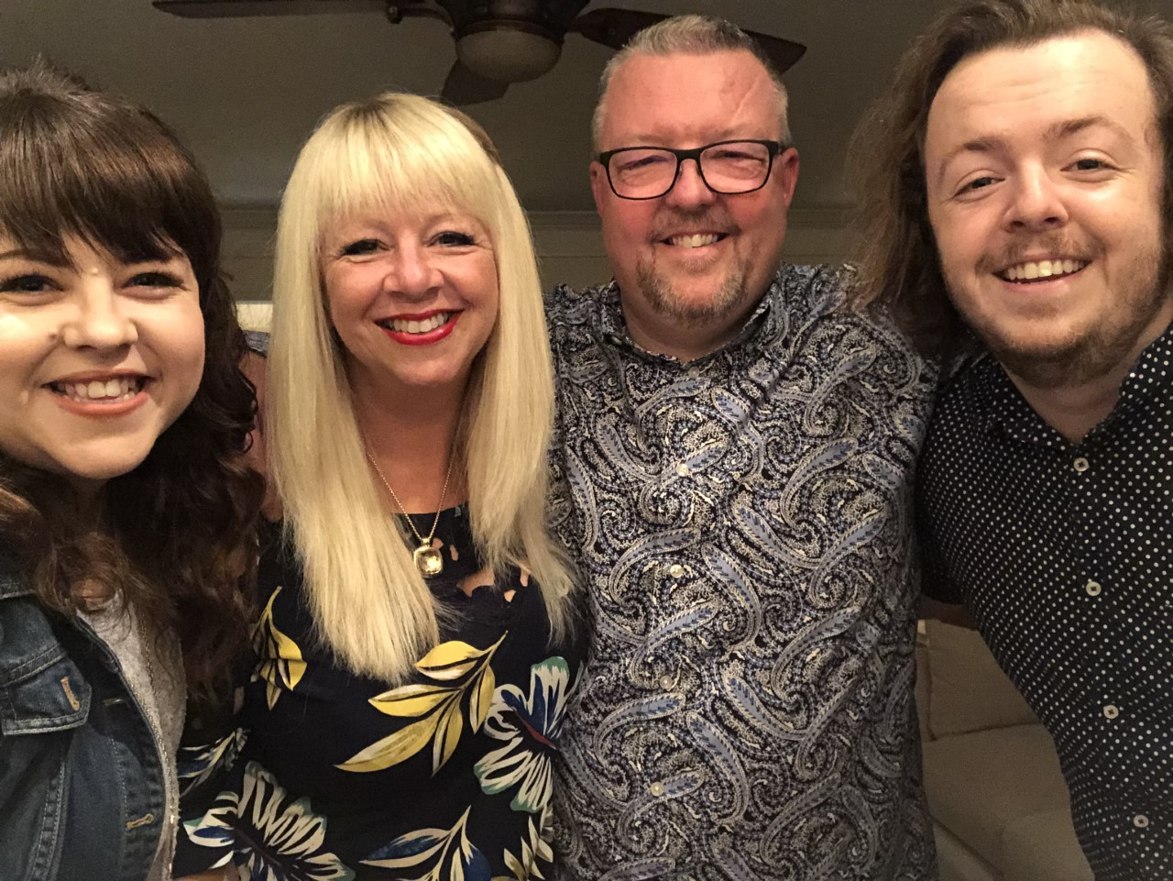
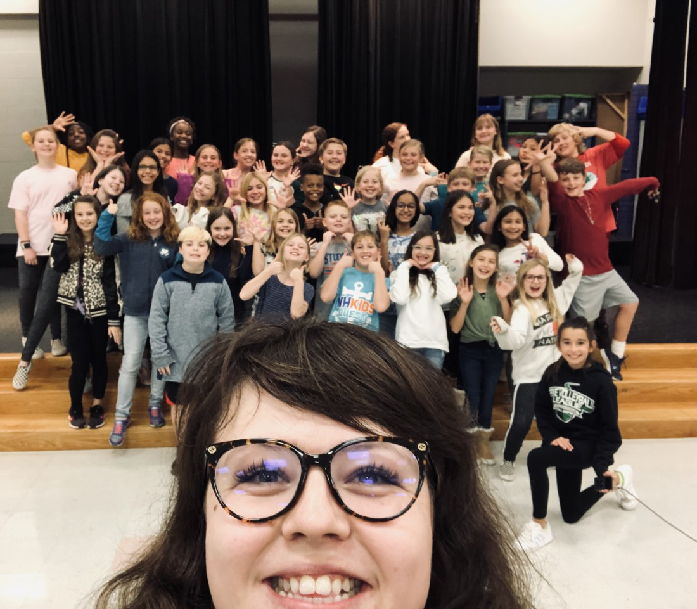
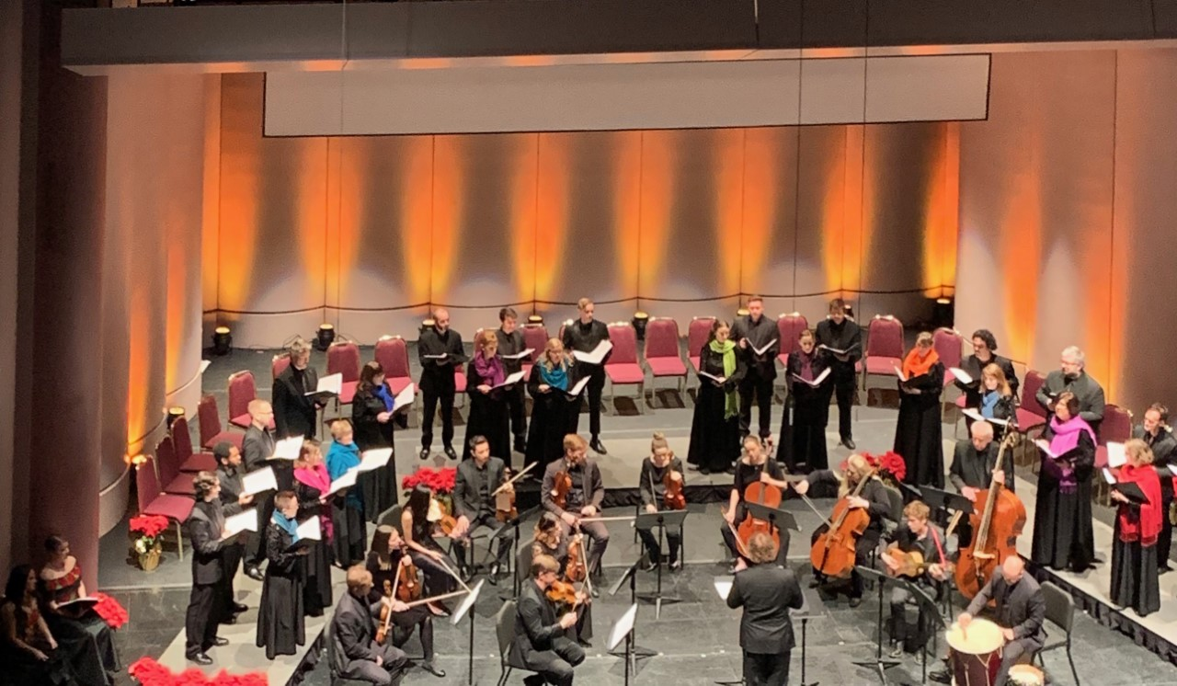
BEST
FRIENDS
mY FAMILY
ASTROS
sHOW
cHOIR
PERFORMING WITH THE SYMPHONY CHORUS

Slide 8
emily.reader@fortbendisd.com
@scanlansings
281-327-7941

