Slide 1
Environment of Australia, Oceania & Antarctica

Slide 2
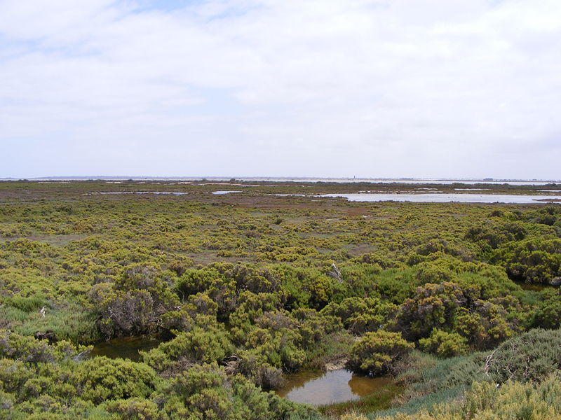
Cause for Concern: Australia
Wheat Belt
May be reduced by 40% due to growing, salty swamps over the next 20 years
Why?
Underwater salt water (from Great Artisan Basin) seeps up from the ground → salty swamps

Slide 3
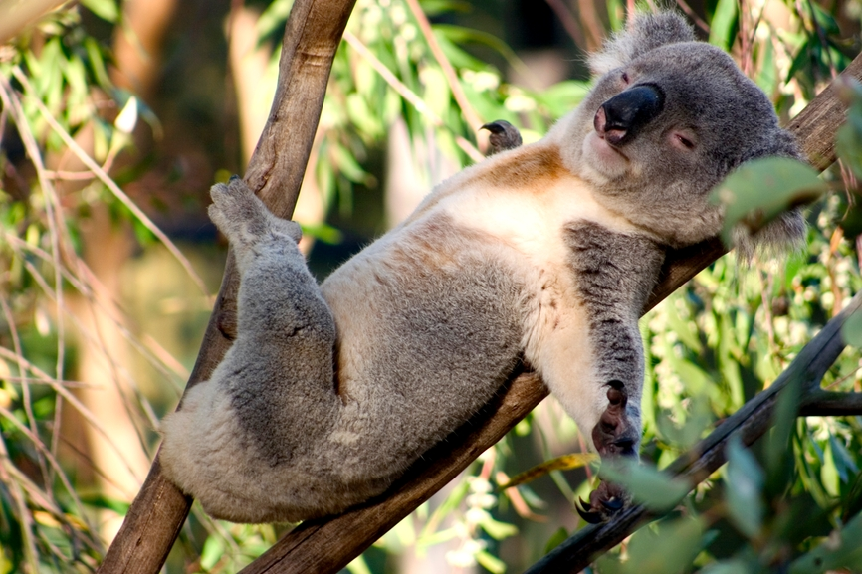
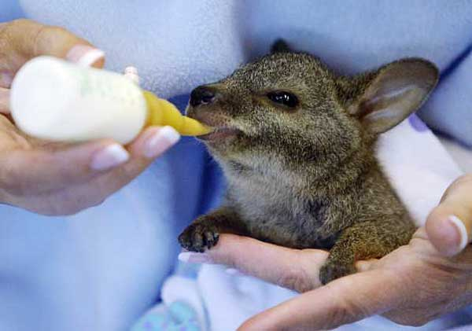
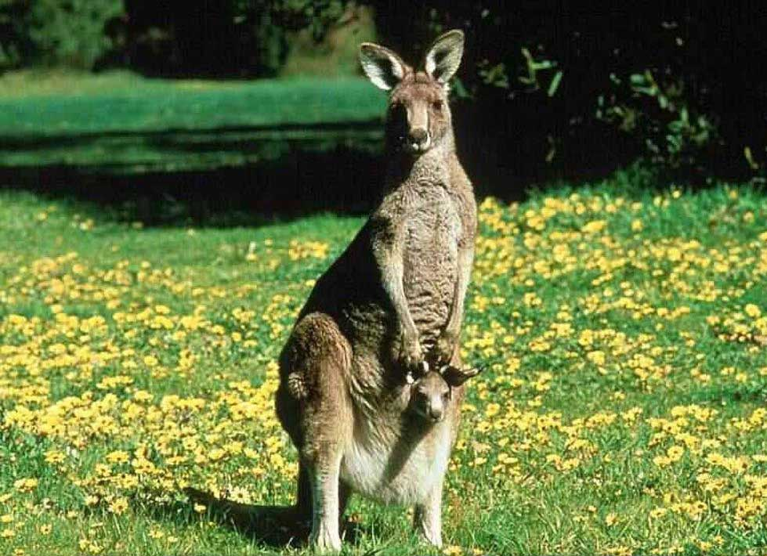
Cause for concern: Australia
Animals
Introduced species are throwing off balance
Taking over native species’ habitats → extinction
Introduced species = dingoes
Native, “unusual” animals: koalas, kangaroos & wallabies

Slide 4
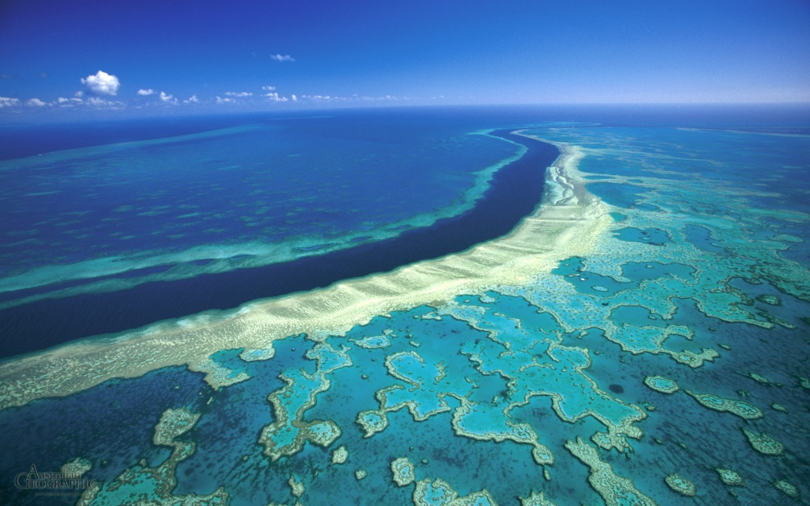
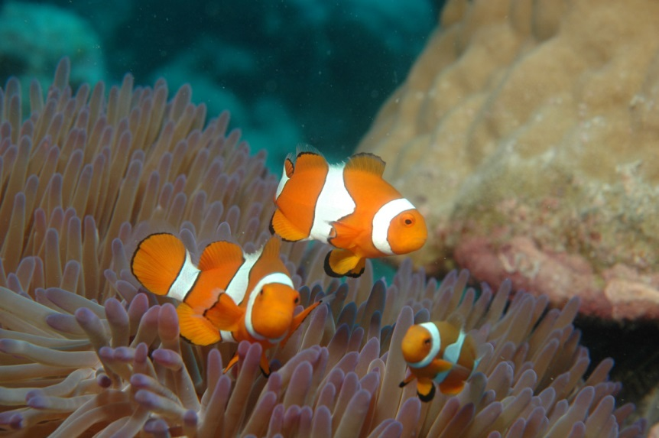
Cause for concern: Australia
Great Barrier Reef
Still a UN World Heritage Site & a national park in Australia
Problems?
Toxic waste threatens underwater life!
tourism, boaters, divers & oil-shale mining also stress the underwater life of the Great barrier Reef
→ Being monitored by United Nations
June 2014: meeting in Qatar to approve draft that would make long-term improvements to the Great Barrier Reef

Slide 5
Cause for Concern: Australia
Other concerns:
Access to freshwater
Has been threatened due to drought, salt, irrigation & agricultural runoff
Murray River Basin: reduced flow of the river
Use of water for agriculture
Growing city population → more usage by people
Deforestation
Wind erosion evident in woodlands because of clearing for farming & grazing lands

Slide 6
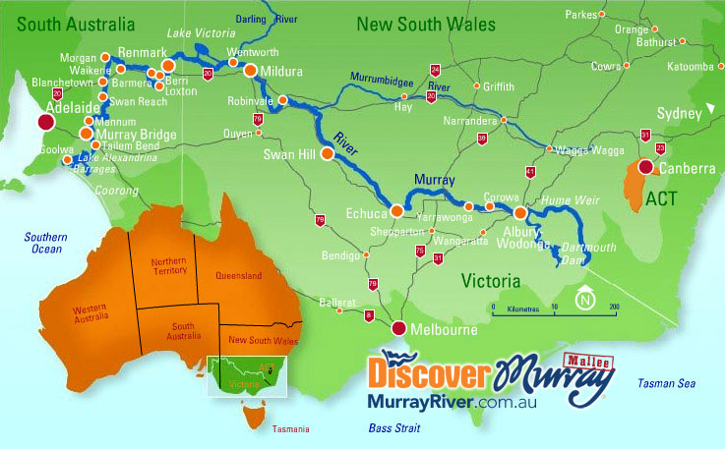

Slide 7
Other concerns: OCeania
Coral atolls & volcanic islands have limited freshwater resources
Resources they DO have are polluted by agricultural runoff and inadequate sanitation → lack of drinking water
→ Low development, low standard of living, lack of economic growth
Oceans in the South Pacific are also threatened due to ag. Runoff, chemical fertilizers & waste

Slide 8
Nuclear Legacy
Late 1940s – early 1950s: USA began conducting above-ground nuclear testing in various South Pacific islands
1954: Bikini Atoll trial, Marshall Islands
Nuclear device tested, people on this atoll moved to safety beforehand
People in Rongelop Atoll, however, were exposed to massive doses of radiation as a result of the explosion
Radiation traveled downwind → effect on people here

Slide 9
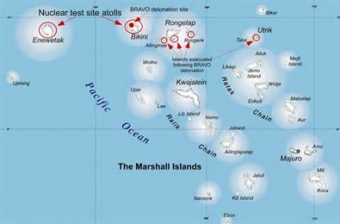

Slide 10
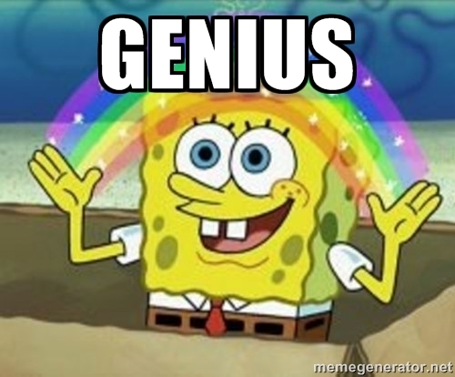
Nuclear legacy
Effects:
Exposure to radiation → deaths, illnesses & genetic abnormalities
Effects of exposure continue to affect people in this region
Atolls affected are off-limits for human settlement
US Government paid reparations in the 1990s:
paid $90 million to help decontaminate Bikini Atoll
Also set up a $45 million trust fund for blast survivors & children from Rongelop Atoll
Antinuclear political activism:
New Zealand banned nuclear-powered ships (and those carrying nuclear weapons) from entering it’s waters (1986)
French plans for testing in French Polynesia → protests → halt to plans
Legacy of Spongebob…?
Idea that Bikini Bottom is actually set below Bikini Atoll

Slide 11
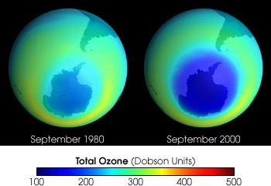
Antarctica: Ozone Layer
Hole over the ozone layer has grown over Antarctica → increased exposure to UV rays, possible contribution to global warming????

Slide 12
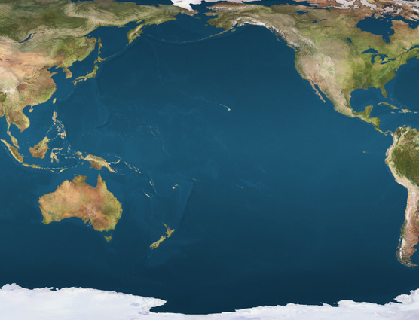
El Nino
What it is: warming of eastern Pacific Ocean + rise in pressure → changes in weather patterns throughout entire area located along the Pacific Ocean
Powerful cyclones (hurricanes) in Northwestern Pacific
Currently happening, has been happening for a YEAR 😐
Is strong
La Nina (opposite effects) predicted for summer 2016
More rain in North & South America but usually, less hurricanes ☺
Australia: HOT weather, droughts

