Slide 1
Student Introduction to
(School-uh-gee)

Slide 2
Traditional Teacher Website
Is a place where teachers can post class calendars, syllabus, information about assignments, and class notes
Is one-way
Teacher → Student

Slide 3
What is Schoology?
Learning Management System
Does everything that a website can do
and….
Students can submit assignments and teachers can grade them electronically
Students can engage in blended learning from school and home
It stores and embeds most resources

Slide 4
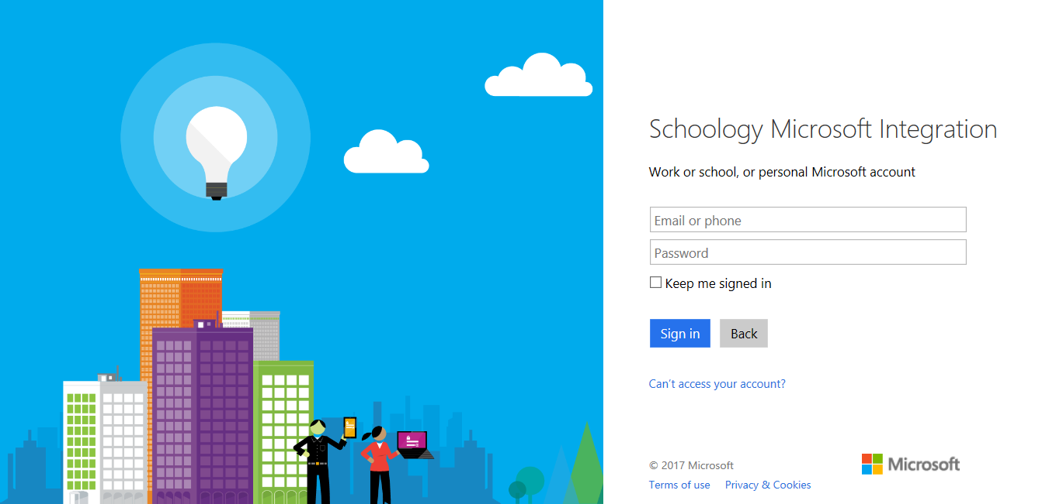
How to log in
Go to: fortbendisd.schoology.com
(also, download the app if you can)

Slide 5
Logging in to fortbendisd.schoology.com
@student.fortbendisd.com email address
Same as network PW

Slide 6
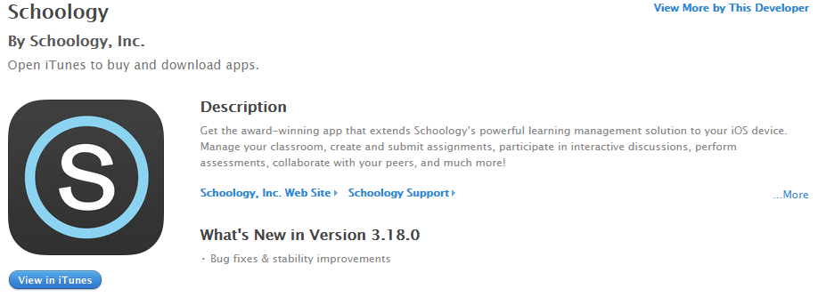
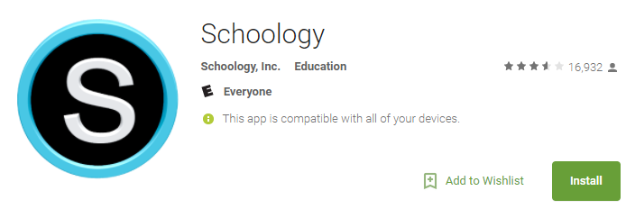
Schoology’s App
Available on iTunes and Google Play
Mobile App Tip: When you click on the app and it asks for your school, type in FBISD (not the campus name). This will bring you to the Office 365 login page and then Schoology page for your campus. This applies to both staff and students accessing the mobile app.

Slide 7
Student 365 Email Lookup Directions

Slide 8
Student 365 Email Lookup Directions
There are FOUR ways for students to obtain their Office 365 district email.
Through Skyward app on mobile device
A personal PC
On a FBISD network computer
Ask your teacher to look in their skyward

Slide 9
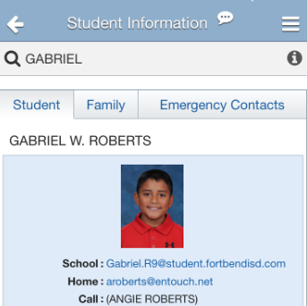
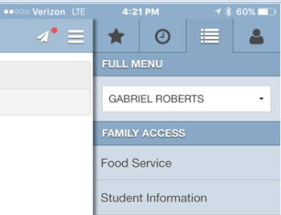
Student Schoology Login – Mobile Device
Students Log into Skyward as normal
Click 3 horizontal bars in top right corner
Click on the tab called “Student Information”
Find email located under student picture

Slide 10
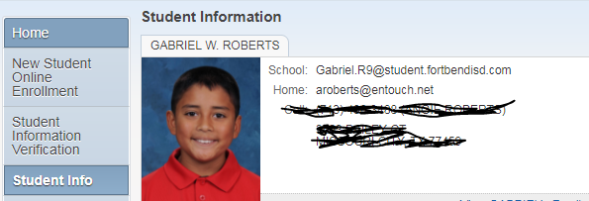
Students Log into Skyward as normal
Click on the tab called “Student Info”
Find email located next to student picture
Student Schoology Login – Personal PC

Slide 11
Students Log into the computer as normal
Click on the “start” button.
Find student name/email on top right of that window.
Student Schoology Login – on a FBISD network

Slide 12
Politely approach your teacher and say “I’m having trouble finding my email address. Would you mind looking at my student profile in skyward for my student email address?”
After it is given to you, write it down and say “thank you”
Student Schoology Login – Teacher Assistance
Teachers: Student Passwords can be found by going to this website: http://studentinfo/Criteria.aspx (This website is only accessible within the FBISD network. Also, you are only able to view your students’ information)

Slide 13
Navigating Schoology

Slide 14
Your Classes are pre-loaded in Schoology
At the top of the webpage, choose “Courses”

Slide 15
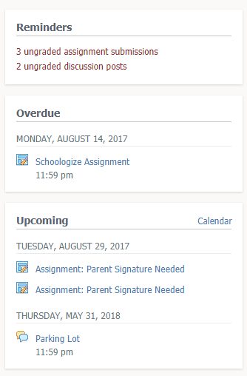
Reminders & Notifications
If a due date is set by your instructor you will see reminders on the right of your homepage and notifications in the app

Slide 16
Customize your notifications
Click on the down menu next to your name at the top right hand corner of your window.
Choose “Notifications”
YOUR NAME

Slide 17
Thank you for being patient!!!
Schoology is new to most of us, and with all new things comes a learning curve! We’re all life-long learners and we’re excited to be learning this with you all!

