Slide 1
Welcome to AP English III
Aka McMennamy land

Slide 2
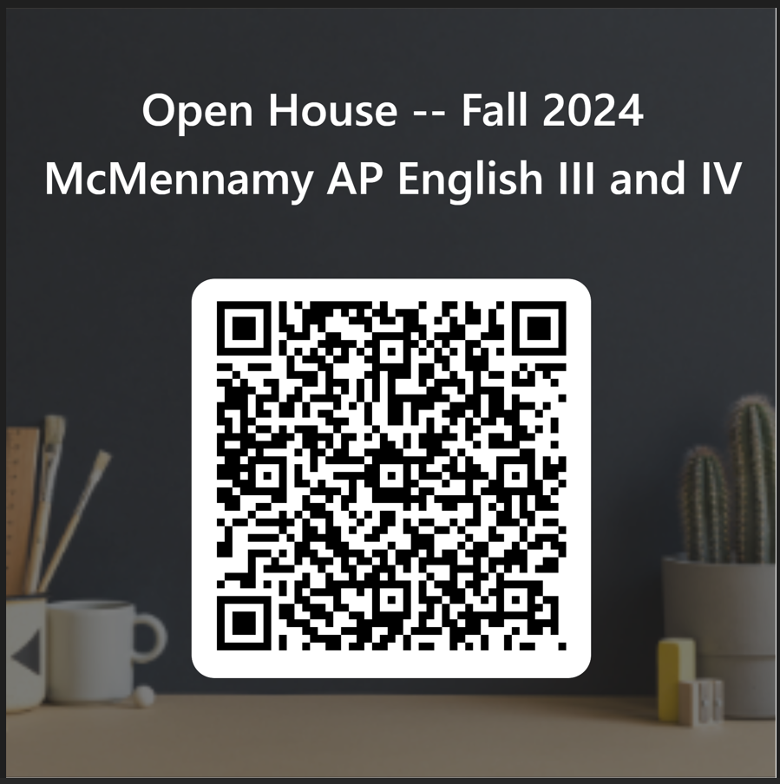

Slide 3
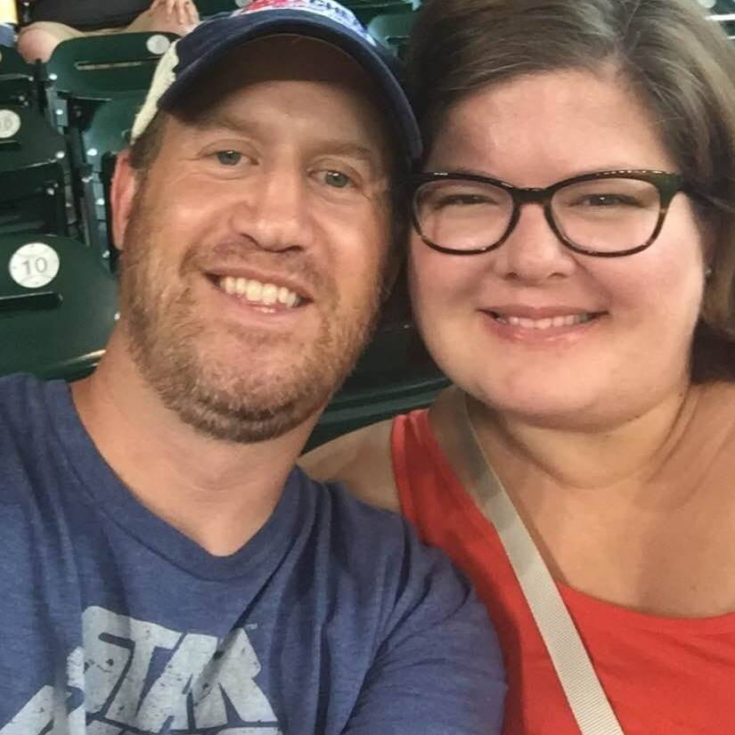
Introduction & Communication
Fort Bend ISD graduate
Aggie – History, Political Science, and English
Year 26 at Clements (20th in AP Lang)
Mike, Ian, & Rosie
3rd period conference
Email: glenys.mcmennamy@fortbendisd.com

Slide 4
Tutorials & Conferencing
AM/PM – most days by appointment
PM: Tuesdays 3-4
Lunch Lab: DLH
A: Tues, Thurs, Fri
B: Mon, Thurs
C: Mon, Tues, Fri

Slide 5
My Goals
Increase all students’ comfort, confidence, and skills to do with writing – particular focus on argument, analysis, and synthesis
All students are able to study topics of personal interest in multiple parts of our year

Slide 6
Readings (Chronological-ish)
Fall Readings:
Student Choice Non-Fiction
18th/ 19th century readings
Assorted Speeches for Rhetorical Analysis
Romantic and Transcendental writers: poems and essays
Spring Readings:
Student Choice Non-Fiction
Assorted satire pieces, nature writing, memoir excerpts
Modern Fiction & Poetry
Post-Modern & Contemporary: essays, short stories, & poems

Slide 7
Writing
All Year: frequent, writing practice (full or partial essays)
Fall: (skill focus in T1; full essays in T2)
Synthesis Essays
Rhetorical Analysis Essays
Argument Essays
Semester Exam Essay: Argument and Rhetorical Analysis
Spring (refining all writing skills)
Student Choice Based on Non-Fiction: Argument/Synthesis for Research (outline; timed writing; source check; rough draft; final draft; speech presentation)
Review of Argument, Analysis, and Synthesis
Fiction Interpretation

Slide 8
AP Lang Writing Types
3 FRQs on the AP English Language and Composition Exam
Synthesis
6-7 sources (use 3 minimum in your argument)
future focused (somewhat like a DBQ)
Rhetorical Analysis
1 non-fiction reading (often a speech),
essay about author or speaker’s purpose and their methods of persuasion/ argumentation
Argument
brief philosophical or concrete prompt
defend your position with evidence you already know

Slide 9
Materials
Composition Notebook (only for English; not a spiral): loads of practice writing/ low risk practice
3 yellow legal tablets: loads of timed writing – don’t worry!
1 box of tissues
pens to write

Slide 10
A Great Course for Your Student
College Credit
Great Preparation
Attractive to Colleges
Skills to be Conscientious Consumers of Information
Close Reading for Author’s Purpose
Rhetorical Analysis (argument, speeches, satire, fiction, non-fiction, memoir, comparative texts, nature writing, scientific writing)
Synthesis (using sources to defend an original argument, to develop priorities, or to craft a compromise)

Slide 11
A Great Course for Your Student
Fall exam registration required by College Board for full year AP courses. November 1 deadline!
Late fee $40.
College Credit
Great Preparation
Attractive to Colleges
Skills to be Conscientious Consumers of Information
Close Reading for Author’s Purpose
Rhetorical Analysis (argument, speeches, satire, fiction, non-fiction, memoir, comparative texts, nature writing, scientific writing)
Synthesis (using sources to defend an original argument, to develop priorities, or to craft a compromise)

Slide 12
AP Exam Data – 2024
May the odds be ever in your favor!
May 2024
311 (CHS) out of 383,667 (Globally)
311 is ~95% of students in the CHS courses for 23-24 school year

Slide 13
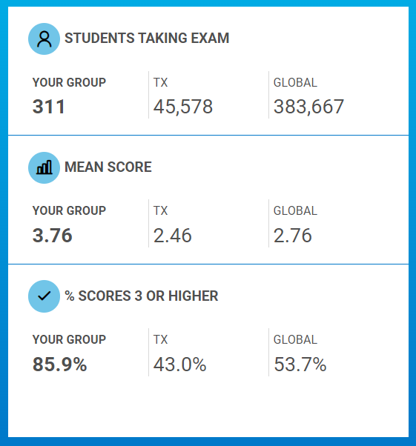
AP Exam Data – 2024
May the odds be ever in your favor!
May 2024
311 (CHS) out of 383,667 (Globally)
311 is ~95% of students in the CHS courses for 23-24 school year

Slide 14
AP Exam Data – 2024
May the odds be ever in your favor!
May 2024
169 (CHS) out of 556,366 (Globally)
TX:
24.1% earning 4 or 5
Globally:
30.1% earning 4 or 5
CHS:
65.5% earning 4 or 5

Slide 15
Thank You.
Let me know if you have questions.

