Slide 1
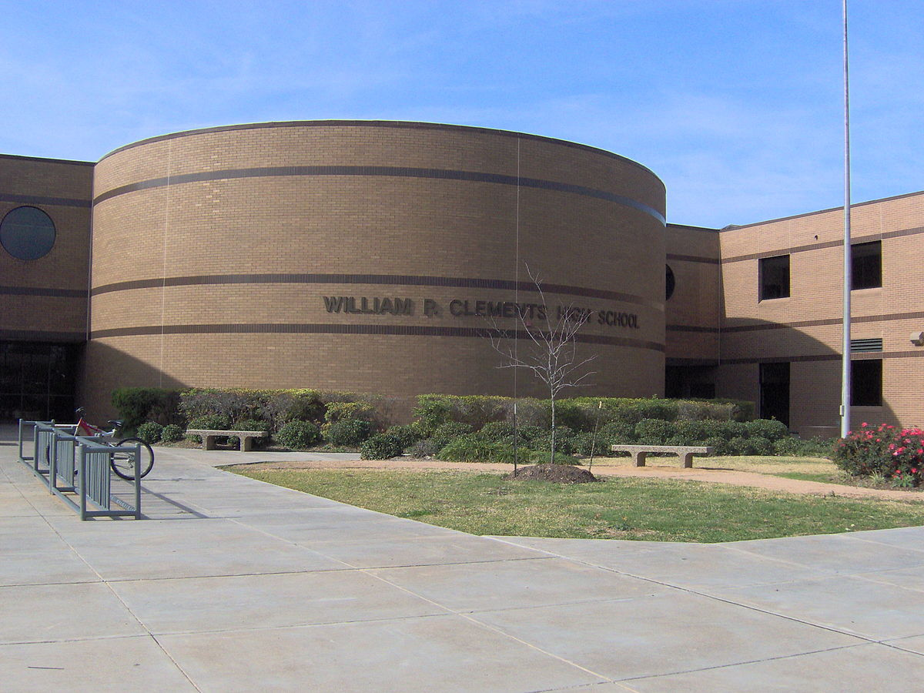
Summer O-lab Orientation
Notes:
Presenter:
Time:
Materials:
Strategy:

Slide 2
Welcome to Summer O-lab Orientation!
Let’s Get Started…

Slide 3
Learning Intentions:
The learner will be able to…
Gain a solid understanding of the curricular components and expectation for students enrolled in an Edgenuity summer course(s) including deadline, final exam, and grade reporting.
Gain a solid understanding of the Edgenuity platform.
Utilize the Edgenuity platform to monitor/document student performance and academic progress.

Slide 4
Success Criteria:
Successfully complete course at 100%.
Communicate with teacher at all times.
Monitor progress and take ownership of learning.
Understand and meet the deadlines set for online learning.

Slide 5
Courses Offered:
2021 Summer O-Lab program will include the following courses:
Health Personal Fitness | Personal Finance Art I A & B | Government Economics
Notes:
Presenter:
Time:
Materials:
Strategy:

Slide 6
Summer O-Lab Teacher Hours:
June 14th - July 29th
Monday-Thursday 8:00 A.M. -10:00 A.M.
Virtual: Monday – Thursday 10:00 A.M. – 2:00 P.M.
Week One | Week Two | Week Three | Week Four | Week Five | Week Six
June 14-17 | June 21-24 | June 28-July 1 | July 12-15 | July 19-22 | July 26-29
16 hours | 16 hours | 16 hours | 16 hours | 16 hours | 16 hours
Students are encouraged to work outside of the normal Summer O-Lab hours to ensure completion by the July 29th deadline. It is highly recommended that students manage his/her time wisely.
Notes:
Presenter:
Time:
Materials:
Strategy:

Slide 7
Final Exams must be proctored F2F by a teacher, administrator, or other professional staff member.
Students must schedule time and date between 8:00 A.M. and 10:00 A.M. Monday - Thursday to take their final exam upon completion of their coursework. Schedule with Olab teacher at least one day prior.
Course(s) must be completed by 12pm (NOON) on July 29th including the final exam. There will be no exceptions. Students who do not complete the course will not be awarded credit.

Slide 8
The Cumulative Exam can only be taken ONCE (may use notes).
Course Credit: Students must earn an overall average of at least 70 AND achieve a minimum score of 65 on the final (cumulative) exam.
Notes:
Allegra
In discussing online learning in FBISD, we can characterize the online learning opportunities into three categories. The reality however is that our students can engage in one, two, or all three of these online learning opportunities. Because of this, it’s critical that the team approach that Susan just discussed be implemented. In essence, we are individualizing and providing students with the best instructional environment for them, in an effort to meet the needs of ALL students. All three of the online learning opportunities shown here have the potential to offer effective learning for FBISD students.
Our onsite learners are those students that are scheduled for O Lab during the school day and physically sit in the O Lab, completing coursework, with the support of their O Lab Teacher.
Our remote learners are those students that are enrolled in online courses that they complete during those times that are best for them. For the student that is a remote learner, self-motivation and self-discipline, while needed for any online learning opportunity, are especially critical.
We also have students that engage in both onsite and remote learning opportunities.
As we come together collaboratively, the question is not “which online instructional environment is best”, it is, “which one works best for this particular student, at this particular time in their educational path”. Considerations include the student’s schedule, their internet access, their organizational skills, etc. We are called upon to look at each student individually to determine which method is best for them and how we can together support them. This springboards us into our next topic, the profiles of our online learners.

Slide 9
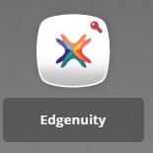
Login Credentials
Student login through Schoology:
Click on the waffle icon →
Click “1Link”
Scroll down to find the Edgenuity Icon
Student Login must now be through 1Link!

Slide 10
Managing an Online Course: Checking for Understanding “Virtually”
Virtual office hours are designated during the summer to answer questions, assist students with log in concerns and other technical difficulties.
Microsoft Teams will be utilized during virtual office hours (10:00 A.M. – 2:00 P.M) if a student needs to conference with an Olab teacher.
Email OLab instructor to be called to TEAMS meeting.

Slide 11
Questions?
Edgenuity Questions:
Robert Boagni– O-Lab Instructor (8:00am-12:00pm)
Robert.Boagni@fortbendisd.com
Dallas Killingsworth- O-Lab Instructor (8:00am-10:00am & 12:00pm-2:00pm)
Dallas.killingsworth@fortbendisd.com

