Slide 1
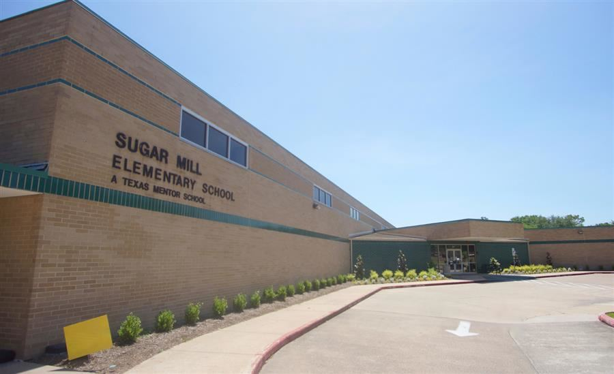
Welcome to Our House

Slide 2
The House System Bringing students together across grade levels
The entire school will come together to create a sense of belonging between adults and students in our learning community, as well as to add some fun to the academic atmosphere.
Students work together to demonstrate school spirit and House pride which builds self esteem, confidence, motivation, and involvement.
Because the Houses are a mix of all age ranges, older students are available to assist younger students. Older students can assume leadership and mentor roles and our youngest learners have older students that serve as role models

Slide 3
Meet the Houses of Elements
The House of Air
Mascot: The Eagle
Color Wristband: Yellow
House Cheer:
We are yellow We are air No one else can compare

Slide 4
The House of Earth
Mascot: Snake
Color Wristband: Green
House Cheer:
We are earth We are green We are on the winning team

Slide 5
The House of Water
Mascot: Shark
Color Wristband: Blue
House Cheer:
We are water We are blue We are the coolest crew

Slide 6
The House of Fire
Mascot: Dragon
Color Wristband: Red
House Cheer:
We are red We’re on fire We desire to inspire

Slide 7
Sorting the Houses
Each student and teacher will receive a wrapped color wristband.
The teacher package is marked. If the tag on the package has a star sticker you are one of the House Leaders
Everyone will attend a House meeting at 2:30pm to learn the House Cheer and sign the House poster.
Make today a great day!

