Slide 1
L.A.C.E.M.O.P.S
Factors that Affect Climate

Slide 2
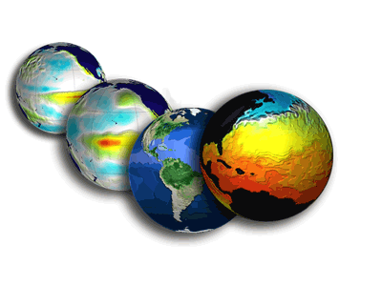
What is climate?
Pattern of weather over a long period of time

Slide 3
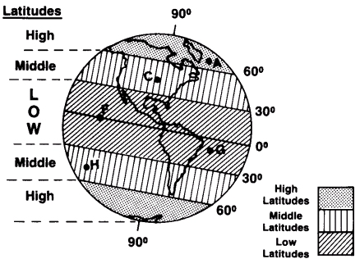
What factors impact climate?
Latitude
  Main temperature control
  3 zones of latitude
  Closer to equator = hotter

Slide 4
“Huddle Up”
Which zone of latitude would you prefer to live in and why?

Slide 5
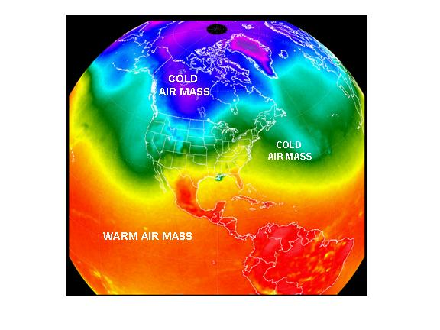
What factors impact climate?
Air Masses
  Large volume of air
  Crosses wide range of land
  Temperature is the same within the air mass
  Takes on temperature and precipitation of surface
  Moves by wind and jet streams
  Fronts form from colliding air masses

Slide 6
What factors impact climate?
Continentality
  Effect of the location of a place on climate
  Inland locations have larger temperature ranges, and usually drier conditions

Slide 7
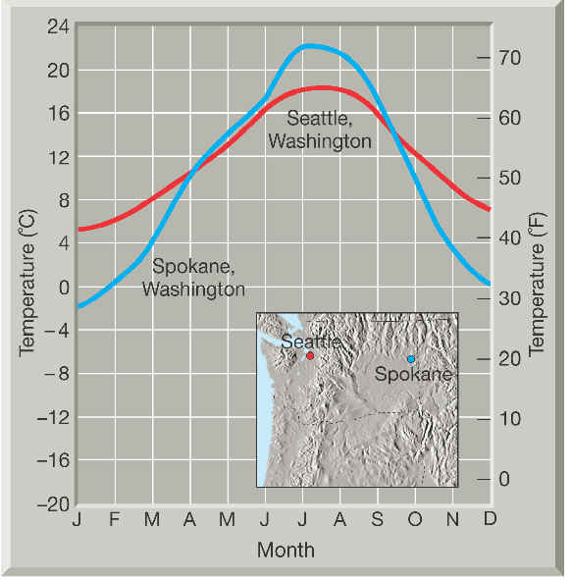
“Huddle Up”
Why is there a bigger difference in temperature between January and July in Spokane?

Slide 8
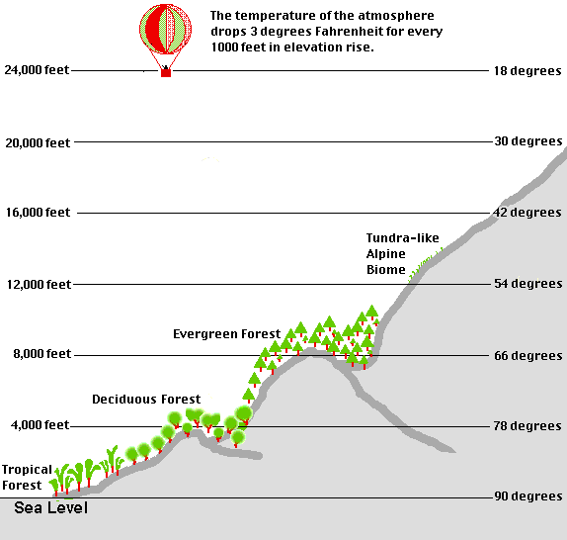
What factors impact climate?
Elevation
  Altitude
  Height above sea level
  Higher up mountain, the colder it is
  Affects precipitation patterns; continued cooling brings precipitation

Slide 9
“Huddle Up”
Explain why high mountaintops are always covered by snow, even in the Tropics.
Notes:
The thinner atmosphere in higher altitudes retains less heat. Therefore temperatures are lower at high altitudes. If the mountaintops are high enough, it will always be too cold for the snow to melt.

Slide 10
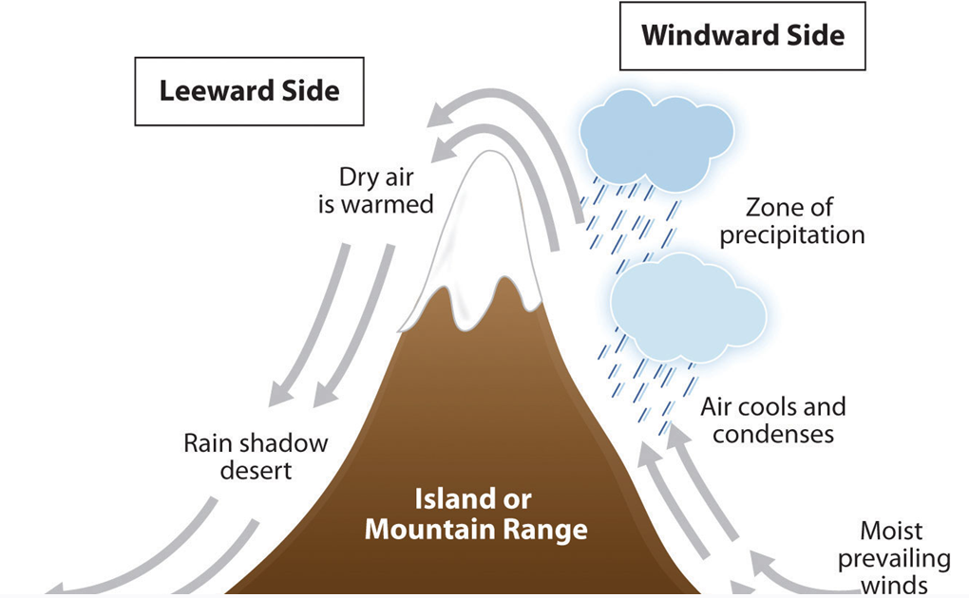
What factors impact climate?
Mountain Barriers
  Rain shadow affect

Slide 11
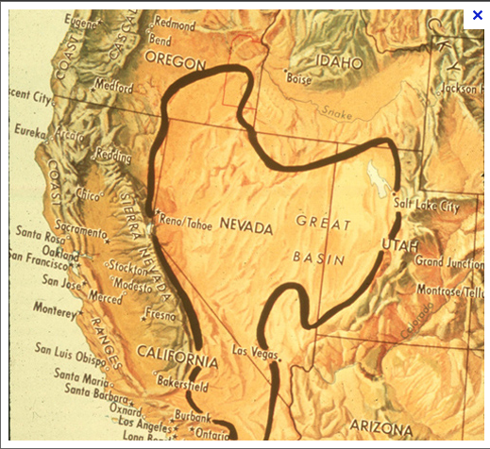
“Huddle Up”
How would you explain the formation of the Great Basin in the American Southwest?

Slide 12
What factors impact climate?
Ocean Currents
  Movements of the ocean’s waters in a circular pattern
  Created by Earth’s winds, rotations, and varying ocean temperatures
  Subtly increases or reduces temperature
  Cold currents create dry conditions; warm currents create wet conditions

Slide 13
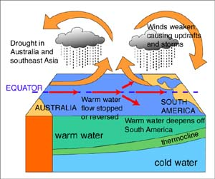
What factors impact climate?
Ocean Currents
  Recurring alterations to weather patterns also impact climate
  Periodic reversal in ocean currents and water temperatures, El Nino, is linked to global warming
  Low pressure rises, and vice versa
  Trade winds stop, or even reverse
  Influences climate around the world in a domino effect

Slide 14
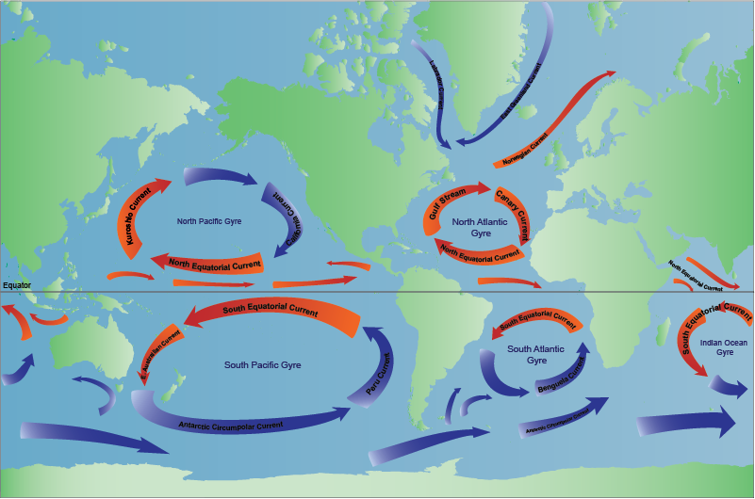
How does the Gulf Stream impact areas such as England and Ireland?

Slide 15
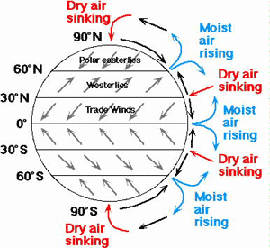
What factors impact climate?
Pressure/Prevailing Winds
  Air pressure changes at different places because of Earth’s unequal heating
  Hot air rises, cold air sinks
  Cold air dries as it sinks towards the surface, creating a high-pressure area
  High-pressure brings clear, stable weather
  Low-pressure bring unstable weather

Slide 16
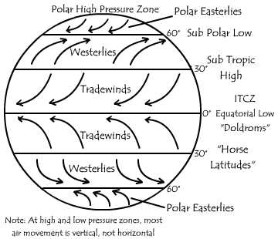
What factors impact climate?
  Pressure/Prevailing Winds
  Global winds that blow in fairly constant patterns
  Affected by the direction of Earth’s rotation and latitude

Slide 17
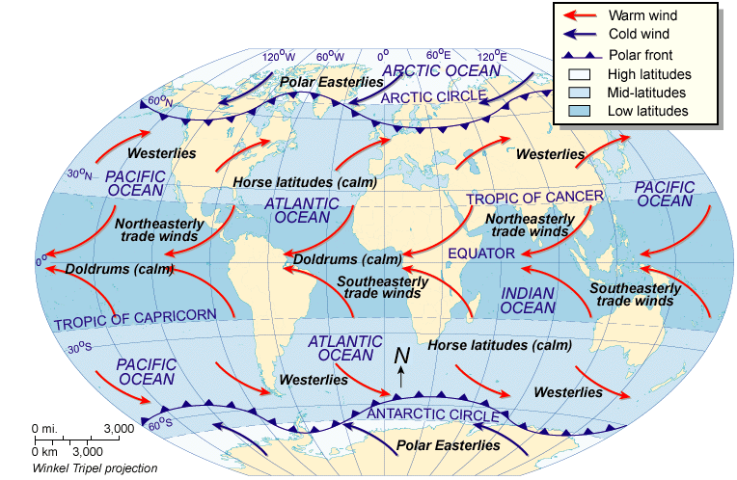
Horse Latitudes: Historically, ships would lighten their loads in order to take advantage of the slightest wind such as cargo, excess supplies and livestock…this also included horses.
Doldrums: windless area near the equator

Slide 18
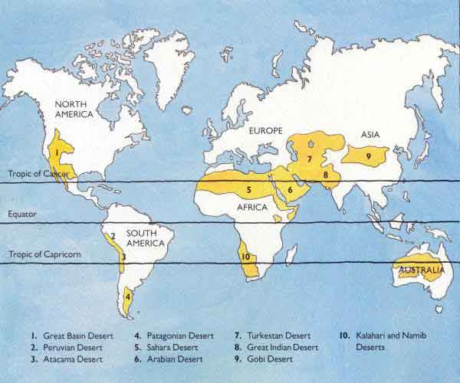
What relationship can you detect between the diagram and the map of the world’s major deserts? HINT: Think high pressure vs. low pressure.

Slide 19
What factors impact climate?
Storms
  Formed when cold and hot air masses meet
  Formed when polar winds meet westerlies
  Mid-latitude cyclones = tornadoes
  Tropical cyclones = hurricanes

Slide 20
“Huddle Up”
Which 3 factors of climate do you think has the greatest impact on climate in the Houston area?

