Slide 1
FOOD TRUCKS

Slide 2
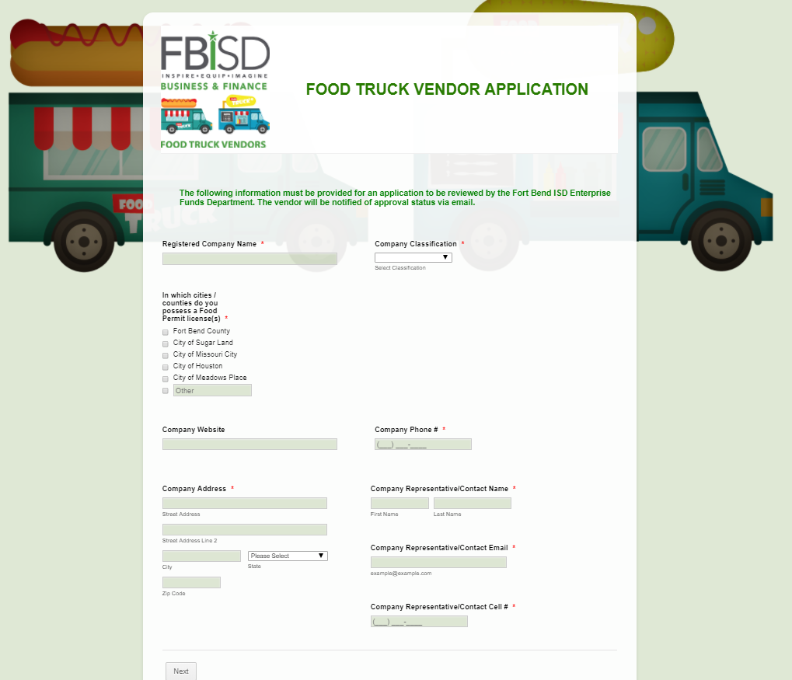
FBISD Food Truck Vendor Registration
Available On-line
All food truck vendors wanting to provide their services to the District can now register and submit payment on-line.
All food truck vendors must be registered and approved by Enterprise Funds department before participating in any campus or District event.
The registration link is found via the following path:
  District Website/Departments and Services/Enterprise Funds/Food Trucks

Slide 3
FBISD Food Truck at Your Event
How to Get a Food Truck at an Event
Step 1
Check the Approved Food Truck Vendor list on the District website (Departments/Enterprise Funds/Food Trucks) to identify trucks you’d like to utilize.
Step 2
Complete the form on our webpage (Departments/Enterprise Funds/Food Trucks Rentals) to let us know about your event and the food trucks you plan to have participating. *completing this form simply keeps us in the “know” so when phone calls come in about trucks, we can properly respond
Step 3
Coordinate your activity with your group and ensure the food truck have been vetted by registering with FBISD Enterprise funds and are on the approved vendor list.
If a vendor is not listed that you’d like to use – guide them to the Food Truck webpage to register.
Have lots of fun!!!

Slide 4
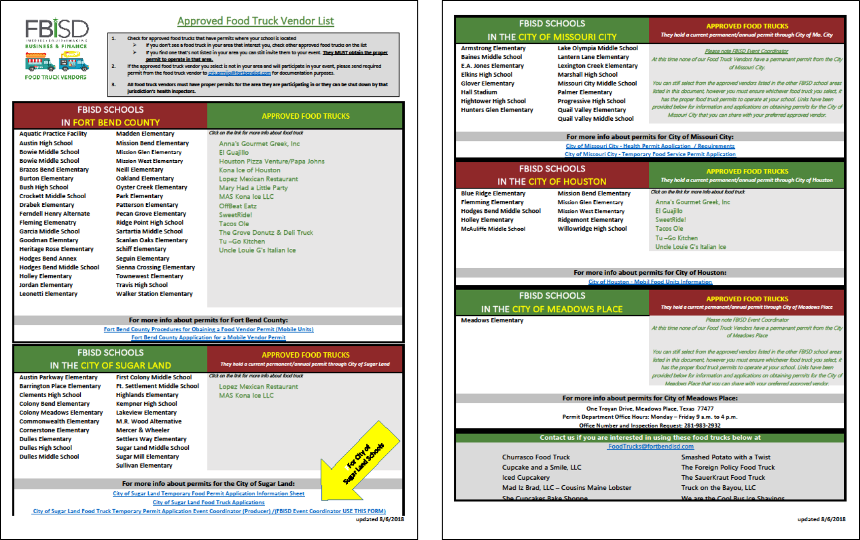

Slide 5
City of Sugar Land –
New Food Truck Ordinance
Who does this affect?
FBISD campuses located in the City of Sugar Land (CoSL)
How does this affect those campuses?
All food trucks that want to participate in FBISD CoSL campus events must not only be registered with FBISD, but they must purchase a CoSL-issued medallion to be displayed while on the premises.
What has changed?
FBISD CoSL campuses no longer have to purchase an Event Producer permit and coordinate with the food trucks to purchase a CoSL temporary permit to participate.

Slide 6
City of Sugar Land –
New Food Truck Ordinance (cont’d)
What are the rules and requirements?
All tent food vendors must comply with State and Local regulations pertaining to temporary events and the Home Cottage Laws.
Sites/events will be routinely inspected by CoSL to verify compliance with permit requirements.
The campuses must take full responsibility for ensuring the Temporary Food Establishments are complying with all permit requirements.
Food trucks must:
  Avoid parking in fire lanes
  Avoid parking on sidewalks and grassy areas
  Park as close to a fire hydrant as possible

