Slide 1
Social Media Cyber Safety Lens

Slide 2
FBISD Internet Safety Curriculum
Digital Citizenship presentation
Internet Safety presentations each 9 wks.
Atomic Learning Modules

Slide 3
OVER
ONE BILLION USERS
13 & OVER

Slide 5
Social Media Tools Parents Need to Know About Now
Twitter
Instagram
Snapchat
Tumblr
Vine
Oovoo
Kik Messenger
Facebook

Slide 6
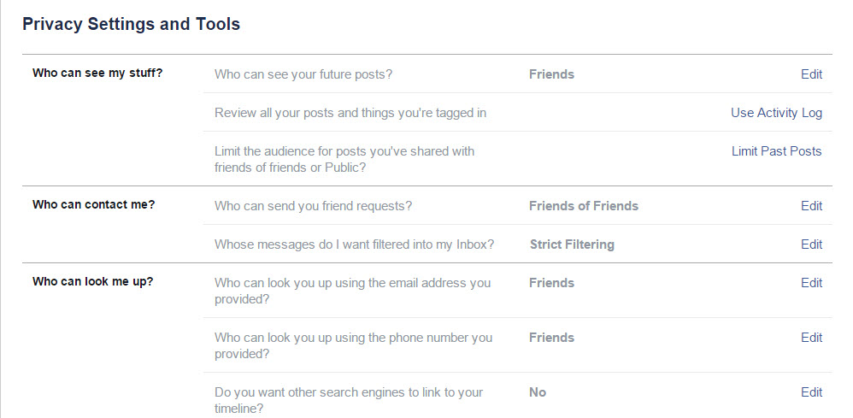
Privacy Settings

Slide 7
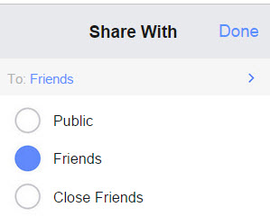
Privacy Settings
Posts
Editing Posts
Deleting Posts

Slide 8
Safety Tips
Communication is key!
Follow your kids online.
Create settings to be notified once they post.
Know who is connecting to your children online and set rules for social networking, instant messaging, emailing and camera usage.
Establish clear guidelines.
Teach kids to only accept friend requests from people they know.

Slide 9
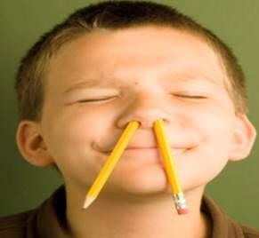
Safety Tips
Nothing is private online.
Images and posts can live online forever.
Posts can be copied, pasted and shared with people all over the world.

Slide 10
Online Reputations Matter
79% of US hiring managers & job recruiters review online reputational information when considering applicants
70% of colleges check student's FB profiles before accepting them into college
70% of US hiring managers have rejected candidates based on what they found:
Unsuitable photos/videos
Concerns about lifestyle
Inappropriate comments

Slide 11
Private Sector Message by Leticia Rios

Slide 12
Notes:
http://www.stopthinkconnect.org/

Slide 13
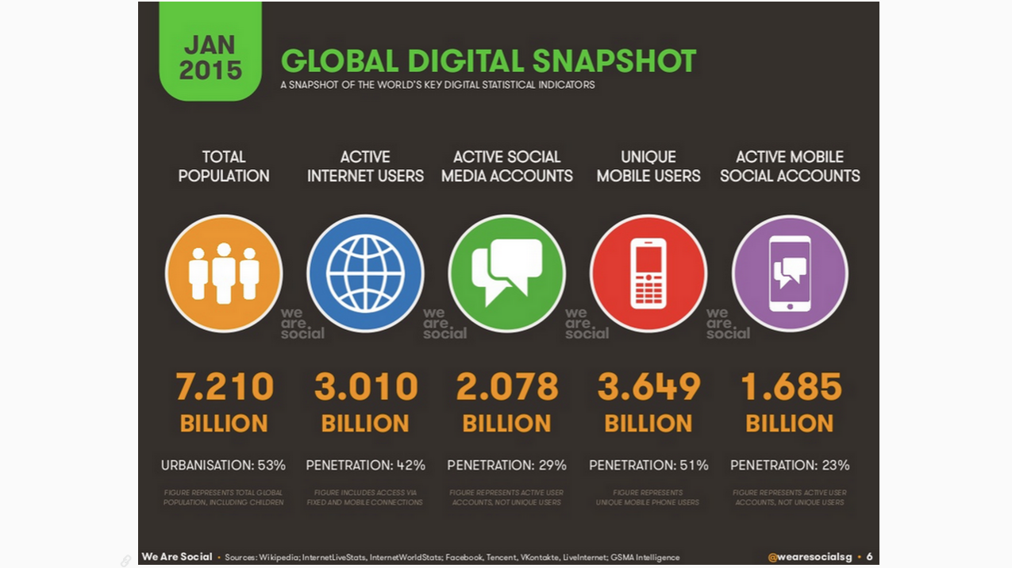
Global Digital Snapshot
Notes:
"Digital, Social & Mobile Worldwide in 2015." We Are Social RSS. N.p., n.d. Web. 20 Feb. 2015.

Slide 14
Where is “Waldo”?
Where’s “Waldo”?

Slide 15
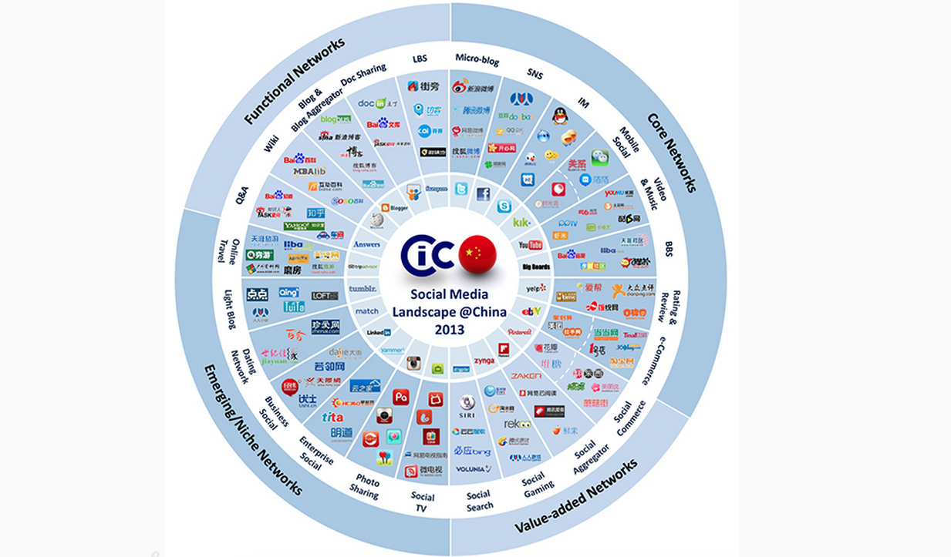
新年快乐! (Happy New Year!)
Notes:
Reference:
1. Social Network Wheel, http://www.seeisee.com/sam/2013/04/02/p3682
2. Year of Goat, 2015, http://www.freeallpictures.com/chinese-new-year-vector-2015.html

Slide 16
Home Router – Smart Wi-Fi
Home Router – Smart Wi-Fi

Slide 17
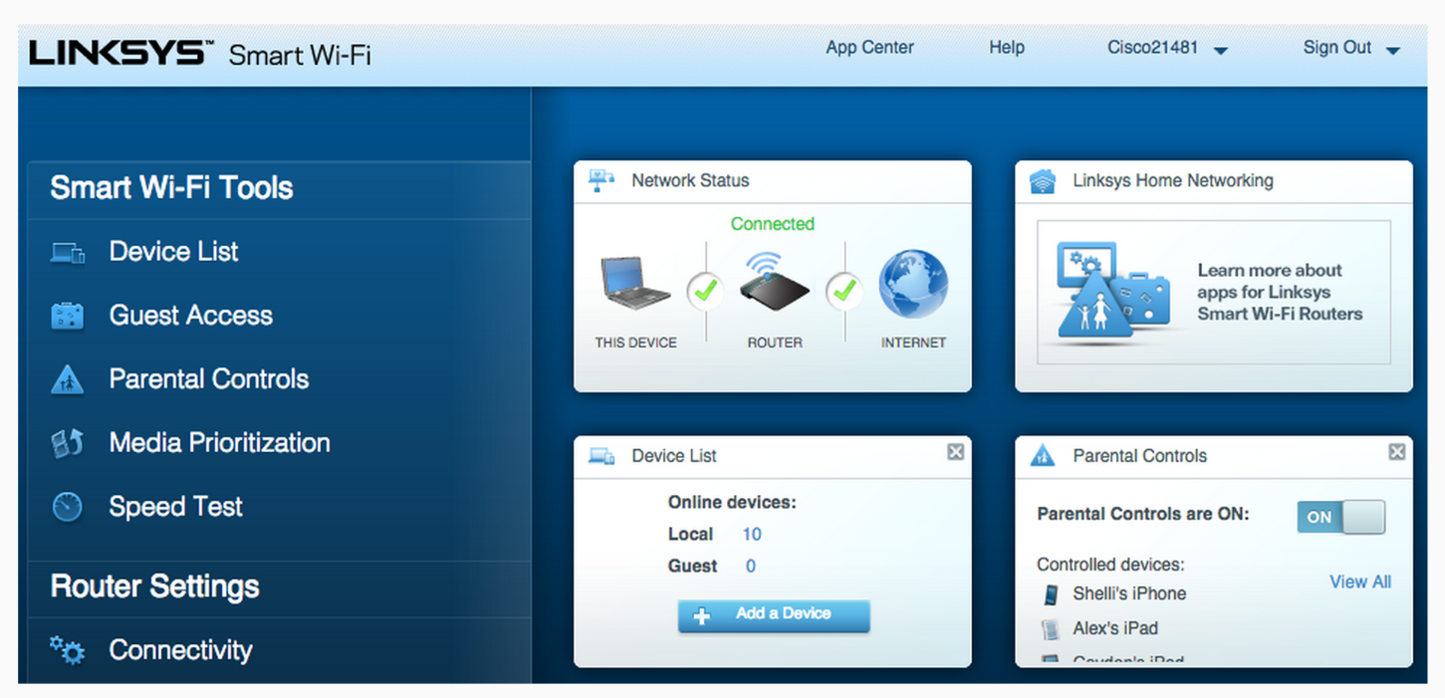
Home Router – Smart Wi-Fi

Slide 18
Social Network Protection
Social Network Protections

Slide 19
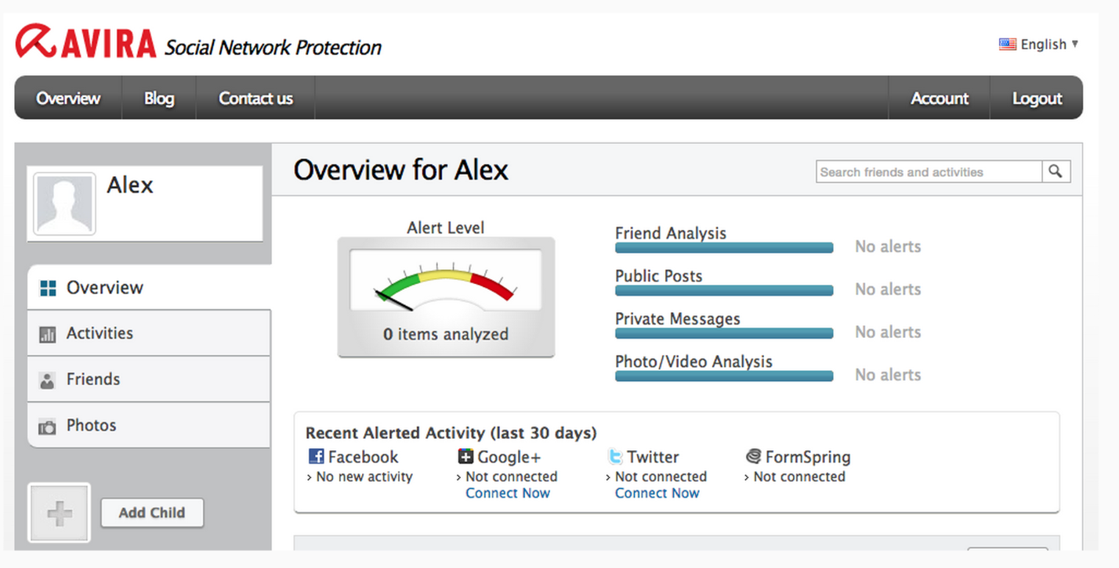
Social Network Protection

Slide 20
DNS Routing 101
The Power of DNS!

Slide 21
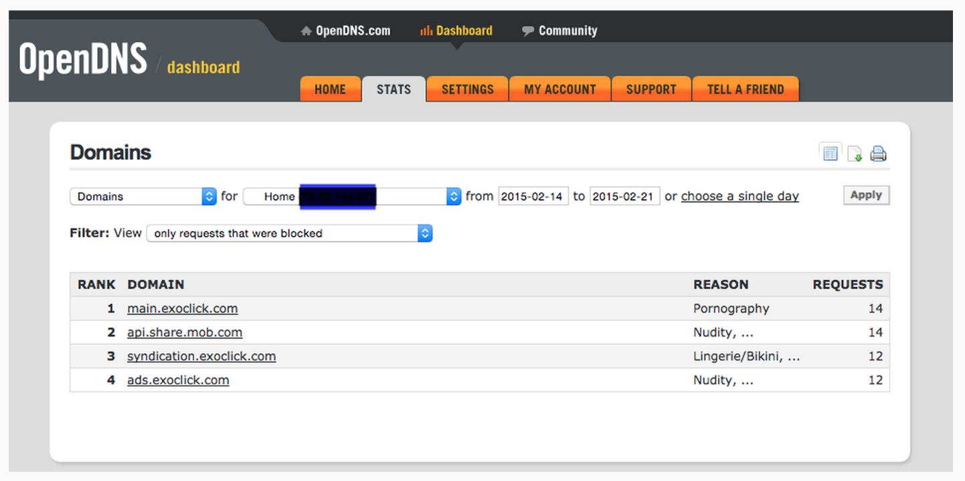
DNS Routing 101

Slide 22
RAIDS Online
RAIDS Online

Slide 23
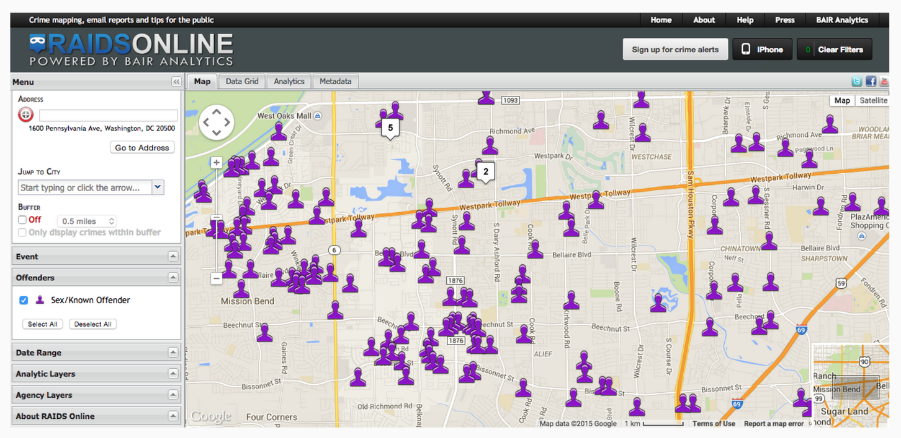
RAIDS Online

Slide 24
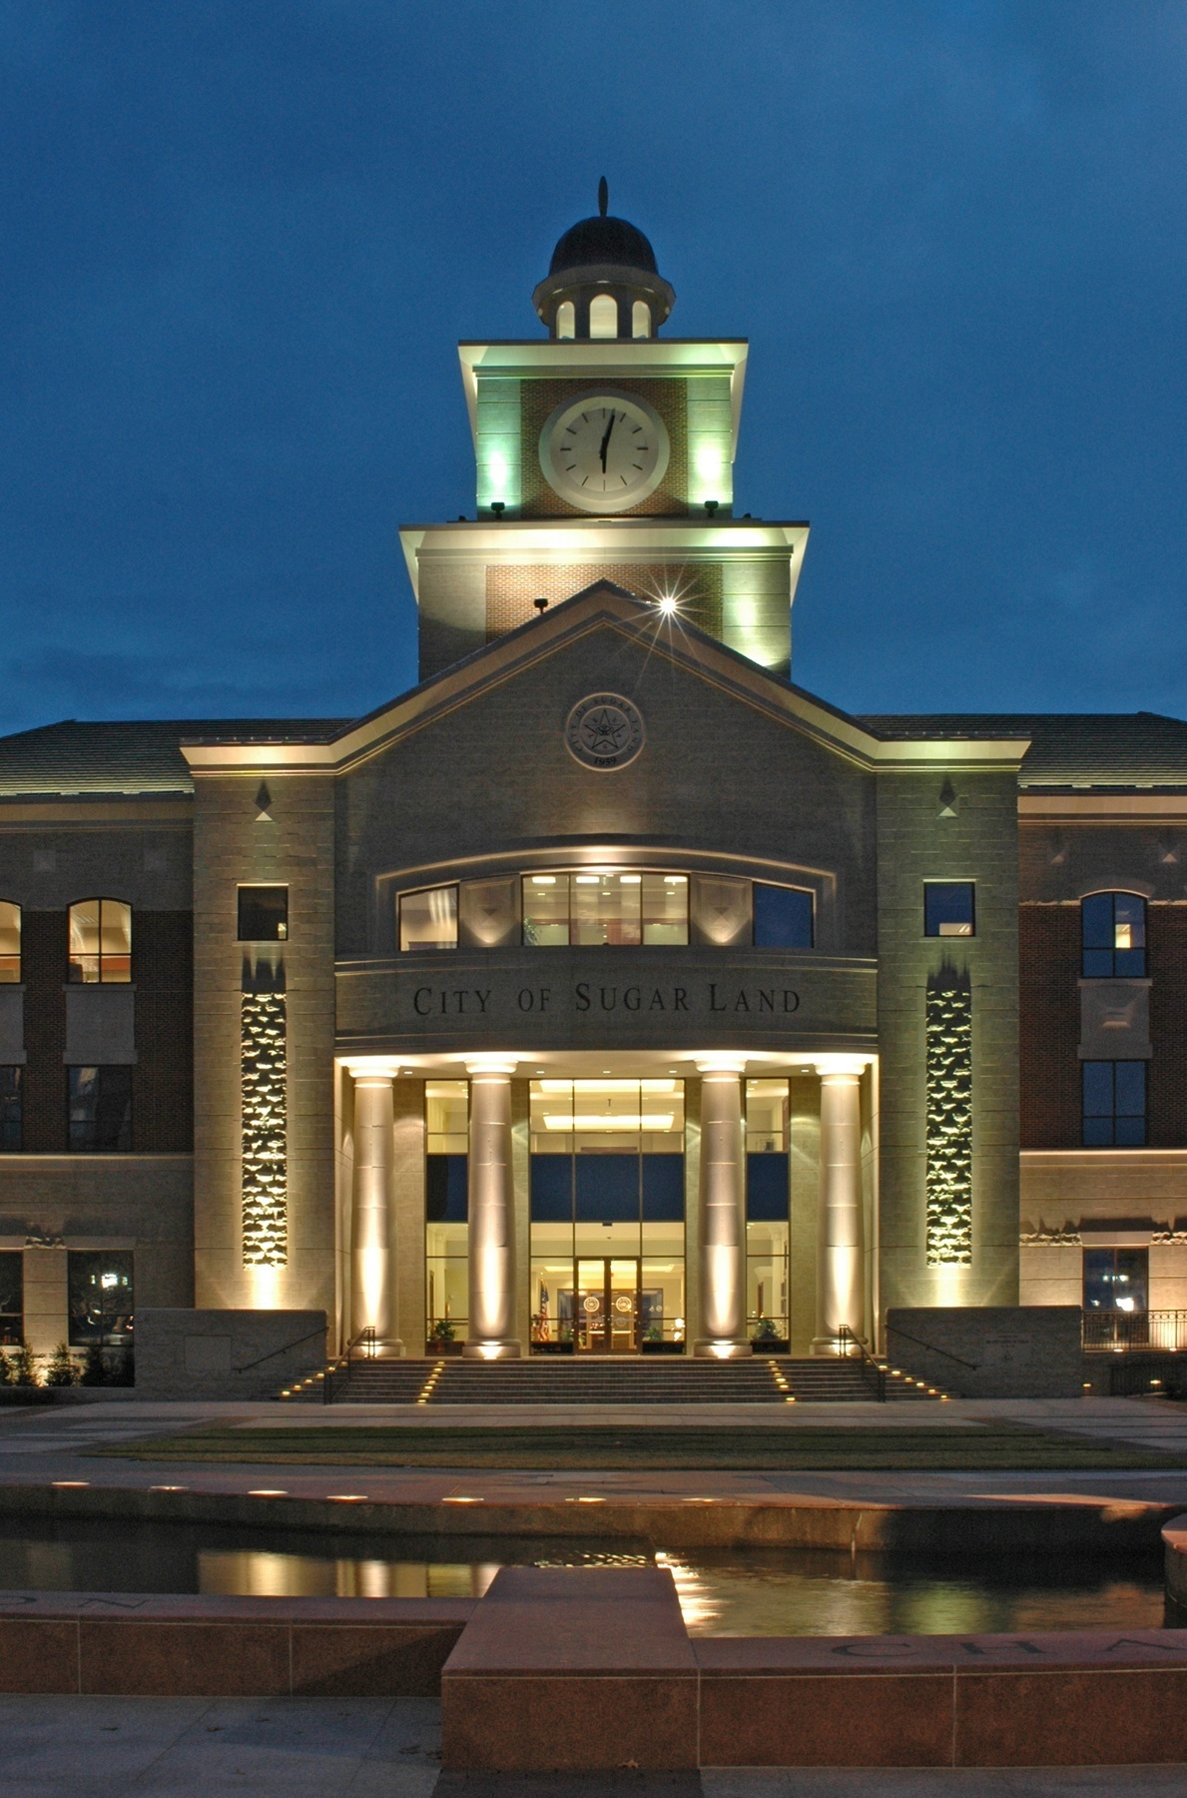
City of Sugar Land
Notes:
House Watch, http://www.sugarlandtx.gov/index.aspx?nid=568

Slide 25
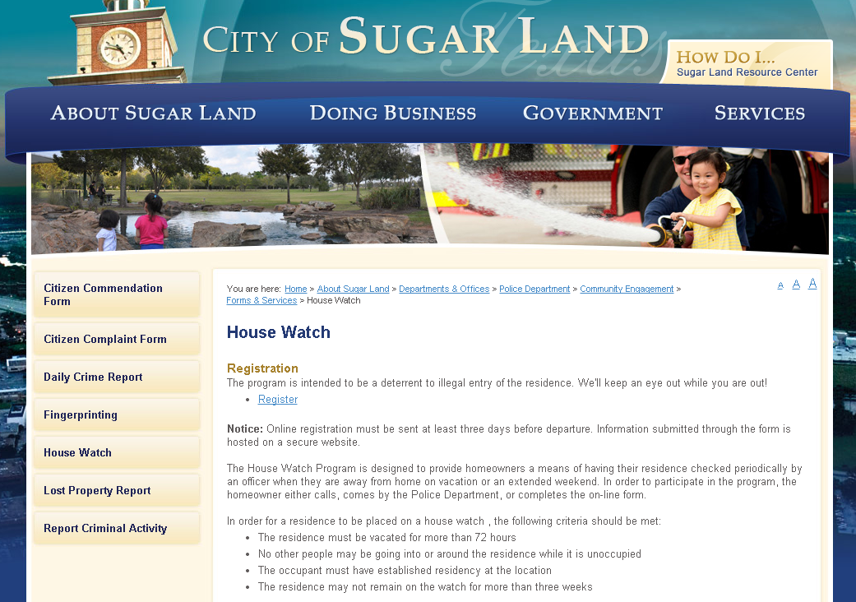
City of Sugar Land
Notes:
House Watch, http://www.sugarlandtx.gov/index.aspx?nid=568

Slide 26
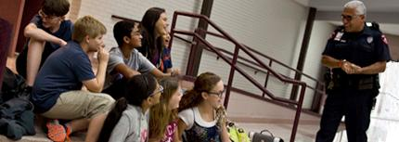
Message from the FBISD Police Department!
Michael Rios!!

