Slide 1
Parents of Elementary Students
Title of Presentation Subtitle Month 00, 2021

Slide 2
What is an Orton-Gillingham Program?
Orton-Gillingham is a highly structured approach that breaks reading and spelling down into smaller skills involving letters and sounds, and then building on these skills over time.

Slide 3
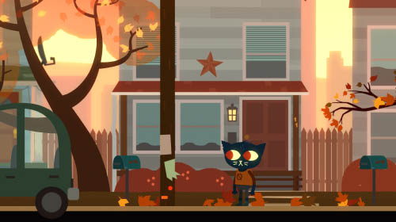
What is an Orton-Gillingham Program?
It also was the first approach to use multi-sensory teaching strategies to teach reading, which is considered extremely effective for teaching students with dyslexia. This means that educators use sight, hearing, touch, and movement to help students connect and learn the concepts being taught.

Slide 4
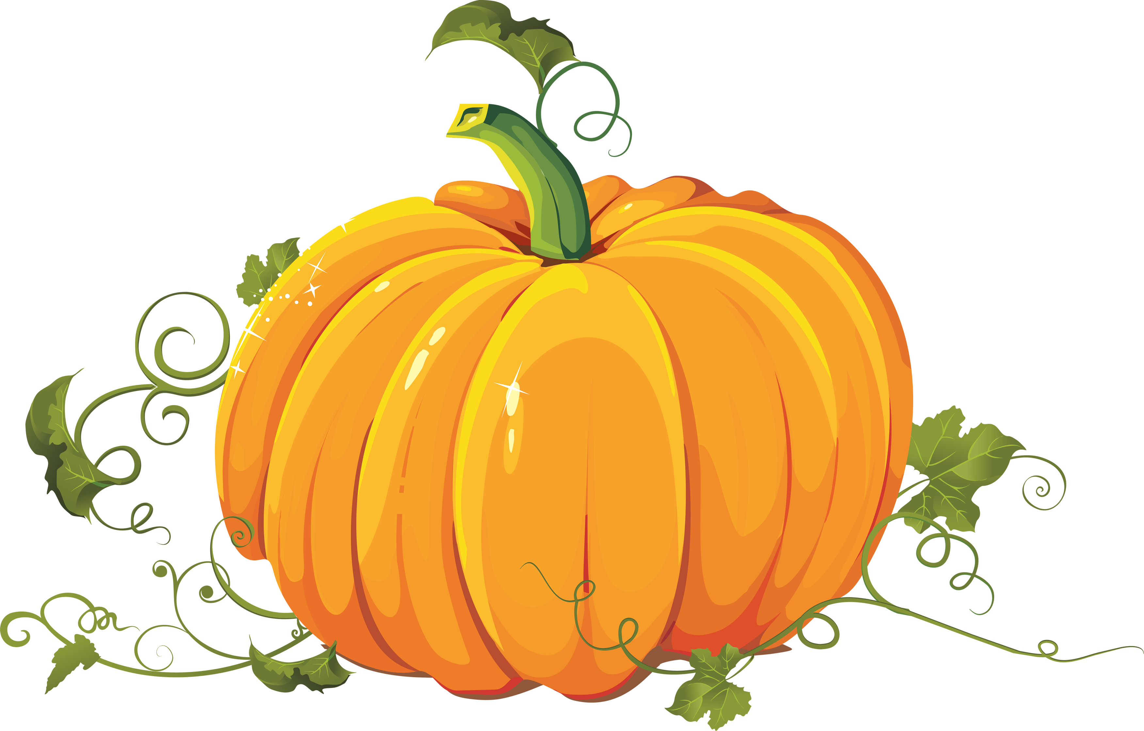
Why an Orton-Gillingham Program?
An OGP is a research-based practice for delivery of dyslexia instruction:
Explicit instruction
Analytic instruction
Multisensory (VAKT)
Diagnostic teaching to automaticity
Synthetic instruction
Systematic and cumulative

Slide 5
Syntax
Morphology
Phonological awareness
An OGP addresses the critical, evidence-based components of dyslexia
instruction:
Orthography
Reading
comprehension
Sound-symbol association
Syllabication
Reading Fluency

Slide 6
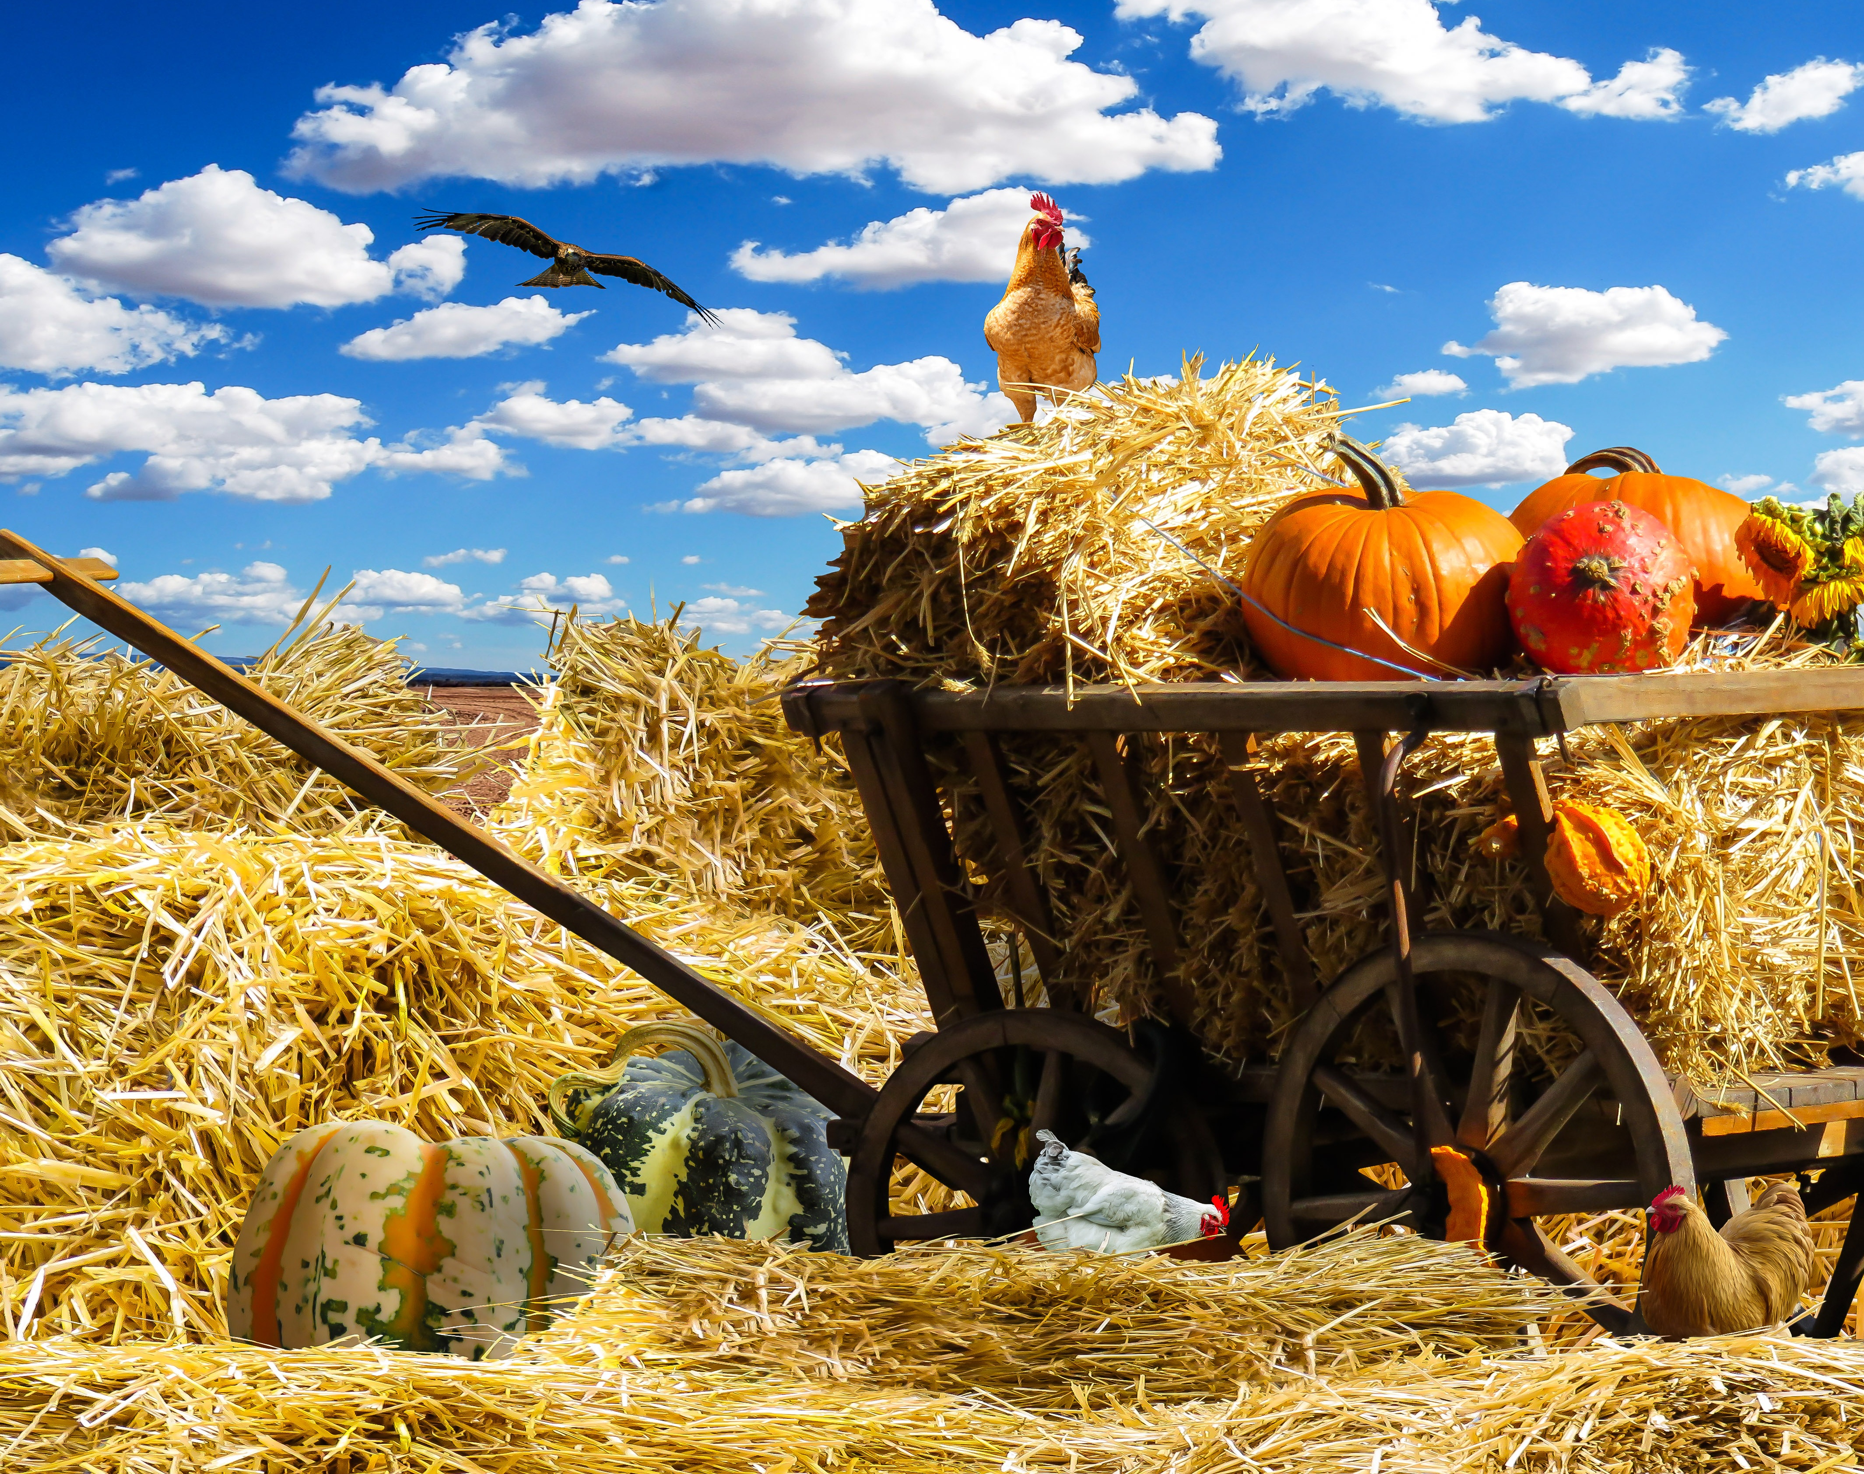
FBISD's Approach to OGP
Offer a full, individual evaluation (FIE)
If the student qualifies, program to the specific needs of the student based on the results of the FIE with consideration to other data

Slide 7
Dyslexia Instruction
Critical, Evidence-Based Components of Dyslexia Instruction
Phonological awareness
Sound-symbol association
Syllabication
Delivery of Dyslexia Instruction
Simultaneous, multisensory (VAKT)
Systematic and cumulative
Explicit instruction
Morphology
Reading fluency
Syntax
Reading comprehension
Diagnostic teaching to automaticity
Synthetic instruction
Analytic instruction

Slide 8
Teacher Introductions
Debra Bryant-Settlers Way Elementary
Arazo Mixon-Juan Seguin Elementary
Richelle Rhine-Heritage Rose Elementary
Naomi Olguin-Walker Station Elementary
Crysta Sheridan-Sugar Mill Elementary

Slide 9
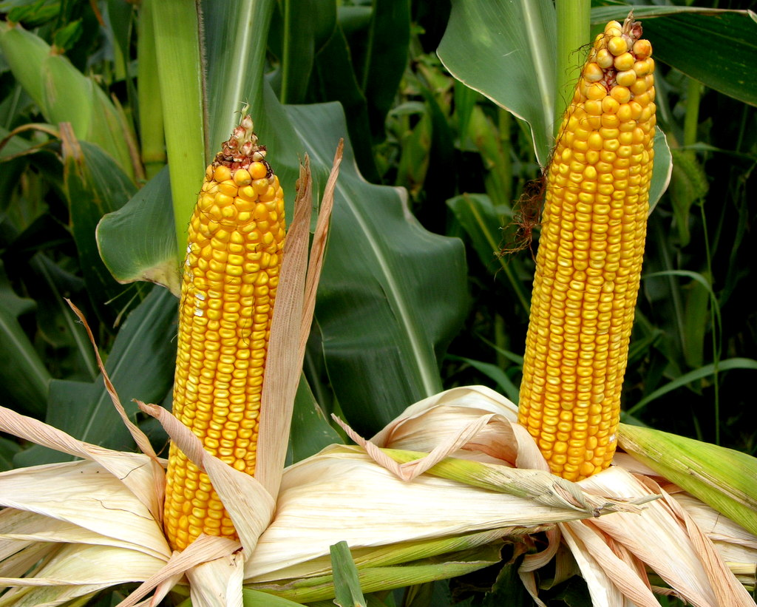
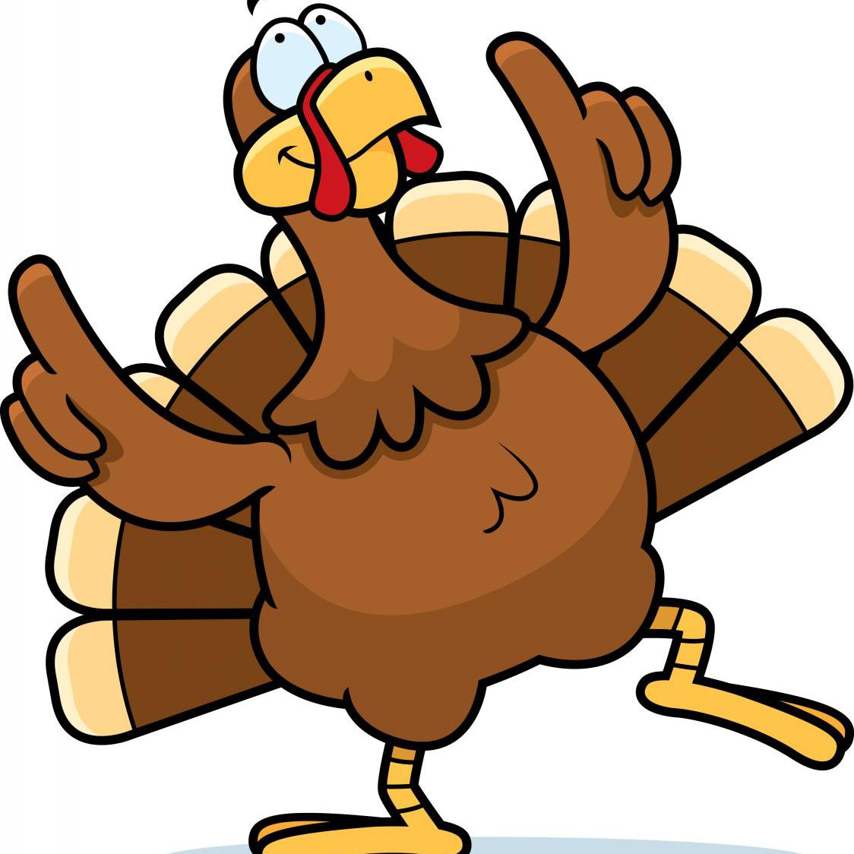
Phonological Awareness
Final
Initial

Slide 10
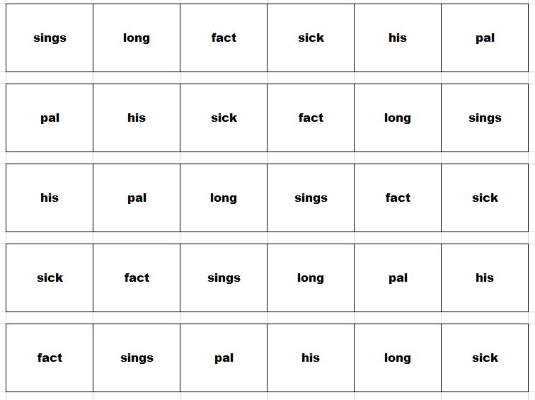
Fluency

Slide 11
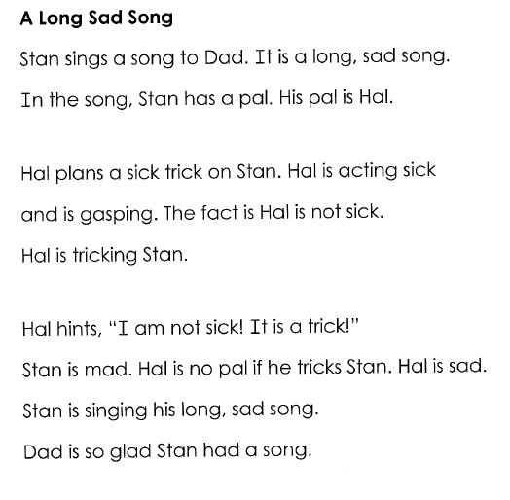
“ ”
,
.
?
!

Slide 12
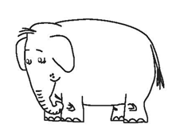
syllabication

Slide 13
hop me quit check
hop
me
quit
check
v
v
v
v
Notes:
Each word under the jelly bean has one "talking" vowel. When the vowel talks in the first word (click on slide to display hop), it says /o/. (Click on slide to underline and show the v). Words with just one "talking" vowel are called jelly bean words. Jelly bean words are unlocked the same way you eat a candy jelly bean. You put the whole thing in your mouth, chew out sounds, tap and swallow, and sweep sounds together. Jelly bean words are unlocked in one gulp.

Slide 14
basket bingo rabbit fantastic
bas ket
bin go
rab bit
fan tas tic
v
v
v
v
v
v
v
v
v
Notes:
The words under the picture are elephant words. Elephant words have more than one talking vowel. (Click on slide to illustrate the 2 bites in basket). It takes more than one bite to eat an elephant. It takes more than one bite to unlock an elephant word. An elephant word has many bites or parts as it has talking vowels. A word with one talking vowel or part of a word is called a syllable. (You can show the body language video or model body language. Click on the slide to finish breaking apart syllables).

Slide 15
comprehension
Notes:
We are going to listen and read along with the story, Eek Halloween by Sandra Boynton. When we are done reading, I am going to ask you questions about the story. Use your story board pieces as we are reading whenever you see or hear them in the story. Remember those are setting (do body language for setting), characters (do body language for characters), problem (do body language for problem), message (do body language for message), and title (do body language for title).

Slide 17
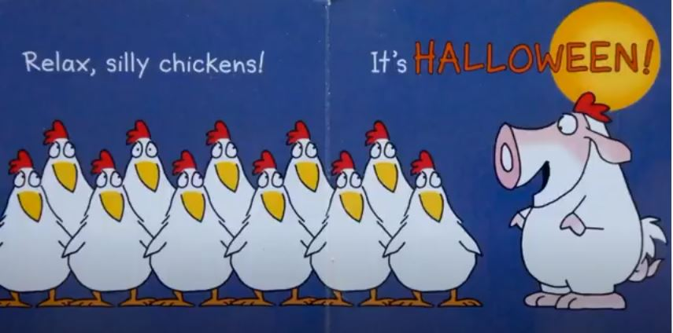
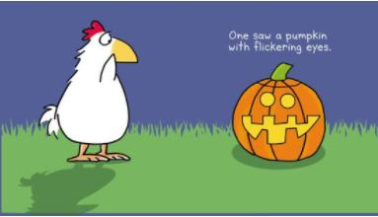
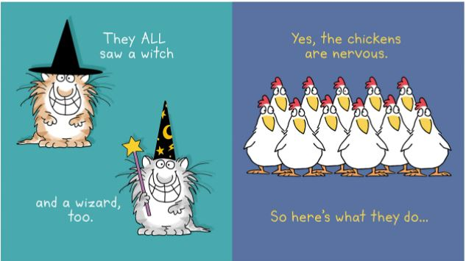
Notes:
Now we are going to answer some questions about the story: (Click on slide) What is the time of the story? (Halloween)
(Click on slide) With whom or what is the main character having a problem? (the strange things that they are seeing)
(click on slide) What is the outcome of the problem? (they learn it is Halloween and the animals are dressed in costumes)
(Click on slide) What did you learn from this story? (Embrace new things; you don’t have to be scared of something new; ask questions before making assumptions....)
(Click on slide) Suggest a new title. (Halloween Style; Scared Chickens…)

Slide 18
writing
Notes:
Richelle’s part
Let’s write a sentence a bare bone sentence summary. Since we just read a Halloween story, we are going to write about a celebration we enjoy. Some people enjoy Halloween, some Thanksgiving, and some people enjoy personal family celebrations that aren’t a holiday, like a birthday. For today, I am going to pick Thanksgiving. Remember (do body language) every sentence starts with a capital and ends with a stop sign. There also needs to be a subject (verbiage with body language) and an action predicate (verbiage with body language).

Slide 19
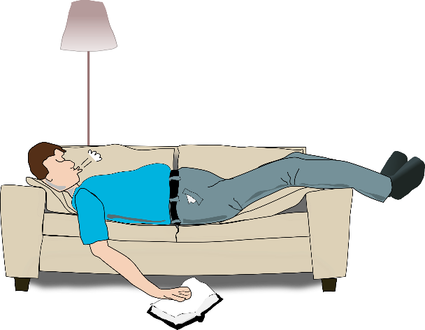
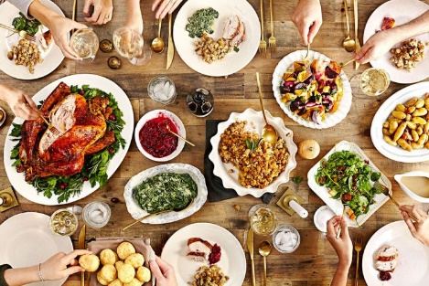
Before
During
After
Pies bake.
Subject choices | Action predicate choices
I (or your first name) Children Game Grandpa Nap Parade Plates | call(s). clear(s,ed). commence(s). on. play(s). sleep(s). snore(s). watch(es).
We eat.
Grandpa snores.
Notes:
My 1st sentence is going to be what we do before Thanksgiving. (click on slide) Pies bake. Pies is the subject and bake is the action predicate. We are going to write another sentence for during Thanksgiving. (click on slide)We eat. Now you try. You can use the word bank for help if you’d like (allow a few seconds for them to look at but they do not have to share. I am going to go with the sentence. Grandpa snores.

Slide 20
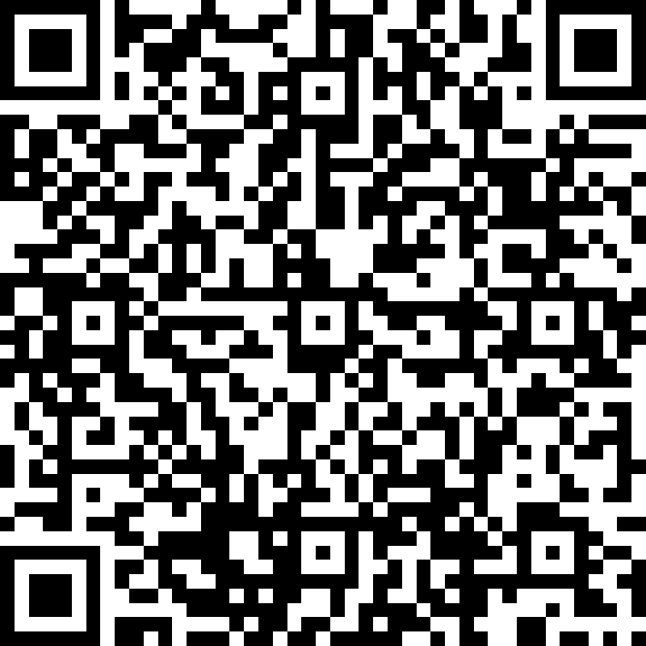
Thank you
Use the Form link or URL below to ask any questions:
https://forms.office.com/r/Z9BMvWpwfD

Slide 21
Student Support Services Department

