Slide 1
CONTINUUM OF SERVICES Fort Bend ISD parent learning opportunity Cindy Manthey, Program manager November 19, 2024

Slide 2
Agenda
Least Restrictive Environment (LRE)
Historical Context & Legal Foundations
Key Principles in Determining LRE
Assessment of Various Factors & Criteria

Slide 3

Least restrictive environment

Slide 4
Least restrictive environment
LRE embodies the principle that students with disabilities should be educated alongside their non-disabled peers to the greatest extent possible, while still receiving the necessary supports and services tailored to their unique needs.
In other words, LRE advocates for the inclusion of students with disabilities in regular educational settings, such as mainstream classrooms, as opposed to segregating them into separate, specialized programs or classrooms.
Understanding LRE is vital for fostering inclusive educational environments that promote the academic and social growth of all students, including those with disabilities.
LRE refers to a crucial component of special education that has evolved over time to ensure that students with disabilities receive an education that is both meaningful and equitable.
LRE does not advocate for a one-size-fits-all approach. Instead, it emphasizes individualized placement, acknowledging that the level of restriction should be determined by the specific needs and abilities of each student.

Slide 5
Historical context & legal foundations
1975 – Part B of the Individuals with Disabilities Education Act (IDEA 2004)
IDEA underscores the importance of placing students with disabilities in the least restrictive environment where they can make meaningful educational progress.
The law requires that children with disabilities are educated in regular educational settings, to the maximum extent appropriate, with the necessary supports and services to ensure their success.
Court cases, such as “Sacramento City Unified School District v. Rachel H.” (1994), further clarified the requirements of LRE. The “Rachel H.” case emphasized the importance of considering placement options in the general education classroom before resorting to more restrictive settings.

Slide 6

Part b of the idea 2004
34 CFR § 300.114 LRE requirements
Each public agency must ensure that–
To the maximum extent appropriate, children with disabilities, [ …]are educated with children who are nondisabled; and
Special classes, separate schooling, or other removal of children with disabilities from the regular educational environment occurs only if the nature or severity of the disability is such that education in regular classes with the use of supplementary aids and services cannot be achieved satisfactorily.

Slide 7


Slide 8

Key principles in determining Lre

Slide 9
Key principles
The LRE is not just a legal mandate; it’s a set of principles that guide the placement of students with disabilities in educational settings.
These principles are designed to ensure that students with disabilities receive an education that is both equitable and appropriate to their unique needs, while also fostering inclusivity and interaction with their typically developing peers.

Slide 10
key principles to guide the placement of students with disabilities in the least restrictive environment:
Individualization: One of the foundational principles of LRE is individualization. It recognizes that each student with a disability is unique, and their educational needs must be addressed on a case-by-case basis. What is considered the least restrictive environment for one student may differ from another based on their specific strengths, challenges, and goals.
Academic and Social Benefit: The primary objective of LRE is to provide students with disabilities an environment where they can benefit academically and socially. This means that while inclusion in a general education classroom is encouraged, it should also ensure that the student has the opportunity to make progress toward their educational and developmental goals.
Non-Academic Benefits: LRE not only addresses academic needs but also considers the non-academic benefits of inclusion, such as social interaction, communication, and the development of self-advocacy skills. These non-academic benefits are integral to a student’s overall growth and well-being.

Slide 11

key principles to guide the placement of students with disabilities in the least restrictive environment: (continued)
Regular Classroom as a Starting Point: LRE advocates for considering the regular education classroom as the starting point for placement decisions. In other words, the default should be to place a student in a general education classroom and then determine if additional support or services are necessary.
Appropriate Support and Services: While inclusion in the general education setting is ideal, it does not mean that students with disabilities are left without the necessary supports and services. In fact, LRE emphasizes that students should receive the individualized support and accommodations required to succeed in the regular classroom.

Slide 12
Assessment of Various Factors & Criteria

Slide 13
Student Needs: The starting point for determining LRE is the assessment of a student’s unique needs: academic requirements, such as specialized instruction, assistive technology, or speech therapy, as well as social and emotional needs, like behavioral supports or counseling.
Student Goals: The individualized goals outlined in a student’s Individualized Education Program (IEP) play a critical role in LRE determination. The IEP should reflect what the student is working towards and what supports are needed to achieve those goals. The closer alignment between the goals and the regular education curriculum, the stronger the case for placement in the general education classroom.
Progress Monitoring: Continual progress monitoring is essential in assessing the appropriateness of the placement. Educators, along with parents and other professionals, should regularly evaluate the student’s progress and make necessary adjustments to ensure that the placement remains the least restrictive while still effective.
Collaboration: Collaboration among educators, specialists, parents, and students is key in determining LRE. Collecting input from multiple stakeholders allows for a comprehensive understanding of the student’s needs and the most suitable placement.
Least Restrictive Environment Options: Educational teams should consider a range of placement options, from full inclusion in general education to partial inclusion with varying levels of support, and, in some cases, specialized settings. The choice of the least restrictive environment should align with the student’s individualized requirements.

Slide 14
The ard committee must consider:
ARD committees may not make placements based solely on the following factors (November 30, 2007 Letter to Trigg):
category of disability;
severity of disability;
configuration of delivery system; (the full continuum of services must be considered)
availability of educational or related services;
availability of space; and/or
administrative convenience (i.e., child’s need doesn’t fit into the master schedule).
whether the student can be educated in less restrictive settings with the use of appropriate supplementary aids and services;
whether the student would receive educational benefit from the general education classroom; and
what effect (any potential harmful effects) the student’s placement would have on the student or on the quality of services that he or she needs (34 CFR § 300.116 (d)).

Slide 15
What does “maximum extent appropriate” mean?
The ARD committee is responsible for identifying the student’s needs and the appropriate placement in which these needs can be met.
Placement decisions should begin with the least restrictive environment, i.e., the general education classroom with or without supplementary aids and services.
All possible placement alternatives should be considered to ensure that services are delivered in the LRE (34 CFR §300.116(a)).
A student can be placed in a more restrictive environment only when the ARD committee concludes that education in the less restrictive setting, even with appropriate supports and services, cannot be achieved satisfactorily.

Slide 16
what is needed for the student to make progress toward his/her annual goal(s)?
STAFF: Examples- General educator in collaboration with special educator, Part time support from special educator, Full time support from special educator
SUPPLEMENTAL AIDS AND SERVICES: Examples- Scheduled time for special education and general education co-planning, Modified curricular goals, Pre-teaching, Alternate ways for student to demonstrate learning, Test modifications, Changing method of presentation, Adaptive equipment, Audio text, Adjustments to sensory inputs, Social skills instruction

Slide 17
What considerations should the ARD committee give to “Harmful effects”?
Any potential harmful effects on the student or quality of services that he/she needs when placement is determined:
On the student with disabilities if the student is removed from general education classes
On the quality of services provided to the student with disabilities if the student is removed from general education classes
If the child’s behavior in the general education classroom, even with the provision of appropriate behavioral supports, strategies or interventions, would significantly impair the learning of others, that placement may not be appropriate for that child.

Slide 18
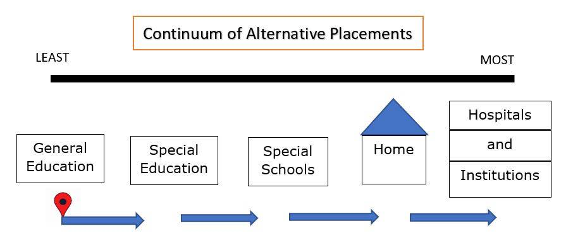
Continuum of alternative placements

Slide 19


Questions?

Slide 20
THANK YOU
Cindy Manthey​
281-327-2653
cindy.manthey@fortbendisd.gov​
Special Education / Parent Learning Opportunities (fortbendisd.com)
References:
20218-LeastRestrictiveInfo-04.06.17 (edl.io)
Least_Restrictive_-Environment_LRE_Q_and_A_2017-1.pdf (texasprojectfirst.org)
Least Restrictive Environment - School Psychology - iResearchNet

