Slide 1

Course Selection
Travis High School

Slide 2
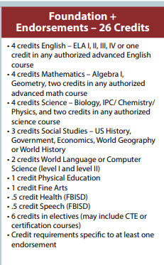
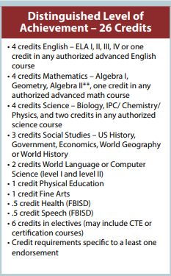

Graduation Plans
A total of 26 specific credits are needed to graduate
Notes:
You will graduate on the Foundation + Endorsements plan or on the Distinguished Level of Achievement plan. On the foundation plan, you must take Algebra I & Geometry, but you get to choose the other two advanced math courses. On the distinguished plan, Algebra I, Geometry & Algebra II are required. You get to pick the 4th math course. Now let’s look at science. Both plans have the same requirements. Now look at Social Studies. Both plans require U.S. History, Government/Economics, but you can choose to take W. Geography, W. History or both. We do suggest that you take both as most 4 year universities do look for that. No matter which plan you pursue, you must complete 2 credits of the same foreign language, Speech and Health, PE and a Fine Art. You can see the other credit requirement of 6 electives will total 26. Because you take 7 classes per year, for four years, many of you will graduate with more than 26 credits. Not to mention your high school courses taken in middle school as well as summer school. I’ve seen some students graduate with more than 30 credits!!

Slide 3

What is an Endorsement?
An Endorsement is a related series of courses that are grouped together by interest or skill set. They provide you with in-depth knowledge of a subject area.
Completing an Endorsement pathway is a requirement for graduation.
Notes:
In addition to you passing all your EOC exams and credit requirements, you must now also earn at least one endorsement to graduate. One important note, your endorsement classes are not taken in addition to your 26 credit requirement, they are actually built within. Your endorsement pathway is completed through those 6 elective credits. Some of your core classes could also earn you an endorsement. Let's first refresh your memory on what an endorsement is. Endorsements consist of a related series of courses that are grouped together by interest or skill set. They provide students with in-depth knowledge of a subject area.
. You may be wondering, how do endorsements help me, especially when applying to college. Well, an endorsement shows college admissions office that you were committed to and completed a series of courses. This can show them that you will be as committed when completing your college major. And if you choose a major similar to your high school endorsement, you may walk into your college classes with more knowledge about that subject than others.

Slide 4
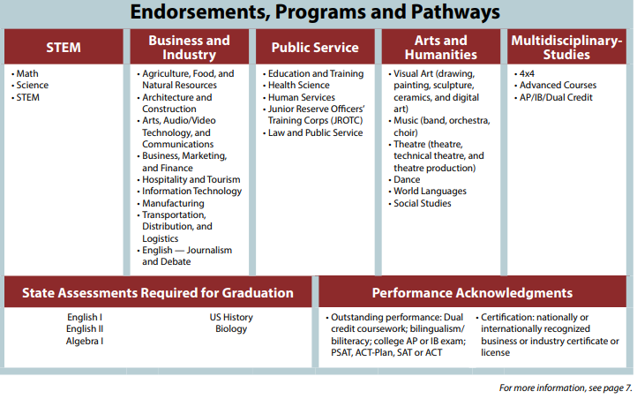
Notes:
You have 5 endorsement options with multiple pathways: READ THE ENDORSEMENTS.

Slide 5
EOC (STAAR) Test Requirements
There are five EOC tests that are required for graduation:
  Algebra 1
  Biology
  English 1
  English 2
  US History
Notes:
You are required to pass all five EOC tests in order to graduate. As a note, passing your STAAR exam is not tied to your classification.

Slide 6
Additional Graduation Requirements
Must pass all 5 STAAR EOC exams
Must complete CPR training- provided on campus
Must complete Peace Officer training- provided on campus
Must complete FAFSA, TAFSA, or opt out form – available your senior year

Slide 7
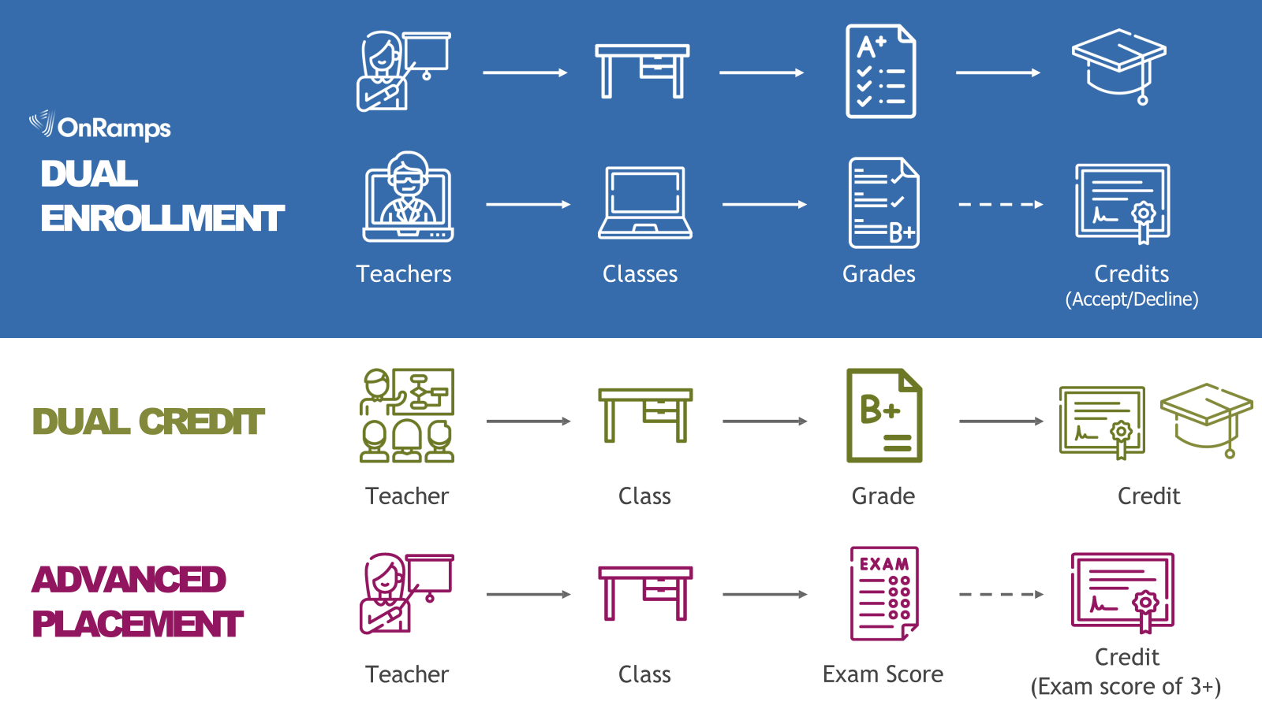
Dual Enrollment Options

Slide 8
Dual Credit
A system in which an eligible high school student successfully completes a college course that is paired to a high school course and receives credit for the course on both the college and the high school transcripts.
Can be taught on the high school campus by an FBISD teacher who is also employed by Houston Community College OR by an HCC professor.
Dual credit courses are college classes first and high school classes second. Students and teachers are required to follow all HCC policies, i.e., attendance, grading, accommodations, academic honesty, etc.
Students must complete the full Dual Credit application and apply to HCC through ApplyTexas. Forms must be turned into Mrs. Martinez (E138) or in Schoology.

Slide 9
Dual Credit Courses offered at THS
English 4 (Seniors Only)
Government (Seniors Only)
Economics (Seniors Only)
Psychology (10th-12th)
Sociology (10th-12th)
In order to take Dual Credit during the school year, you must complete all information found in the Schoology course
4WF4-NS5K-KHN4F
All paperwork must be completed no later than February 27, 2026.

Slide 10
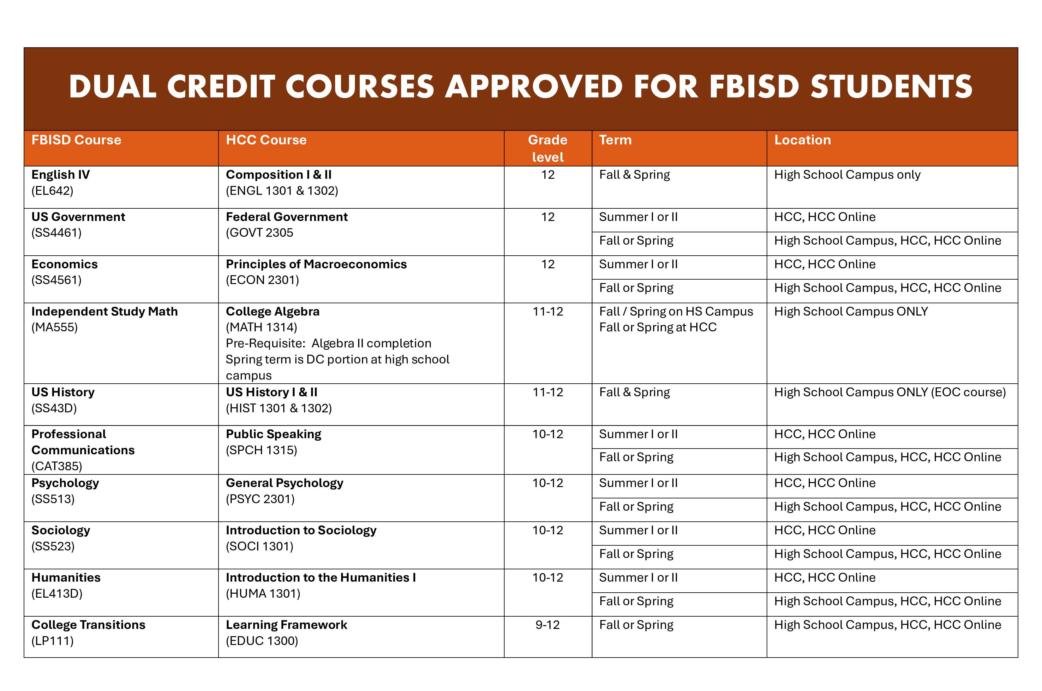
Summer Dual Credit
A separate form must be completed for summer courses if you are wanting to take courses during the school year and during the summer! You can only take ONE course over the summer. Please see details on Schoology course
4WF4-NS5K-KHN4F

Slide 11
OnRamps
UT OnRamps is a University of Texas initiative offering Texas high school students college-credit courses, primarily through blended learning. Students earn both high school and college credit, but have the choice to decline the college credit
OnRamps Courses offered at THS:
Physics
English 4
Algebra 2
US History
Chemistry
Statistics
All students can take an OnRamps course, if they meet the prerequisites.

Slide 12
Gifted and Talented
If you are GT identified, you must enroll in advanced courses (AAC, AP, Dual Credit, or OnRamps) in your areas of GT strength.
GT areas of strength:
•Math and Science
•English and Social Studies
•All four areas
If you are unsure of your area of strength, reach out to our GT Counselor, Ms. Sims.

Slide 13


James Reese Career and Technical Center
If you plan to apply for a Reese Center course, DO NOT add this on your course selection sheet or in SchoolLinks. Please add courses that you will take if you do not get accepted. Counselors will add Reese courses to your schedule when we are provided the students that have been accepted.

Slide 14

AVID-Advancement Via Individual Determination

Slide 15
Off Campus/Office Aide- Seniors only
To qualify for off campus or office aide, student must:
Be classified as a senior (18 or more credits, no missing required credits)
Passed all EOC’s
No DAEP or major discipline violations
Earned CCMR point before end of junior year
Seniors can have up to two periods of off campus/office aide
Seniors must leave campus during their off period- if they do not leave campus, the off period will be replaced with a course
Please DO NOT add off campus/office aide to your course requests. These will be added to your schedule by your counselor, if you qualify.

Slide 16
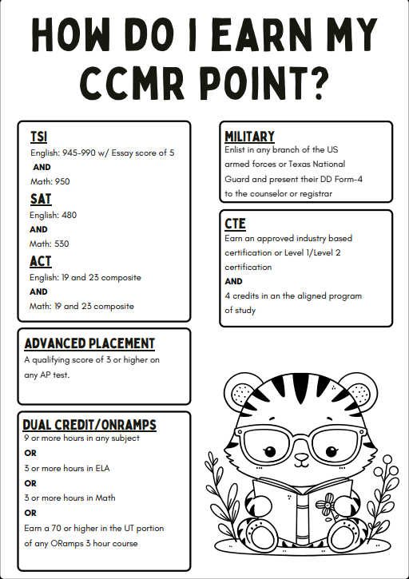
CCMR- College, Career, and Military Readiness
Fort Bend ISD aims for at least 90% of senior students to achieve college, career, and/or military readiness as they prepare for their unique futures.

Slide 17
Schedule Verification and Corrections
Course Selection Window: 1/26/2026-2/13/2026-
Students input Course Selection in School Links
Verification Window: 3/9/2026-3/13/2026-
Students and parents review Course Selection and make changes if necessary.
The verification period is the last time
students will be able to make changes
to course selections.
After the verification period, Counselors will only make schedule corrections for the following reasons:
•You are in a class you already have credit for
•You are missing a period
•You are missing a class that is required for graduation

Slide 18
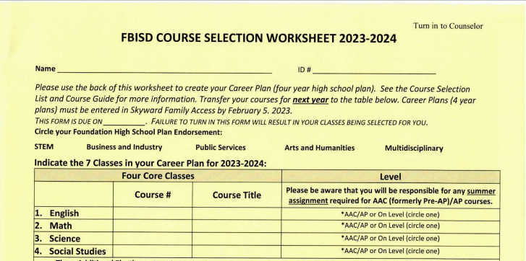
Course Selection Form-Endorsement and Core Courses
Neatly print your name and ID #
Circle your chosen endorsement plan
Select your Core Courses:
  English (need 4 credits)
  Math (need 4 credits)
  Science (need 4 credits)
  Social Studies (need 3 credits- highly recommend 4)
Select Level- AAC/AP or On Level
Use the Universal Course Selection Worksheet or Course Guide to locate Course #
Sally Smith
0246810
EL121
English 1
MA212
Algebra
SC322
Biology
SS412
World Geo
Notes:
Now let’s begin selecting your courses for 9th grade.

Slide 19
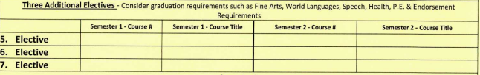
Course Selection Form- Electives
Select three additional courses. Please consider your graduation requirements such as Fine Arts, Language, PE, & Speech/Health, as well as the courses required in your endorsement pathway. If the course is only one semester, please ensure you select another course for second semester.
CHS010
Prin. Health Sci
CHS010
Prin. Health Sci
FL112
Spanish 1
FL112
Spanish 1
PH0111
Health
CAT380
Speech
Notes:
Where will course selection sheet be for students to be able to find the course numbers?

Slide 20

Course Selection Form- Alternatives
PE311
PE
FA013
Art 1
CBU010
Prin. of Business, Marketing, Fin.
In order of preference, list at least three alternative courses. Alternatives are highly suggested in World Languages, Fine Arts, and your Endorsement Pathway.
IF YOU DO NOT SELECT ALTERNATES, YOUR COUNSELOR WILL SELECT FOR YOU BASED ON COURSE AVAILABILITY AND YOUR GRADUATION REQUIREMENTS.

Slide 21
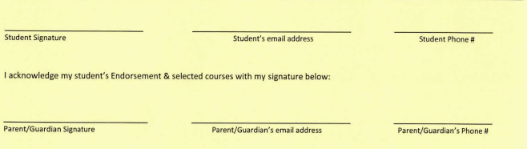
Course Selection Form- Signatures
Please make sure you sign your Course Selection Sheet and get your parent to sign. Course Selection Sheets will not be accepted without a parent signature.
Sally Smith
Sally.S1@student.fortbendisd.com
281-327-0116
Susan Smith
Sallymom@gmail.com
281-327-0116

Slide 22

Course Selection- School Links
Students will input course selections in School Links for the 2026-2027 school year.
Instructions on how to complete course selection in School Links will be sent to students and parents.

Slide 23
Questions?

