Slide 1
GT Awareness Meeting for Parents

Slide 2


Slide 3
Students with Gifts and Talents:
National Association for Gifted Children (NAGC)
Come from all racial, ethnic, and cultural populations, as well as all economic strata.
Require sufficient access to appropriate learning opportunities to realize their potential.
Can have learning and processing disorders that require specialized intervention and accommodation.
Need support and guidance to develop socially and emotionally as well as in their areas of talent.
Require varied services based on their changing needs.

Slide 4
Texas Education Agency (TEA)
The Texas Education Agency defines a gifted/talented student as a child who performs at or shows the potential for performing at a remarkably high level of accomplishment when compared to others of the same age, experience, or environment and who
exhibits high performance capability in an intellectual, creative, or artistic area;
possesses an unusual capacity for leadership; or
excels in a specific academic field. (Texas Education Code §29.121)

Slide 5
Gifted and Talented Services

Slide 6
Fort Bend ISD Gifted and Talented
Areas Served
FBISD Gifted and Talented Student
English Language Arts
Mathematics
Social Studies
Science
Students are currently identified and served in the 4 core areas.
Notes:
Your child is identified in either Math and Science, ELA and SS, or all areas. Your child’s teacher in these subject areas will provide additional differentiation according to your child’s needs.

Slide 7

Goal
What is our goal for gifted students?
In alignment with the Texas State Goal for Services for Gifted/Talented Students and Fort Bend ISD’s Mission and Vision, the purpose of Fort Bend ISD’s Gifted and Talented Services is to provide students identified for gifted services with opportunities to develop their capabilities and demonstrate skills in self-directed learning.
How will we know students have achieved the goal?
The ability to develop innovative products and performances that reflect creativity and individuality in addition to refined research, critical thinking, and communication skills will serve as evidence of mastery of the goal.
What do we do to help students achieve the goal?
In Fort Bend ISD, GT Services take the form of educational interventions- content extensions, curricular alternatives, and advanced level projects in the core foundational curricular areas-Math, Science, ELA, and Social Studies, provided during the school day along with self-directed goals indicated in the GT Learning Plan.

Slide 8
Gifted and Talented Services
Elementary
All students identified as Gifted and Talented are provided the following:​
  GT services are provided in the core subject areas
  (English Language Arts and Social Studies, Math and Science, or all areas)​
  GT Learning Plans​
  Identified students in grades K-5 are cluster grouped with GT-trained teachers.
  Completion of a Texas Performance Standards Project (TPSP)/Innovation Hour Project is required for 1-5

Slide 9
Cluster Grouping
Gifted and Talented students are ensured opportunities to work together as a group, work with other students, and work independently during the school day as well as the entire school year.
GT students are placed together for instruction in the appropriate content area(s) for which they have been identified in cluster grouping.
Teachers are trained to adapt curriculum and instruction for their gifted learners.
Notes:
Differentiating the pace of learning for GT students provides an opportunity for them to learn at a pace commensurate with their abilities in order to maintain their interest and provide a developmentally appropriate level of challenge. Acceleration practices involving pacing include continuous progress, curricular compacting, and subject-matter acceleration.

Slide 10

Overview of GT Services
The focus of the FBISD GT program is to:
Assess routinely to determine student needs, interests, and abilities.
Differentiate instruction with respect to content, process, product, and learning environment.
Offer cross-curricular opportunities through integrated academic and real-world connections with problem solving experiences.
Provide opportunities for collaborative research and independent study.
Encourage students to design, create, and showcase advanced-level products for a variety of audiences.
Utilize technology as a resource, productivity, and communication tool.

Slide 11
Referral and Identification Process

Slide 12
When are the GT referral windows?
Fall: August 8-September 30, 2024 for students currently enrolled in FBISD schools.
Spring: January 6-January 31, 2025 for students who enroll in FBISD schools after the Fall window closes.

Slide 13
Identification Process
Step 1: Online Referral https://gt.fortbendisd.com/
September 30th deadline
Step 2: Data Collection
  Cognitive Abilities Testing in nonverbal, verbal, and quantitative areas. Teacher and parent inventories in math, science, social studies, and English Language Arts.
Step 3: District Selection Committee Review
Step 4: Parent Notification (March 2024)
Step 5: Services Begin
  Kindergarten ONLY March 1
  1st-11th grade at beginning of 2025-2026 school year

Slide 14

GT Assessment
Quantitative Measures
CogAT (Nonverbal Assessment) - measures a student’s reasoning abilities through the use of visuals/pictures.
CogAT (Verbal Assessment) - measures verbal aptitude, word knowledge and concepts, facility with language, verbal reasoning, and analogies.
CogAT (Quantitative Assessment) - measures mathematical reasoning and problem solving, numerical sequences and patterns, manipulation of mathematical concepts.

Slide 15

We also look for input from those who know the student.
Qualitative Measures
Parent Inventory
Teacher Inventory

Slide 16
Identiﬁcation Timeline-Fall Referrals (Gr. 1-11)
Referrals
Referrals are accepted from parents, teachers, and students.
Committee Decision
Emails will be sent notifying parents of the results of the identiﬁcation process.
August
2025
October - November
August -
March
September
Testing
Service Begins
Students identiﬁed as gifted/talented in 2024-2025 will receive gifted services beginning in 2025-2026.
Students with a Parent Consent will take CogAT.

Slide 17
Identiﬁcation Timeline-Fall Referrals (Kindergarten Only)
Referrals
Referrals are accepted from parents, teachers, and students.
Committee Decision
Emails will be sent notifying parents of the results of the identiﬁcation process..
March
2025
October - November
August -
March 1, 2025
September
Testing
Service Begins
Kindergarten students identiﬁed as gifted/talented in 2023-2024 will receive gifted services beginning in March 2025.
Students with Parent Consent will take CogAT.

Slide 18
Don’t Forget...
Referral Deadline
September 30th
^{www.fortbendisd.com/gifted}

Slide 19
Frequently Asked Questions

Slide 20
Frequently Asked Questions
If my child does not qualify for GT services, can they be referred again?
Yes, Your child can be referred for GT evaluation on an annual basis until the 12th grade.
My child is already identified as GT in all areas, can they be referred for re-testing?
Referrals are not accepted for students who have been identified for GT services in all areas.

Slide 21
Frequently Asked Questions
My child is already identified for GT services in one area, can they be referred for re-evaluation?
Students currently identified for GT services in one area may not be referred to add additional areas. Once a student is identified for GT services, no additional evaluation will be available.

Slide 22
Frequently Asked Questions
How does FBISD service Gifted Learners?
GT services are provided in the core subject areas: English Language Arts, social studies, math, and science.
Students are cluster grouped with GT-Trained teachers.
GT Learning Plans for each student are completed to support student growth.
FBISD teachers also provide curricular compacting, lesson differentiation, and participation in projects aligned to the Texas Performance Standards Project (TPSP).

Slide 23
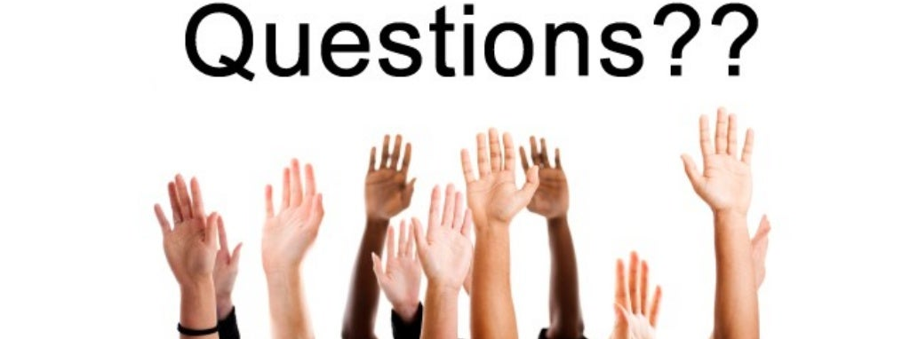
Please write them in the chat.
Notes:
Say: We will take questions until the end of this information session at 7:00 pm. Please write them in the chat. To review this video as well as Questions posed in the chat, please visit the GT Webpage.

Slide 24
FBISD Gifted and Talented Department
  Dr. Laurie Westphal (Director)
  Crystal Wilson (Elementary Program Manager)
  Aisha Coleman-Holmes (Secondary Program Manager)
  Terry White (Curriculum Integration Coordinator)
  Nancy Bryant (GT Mentorship Specialist)
  Joseph Bernhart (GT Academy Coordinator)

Slide 25

FORT BEND ISD
16431 Lexington Blvd.
Sugar Land, TX 77479
281-634-1000
www.fortbendisd.com
Notes:
Presenter:
Time:
Strategy:
Materials:
Say:

