Slide 1
General SHAC Meeting
SHAC Celebrates
Wednesday, May 17, 2023
Notes:
Presenter:
Time:
Strategy:
Materials:
Say:

Slide 2
Welcome & Mindful Moment
Allison Thummel
SHAC Chair

Slide 3
Getting to Know the Health & Safety Subcommittee

Slide 4
Health & Safety Subcommittee Leaders
Health & Safety Subcommittee Leaders
Sharyll Etuk
Shumaila Ali
Nicholas Petito

Slide 5
FBISD Safety Updates – “See Something, Share Something”
Nicholas Petito
FBISD Communications, Public Information Officer

Slide 6
Report Accurate Information
The Fort Bend ISD Police Department encourages everyone to “see something, share something” when it comes to school safety. We want each student to feel comfortable reporting anything they consider threatening or unsafe to a campus administrator, teacher, or trusted adult. Students, staff, and our families can also submit information through the See Something, Share Something app, through the CrimeStoppers program at (281) 491-TIPS, or by contacting the Fort Bend ISD Police Department directly at (281) 634-5500.

Slide 7
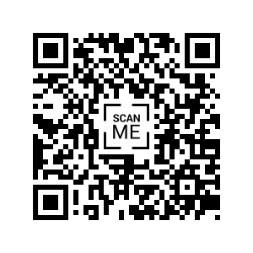
The See Something, Share Something mobile app allows students, staff, and the community the ability to submit crime tips and suspicious activity anonymously, 24 hours a day, 7 days a week from a mobile device. The District’s first-ever mobile app empowers students, staff, and parents to play an active role in identifying and reporting suspicious activity and bullying.

Slide 8
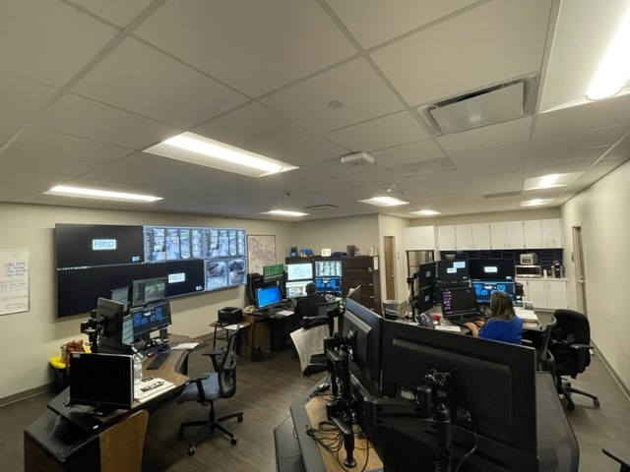
FBISD Police Department Dispatch
The FBISD Police Department’s Dispatch team takes calls for service 24 hours a day, 7 days a week, 365 days a year!
Phone: (281) 634-5500

Slide 9
CrimeStoppers
The Fort Bend Independent School District Crime Stoppers program provides a safe and anonymous system to give information about criminal activity, threats, drugs or weapons, without fear of retaliation. If you have information about a crime committed on or around school property, or about threats of a crime, call the 24-Hour Campus Crime Stoppers Tip Line at (281) 491-TIPS (8477).

Slide 10
Child Advocates “Child Safety and Teen Safety Matters” Lindsey Castellanos Community Outreach Coordinator Casey Davis Community Engagement Director Child Advocates of Fort Bend

Slide 11
with
Notes:
This 45-minute Information PowerPoint is a great resource to be used to educate faculty and staff about the program and topics of concern.
The minimum presentation time is 45-minutes with no discussion, however, allowing for 60- minutes is optimal to allow for questions and incorporating notes into the presentation.
Topics include:
Program introduction
Prevention education importance/need
Research
Program benefits/features and curriculum details
Additional resources are available on your flash drive and at www.mbfpreventioneducation.org for you to share with staff:
Safety Brief: Victimization, Prevention, & Academic Achievement
Safety Brief: 5 Safety Rules
Safety Brief: Safe Adults
Safety Brief: Identifying and Reporting Child Abuse
Safety Brief: Identifying and Reporting Bullying

Slide 12
What does it cover?

Slide 13
Comprehensive Content CSM (Grades K – 5^{th)}
Lesson 1
Lesson 2
General Safety and Prevention
Shared Responsibility
Types of Abuse
Who Harms Kids and How
Safe vs. Unsafe Strangers
Safe Adults
Safety Rules
Bullying and Cyberbullying
Digital Abuse and Safety
Peers and Predators
Digital Citizenship
Safe Adults
Safety Rules
Notes:
Effective programs should be comprehensive and cover all types of victimization.
But they also HAVE to be practical for schools (i.e. can’t take up too much class time).
CSM is 2 lessons (35- 55 min each depending on grade/age) – or can be broken down into 4 shorter lessons.

Slide 14
Comprehensive Content
Lesson 1 – Digital Safety
Lesson 2 – Physical/Emotional Safety
Safe Adults – All
Safety Rules – All
Cyberbullying – All
Digital Abuse And Safety – All
Digital Citizenship - All
Exploitation & Trafficking – All
Digital Self-awareness – 8th – 12th
Digital Self-management – 8th – 12th
Safe Adults – All
Safety Rules - All
4 Types of Child Abuse – All
Relationship Abuse – All
Bullying – All
Exploitation & Trafficking – All
Sexual Assault – 7th – 12th
Notes:
TSM covers a wide variety of victimization types.

Slide 15
The foundation of the programs
TSM- The 5 Safety Rules
Notes:
The programs are built on two foundational elements… the 5 Safety Rules and Safe Adults.
Research has shown prevention best-practices teaches children rules for safety rather than teaching them to rely on an uh-oh feeling.
The 5 safety rules educate and empower students with strategies they can use in any unsafe situation they might encounter.
The program incorporates the safety rules throughout every lesson because research says it is important to teach kids rules to follow regarding safety vs just talking about an uncomfortable or uh-oh feelings.
Each rule has an icon that matches.

Slide 16
Program Related Reports
It is important that facilitators, school staff, and parents be educated regarding disclosure and reporting when using the programs.
Student Disclosures of Abuse:
Student Reports of Bullying:
41%
51%
of schools that implemented the program (and submitted feedback data) reported one or more disclosures of abuse within 4 weeks after implementing the program.
of schools that implemented the program (and submitted feedback data) reported one or more disclosures of bullying within 4 weeks after implementing the program.
Notes:
Why do you need to know?
Data we have collected from facilitators has shown that after implementing the program, children disclosed abuse and bullying.

Slide 17
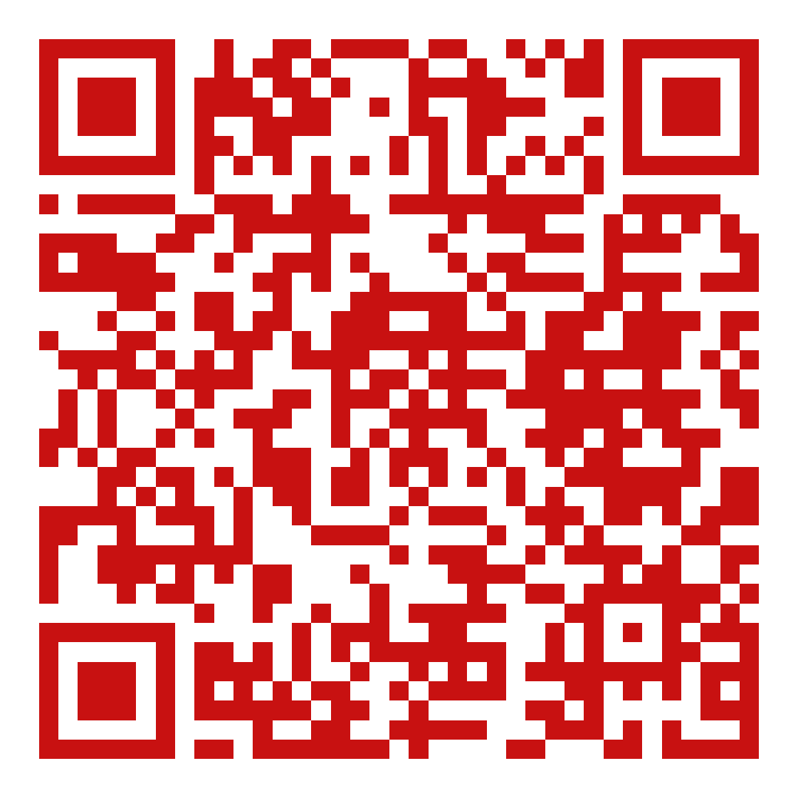
How to request a presentation
Schools can contact us directly for presentations. We also can work on a district wide level to schedule schools by semester.
Notes:
https://www.cafb.org/programs/community-education/speaker-requests/

Slide 18
Contact Us
Email
Website
Phone
lcastellanos@cafb.org
www.cafb.org
281-344-5259
Notes:
Please contact MBF with any questions or for further information.

Slide 19
Crime Stoppers “Safe School Institute 101” Joshua Webb Program Coordinator, Crime Stoppers of Houston

Slide 21
JOSHUA WEBB
Programs Coordinator, Safe School and Safe Community Institute
jwebb@crime-stoppers.org

Slide 22
Safe School Institute 101

Slide 23
PROGRAMMING
Crime Stoppers of Houston
Crime Solving
Crime Prevention
Fallen Hero Project
Victim Advocacy
Safe Community Institute
Safe School Institute
Tip Line
The Balanced Voice Podcast & Research Center
Statewide Expansion to all TX Crime Stoppers

Slide 24
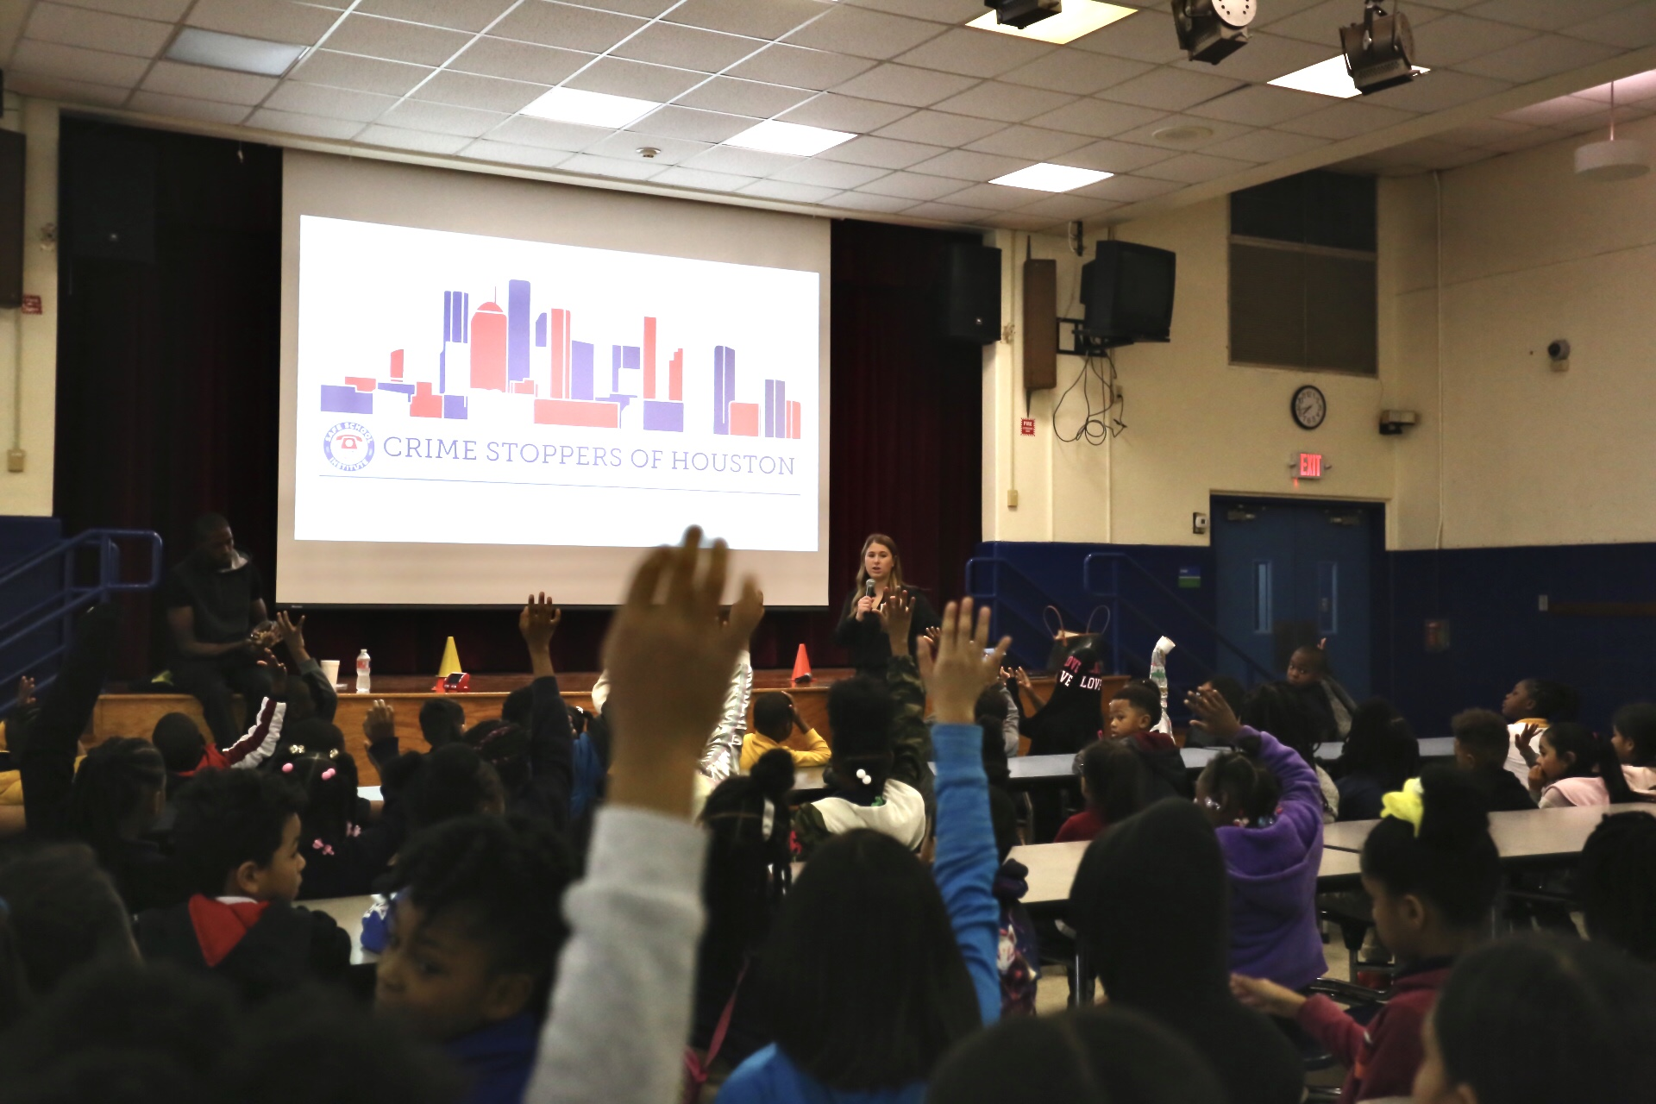
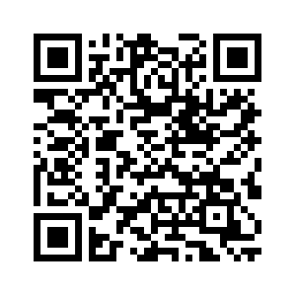
SAFE SCHOOL INSTITUTE (SSI)
The function of the Safe School Institute is to create a one-stop center for all aspects of school safety.
Creates a proactive dialogue with students, school staff, and law enforcement
.
Promotes anonymous reporting
Recognizes that students are the first line of intelligence
SSI WEBSITE:

Slide 25
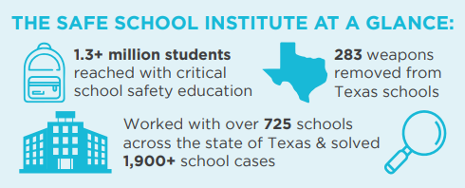
OVERVIEW
Free
Reputable brand
PK-12
Public, Private, Charter, & Home Schools
In over 70 school districts- GHA + State
Year-round
Satisfies state mandates

Slide 26
GOALS
Reduce victimization
Deter delinquency
Promote anonymous reporting
Make sound decisions
Safety is top of the priority list
Honest/ transparent/ informative education

Slide 27
MESSAGING
No scare tactics
Real life examples
Age appropriate
Work directly with campus needs
Relatability

Slide 28
PRESENTATIONS OFFERED
www.crime-stoppers.org/presentation_request
Student:
-Tip Line (6-12)
-Active Shooter (6-12)
-Animal Safety (Elementary)
-Cyber Safety (PK-12)
-Bullying Prevention (3-12)
-Human Trafficking (6-12)
-Juvenile Laws (6-12)
-Mental Health (PK-12)
-Social Media & Mental Health (6-12)
-Situational Awareness (6-12)
-Substance Use Prevention (3-12)
-Teen Dating/Sexual Misconduct (6-12)
-Prom Safety (High School)
Educator:
-Tip Line
-Active Shooter
-Bullying Prevention
-Cyber Safety Awareness
-Cyber Safety and Human Trafficking
-Gaming Safety
-Human Trafficking
-Mental Health
-Reporting and Recognizing Child Abuse and Neglect
-Social Media Safety
-Substance Use Prevention
-Teen Dating/Sexual Misconduct
Newest Presentation: Vaping Prevention for Teens

Slide 29
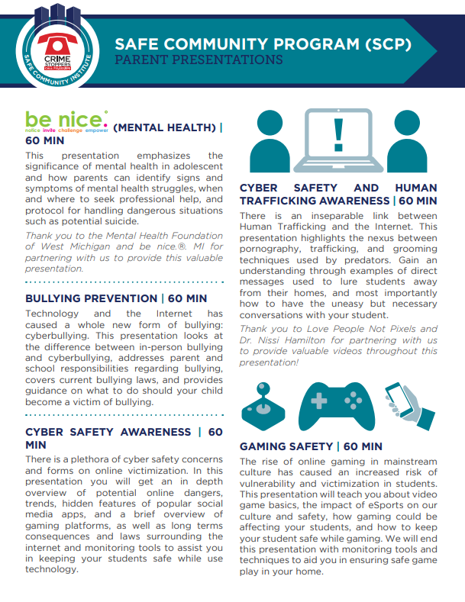
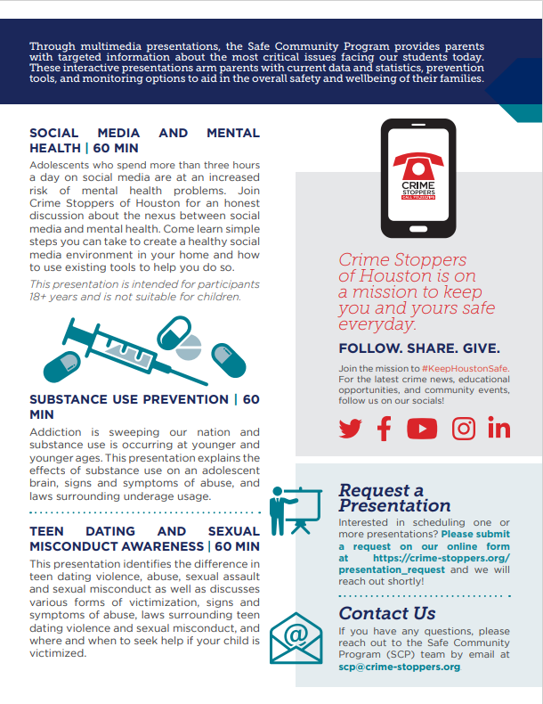
SAFE COMMUNITY INSTITUTE - PARENTS

Slide 30
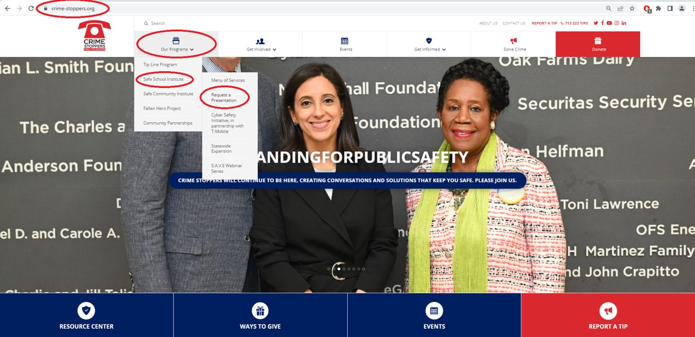
REQUESTING A PRESENTATION

Slide 31
POST-PRESENTATION SUPPORT
The Safe School Institute is the hub for all
aspects of school safety.
Student Tip Cards
Parent & Educator Tip Cards/Handouts
Educator Flow Charts
Post Assessment Quizzes for MS and HS students
Metal Signs and Posters: Tip Line
Newest Addition: Post-presentation lesson plans for HS students

Slide 32
VIRTUAL REACH
S.A.V.E Webinar Series in Partnership with the TEA every Monday at 10am: crime-stoppers.org/safe-school-institute/save-webinar-series
Cyber Safety Conversations available on the CSOH YouTube Channel
Safety Hot Topic Videos available on the CSOH YouTube Channel
Presenting to students, staff, parents, LE via Zoom/TEAMS/Google Chat, etc.
Pre-recorded presentations available for schools and the community
SCI scheduled virtual programming every Tuesday at 11am

Slide 33
PARTNERSHIPS
Collaborations/Partnerships
Jet Blue
be nice. Mental Health Foundation of West Michigan
David’s Legacy Foundation

Slide 34
STUDENT ENGAGMENT OPPORTUNITIES
Child ID Kit Community Service Project
Student Ambassador Leadership Program
Annual High School PSA Contest

Slide 35
COMING UP…
Sextortion and Pornography Guide for families
Drugs in a Snap booklet for students
Poster campaign for students

Slide 36
EXPECTED RESULTS
Reduce campus crime
Empower students to advocate for themselves and others
Create a safer learning and working environment
Student / campus buy-in
Minimize violations of the Student Code of Conduct
Improve school climate

Slide 37
SAFE SCHOOL INSTITUTE (SSI)
The Safe School Institute is A
resource
and a
solution!

Slide 38
SAFE SCHOOL INSTITUTE (SSI)
QUESTIONS
AND
ANSWERS

Slide 39
AVDA John Reyes Prevention & Education Manager, AVDA

Slide 40
Presentations and Programs for Youth Offered By AVDA
end abuse/begin again
YOU DESERVE SAFETY.
ITS YOUR LEGAL RIGHT.
John Reyes
Prevention and Education Manager
1001 Texas Ave., Suite 600
Houston, TX 77002
713.224.9911

Slide 41
Founded by the National Council of Jewish Women – Greater Houston Section in 1980
AVDA has provided services in the Greater Houston area for 40 years

Slide 42
AVDA’s Services
For Victim/Survivors
Free Legal Representation
Protective Order
Divorce
Child Support/Custody
Advocacy
Safety Planning
Crime Victims Compensation
Referral
Financial and Tuition Assistance
Counseling
Individual, group
Adults, children
For Abusers
Battering Intervention and Prevention Program (BIPP)
Psychoeducational Counseling
18 weeks minimum
State accredited
Group format (19 grps)
Accountability based
Victim safety components
Youth Education and Prevention
Community Outreach

Slide 43
Presentations Offered By AVDA
Presentations are best when they are scheduled for 90 minutes. This gives enough time for information sharing, activities and questions.
Presentations can be altered to fit other time frames and can have the subject matter altered to meet the needs of the students or school.
Can accommodate various sized groups.
Topics include:
Teen Dating Abuse
Healthy Relationships
Teen Dating Abuse and Healthy Relationships
The Intersection of Relationship Abuse and Human Trafficking
Healthy Manhood.
* Source materials for presentations come from the CDC, TCFV, loveisrespect.org, thatsnotlove.org, Safe Dates and Live Respect

Slide 44
Programs Offered by AVDA
Safe Dates – 8-week program
Live Respect – 8-week program
Love 146 – Not A Number – 5-week program

Slide 45
Safe Dates
How AVDA provides the national Safe Dates program:
8- week program
Focuses on healthy relationships
Middle school or high school aged students
Co-ed classes
No larger than classroom sized groups

Slide 46
Safe Dates

Slide 47
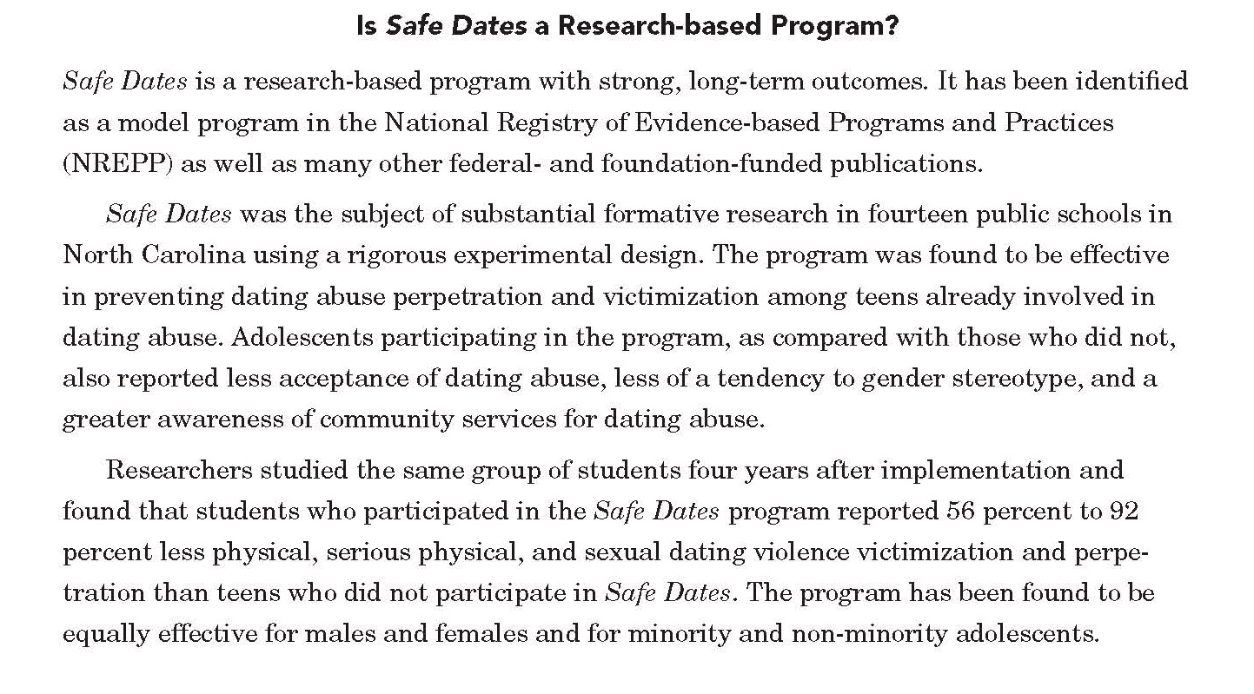
Safe Dates

Slide 48
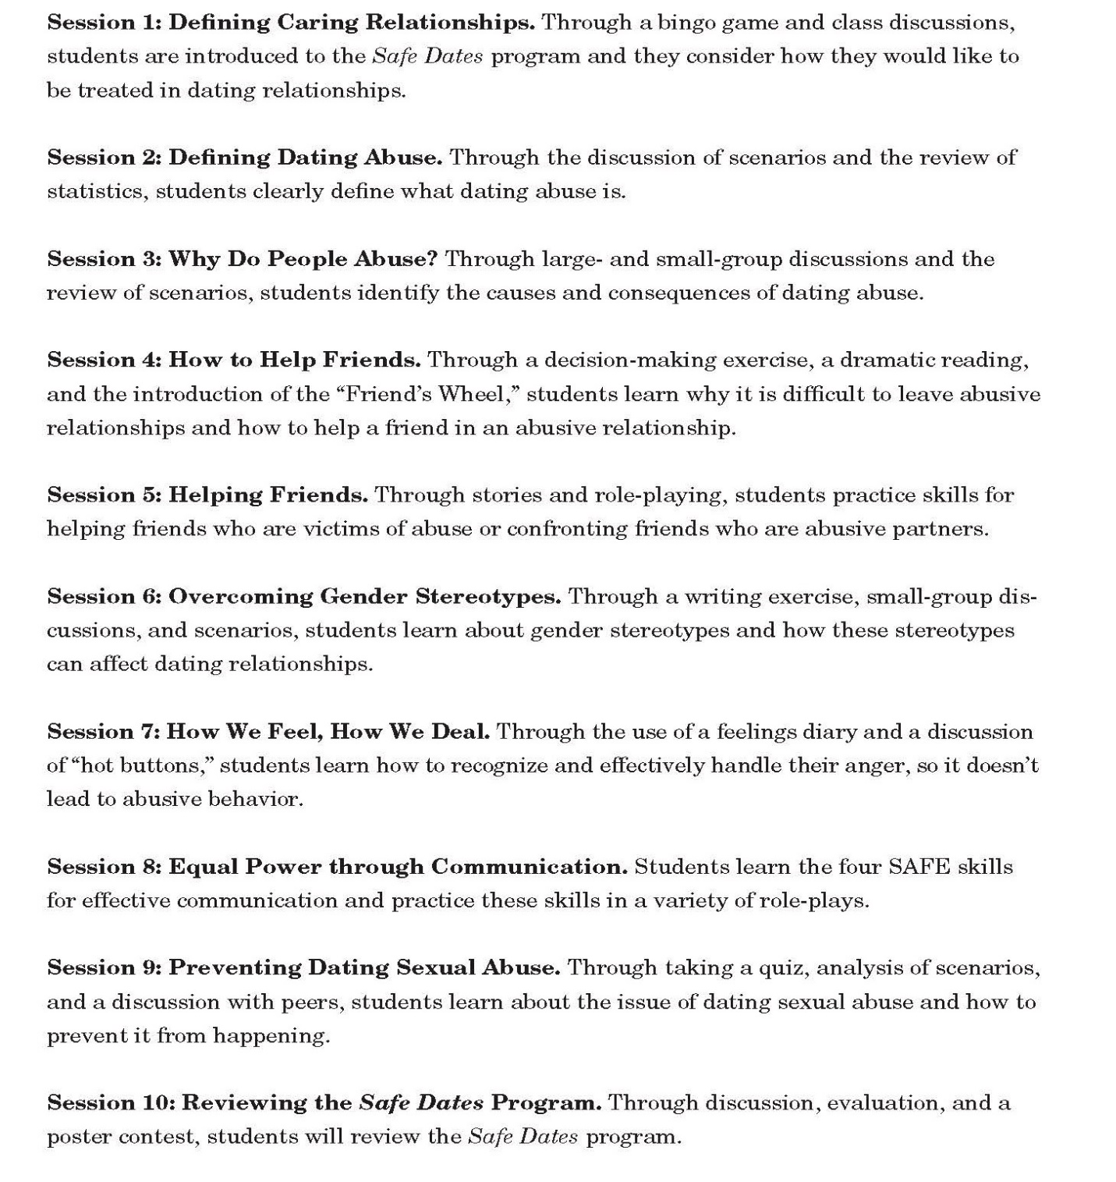
Safe Dates

Slide 49
Live Respect
How AVDA provides the national Live Respect program:
8- week program
Focuses on healthy manhood and the respectful treatment of women and girls
Middle school or high school aged students
For male students
No larger than classroom sized groups

Slide 50
Live Respect

Slide 51
Live Respect

Slide 52
Live Respect

Slide 53
Love 146 – Not A Number
How AVDA provides the national Love 146 program:
5- week program
Focuses on identifying and recognizing human trafficking and relationship abuse
Middle school or high school aged students
For female or co-ed students
No larger than classroom sized groups

Slide 54
Love 146 – Not A Number
ABOUT THE CURRICULUM
Not a Number is an interactive child trafficking and exploitation prevention curriculum designed to provide youth with information and skills in a manner that inspires them to make safe choices. Youth learn to identify and utilize healthy support systems that may decrease their vulnerabilities.
Through open conversations, engaging activities, the use of media, and opportunities for self-disclosure, participants will:
Raise their awareness of what constitutes human trafficking and exploitation.
Learn how to recognize recruitment tactics and understand vulnerabilities.
Challenge harmful stereotypes and societal attitudes.
Identify healthy support systems.
Develop skills to safely navigate potential and existing exploitative situations.
Learn how to access community resources when situations occur that increase their vulnerability (or if exploitation is already underway).

Slide 55
Love 146 – Not A Number
MODULE 1 - AN INTRODUCTION TO HUMAN TRAFFICKING AND EXPLOITATION
MODULE 2: SOCIETY AND CULTURE
MODULE 3: RED FLAGS AND RELATIONSHIPS
MODULE 4: VULNERABILITY AND RESILIENCE
MODULE 5: REDUCING RISKY BEHAVIOR AND GETTING HELP

Slide 56
Love 146 – Not A Number
HOW IS NOT A NUMBER DESIGNED TO MEET THE NEEDS OF YOUTH?
It moves beyond the traditional “information deficit” model and instead encourages peer-to-peer prevention, as youth often confide in one another before alerting an adult. It motivates youth to advocate for themselves and others through an environment that fosters mutual support. It establishes a safe and respectful space for youth and adults to have open and informed dialogue necessary for effective prevention.
It prepares youth to navigate content specific to their experiences as young people, including recognizing how the internet and social media can be used by traffickers, questioning the cultural norms created by media, reducing risky behavior in physical and digital setting, and identifying the characteristics of healthy and unhealthy relationships.
It takes a cooperative, holistic approach to young people’s needs focusing on social-emotional abilities, such as empathy, respect, and the relationship between personal and societal pressures that create or increase vulnerabilities.

Slide 57
QUESTIONS?

Slide 58
Brain Break SHAC Health & Safety Subcommittee

Slide 59
Rock Paper Scissors Evolution
Brief:
Standard rock-paper-scissors rules apply: go on ‘SHOOT’ or ‘GO’
There are 5 stages: Egg, chicken, eagle, dinosaur, King or Queen. Participants can only play others who are also at their same stage. If you win, you go to the next stage, and if you lose, you go down a stage.
Everyone starts out as an egg
Stages
Egg: holding both hands above head in a circle
Chicken: have arms bent at the elbows like wings
Eagle: have arms spread wide like you are soaring
Dinosaur: have arms tucked in close to chest like T-rex, and stomp around
King or Queen: hold hands beside head, with fingers pointing up like a crown
If you lose as an egg, you stay an egg, if you win as a King/Queen you stay a King/Queen BUT if you lose as a King/Queen you go all the way back down to an egg and have to start over

Slide 60
Safety Guidelines:
Don’t hit people with your eagle wings
Notes:
Espi

Slide 61
Processing suggestions (debrief)
What do you do to get back up or keep going?
Did anyone get stuck in a losing cycle?
Why did you risk it?

Slide 62
FBISD Ranking Presentation Dr. Pilar Westbrook FBISD Executive Director of SEL and Comprehensive Health

Slide 63
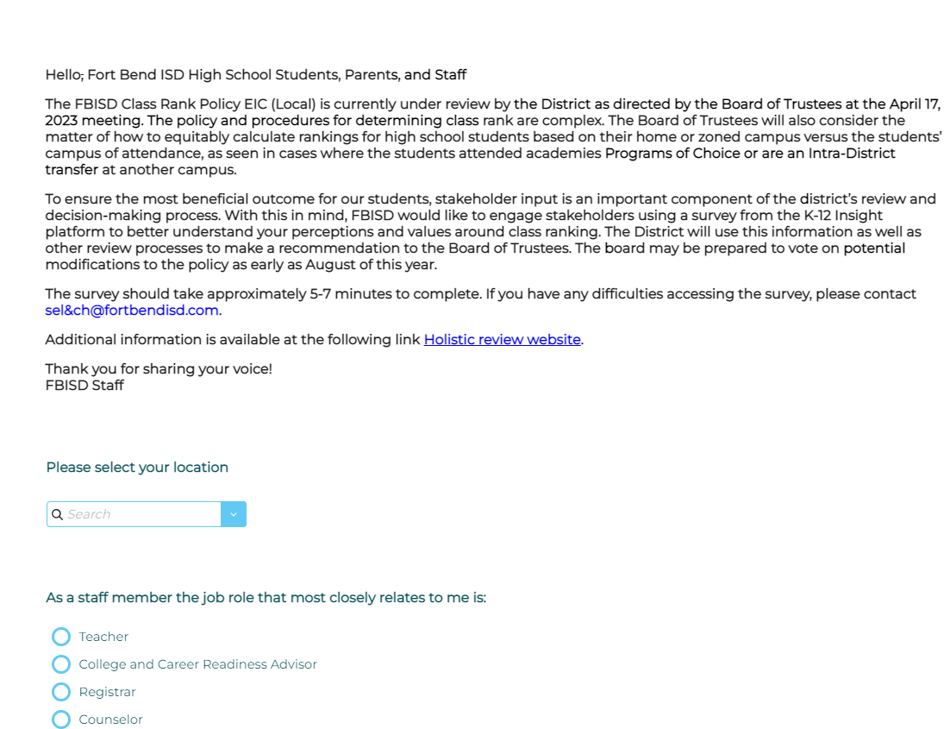
Policy EIC (Class Rank)
If interested, please complete this survey by Friday, May 19th.

Slide 64
SHAC Votes!
Approve Minutes – April 19, 2023
SHAC Executive Team
Cathy Hunter
SHAC Secretary

Slide 65
Celebrations! Allison Thummel Fort Bend ISD SHAC Chair

Slide 66
2022-2023 FBISD Wellness Heroes

Slide 67
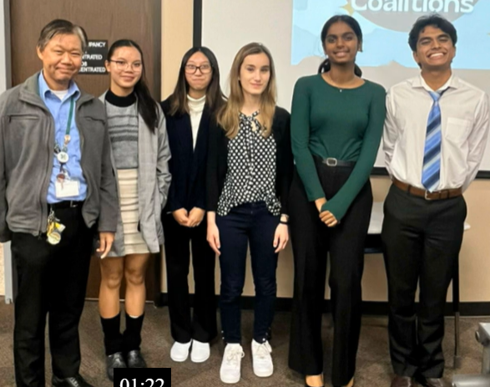
HHS Student Wellness Committee Officers SriVeda Chinapuvula, Jude Chittet, Isabella Orlaska, Allison Nguyen, Reeya Mequiabas
These students created a plan to address the health and wellness needs of students at HHS and secured $2500 in funding from 2 separate project proposals for activities such as Mindfulness Day, Self Care Day, Pet Day, Field Day, etc. To date, at least 150 students have participated in at least one of SWC's events.
We also want to thank Dr. John Ramon for supporting this amazing Student Wellness Committee!

Slide 68
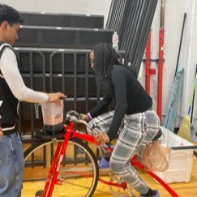
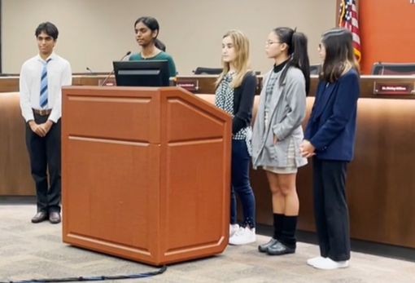
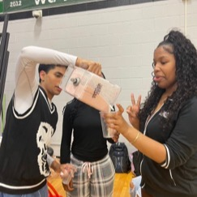
Hightower HS SWC

Slide 69
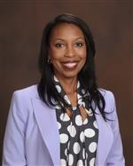
Felicia Holmes Neill Elementary Assistant Principal
She championed the return of Harvest of the Month to Neill. She is also a supporter of the Neill Garden. She helped to share what we are growing in the garden. She encourages the teachers to visit the garden with their students.

Slide 70
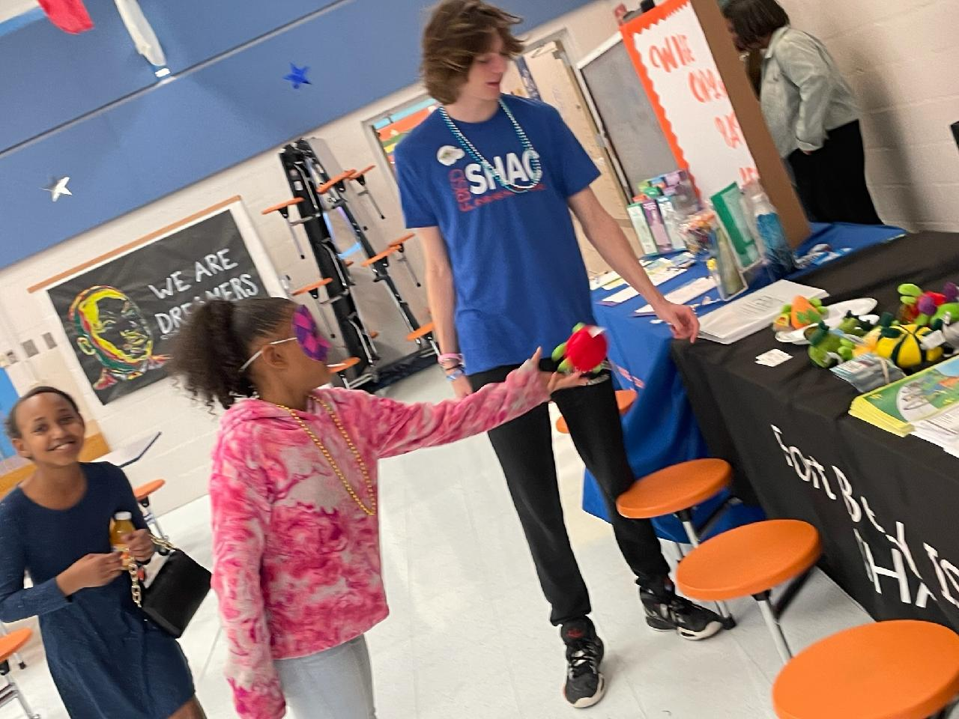
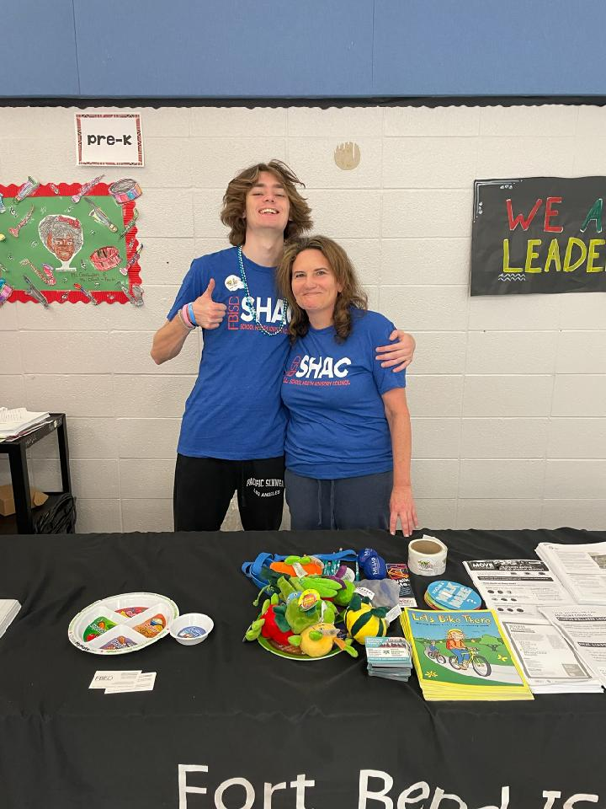
Andrew Ross
In the past year, Andrew Ross has been a participating member of the Clements Mental Health Club, an active member of the FBISD Prevention Support Materials Review Committee, the Secretary of the SHAC Advocacy Subcommittee, and a participant of a 9-month Youth Leadership Program with Ft. Bend County. As a young man, he is growing in his awareness of his contributions to wellness, health, and his community. He is actively participating and learning about his civic duties. I think Andrew Ross exemplifies the Profile of a Graduate.

Slide 71
Nurse Appreciation Week Sharyll Etuk Health Specialist, FBISD Health Services

Slide 72
Welcome to School Nurse Appreciation Week!
Thank you to our sponsors!
FBISD SCHOOL HEALTH ADVISORY COUNCIL (SHAC)
Notes:
We would again like to say thank you to all our sponsors who supported Nurse Appreciation Week.

Slide 73
SHAC Subcommittee Meeting
Nurse Appreciation Ballot
Essay Submission
Notes:
SHAC met to discuss the specific criteria to be used to select the Nurse of the Year to be presented during Nurse Appreciation week
Member of TSNO/NASN
3 years experience as a school nurse
Use School Nursing: Scope and Standards of Practice 11-15 and (5 Pillars) for the Framework for 21st Century School Nursing Practice
Ballots were sent to the campus nurses for Nominations.
The Top 3 candidates in each category (Elementary, Secondary, and Specialized Education) were notified and advised to submit an essay showing how they exemplified the scope and Standards of School Nursing Practice and how they incorporated the 5 pillars of the 21st century

Slide 74
FBISD 2022-2023 Elementary Nurse of the Year
Noby Kandarapally, BSN, RN
Notes:
Elementary Nurse of the Year award winner is Noby Kandarapally, BSN, RN, Lantern Lane Elementary
She has served as an excellent mentor. She consistently exemplifies leadership and guides others to do the same.

Slide 75
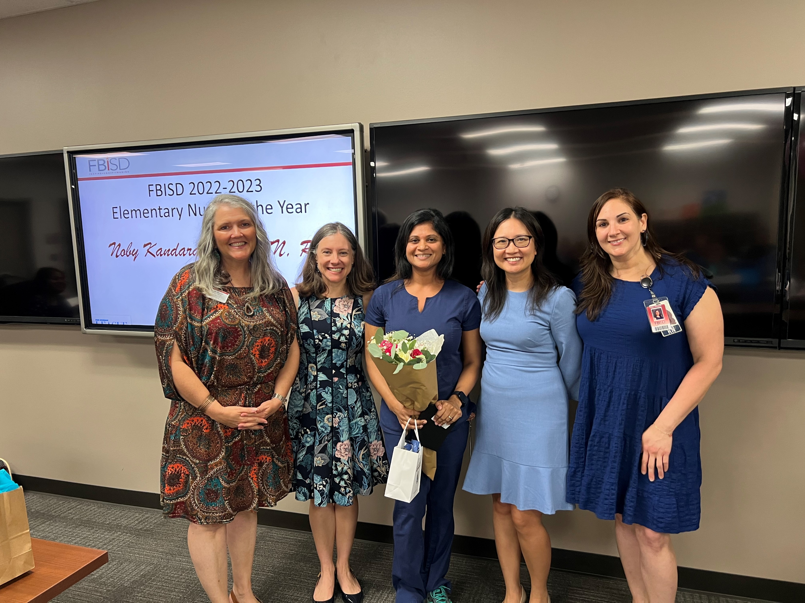
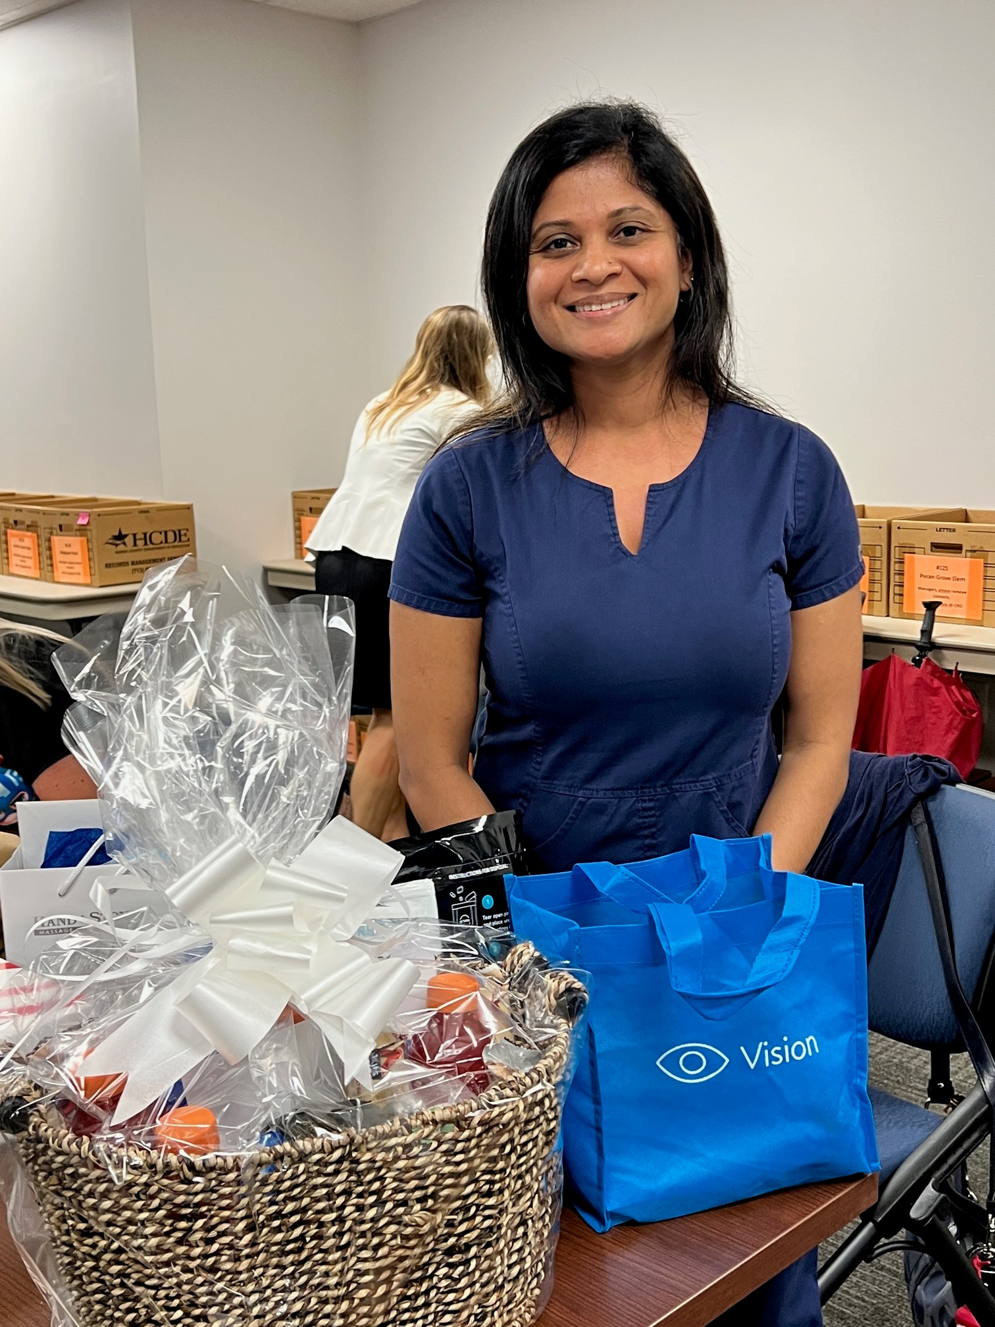
Noby Kandarapally, BSN, RN
Lantern Lane Elementary

Slide 76
FBISD 2022-2023 Secondary Nurse of the Year
Natalie Bostic, BSN, RN
Notes:
Secondary Nurse of the Year winner is Natalie Bostic, BSN, RN, James Reese CTE
She is a dynamic leader and a great resource regarding nursing practice and the scope of practice in the school setting. She is caring and compassionate and loves working with children. She is an excellent communicator sharing her knowledge with others to help promote a safe school environment.

Slide 77
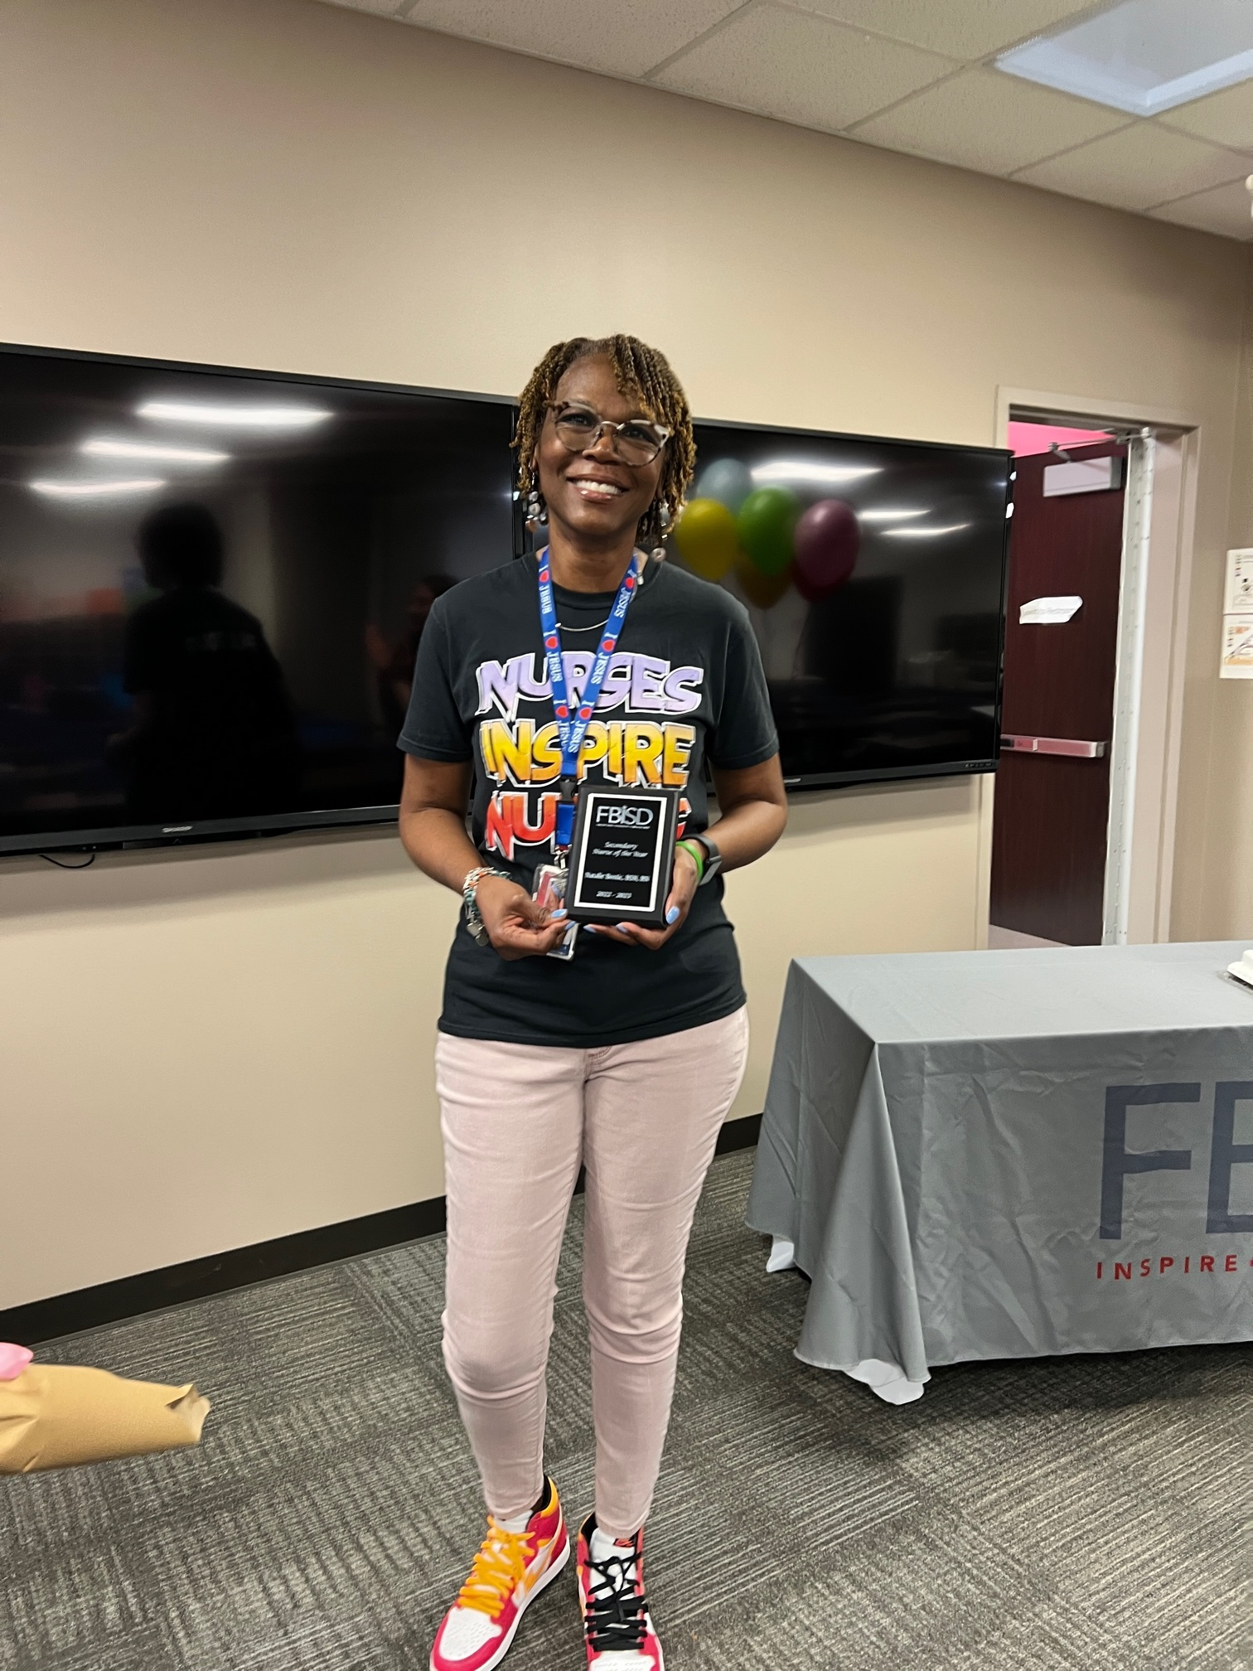
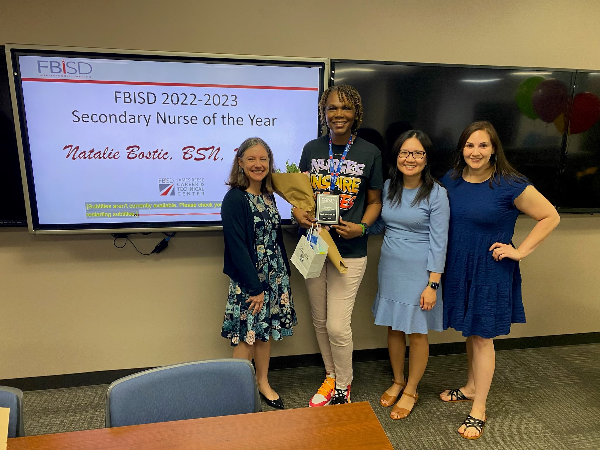
Natalie Bostic, BSN, RN
James Reese Career and Technical Center

Slide 78
FBISD 2022-2023 Special Education Nurse of the Year
Michelle Kendrick, MSN, RN
Notes:
Special Education Nurse of the Year is Michelle Kendrick, MSN, RN, Palmer Elementary
She is a great example of what a prudent, professional, and competent nurse should be. She exhibits superior clinical competence, is knowledgeable about chronic disease management and prevention, and is very disciplined. She is an excellent resource to teachers and staff when educating them on how to manage certain minor medical issues in the classroom.

Slide 79
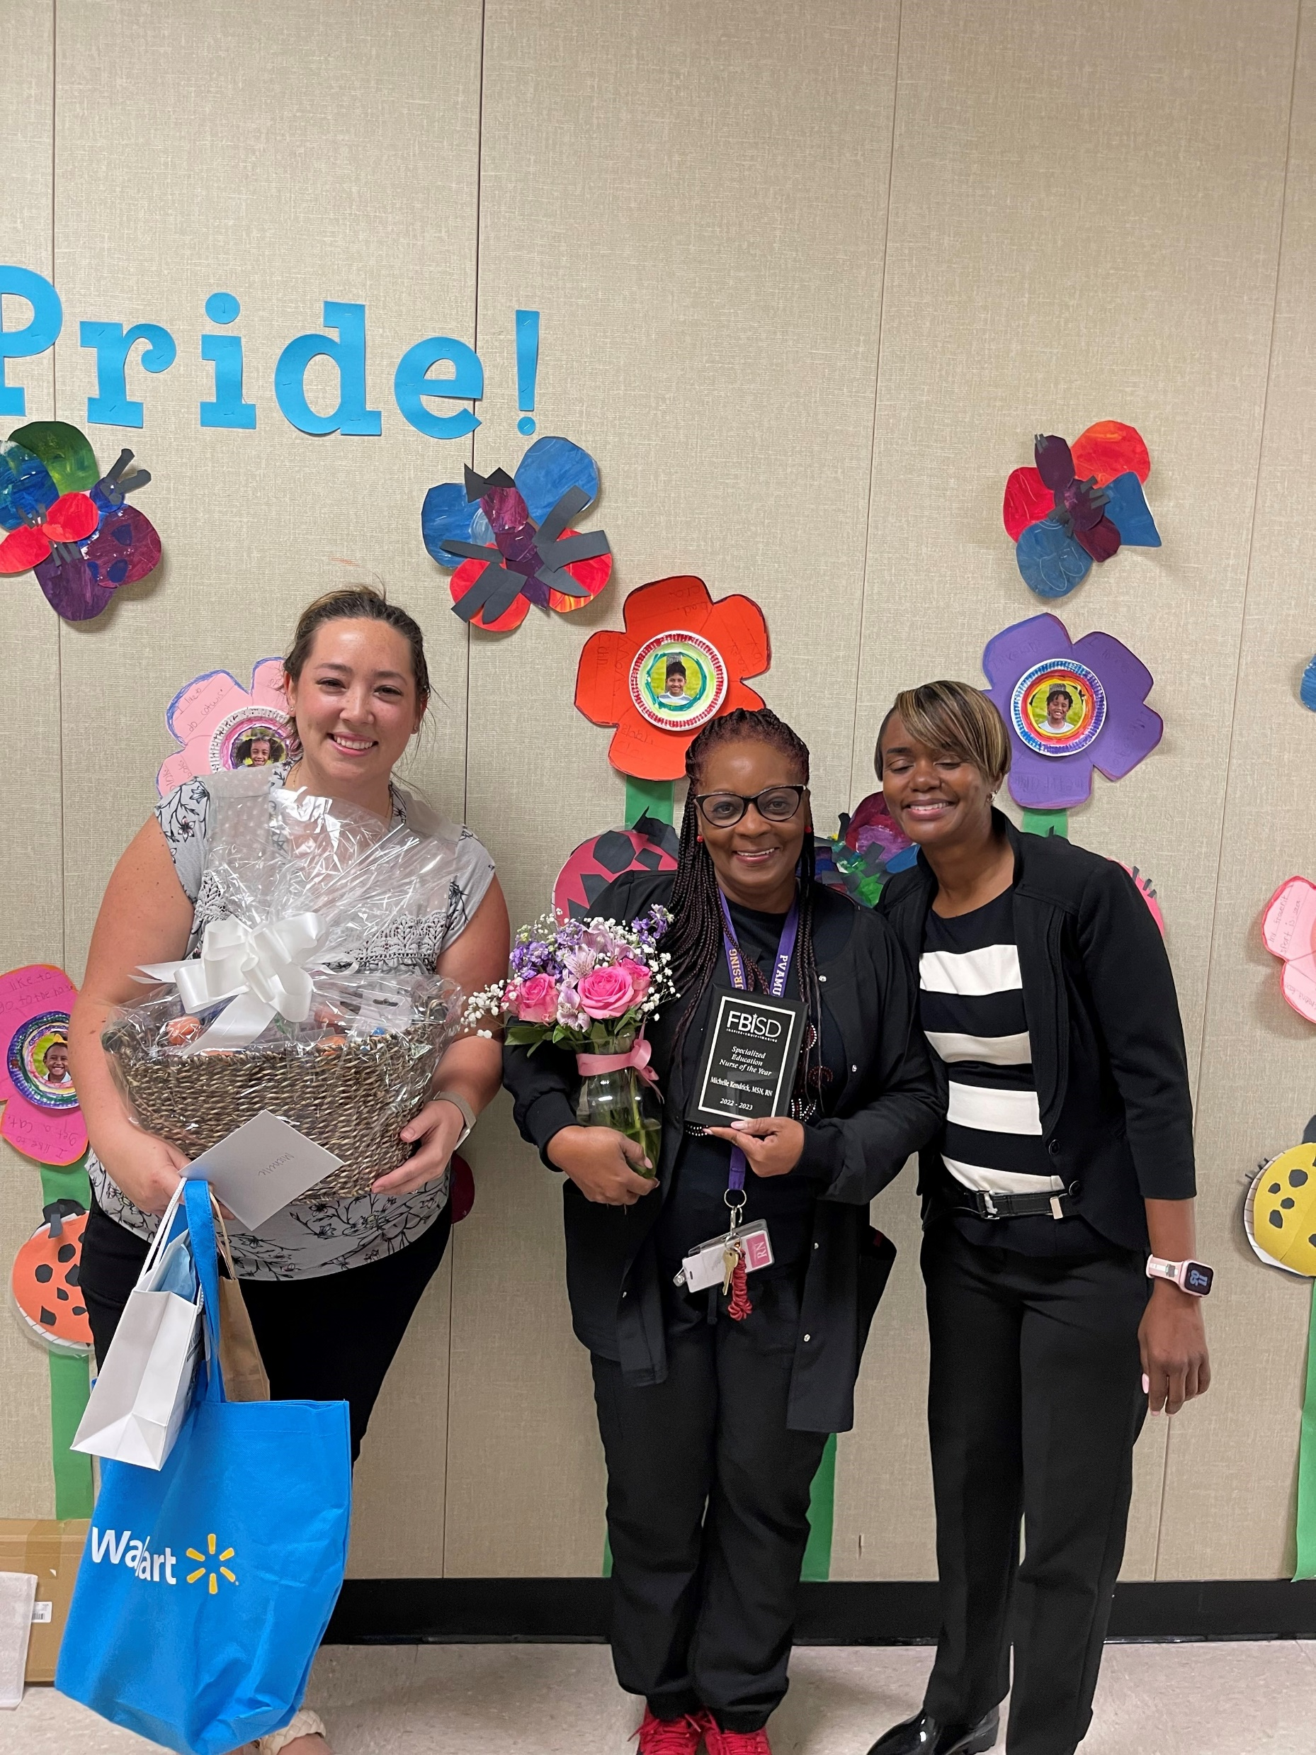
Michelle Kendrick, MSN, RN
Palmer Elementary - FLaSH

Slide 80
Announcements LaDonna Green FBISD Wellness, Health & Prevention Specialist

Slide 81
FBISD Summer Meal Program

Slide 82
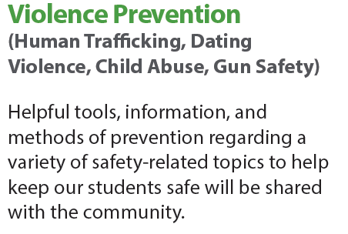
Whole Child Health Webinar TONIGHT!

Slide 83
NAMI Walks
To register as a Team Captain, please Scan the QR Code above or visit http://namiwalks.org/greaterhouston/

Slide 84
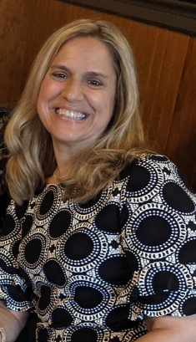
Thank You!
The Fort Bend ISD SHAC would like to thank
Cathy Hunter
for 10+ years of service!
We appreciate your dedication to the Health & Wellness of the faculty, students, and staff in Fort Bend ISD!

Slide 85
Questions?

Slide 86
Break Out Session
For SHAC

Slide 87
Subcommittee Survey
FBISD SHAC Subcommittee Survey
Is linked below:
https://www.surveymonkey.com/r/GLVYFJJ
https://www.surveymonkey.com/r/7KVNQ3G
https://www.surveymonkey.com/r/G8XDVYB

Slide 88
Meeting Closure
Next Fort Bend ISD SHAC Meeting:
Fort Bend Administration Building
FBISD Board Room
September 7, 2023
12:00 pm – 1:30 pm
16431 Lexington Blvd.
Sugar Land, TX 77479

