Slide 1
Fort Bend ISD SHAC Meeting
SHAC SHINES!
Wednesday, September 7, 2022
Notes:
Presenter:
Time:
Strategy:
Materials:
Say:

Slide 2
Welcome
& Mindful Moment
Allison Thummel
SHAC Chair

Slide 3
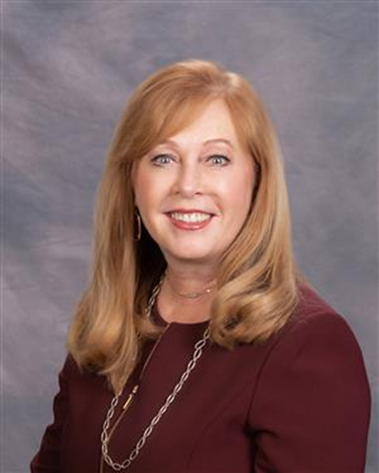
Welcome
Dr. Christie Whitbeck
Fort Bend ISD Superintendent

Slide 4
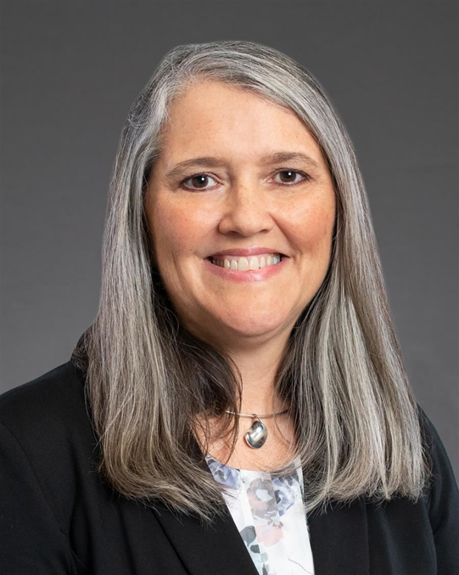
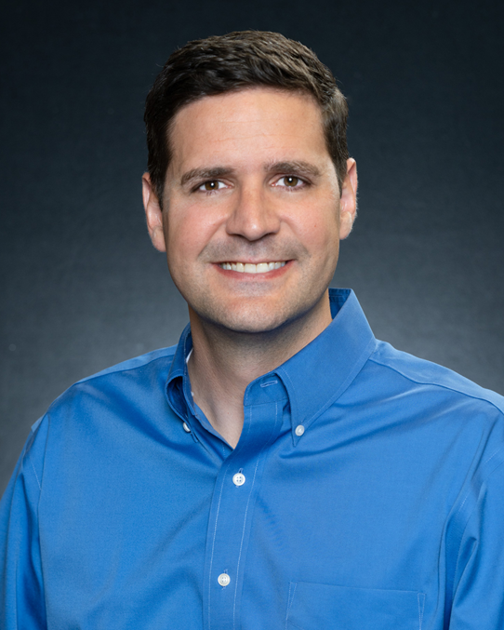
Board of Trustees SHAC Representatives
Introductions
Angie Hanan
David Hamilton

Slide 5
2022-23 SHAC District Subcommittee Leaders
Advocacy
Colby Wilbanks
Chassidy Olainu-Alade
SHAC Action
Payal Pandit
Health & Safety
Sharyll Etuk
Shumalia Ali
Nicholas Petito
Nutrition
Sierra Bell
Health & PE
LaDonna Green
SEL & Mental Health
Rosa Martinez Quiroga
Priti Avantsa
Staff Wellness
Gary Hajdasz
Janet Singleton

Slide 6
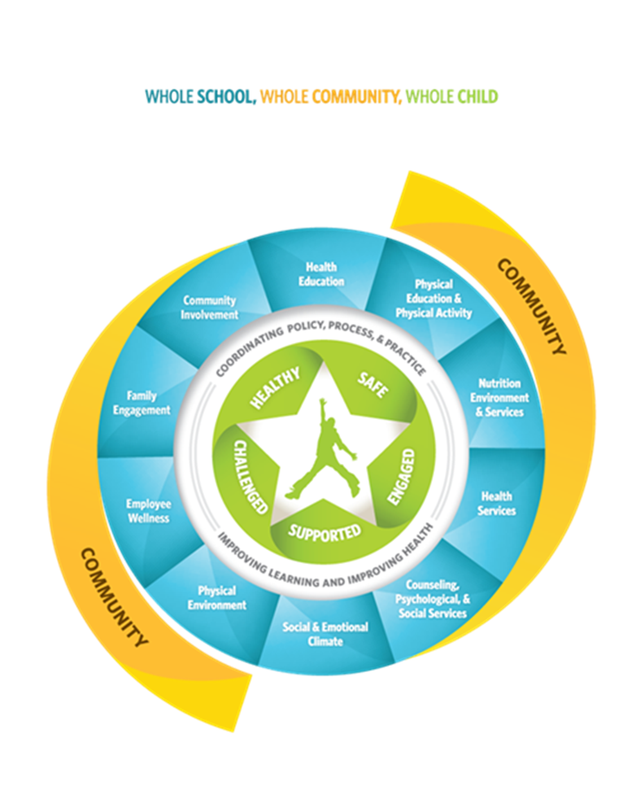
SHAC Overview
Allison Thummel
SHAC Chair

Slide 7
Vision, Mission, Goals

Slide 8
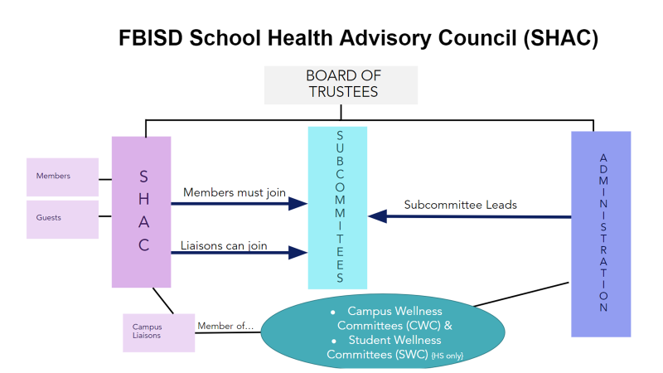
Org Charts

Slide 9
Org Charts

Slide 10
2022-2023 Goals
GOAL 1: Support expansion of Action Based Learning Labs.
GOAL 2: Create incentives for Campus Wellness Champions. Non-financial incentives are suggested since funding is not available at this time.
GOAL 3: Increase opportunities for high school students to engage in physical activity.
GOAL 4: Streamline communication channels/process to promote all Whole Child Health programs and resources in the District. Guidelines for effective promotion of all wellness programs, including lead time for advertising and coordination between departments.
GOAL 5: Continue to provide mental health supports for students and staff.
GOAL 6: Develop a process for providing SHAC input on Whole School, Whole Child, Whole Community (WSCC) policy development.

Slide 11
CWC, SWC, DSWC
CWC: Campus Wellness Committee- a group on campus, staff-driven, typically led by AP, RN or Counselor. SHAC wants a parent liaison on CWCs.
SWC: Student Wellness Committee-a group on high school campuses, student-driven and staff-facilitated. A parent liaison can participate in SWCs.
DSWC: District Student Wellness Coalition-a group of high school students, typically representing their school SWC. District will provide staff advisors and coordinate regular meetings.

Slide 12
Campus Information Review
Lori Sartain
Assistant Director of Health & Wellness

Slide 13
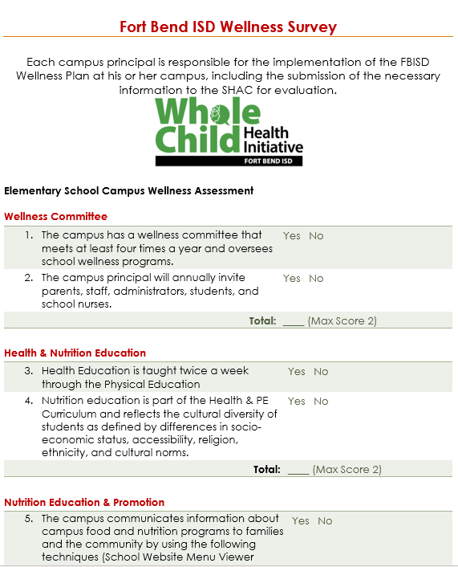
Campus Wellness Assessment
Aligned to FFA(LOCAL)
What?
The Campus Wellness Assessment/Recognition process is designed to celebrate wellness efforts on your campus, identify your campus wellness level, and areas for growth and additional support.
Who?
Campus Wellness Committee - an administrator, teacher, students, parents, campus nurse, PE teacher, and others in the school community with a passion to grow health and wellness on campus.
When?
Twice a year: Start of the school year; End of school year

Slide 14
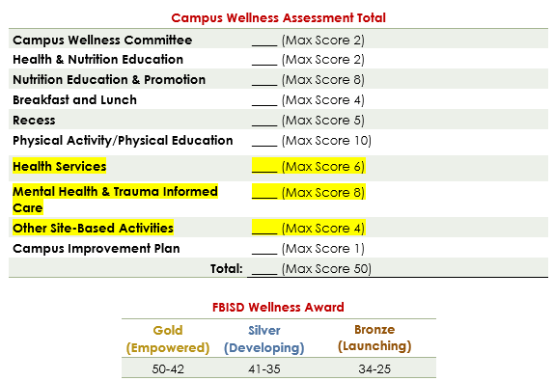

Slide 15
2021-22 Campus Wellness Assessment/Recognitions Results
Silver
Bronze
Gold
70-84% Meet
Elementary - 9
Middle School - 3
High School -0
50-69% Meet
Elementary -0
Middle School - 1
High School - 0
85% Meet
Elementary - 43
Middle School - 11
High School - 11

Slide 16
FBISD Whole Child Health Initative
Focus
Increase Awareness of Mental Health Services
Increase Access to Mental Health Services
Reduce the Stigma Around Mental Health

Slide 18
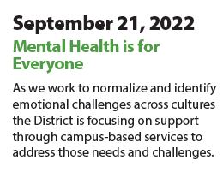
Parent Webinars

Slide 19
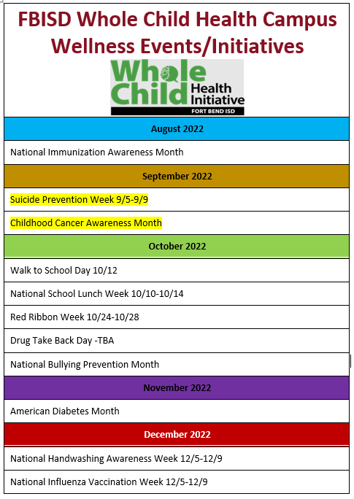
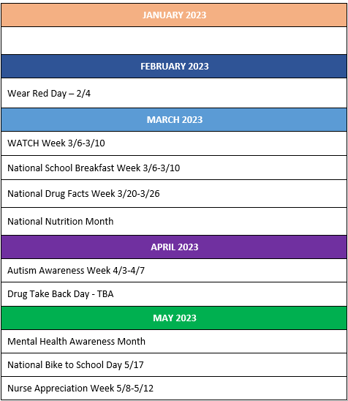

Slide 20
Resources for SHACs
Nomita Bajwa, PharmD
University of Houston, Population Health
School Wellness Volunteer

Slide 21
Topics for discussion
What does SHAC do? (Goals and roles)
Introduction to TSHAC Resources

Slide 22
Goal of SHACs: Empower youth to adopt healthy behaviors, improve health literacy to promote learning
@WellGeeks
Notes:
Stephanie: You may have seen this graphic many times - it shows how exercise can improve academic outcome. Over the last decade, we have seen a dramatic increase in evidence that demonstrates how important health is in school aged children. But what is good health? As public health begins working with the Social determinants of health, we can see that education is a primary dependent factor in future health status. If we want to begin tackling some of our chronic and debilitating disease, we need to pay attention to the time in which the habits and lifestyle choices are emerging- in the K-12 years. School aged children spend at least 8 hours a day in school, most of their waking hours. Many more children receive ⅔ of their calories in the school day. For those with chronic health conditions now, medical treatment is only available during school hours, which lead to more missed time in classrooms. Until recently, with the pandemic, it was not unusual for parents to send their kids to school ill. Childhood trauma now occurs in schools, with an increase in shootings, and active shooter trainings. It is more important than ever for us as medical practitioners to take an interest in school health, for the present and future health of our society.

Slide 23
What is the purpose of FBISD SHAC?
To improve the health of students, staff, and the families who attend school in Fort Bend

Slide 24
How does the SHAC do this?
By supporting the FBISD school wellness policy & recommending new policy or policy changes to the school board

Slide 25
Health happens in schools
Nutrition
Physical Activity
Socializing
50% of waking hours
Other adults
Health services
Disease mgt
Screening
Referrals
Access
Access
Education
Access
Peers
2/3 of daily calories
Notes:
This slide utilizes powerpoint smart art graphics and available icons.
The point of this slide is to provide attendees with the goal of introducing them to the top 4 areas in which health is important to student success which follows the Principle of Relevance. The idea that health is already engaging in health related activities is a key one for parents and community members. As mentioned in one of the attached smart art tutorials, I took a bulleted list and went tried various smart art graphics until I came across this one. Although I have more than 4 items as recommended by the rule of four in the principle of capacity limitations, this smart art graphic prioritizes the important parts into 4 separate groups. Since each of the items are equally important, I considered the principle of compatibility in which the graphic does not ascribe a particular hierarchy to any of the major topicss. Bulleting prior to the white text emphasizes that these are details-not the major topics of the slide. I realized that the bulleted points were aligned visually, since physical activity and health services was 2 words, so I made sure the white bulleted text were aligned. The slide looked a little empty, so I added icons to provide additional context for the 4 main topics. The principle of discriminability was applied as I changed the background to its current blue-grey color. The previous white background of the slide made the bright colors a little hard to look at, so I added a darker version of blue to the background to help manage the brightness of the colors and make it easier to see. I also changed the topic text from white to black to help discriminate that text from the white text below.

Slide 26
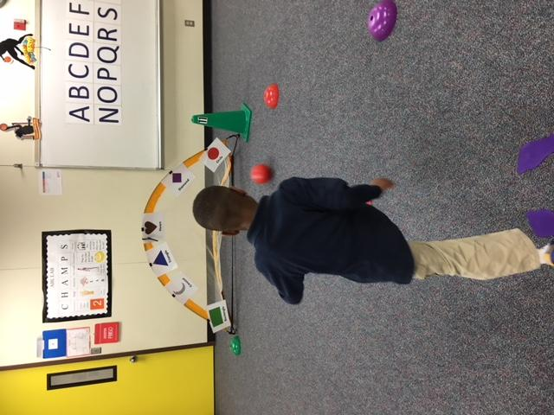
SHACs promote School Health via partnerships
Awareness and Education
Harvest of the Month
Build capacity
Recipe for Success
Integrate into curriculum
Action Based Learning
"The connections between schools and community individuals, organizations, and businesses that are forged to promote students' social, emotional, physical, and intellectual development" (Sanders, 2001; Hand, 2005)
Notes:
New model encourages community engagement with schools to promote health. - WSCC
The topic of my research is school-community partnerships in health promotion
I wanted to share the outcomes of some successful parnterships here and show you that there is a spectrum of expected objectives: from raising awareness ( like the vegetable tasting of Harvest of the Month), to the development of skills in recipe for success. The last picture, ABL, is an example of school wellness integrated into the school day.

Slide 27
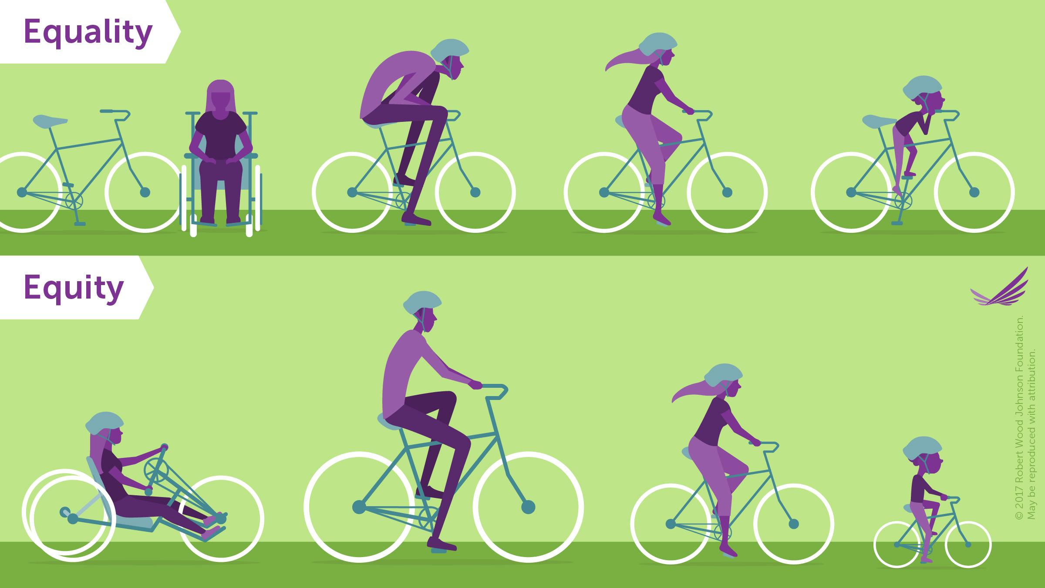
Robert Wood Johnson Foundation (rwjf.org)
SHACs ensure that EQUITY is at the foundation of health education.
Notes:
Nomita
Mindset Icebreaker + Health Equity (audience reflection: wordle): Open mindset is key to learnings; Health Equity intro and activity with audience; Levelset with the image (how we define health equity)

Slide 28
SHACs seek to engage a diversity of perspectives
Advise
Accountability
Equity
Expertise of all stakeholders
Notes:
Image by Gerd Altmann from Pixabay

Slide 29
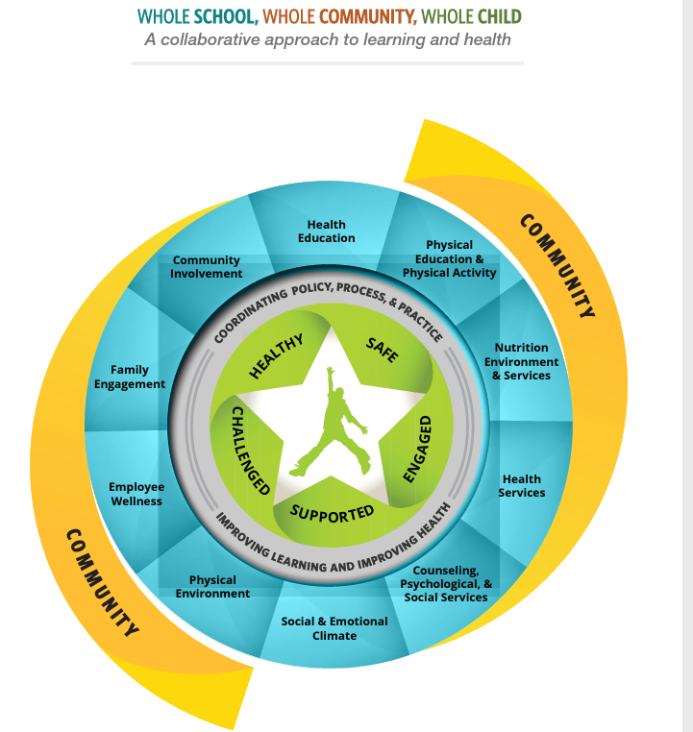
Whole School, Whole Community => Whole Child
https://www.cdc.gov/healthyyouth/wscc/
Notes:
After Slide: For this slide, I could not figure out how to make the background more cohesive visually. In this challenge there was a section on how to take a crop of the photo and then extend that, which is what I did. It makes the slide look more professional and the colors extend nicely. The other thing I did was added animation for the question to arrive a few seconds after the slide is clicked. This allows for me to introduce the story about Ron, who is having difficulty learning. The question can come in , which will allow those who understand school health better to start thinking, and others who may need more explanation to stay with my discussion. In the end, I could also add a poll and create a wordcloud for everyone to see. It will also give me an idea of where the audience has holes in their understanding of school health.

Slide 30
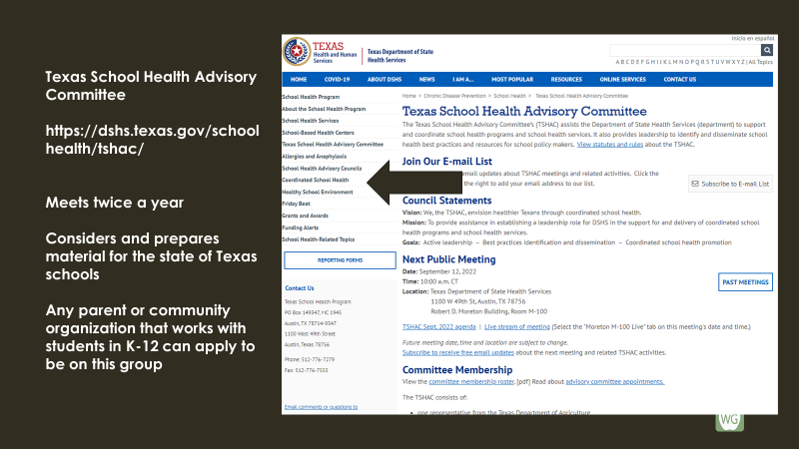
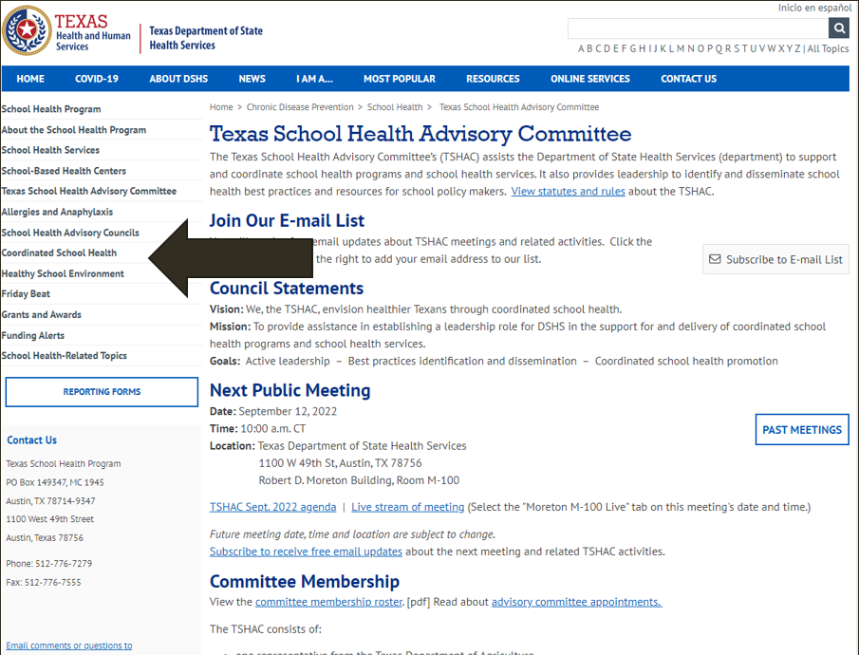
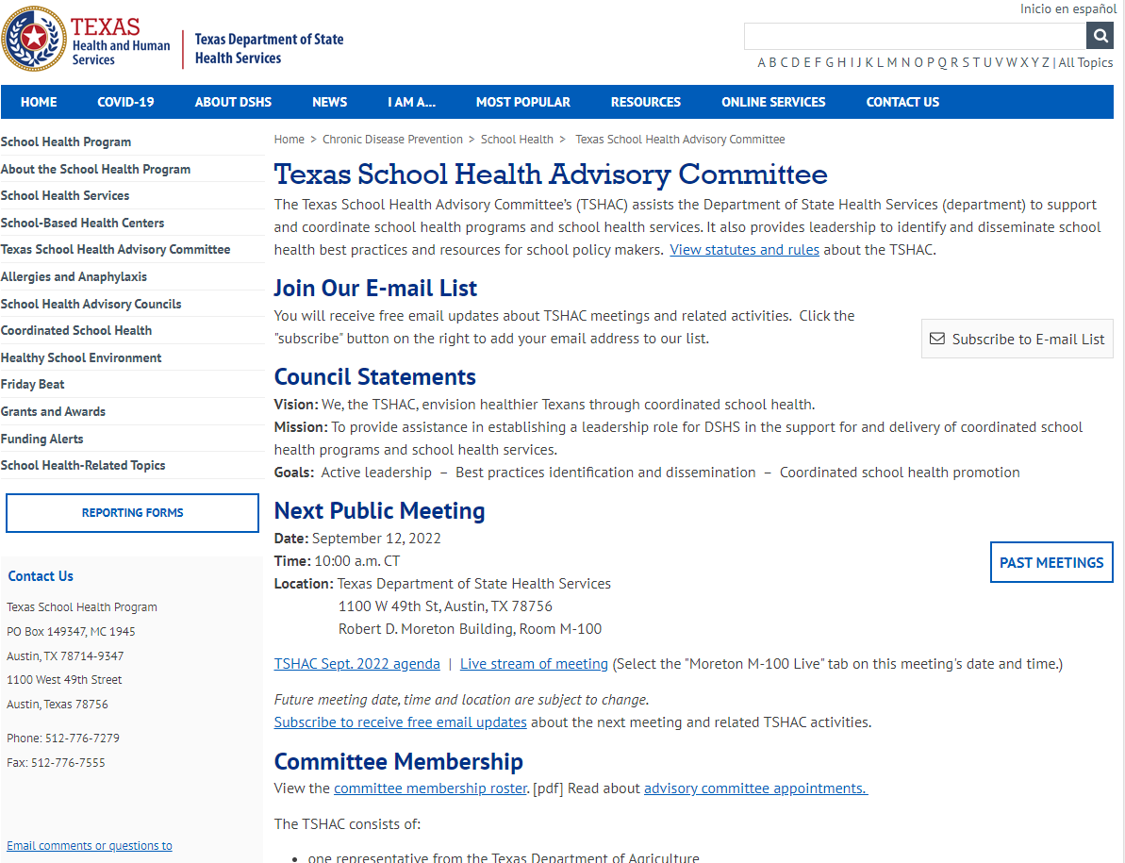
Texas School Health Advisory Committee
https://dshs.texas.gov/schoolhealth/tshac/
Meets twice a year
Considers and prepares material for the state of Texas schools
Any parent or community organization that works with students in K-12 can apply to be on this group

Slide 31
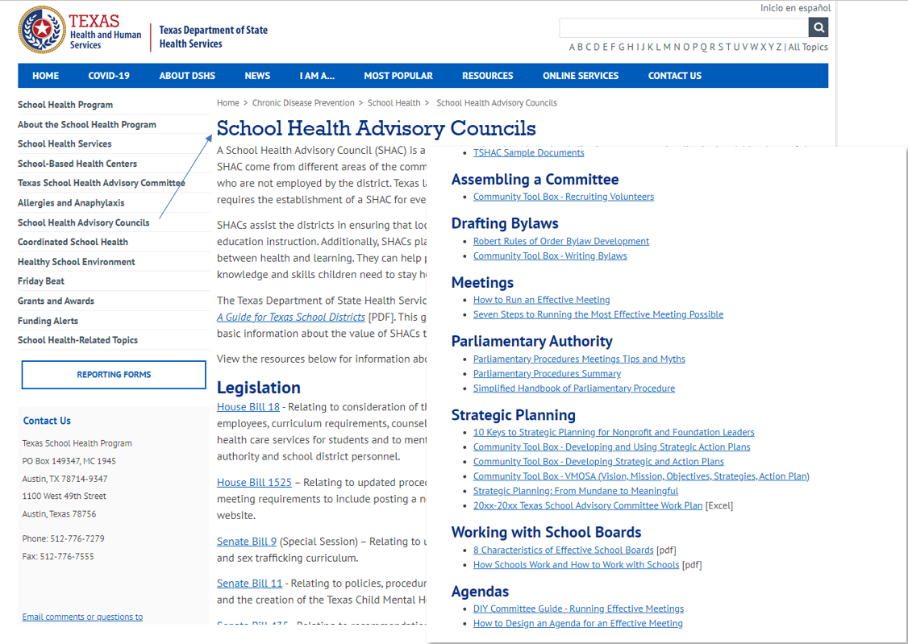
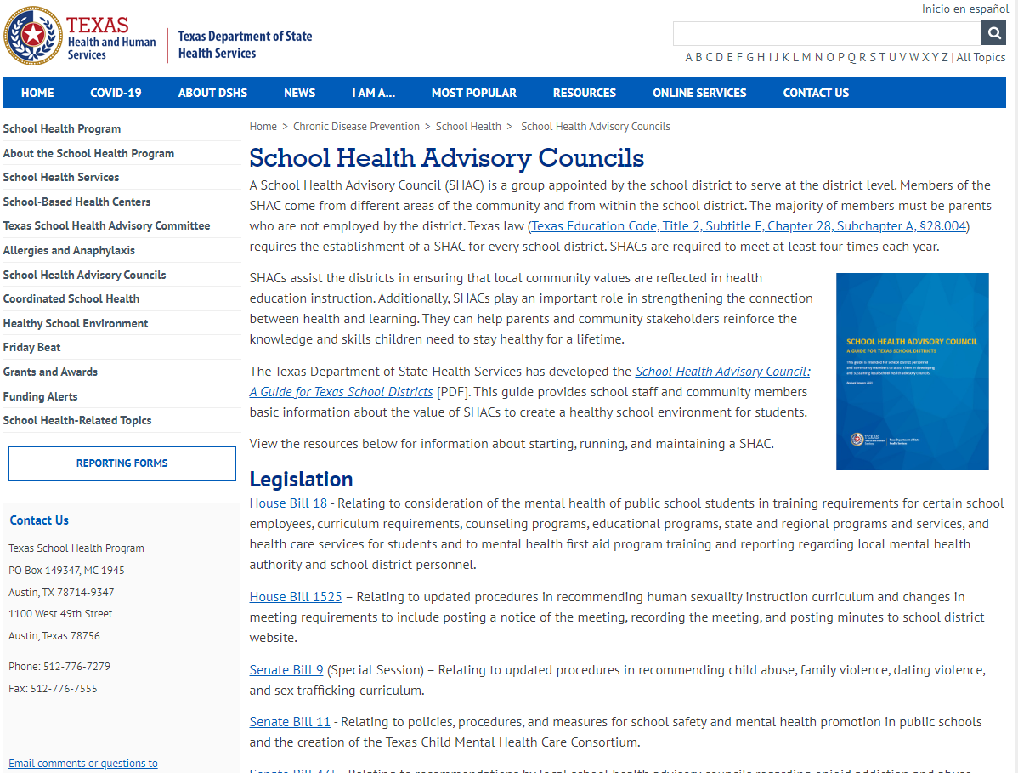
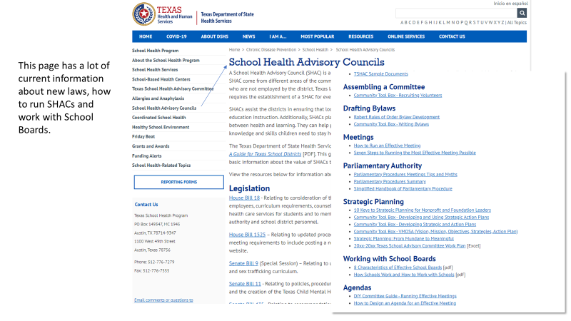
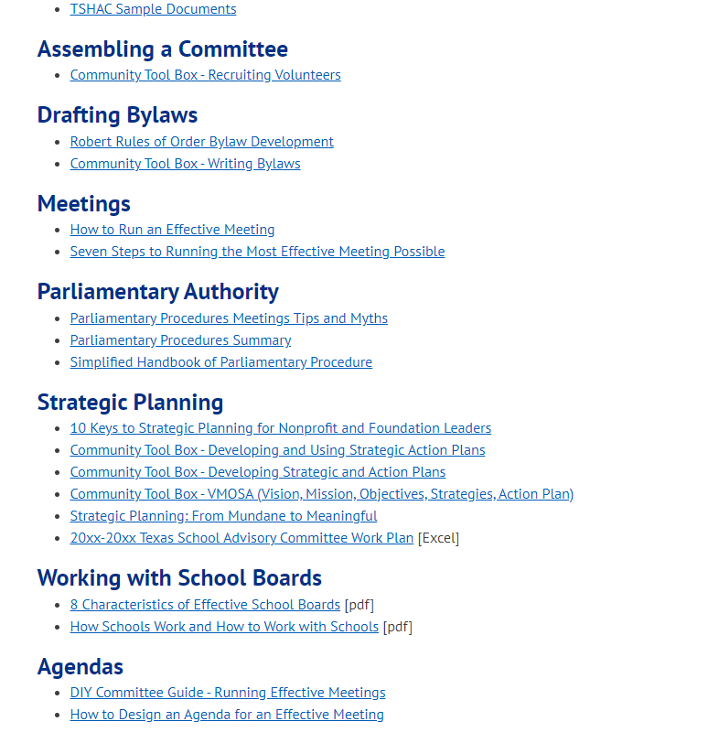
This page has a lot of current information about new laws, how to run SHACs and work with School Boards.

Slide 32
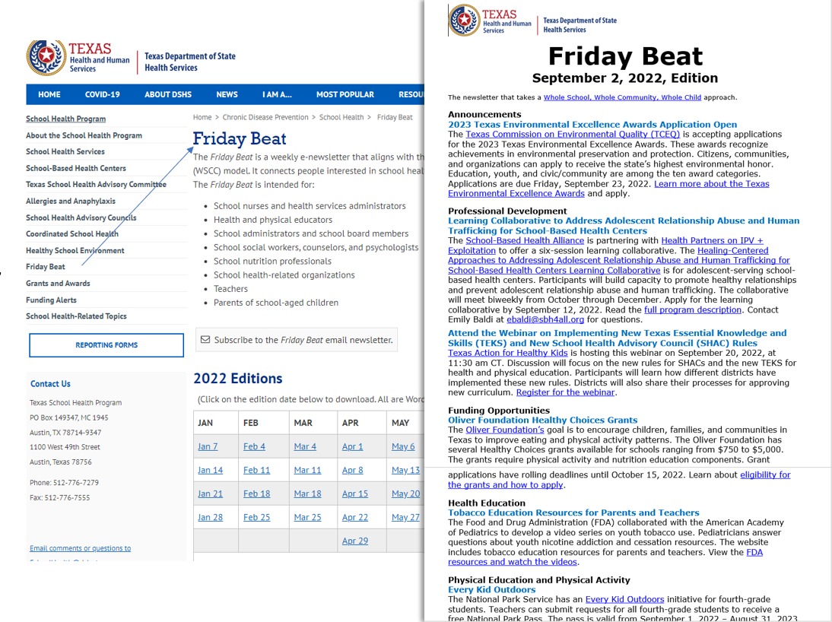
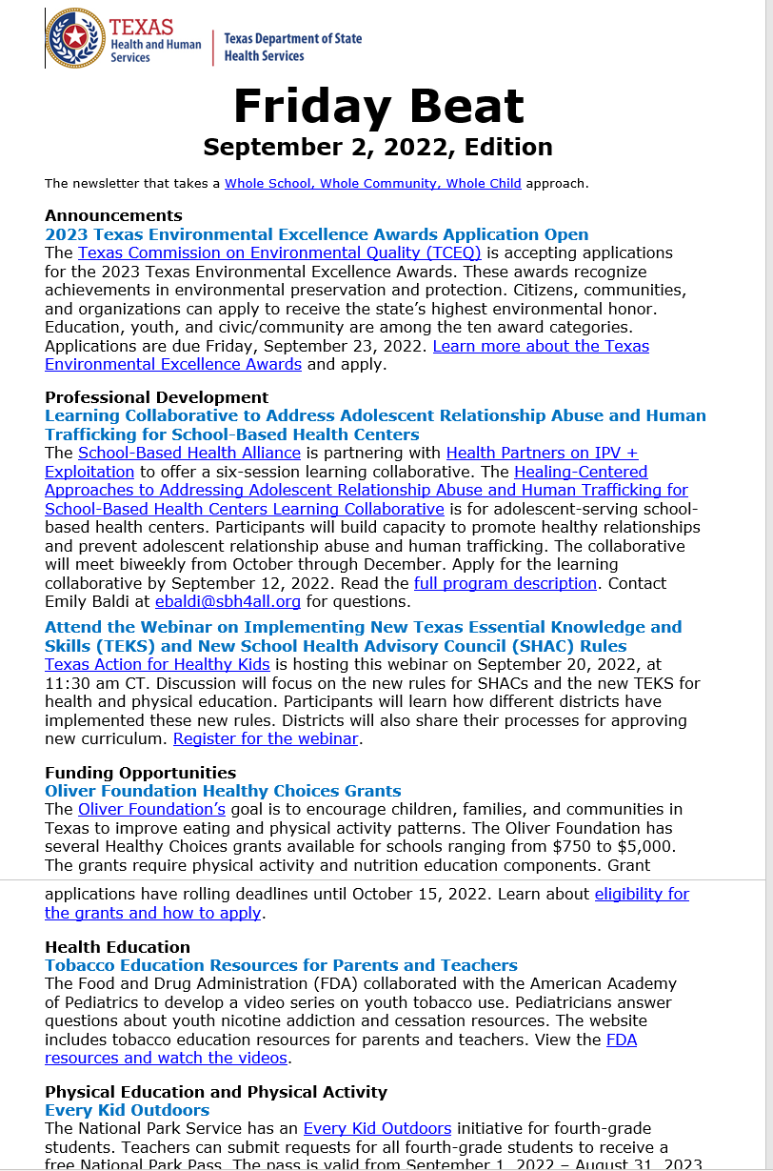
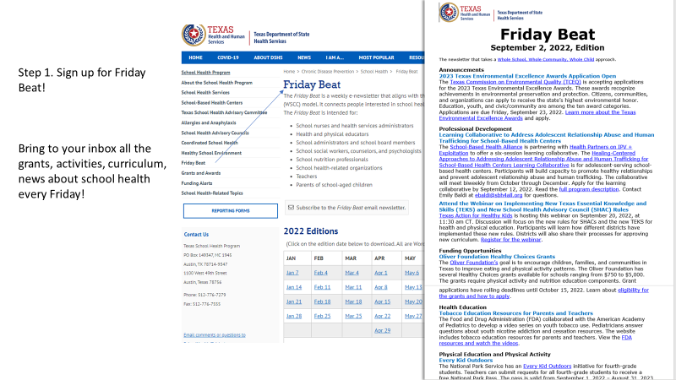
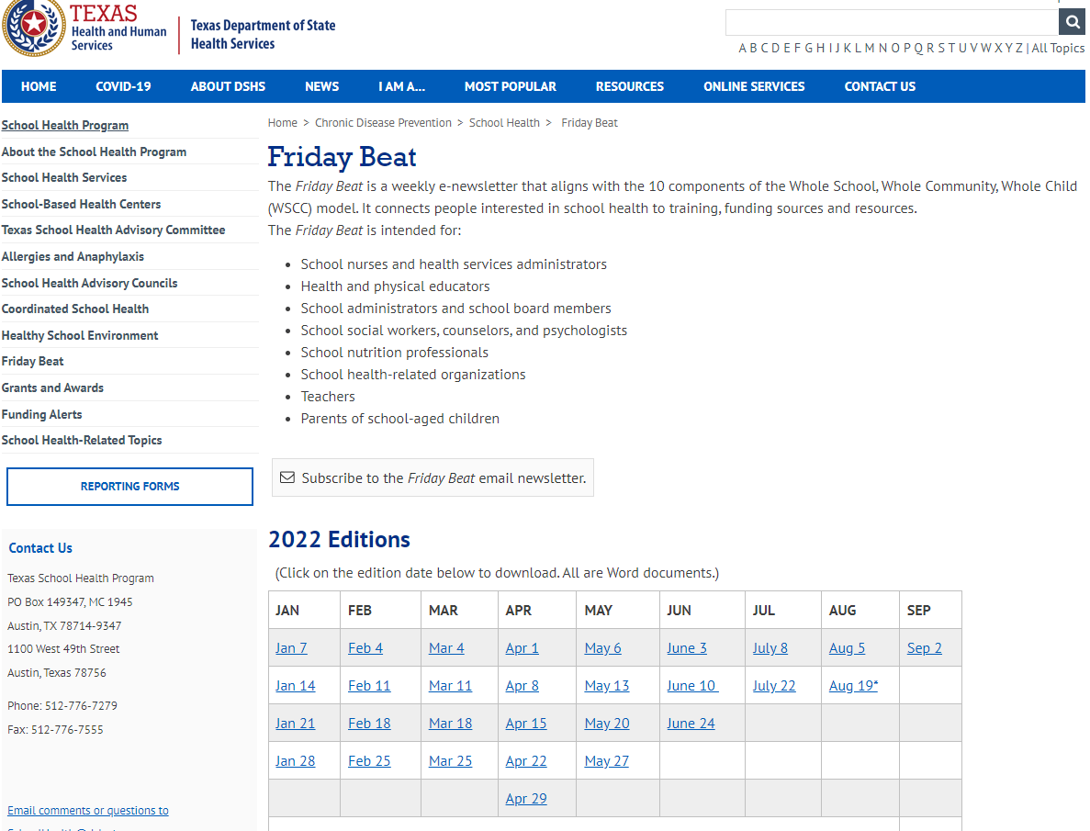
Step 1. Sign up for Friday Beat!
Bring to your inbox all the grants, activities, curriculum, news about school health every Friday!

Slide 33
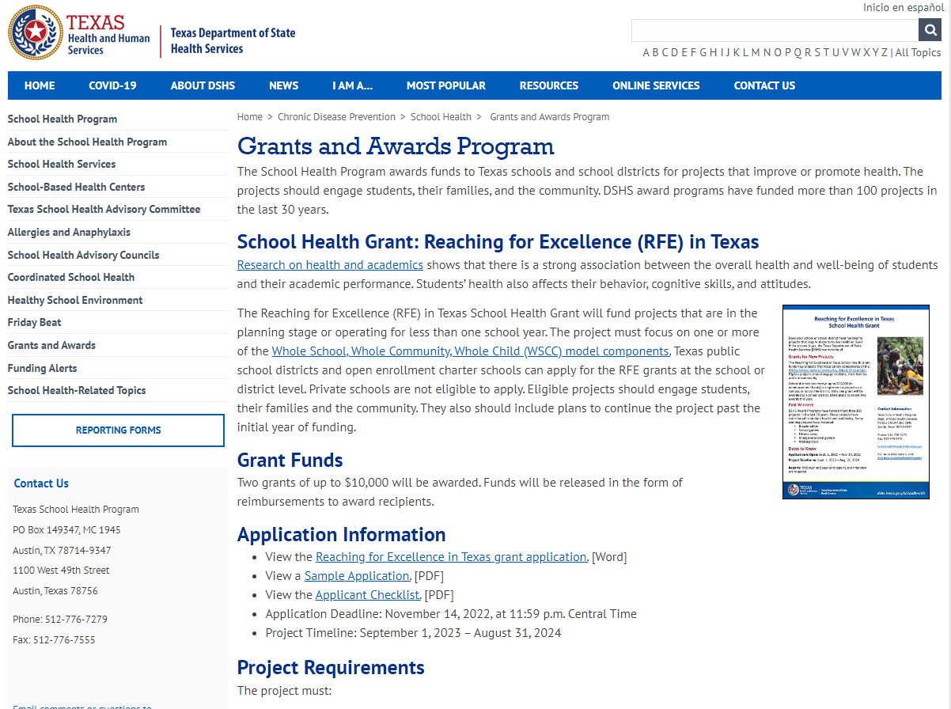
Step 2:
Identify some great projects and programs schools need help with and write it up!
Deadline to submit is 11/14/22
For projects which will take place 9/23-8/24

Slide 34
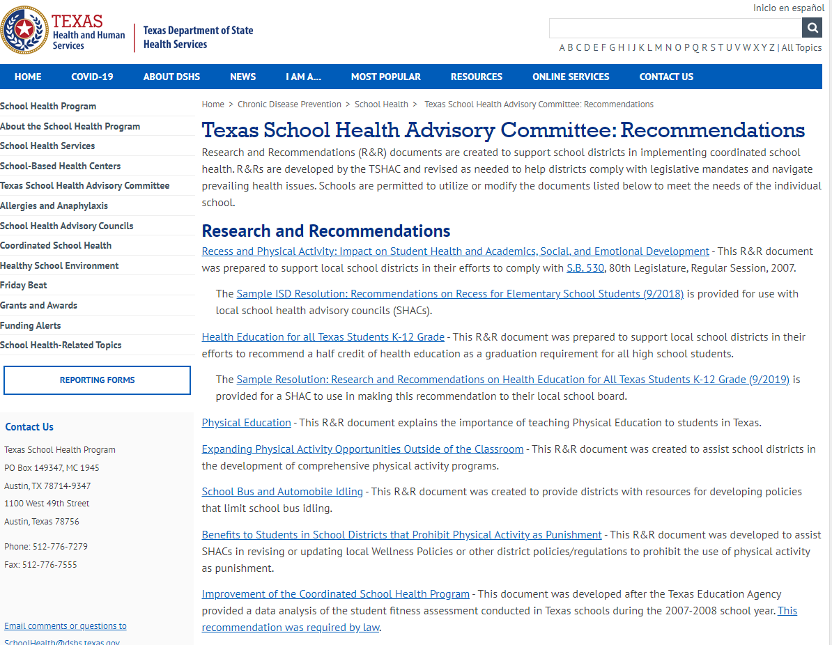
STEP 3: use for reference
If you are working on a particular topic, the group might have already created a white paper on it.
Background information, Health effects, Texas Legislation, best practices and references

Slide 35
Child Nutrition Department Updates
Sierra Bell
Fort Bend ISD Child Nutrition Dietitian

Slide 36
Approve Minutes- May 17, 2022
Cathy Hunter
SHAC Secretary

Slide 37
Brain Break
LaDonna Green
FBISD Wellness, Health & Prevention Specialist

Slide 38
Upcoming Events
General SHAC Meeting: October 19, 2022, 12-2pm
Subcommittee Breakouts will follow the October 19th SHAC meeting

Slide 39
$$ Opportunities
Apply for School Health Grant: Up to $10K Awarded
Texas Department of State Health Services invites public and charter schools to apply for the Reaching for Excellence (RFE) in Texas School Health Grant. The goal of the RFE grants is to fund projects that inspire students to live healthier lives. The RFE grant funds new projects or projects operating for less than a year. The project must focus on at least one key component of the Whole School, Whole Community, Whole Child model. Eligible projects should engage students, their families, and the community. They also should include plans to continue the project past the initial year. A school district can receive up to $10,000 (in reimbursement funds) to implement a project at the district level or on a school campus. If selected, the school district will receive funds for one project. Learn more and apply for a Reaching for Excellence Grant. Application Is Open: 9/1/2022 to 11/14/2022 Project Begins 9/1/2023 Project Ends 8/31/2024 DSHS award programs have funded more than 100 projects in the last 30 years. Some winning projects have included: Bicycle safety, School garden, Fitness camp, Intergenerational garden, Walking trails Register for one of the informational webinars today and reserve your spot. All webinars will present the same content. RFE Grant Webinar #1 – Sept. 8 from 3-4 PM CDT RFE Grant Webinar #2 – Sept. 14 from 11:30-12:30 PM CDT RFE Grant Webinar #3 – Sept. 20 from 3-4 PM CDT Questions? Email schoolhealthawards@dshs.texas.gov or call 512-776-7279.

Slide 40
#TurnItGold September is National Childhood Cancer Awareness Month. This is the time to honor children and families affected by the disease and rally support for groundbreaking research that can save kids’ lives.

Slide 42
Mental Health Video Contest
Video submissions are due at
the end of this month!
We're accepting .MP4 and
.MOV file types.
Submission Deadline: Sept. 30, 11:59 pm CST

Slide 43
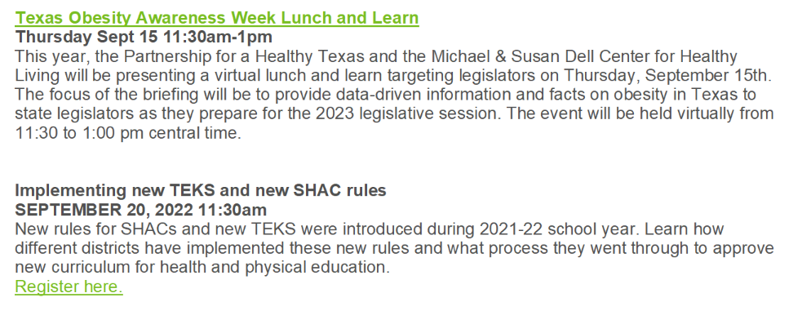
Virtual Learning & Summit Opportunities
Register here
Register here
Register here

Slide 44
Liaison Action Items
Join CWC or make contact with your campus rep
Look into grants for your school ($10K or SHAC google drive)
3) Promote Turn It Gold 4) Promote Nutrition Art Contest
5) Listen to Mental Health Webinar: Sep. 21 @ 6pm

Slide 45
Closure

