Slide 1
General SHAC Meeting
SHAC EXPRESSES!
Wednesday, February 15, 2023

Slide 2
Welcome & Mindful Moment
Allison Thummel
FBISD SHAC Chair

Slide 3
Introducing Bella!

Slide 4
Welcome
Acknowledgment of Guests

Slide 5
Prevention Support Materials
n Public Hearing #1
Lori Sartain
FBISD Assistant Director of Health & Wellness
Allison Thummel
FBISD SHAC Chair
Notes:
Presenter:
Time:
Strategy:
Materials:
Say: Hello, this is the prevention support materials public meeting #1
Presenting today is:
- Allison Thummel, the FBISD School Health Advisory Council (SHAC) Chair and
- Myself- Lori Sartain, FBISD’s Assistant Director of Health & Wellness

Slide 6
Prevention Curriculum Material Adoption
Child Abuse
Family Violence
Dating Violence
Sex Trafficking
Notes:
Presenter: Lori
Say: During the 87th Texas Legislature, Second Called Session, 2021, TEC, §28.004(q-4), the state legislature enacted legislation, Senate Bill 9 (SB9), requiring the board of trustees of each local school district to determine the specific content of the district’s instruction relating to the prevention of child abuse, family violence, dating violence, and sex trafficking. Prior to the existence of SB9, campus, and district leadership identified and approved prevention materials.
In April 2022 the Board adopted Policy EHAA(Local) which outlined the process for adopting prevention materials related to SB9. The process began in November of 2022, with the Board adopting a resolution to convene the School Health Advisory Council (SHAC) to review and recommend support materials the district can use to teach and encourage the prevention of child abuse, family violence, dating violence, and sex trafficking. Whenever possible, the materials must include essential knowledge and skills as developed by the State Board of Education, which sets the standards for what students are to learn in each course or grade. Materials selected for adoption by the FBISD Board of Trustees will be available for campuses to start implementing beginning in May 2023.

Slide 7
Curriculum Adoption Process – EHAA(LOCAL) Policy
1. The Board Adopts a Resolution Convening the SHAC to Make Recommendations
Adoption
Of
Curriculum Resource
2. SHAC Holds At Least 2 Public Meeting and a Public Review Period
3. SHAC Provides Recommendations to the Board at a Public Board Meeting
4. The Board, at a Public Board Meeting, will Act on the Adoption of Recommendations Through a Record Vote
Notes:
Presenter: Lori
Say: On this slide, you will see the process outline in Board Policy EHAA(LOCAL), which was approved by the Board in April 2022.
1. The Board adopts a resolution convening the District’s SHAC to recommend curriculum materials for instruction. This occurred in November 2022.
2. The SHAC holds at least two public meetings on the curriculum materials before adopting recommendations to present to the Board.
This is the first public meeting. The first public meeting will provide an introduction and overview of the curriculum materials considered for adoption.
The second public meeting will include an update on the process and will be held on March 21st here in the FBISD Board Room from 12-12:30 PM.
The District shall promote the public meetings to the community via the District webpage and other appropriate means.
The SHAC will also hold a two-week public review of the considered curriculum materials. The public review starts today, February 15th, and will close at midnight on March 2nd. This will an opportunity for the community to view the resources that are up for adoption and provide feedback on those resources via the SHAC Webpage.
We encourage all SHAC members, parents, and the community to participate and provide feedback on the curriculum materials under consideration.
3. The SHAC must provide recommendations to the board at a public board meeting and must comply with the instructional content requirements in the law. Recommendations must be suitable for the subject
and grade level for which the materials are intended and be reviewed by academic experts in the subject and grade level for which the materials are intended.
4. The Board, at a Public Board Meeting, will Act on the Adoption of Recommendations Through a Record Vote. This will occur at the April 17th FBISD Board Meeting.

Slide 8
P2022 Prevention Support Materials Adoption Task Force
Prevention Support Materials Adoption Team
Academic experts in the subject and grade level for which the materials are intended
SHAC Members
Meeting Schedule:
December 14th, 2022
January 10th, 2023
January 12th, 2023
March 8th, 2023
Notes:
Presenter: Lori
Say: The Fort Bend P2022 Leadership Team led the activation of the P2022 Task Force beginning in November 2022. Task Force members were selected to serve as district-level reviewers helping to select the new prevention support materials. The P2022 Task Force was diverse by design and included fourteen members. Among the group were a health teacher, a Safe and Drug-Free Specialist, the Coordinator of School Counseling, the Coordinator of Mental Health and Social Work Services, the district Public Information Officer, the Coordinator of Health, PE, and Wellness, and a FBISD student. The Task Force also included three members of the FBISD School Health Advisory Council (SHAC).

Slide 9
Prevention Support Materials Scoring Rubric
Mission & Vision
Content
Objectives
Relevance
Unbiased
Implementation Plan
Collaboration Plan
Notes:
Presenter: Lori
Say: The Prevention Support Materials Adoption Team will use a scoring rubric to evaluate each program. The rubric includes 7 focuses:
Mission & Vision
Content
Objectives
Relevance
Unbiased
Implementation Plan
Collaboration Plan
I will now turn the presentation over to Allison Thummel, the FBISD SHAC Chair, who will provide information regarding the specific prevention support materials being considered.

Slide 10
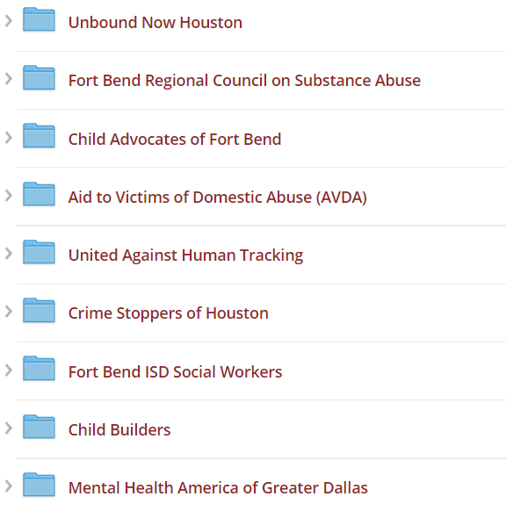
Vendors
Notes:
Presenter: Lori
Say: The vendors/programs that have applied to provide no-cost instructional materials relating to the prevention of child abuse, family violence, dating violence, or human trafficking include:
Unbound Now Houston
Fort Bend Regional Council on Substance Abuse
Child Advocates of Fort Bend
Aid to Victims of Domestic Abuse (AVDA)
United Against Human Tracking
Crime Stoppers of Houston
Fort Bend ISD Social Workers
Child Builders
Mental Health America of Greater Dalla

Slide 11
Unbound Now Houston
Program(s): | Prevention Area(s): | Target Grade Level:
Sentinels, Keeping Students Safe | Sex Trafficking | 6-12
Notes:
Presenter: Allison

Slide 12
Fort Bend Regional Council on Substance Abuse
Program(s): | Prevention Area(s): | Target Grade Level:
Youth Connection, LifeSkills | Child Abuse, Family Violence, Dating Violence | 3-12
Notes:
Presenter: Allison

Slide 13
Child Advocates of Fort Bend
Program(s): | Prevention Area(s): | Target Grade Level:
Child Safety Matters, Teen Safety Matters | Child Abuse, Family Violence, Dating Violence, Sex Trafficking | 6-12
Notes:
Presenter: Allison

Slide 14
Aid to Victims of Domestic Abuse (AVDA)
Program(s): | Prevention Area(s): | Target Grade Level:
Teen Dating Abuse & Healthy Relationships, Safe Dates, Live Respect, Love 146 | Child Abuse, Family Violence, Sex Trafficking | 6-12
Notes:
Presenter: Allison

Slide 15
United Against Human Trafficking
Program(s): | Prevention Area(s): | Target Grade Level:
Youth Awareness Workshop, Real Talk Group | Sex Trafficking | 6-12
Notes:
Presenter: Allison

Slide 16
Crime Stoppers of Houston
Program(s): | Prevention Area(s): | Target Grade Level:
Safe Schools Institute, Safe Community Institute | Dating Violence, Sex Trafficking | 6-12
Notes:
Presenter: Allison

Slide 17
Fort Bend ISD Social Workers
Program(s): | Prevention Area(s): | Target Grade Level:
FBISD Social Work | Child Abuse | PreK-12
Notes:
Presenter: Allison

Slide 18
Child Builders
Program(s): | Prevention Area(s): | Target Grade Level:
Stand Strong “Stay Safe”, Building Pathways to Mental Health | Child Abuse, Family Violence, Sex Trafficking | PreK-5
Notes:
Presenter: Allison

Slide 19
Mental Health America of Greater Dallas
Program(s): | Prevention Area(s): | Target Grade Level:
WHO | Child Abuse, Family Violence, Dating Violence, Sex Trafficking | K-12
Notes:
Presenter: Allison

Slide 20
Prevention Support Materials Timeline
Public Meeting 1
Public Meeting 2
February 15
2022
March 21, 2023
Once approved by the board by the Board of Trustees, campuses can utilize the resources.
Public Review
Board Meeting
February 15, 2023 – March 2, 2023
April 17, 2023
Notes:
Presenter: Allison
Say: Here you will see the prevention support materials timeline.
Feb 15th – Public Meeting 1
Feb 15th – March 2nd – Public Review via the SHAC webpage
March 21st – Public Meeting 2
April 2023 – Board of Trustee Meeting
Once approved by the board by the Board of Trustees, campuses can utilize the resources. Ensuring that the programs are only provided if parents approve their participation through written consent.

Slide 21
Public Review
Notes:
Presenter: Allison
Say: Following the hearing, staff and community members will have two weeks to review the resources and provide feedback. FBISD’s virtual public review and submission window is open starting today, Wednesday, February 15, through Thursday, March 2, 2023. Information regarding the public review has been shared with the community via the District webpage, a press release on January 30th, and other appropriate means. To access the resources, please visit the FBISD SHAC Webpage.

Slide 22
Quick Show of Hands
Public Hearing #2
Tuesday, March 21, 2023
In-person
Or
Virtual?

Slide 23
Public Comment Opportunity:
Notes:
Presenter: Lori
Say: At this time we will allow for public comment. Anyone that would like to speak will have 3 minutes and will be given a 30-second reminder after speaking for 2 ½ minutes. We ask that you do not mention a specific student/employee name or specific campus while you are speaking.

Slide 24
Notes:
Presenter:
Say:

Slide 25
FBISD: Our Mental Health Journey
Priti Avantsa, LMSW
FBISD Coordinator of Mental Health and Social Work Services

Slide 26
Statistics from Mental Health America
LIFE DURING COVID
55% reported experiencing emotional abuse by a parent or other adult in the home.
11% experienced physical abuse
29% reported a parent or another adult lost their job
SCREENERS
500% increase over the number of people who completed a mental health screening from 2019
45% of individuals who took the screener were youth ages 11-17.
ANXIETY
422% increase in the number of people who took an anxiety screen from 2019.
79% who scored moderate to severe anxiety reported frequent suicidal ideations
Anxiety jumped from 9.4% to 11.8% pre pandemic to the first year of covid for ages 3-17
SUICIDAL
51% of youth ages 11-17, who took the depression screener reported having suicidal thoughts on at least ½ to nearly everyday of the previous two weeks
63% of youth ages 11-17 who identified as LGBTQ reported frequent suicidal ideations.
MENTAL HEALTH Among individuals who screened moderate to severe for a mental health condition in 2021, these were the top three contributing factors
loneliness or isolation
past trauma
relationship problems

Slide 27
Multi-Tier Systems of Support
Individualized and Intensive
Small group interventions, community resource referrals, short term interventions
Classroom and large group lessons
SEL curriculum
Note: Tier I and Tier II interventions should be implemented for a period of time, prior to making a Tier III referral. However, there can be some exceptions to the rule.

Slide 28
Tier III Mental Health Support
Clearhope Counseling | Campus Partners
Virtual and face to face counseling Services are available to all campuses. Partnering Campuses receive campus-based services Non partnering campuses have an option to receive virtual/office-based services. | High Schools (14) | Middle Schools(14) | Elementary Schools (21)
Virtual and face to face counseling Services are available to all campuses. Partnering Campuses receive campus-based services Non partnering campuses have an option to receive virtual/office-based services. | Austin HS Bush HS Clements HS Dulles HS Elkins HS Hightower HS Kempner HS Marshall HS Progressive HS Ridge Point HS Travis HS Willowridge HS Ferndell Henry Learning Center | Baines MS Bowie MS McAuliffe MS Crockett MS Dulles MS First Colony MS Fort Settlement MS Garcia MS Hodges Bend MS Lake Olympia MS Missouri City MS Sartartia MS Sugar Land MS Thornton MS | Arizona Fleming ES Barrington Place ES Brazos Bend ES Colony Bend ES Dulles ES Highlands ES Holley ES Lakeview ES Meadows ES Mission Bend ES Mission Glen ES Mission West ES Neill ES Oyster Creek ES Pecan Grove ES Scanlan Oaks ES Schiff ES Settlers Way ES Sienna Crossing ES Sugar Mill ES Townewest ES

Slide 29
Tier III Mental Health Support
Invocare-IMPACT | Campus Partners
Home based and face to face counseling | High Schools (0) | Middle Schools(1) | Elementary Schools (15)
Virtual and face to face counseling Services are available to all campuses. Partnering Campuses receive campus-based services Non partnering campuses have an option to receive virtual/office-based services. |  | Quail Valley MS | Armstrong ES Blueridge ES Briargate ES Burton ES EA Jones ES Glover ES Goodman ES Heritage Rose ES Hunters Glen ES Lantern Lane ES Lexington Creek ES Quail Valley ES Ridgegate ES Ridgemont ES Rosa Parks ES

Slide 30
Tier III Mental Health Support
Sugar Land Counseling | Campus Partners
Sessions at Sugar Land office Accepts some forms of insurance and self-pay | High Schools (0) | Middle Schools (3) | Elementary Schools (1)
Virtual and face to face counseling Services are available to all campuses. Partnering Campuses receive campus-based services Non partnering campuses have an option to receive virtual/office-based services. |  | First Colony MS Fort Settlement MS Sartartia MS | Austin Parkway ES

Slide 31
Tier III Mental Health Support via the BHAW Dept.
TCHATT | Campus Partners
Short term counseling (4-6 sessions) and then they refer out Virtual sessions only | TCHATT provides therapy virtually to students from: Progressive HS The Reese Center TCHATT provides virtual psychiatric services to students throughout the district, from all campuses.

Slide 32
Tier III Mental Health Support via the BHAW Dept.
FBISD Mental Health Counselors (MHC)
6 District LPCs Short term counseling (6-10 sessions) Face to face at campus/ some virtual sessions when appropriate Family with limited resources MHCs are FBISD employees (available for consults without parent permission to discuss concerns and next steps) Support all campuses

Slide 33
Reminders
Students MUST have a written parent consent
To be referred for mental health services
Start counseling with a therapist
All referrals should come directly from the school counselor.

Slide 34
Campuses with Mental Health Partners
Mental Health and Social Work Services

Slide 35
Number of Therapists
Mental Health and Social Work Services

Slide 36
Tier III Students Seen
Mental Health and Social Work Services

Slide 37
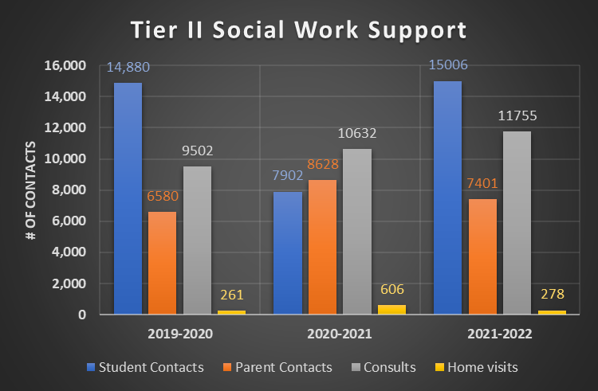
Mental Health and Social Work Services
Tier II Social Work Support

Slide 38
Challenges
Challenges
Parent consent to refer
52% of youth ages 12-17 view their mental health differently than their parents. 2/3 rated it less positively than their parents
Parent permission to start services
Shortage of providers
19.5 individuals providing Tier III Services in the district. FB county the patient to Clinician ratio is 1,351 to 1
Shortage of bilingual therapists
Continued stigma: Suffering in silence
Funding:
VOCA grant can only pay for counseling for Victims of Crime
6 MH therapists in the district who support 13-16 campuses each
Missing instructional time
Student willingness to participate
Attendance
Notes:
Stigma

Slide 39
Spreading the Word
Socializing
Parents
Whole Child Health initiative (2nd year)
Parent Webinars
Health Fairs –Aug and April
Campus newsletters
Open houses
District website
Campus parent trainings
Individual parent meetings
Students
Talkline posters at campuses
Student Wellness Committees
District website
Leadership meetings
Counselors

Slide 40
SHAC’s Legislative Priorities Update
Allison Thummel
FBISD SHAC Chair

Slide 41
SHAC's Legislative Priorities Update

Slide 42
Approve Minutes
December 7, 2022 & January 25, 2023
Cathy Hunter
FBISD SHAC Secretary

Slide 43
Virtual Voting?
Virtual Voting?
Text vote to 281-217-8440
Text vote to: 281-217-8440

Slide 44
Brain Break Rosa Martinez Coordinator of SEL & Enrichment Programs

Slide 45
Special People in Our Lives

Slide 46
Virtual Voting?
Mentor
Text vote to 281-217-8440

Slide 47
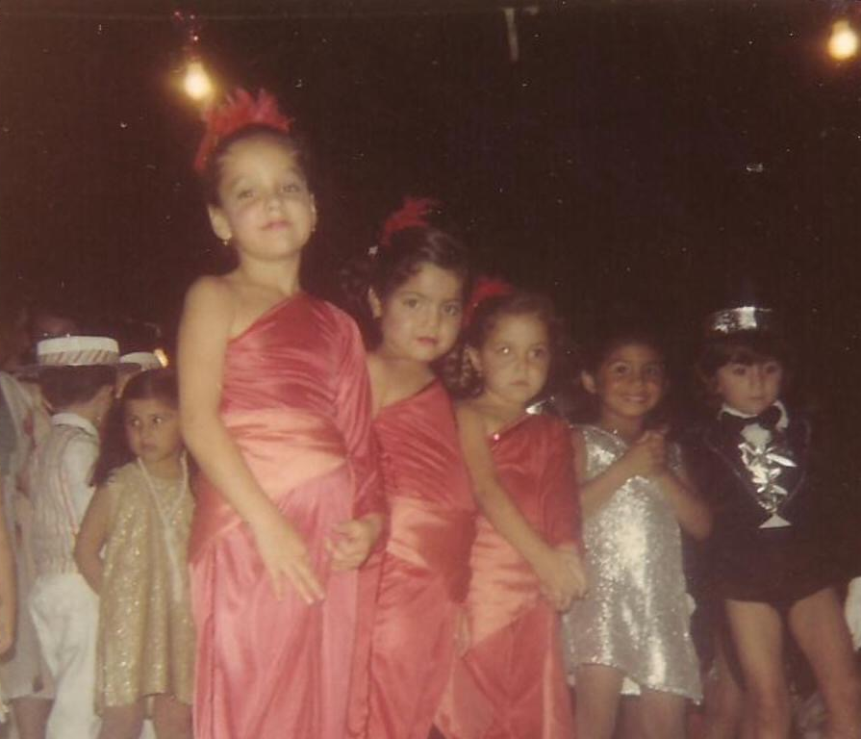
Virtual Voting?
Friend
Text vote to 281-217-8440

Slide 48
Virtual Voting?
Colleague
Text vote to 281-217-8440

Slide 49
Virtual Voting?
Think about…
Text vote to 281-217-8440
Mentor Friend Colleague

Slide 50
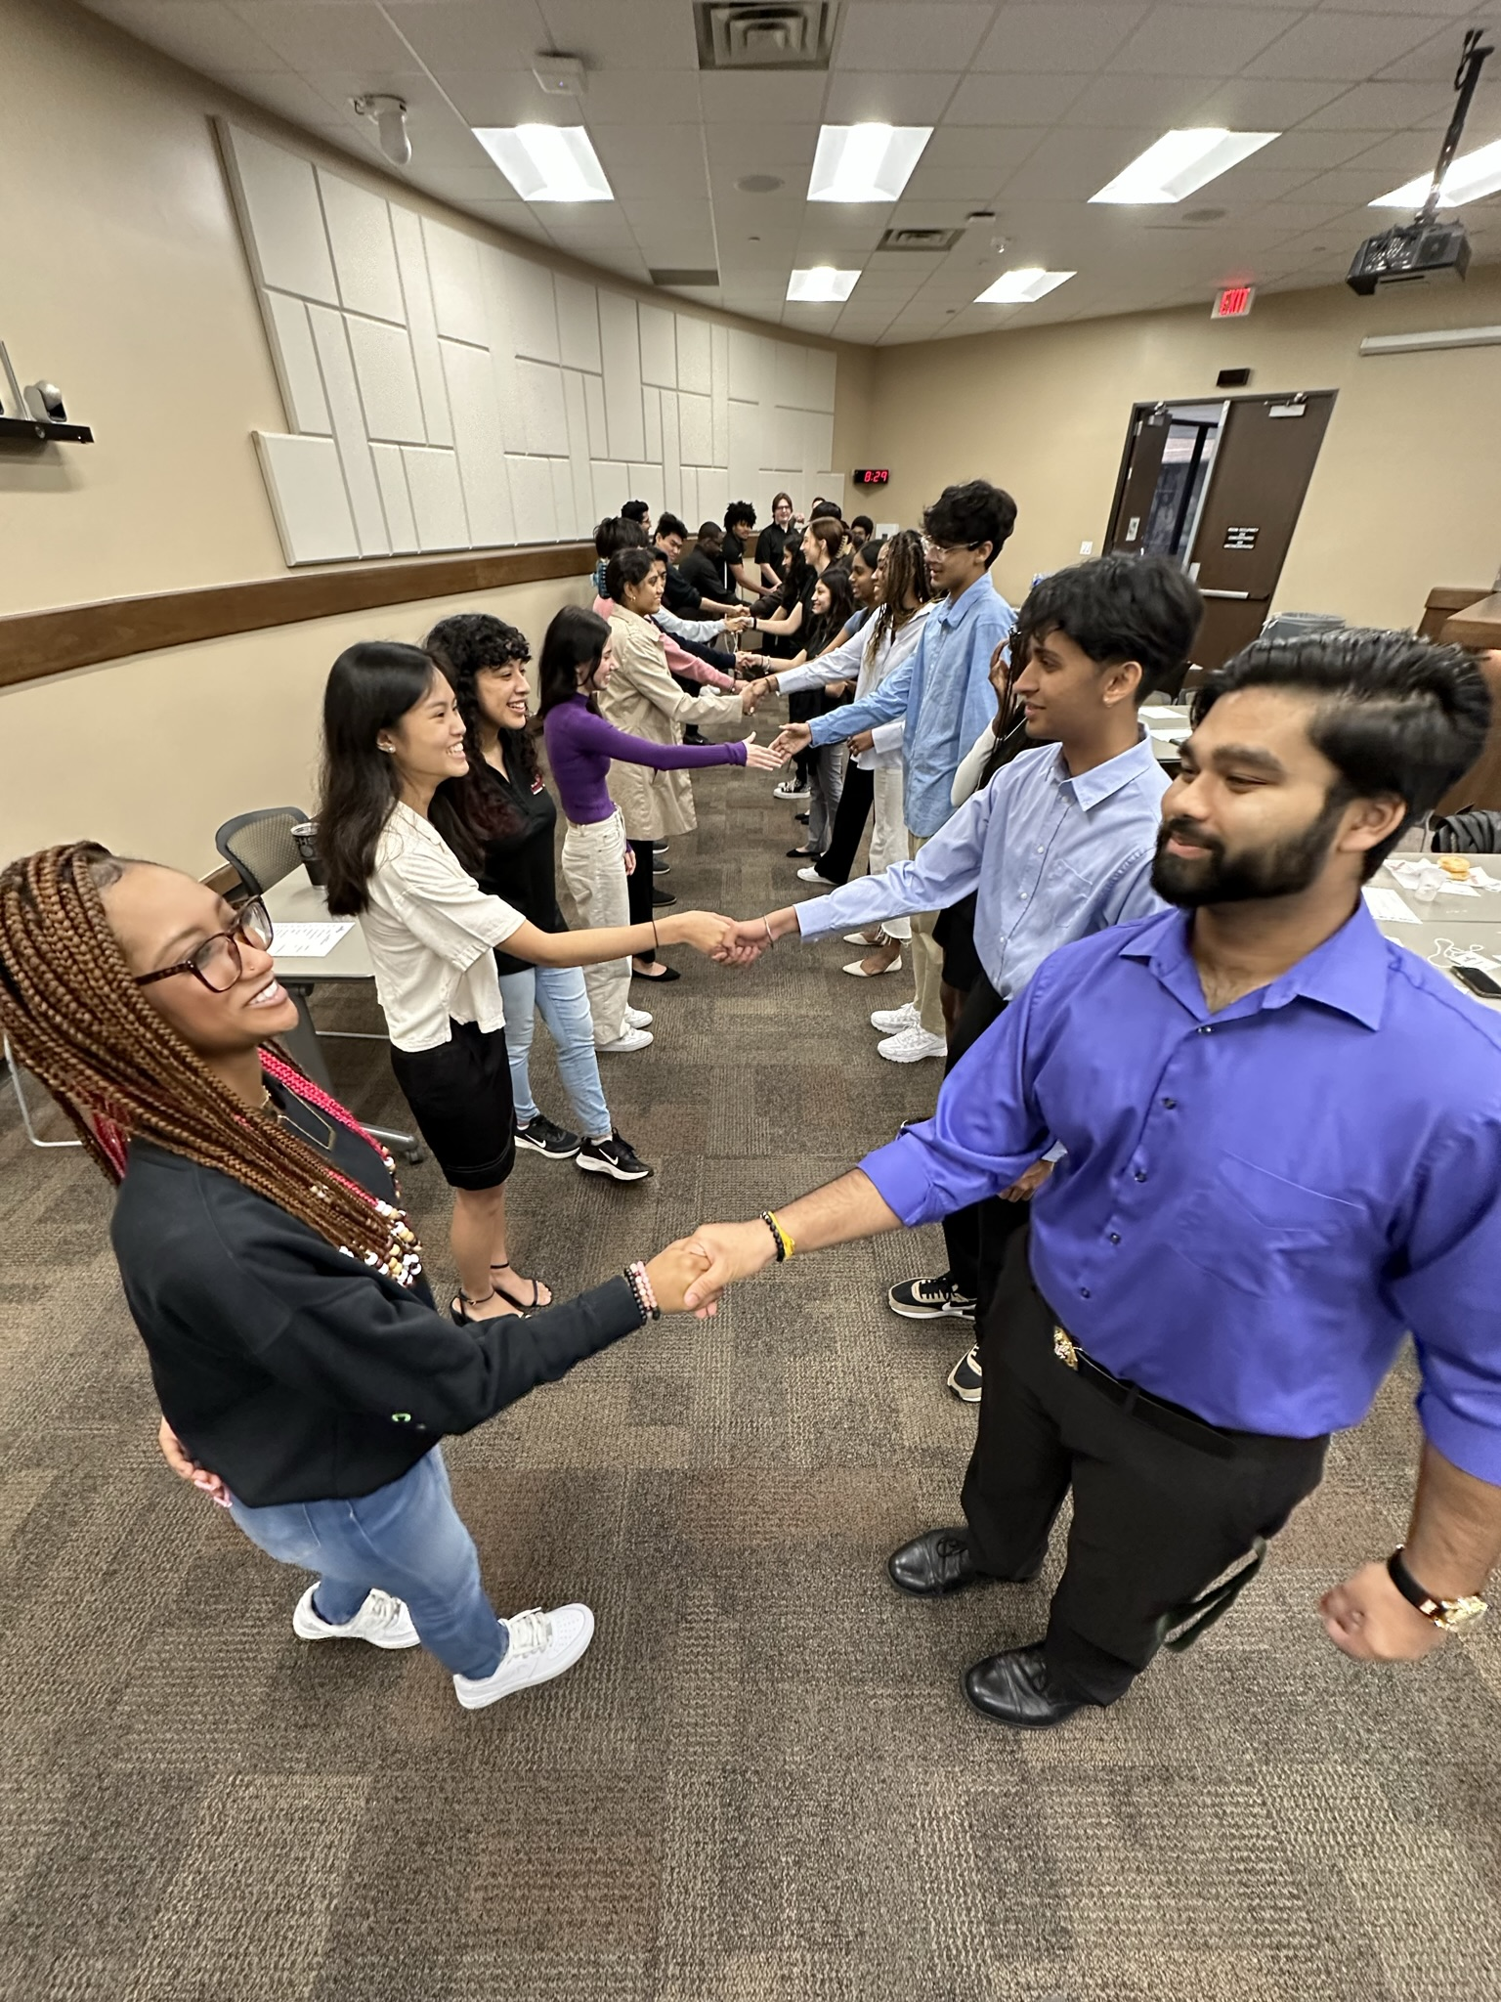
Virtual Voting?
Let’s Share!
Text vote to 281-217-8440
Greet your partner
Take turns to share
Thank your partner

Slide 51
Upcoming Events
LaDonna Green
FBISD Wellness, Health & Prevention Specialist

Slide 52
Upcoming Whole Child Health Parent Webinar
Parents and caregivers will be equipped with research-based strategies and tools to help students to be better prepared for school, state, and national assessments. Information about test anxiety symptoms, current district and campus support systems to address it, and best practices regarding how to lower and/or minimize it will also be shared.

Slide 53
Upcoming WCH Webinars

Slide 54
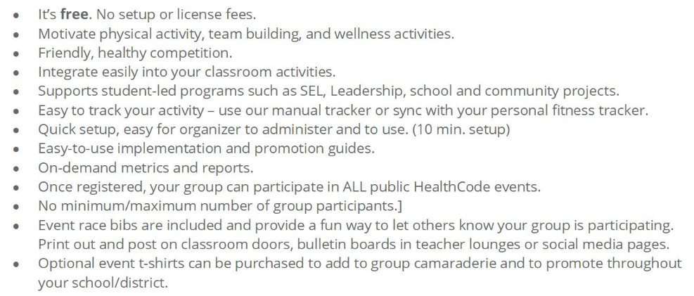
HealthCode’s April Million Mile Month

Slide 55
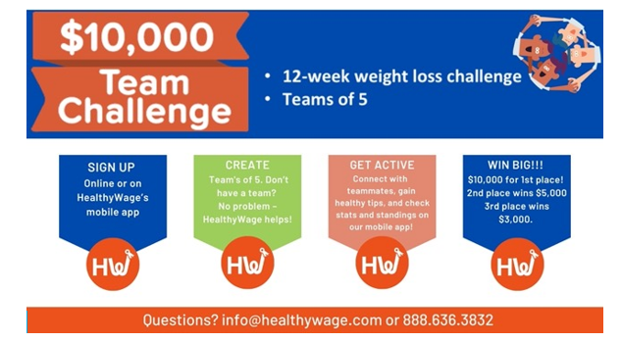
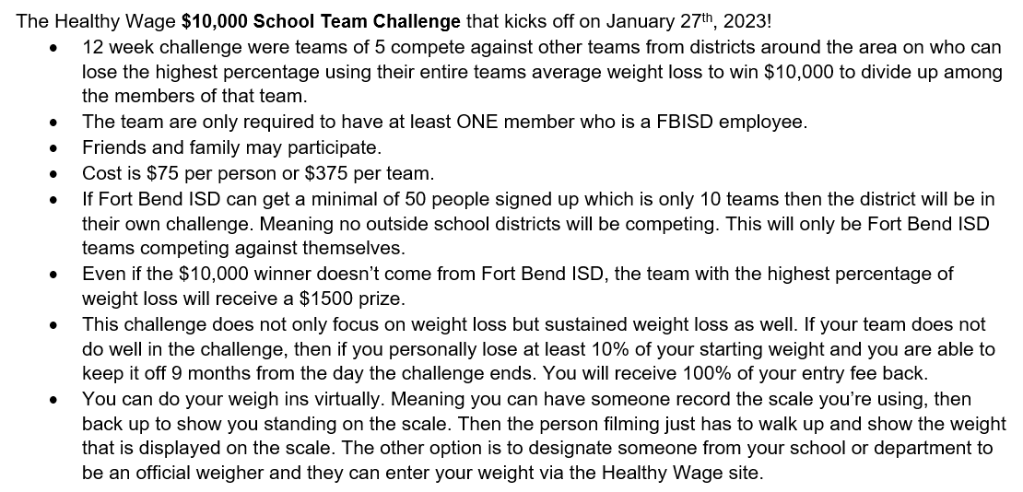
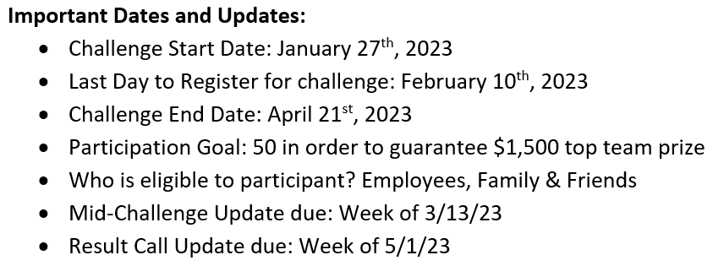
Healthy Wage Team Challenge

Slide 56
Creative Arts Contest

Slide 57
Child Nutrition Upcoming Events

Slide 58
Liaison To Do List
SHAC Liaisons Action items
* Review and comment on prevention support materials
* Upcoming health or wellness fairs @ your campus?
*Study skills webinar tonight
*Attend and Promote Mental Health event 4/5 *Promote NNM Pizza contest
*Promote Million Mile Month
*Feminine Supply Drive
*Upcoming Campus Wellness recognitions

Slide 59
Update on Student Wellness Committees
Laine Skelton
Coordinator of HS Programs: Enriched Opportunities

Slide 60
District Student Wellness Coalition
The District Student Wellness Coalition is an extension of the School Health Advisory Committee run by students to promote health and wellness on each of the district's high school campuses.
January 25th Summit recap
Campus SWC initiatives
April in-person SWC Final Summit Meeting

Slide 61
SHAC Updates
Allison Thummel
FBISD SHAC Chair

Slide 62
SHAC Updates
Membership of SHAC reminders
Looking for quality, active new members
Vote for materials
Upcoming Campus Wellness Assessments/HEROES

Slide 63
SHAC Membership Criteria
Membership
Constitute parents, community members & district representatives
Majority members should be parents
Must undergo District volunteer background check
The term of service for an appointment shall be two years
If a SHAC member misses two (2) consecutive meetings of the full SHAC, the Executive Committee shall request the member to declare his or her intention to continue.

Slide 64
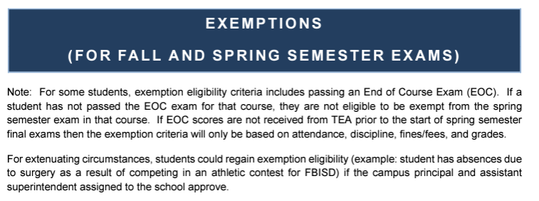
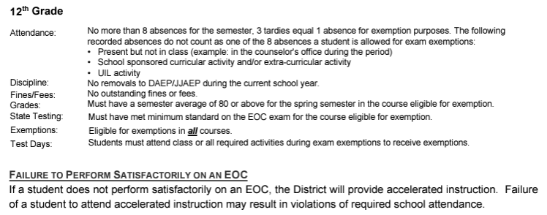
Exemptions For Fall & Spring Semester Exams
For questions on attendance, please contact Dr. Julie Guillory at
Julie.joubertguillory@fortbendisd.com

Slide 65
Questions, Comments & Suggestions

Slide 66
Subcommittees Meet
Subcommittees Meet
Begin planning goals for 2023-2024 for your subcommittee.​
Turn in to Allison by 2/27/23.
Begin planning goals for 2023-2024 for your subcommittee.
Turn in to Allison by 2/27/23.

Slide 67
General SHAC Meeting Closure
Next General SHAC Meeting
April 19, 2023
12 pm- 2 pm
FBISD Administration Building
Board Room
16431 Lexington Blvd.
Sugar Land TX 77479

Slide 68
FORT BEND ISD
16431 Lexington Blvd.
Sugar Land, TX 77479
281-634-1000
www.fortbendisd.com

