Slide 1
SHAC Votes!
Special Called SHAC Meeting
Tuesday, March 21, 2023
Notes:
Presenter:
Time:
Strategy:
Materials:
Say:

Slide 2

Welcome & Mindful Moment
Allison Thummel
SHAC Chair

Slide 3

Important & Relevance of Public Hearing #2

Slide 4
Prevention Support Materials
n Public Hearing #
March 21st, 2023
Notes:
Presenter:
Time:
Strategy:
Materials:
Say: Hello, this is the prevention support materials public meeting #2
Presenting today is:
- Allison Thummel, the FBISD School Health Advisory Council (SHAC) Chair and
- Myself- Lori Sartain, FBISD’s Assistant Director of Health & Wellness

Slide 5
Prevention Curriculum Material Adoption
Child Abuse
Family Violence
Dating Violence
Sex Trafficking
Notes:
Presenter: Lori
Say: During the 87th Texas Legislature, Second Called Session, 2021, TEC, §28.004(q-4), the state legislature enacted legislation, Senate Bill 9 (SB9), requiring the board of trustees of each local school district to determine the specific content of the district’s instruction relating to the prevention of child abuse, family violence, dating violence, and sex trafficking. Prior to the existence of SB9, campus, and district leadership identified and approved prevention materials.
In April 2022 the Board adopted Policy EHAA(Local) which outlined the process for adopting prevention materials related to SB9. The process began in November of 2022, with the Board adopting a resolution to convene the School Health Advisory Council (SHAC) to review and recommend support materials the district can use to teach and encourage the prevention of child abuse, family violence, dating violence, and sex trafficking. Whenever possible, the materials must include essential knowledge and skills as developed by the State Board of Education, which sets the standards for what students are to learn in each course or grade. Materials selected for adoption by the FBISD Board of Trustees will be available for campuses to start implementing beginning in May 2023.

Slide 6
Curriculum Adoption Process – EHAA(LOCAL) Policy
  1. The Board Adopts a Resolution Convening the SHAC to Make Recommendations
Adoption
Of
Curriculum Resource
  2. SHAC Holds At Least 2 Public Meeting and a Public Review Period
    3. SHAC Provides Recommendations to the Board at a Public Board Meeting
  4. The Board, at a Public Board Meeting, will Act on the Adoption of Recommendations through a Vote
Notes:
Presenter: Lori
Say: On this slide, you will see the process outline in Board Policy EHAA(LOCAL), which was approved by the Board in April 2022.
1. The Board adopts a resolution convening the District’s SHAC to recommend curriculum materials for instruction. This occurred in November 2022.
2. The SHAC holds at least two public meetings on the curriculum materials before adopting recommendations to present to the Board.
The first public meeting was held on February 15th and provided an introduction and overview of the curriculum materials considered for adoption.
Today, March 21st, is the second public meeting. In today’s public meeting, we will be providing an over of the curriculum materials being recommended for adoption.
The District has promoted this public meeting to the community via the District webpage and other appropriate means.
The SHAC held a two-week public review of the considered curriculum materials from February 15th till midnight on March 2nd. This was an opportunity for the community to view the resources that are up for adoption and provide feedback on those resources via the SHAC Webpage. All SHAC members, parents, and the community were encouraged to participate and provide feedback on the curriculum materials under consideration.
3. The SHAC must provide recommendations to the board at a public board meeting and must comply with the instructional content requirements in the law. Recommendations must be suitable for the subject
and grade level for which the materials are intended and be reviewed by academic experts in the subject and grade level for which the materials are intended. After this public meeting, the SHAC will take action on the Prevention Material recommendations through a recorded vote.
4. The SHAC will then provide their recommendations to the FBISD Board of Trustees, who at a Public Board Meeting, will Act on the Adoption of SHAC’s Recommendations through a vote. This will occur at the April 17th FBISD Board Meeting.
Once the resources are adopted by the board, they will be made available to campuses.

Slide 7

Support Materials Adoption Review Process
P2022 Prevention Support Materials Adoption Team
Academic experts in the subject and grade level for which the materials are intended
SHAC Members
Virtual Public Reviews
Public Review
Board of Trustee Review
Academic Experts Feedback
Board of Trustee Review
High School Health/PE Department Heads
Middle School Health/PE Department Heads
Elementary PE Cadre
Notes:
Presenter: Lori
Say: The Support Materials Adoption Process included three components.
The first is the P2022 Prevention Support Materials Adoption Team
- The Fort Bend P2022 Leadership Team led the activation of the P2022 Task Force beginning in November 2022. Task Force members were selected to serve as district-level reviewers helping to select the new prevention support materials. The P2022 Task Force was diverse by design and included fourteen members. Among the group were a health teacher, a Safe and Drug-Free Specialist, the Coordinator of School Counseling, the Coordinator of Mental Health and Social Work Services, the district Public Information Officer, the Coordinator of Health, PE, and Wellness, and a FBISD student. The Task Force also included three members of the FBISD School Health Advisory Council (SHAC). The task force met 4 times to participate in optional vendor presentations and to review the information provided by the vendors. Each task force member evaluated each vendor using the Prevention Support Material Scoring Rubric.
Second is the - Virtual Public Reviews
- A public review opportunity was offered to the community and to the Board of Trustees from February 15th through March 2nd.
And Third is the feedback from our academic experts
In addition to the P2022 Prevention Support Materials Task Force and public review opportunities, the District collected feedback from academic experts. These academic experts included:
High School Health/PE Department Heads
Middle School Health/PE Department Heads
Elementary PE Cadre

Slide 8

Prevention Support Materials Scoring Rubric
Mission & Vision
Content
Objectives
Relevance
Unbiased
Implementation Plan
Collaboration Plan
Notes:
Presenter: Lori
Say: The Prevention Support Materials Adoption Team and academic experts used a scoring rubric to evaluate each program being considered. The rubric includes 7 focuses:
Mission & Vision
Content
Objectives
Relevance
Unbiased
Implementation Plan
Collaboration Plan
I will now turn the presentation over to Allison Thummel, the FBISD SHAC Chair, who will provide information regarding the prevention resources being recommended for adoption.

Slide 9
Recommended Elementary Prevention Resources
Elementary Prevention Support Materials
Resource | Prevention Support Focus | Program Materials | Program Delivery
Fort Bend Regional Council on Substance Abuse, Inc. | Child Abuse, Family Violence, Dating Violence | Youth Connection, LifeSkills (Elementary) | Small Group (Tier2)
FBISD Social Work Services | Child Abuse | FBISD Social Work Services | Small Group (Tier2)
Child Builders | Child Abuse, Family Violence, Sex Trafficking | Stand Strong “Stay Safe”, Building Pathways to Mental Health | Large Group (Tier 1)
Child Advocations of Fort Bend | Child Abuse, Family Violence, Dating Violence, Sex Trafficking | Child Safety Matters | Large Group (Tier 1)
Mental Health America of Greater Dallas | Child Abuse, Family Violence, Dating Violence, Sex Trafficking | WHO | Large Group (Tier 1)
Notes:
Say: Here you will see the elementary preventions support materials recommended for adoption:
The Elementary Prevention Support Materials Recommendations include 5 programs:
Fort Bend Regional Council on Substance Abuse, Inc. comprehensively addresses prevention through youth prevention and leadership development programs, treatment for individuals and families struggling with child abuse, family violence, and dating violence, and outreach programs to help families and communities stay safe and violence free. FBRC’s elementary program is Youth Connection. Youth Connection is a curriculum-based support group program, designed to increase resilience and protective factors in children and youth, is an excellent modality for them to learn and practice the social, emotional, and coping skills they need both now and in the future. The program includes 10 to 12 small group (6-12 students) sessions focusing on the development of social, emotional, and coping skills. It is led by a trained, supportive, adult Facilitator who guides participants through a series of activities and discussions designed to help them learn and apply the knowledge, attitudes, and skills needed to cope with difficult situations, resist negative peer pressure, set and achieve goals, and make healthy life choices.
FBISD Social Work Services provides direct counseling and social work services to all Fort Bend Independent School District campuses. Social work services are oriented toward helping students make satisfactory school adjustments and to coordinate the efforts of home, school, and community to achieve this goal. Their elementary program focuses on helping students understand what child abuse is and that child abuse can happen anywhere —at home, school, childcare, at a friend's house, or even in a church or other religious building.
Child Builders works to promote child abuse and family violence by empowering children, parents, and teachers with assertiveness skills, emotional control, empathy, resilience, and the ability to resolve conflict nonviolently. Child Builders offers the Stand Strong “Stay Safe” program to elementary-age students. Stand Strong “Stay Safe” is an elementary-focused classroom-based curriculum that promotes personal safety by teaching children how to set boundaries and be assertive. Using interactive presentations, skills practice, and role-play, this program helps children develop skills to stay safe from physical abuse, sexual abuse, emotional abuse, and bullying. Child Builders also offers the Building Pathways to Mental Health program which is a webinar series designed to support mentally healthy parenting, caregiving, and teaching practices throughout the community.
Child Advocates of Fort Bend exists to strengthen the child’s voice, heal the hurt and break the cycle of abuse and neglect for children and families in the school community. MBF Child Safety Matters is the comprehensive, evidence-based curriculum they provide for elementary school students in grades K-5. The program educates and empowers children and all relevant adults with information and strategies to prevent, recognize, and respond appropriately to bullying, cyberbullying, all types of abuse, and digital abuse dangers.
Mental Health America of Greater Dallas (MHA Dallas) is an organization working to support the community by supplying information, education, and advocacy related to the prevention of child abuse, family violence, dating violence, and sex trafficking preventive. MHA Dallas offers the WHO program to students in Kindergarten – 12th grade. WHO was designed to prevent the likelihood of child victimization by building children’s ability to analyze strange or dangerous situations. WHO is a series of research-based curricula that are formed on sensitive, non-threatening content and methodology. WHO Training prepares school counselors, child advocates, nurses, teachers, case workers, and volunteers to present WHO in classroom settings.
Secondary Prevention Support Materials Recommendations include 8 programs:
United Against Human Trafficking (UAHT) is committed to fighting human trafficking. They support those with a history of past trauma, abuse, and trafficking who are at high risk for human trafficking (re)victimization. UAHT offers the Real Talk program and youth awareness workshops to students in grades 6-12. Real Talk is a trauma-informed support group, which engages teens who have already experienced trauma or trafficking and are vulnerable to recruitment and (re)victimization. This program consists of seven virtual or on-site visits that provide participants a chance to process through open conversations and enrichment activities.
Aid to Victims of Domestic Abuse (AVDA) strives to end family violence, dating violence, and sex trafficking by advocating for the safety and self-determination of victims, promoting accountability for abusers, and fostering a community response to abuse. AVDA is dedicated to providing multilingual, transformational, life-saving services to survivors of abuse and their families. AVDA offers serval programs to students in grades 6-12, including Teen Dating Abuse & Healthy Relationships,
Safe Dates, Live Respect, and Love 146. Their prevention programs for youth take three different tracks: one-time presentations by AVDA staff to school and Juvenile Justice audiences; eight-week curriculums for group sessions; and training coaches to mentor their athletes.
Child Advocates of Fort Bend exists to strengthen the child’s voice, heal the hurt and break the cycle of abuse and neglect for children and families in the school community. MBF Teen Safety Matters is the comprehensive, evidence-informed prevention education program they provide for middle school students in grades 6-8 and high-school students in grades 9-12. The program educates and empowers teens and all relevant adults with information and strategies to prevent, recognize, and respond appropriately to bullying, cyberbullying, all types of abuse, relationship abuse, digital dangers, exploitation, and human trafficking.
Unbound Now Houston supports survivors and provides resources to our community to fight human trafficking in three primary ways: prevention and awareness, professional training, and survivor advocacy. Sentinels is the sex trafficking prevention resource they have available to students in grades 6-12. Sentinels is a sex trafficking prevention curriculum comprised of five videos and accompanying activities designed to equip youth to recognize and avoid potential exploitation and empower them to make a positive difference in their communities.
Crime Stoppers of Houston works diligently in Fort Bend County to empower, educate and engage the community in important conversations about dating violence, sex trafficking, and the protection of society’s most vulnerable citizens. Crime Stoppers offers the Safe Schools Program to students in grades 6-12. The Safe School Institute (SSI) is a one-stop center for all aspects of school safety. SSI keeps schools safe by creating a proactive dialogue with students, school staff, and law enforcement about personal and school safety. The institute strives to reduce victimization, deter delinquency, and increase campus reporting through prevention-based presentations and training.
FBISD Social Work Services provides direct counseling and social work services to all Fort Bend Independent School District campuses. Social work services are oriented toward helping students make satisfactory school adjustments and to coordinate the efforts of home, school, and community to achieve this goal. Their secondary program focuses on helping students understand what child abuse is and that child abuse can happen anywhere —at home, school, childcare, at a friend's house, or even in a church or other religious building.
Mental Health America of Greater Dallas (MHA Dallas) is an organization working to support the community by supplying information, education, and advocacy relateprevention of child abuse, family violence, dating violence, and sex trafficking preventive. MHA Dallas offers the WHO program to students in Kindergarten – 12th grade. WHO was designed to prevent the likelihood of child victimization by building children’s ability to analyze strange or dangerous situations. WHO is a series of research-based curricula that are formed on sensitive, non-threatening content and methodology. WHO Training prepares school counselors, child advocates, nurses, teachers, case workers, and volunteers d to the to present WHO in classroom settings.
Review of Prevention Support Materials
The table below lists the vendors for each prevention program level that are being recommended. The district provides the Board of Trustee members with access to resources for review. As referenced in the previous proclamation memos in November and January, Board members had an opportunity to virtually review all the prevention support materials via the FBISD SHAC Webpage, from February 15th – March 2nd.

Slide 10
Recommended Secondary Prevention Resources
Secondary Prevention Support Materials
Resource | Prevention Support Focus | Supporting Materials
United Against Human Trafficking | Sex Trafficking | Youth Awareness Workshop, Real Talk Program | Small Group (Tier2), Large Group (Tier 1)
Aid to Victims of Domestic Abuse (AVDA) | Family Violence, Dating Violence, Sex Trafficking | AVDA Programs - Teen Dating Abuse & Healthy Relationships, Safe Dates, Live Respect, Love 146 | Small Group (Tier2), Large Group (Tier 1)
Child Advocates of Fort Bend | Child Abuse, Family Violence, Dating Violence, Sex Trafficking | Teen Safety Matters | Large Group (Tier 1)
Fort Bend Regional Council on Substance Abuse, Inc. | Child Abuse, Family Violence, Dating | Youth Connections | Small Group (Tier2), Large Group (Tier 1)
Unbound Now Houston | Sex Trafficking | Sentinels, Keeping Students Safe | Large Group (Tier 1)
Crime Stoppers of Houston | Dating Violence, Sex Trafficking | Safe Schools Institute, Safe Community Institute | Large Group (Tier 1)
FBISD Social Work Services | Child Abuse | FBISD Social Work Services | Small Group (Tier2)
Mental Health America of Greater Dallas | Child Abuse, Family Violence, Dating Violence, Sex Trafficking | WHO | Large Group (Tier 1)
Notes:
Say: Here you will see the secondary preventions support materials recommended for adoption:
Secondary Prevention Support Materials Recommendations include 8 programs:
United Against Human Trafficking (UAHT) is committed to fighting human trafficking. They support those with a history of past trauma, abuse, and trafficking who are at high risk for human trafficking (re)victimization. UAHT offers the Real Talk program and youth awareness workshops to students in grades 6-12. Real Talk is a trauma-informed support group, which engages teens who have already experienced trauma or trafficking and are vulnerable to recruitment and (re)victimization. This program consists of seven virtual or on-site visits that provide participants a chance to process through open conversations and enrichment activities.
Aid to Victims of Domestic Abuse (AVDA) strives to end family violence, dating violence, and sex trafficking by advocating for the safety and self-determination of victims, promoting accountability for abusers, and fostering a community response to abuse. AVDA is dedicated to providing multilingual, transformational, life-saving services to survivors of abuse and their families. AVDA offers serval programs to students in grades 6-12, including Teen Dating Abuse & Healthy Relationships,
Safe Dates, Live Respect, and Love 146. Their prevention programs for youth take three different tracks: one-time presentations by AVDA staff to school and Juvenile Justice audiences; eight-week curriculums for group sessions; and training coaches to mentor their athletes.
Child Advocates of Fort Bend exists to strengthen the child’s voice, heal the hurt and break the cycle of abuse and neglect for children and families in the school community. MBF Teen Safety Matters is the comprehensive, evidence-informed prevention education program they provide for middle school students in grades 6-8 and high-school students in grades 9-12. The program educates and empowers teens and all relevant adults with information and strategies to prevent, recognize, and respond appropriately to bullying, cyberbullying, all types of abuse, relationship abuse, digital dangers, exploitation, and human trafficking.
Unbound Now Houston supports survivors and provides resources to our community to fight human trafficking in three primary ways: prevention and awareness, professional training, and survivor advocacy. Sentinels is the sex trafficking prevention resource they have available to students in grades 6-12. Sentinels is a sex trafficking prevention curriculum comprised of five videos and accompanying activities designed to equip youth to recognize and avoid potential exploitation and empower them to make a positive difference in their communities.
Crime Stoppers of Houston works diligently in Fort Bend County to empower, educate and engage the community in important conversations about dating violence, sex trafficking, and the protection of society’s most vulnerable citizens. Crime Stoppers offers the Safe Schools Program to students in grades 6-12. The Safe School Institute (SSI) is a one-stop center for all aspects of school safety. SSI keeps schools safe by creating a proactive dialogue with students, school staff, and law enforcement about personal and school safety. The institute strives to reduce victimization, deter delinquency, and increase campus reporting through prevention-based presentations and training.
FBISD Social Work Services provides direct counseling and social work services to all Fort Bend Independent School District campuses. Social work services are oriented toward helping students make satisfactory school adjustments and to coordinate the efforts of home, school, and community to achieve this goal. Their secondary program focuses on helping students understand what child abuse is and that child abuse can happen anywhere —at home, school, childcare, at a friend's house, or even in a church or other religious building.
Mental Health America of Greater Dallas (MHA Dallas) is an organization working to support the community by supplying information, education, and advocacy relateprevention of child abuse, family violence, dating violence, and sex trafficking preventive. MHA Dallas offers the WHO program to students in Kindergarten – 12th grade. WHO was designed to prevent the likelihood of child victimization by building children’s ability to analyze strange or dangerous situations. WHO is a series of research-based curricula that are formed on sensitive, non-threatening content and methodology. WHO Training prepares school counselors, child advocates, nurses, teachers, case workers, and volunteers d to the to present WHO in classroom settings.
Review of Prevention Support Materials
The table below lists the vendors for each prevention program level that are being recommended. The district provides the Board of Trustee members with access to resources for review. As referenced in the previous proclamation memos in November and January, Board members had an opportunity to virtually review all the prevention support materials via the FBISD SHAC Webpage, from February 15th – March 2nd.

Slide 11
Prevention Support Materials Timeline
Public Meeting 2
Board Meeting
March 21, 2023
April 17, 2023
SHAC Vote
Resources to Campus
March 21, 2023
April 18, 2023
Notes:
Presenter: Allison
Say: Here you will see the prevention support materials timeline.
March 21st – Public Meeting 2
March 21st – SHAC will vote on the recommendations
At the April 17th Board Meeting, the Board of Trustees will take action with a vote on the recommendations
Once approved by the board by the Board of Trustees, campuses can utilize the resources. Ensuring that the programs are only provided if parents approve their participation through written consent.

Slide 12
Public Comments
2 minutes

Slide 13

Notes:
Presenter: Allison
Say: Thank you so much for attending. We will now open the floor to public comment or questions.

Slide 14
Q&A
Prevention Support Materials

Slide 15
Vote Prevention Support Materials
Cathy Hunter
SHAC Secretary

Slide 16

Vote on SHAC Meeting Minutes
SHAC Votes!
December 7, 2022 SHAC Meeting
February 15, 2023 SHAC Meeting
January 25th Special Called Meeting

Slide 17
Announcements & Celebrations

Slide 18


Fort Bend ISD
SHAC Shirts are for sale for $24. To order a shirt, click the link below.
SHAC Shirts
https://www.etsy.com/listing/1403191952/custom-order-fbisd-premium-short-sleeve

Slide 19


Fort Bend
ISD’s
Whole Child Health
Mental & Behavioral
Wellness Fair

Slide 20




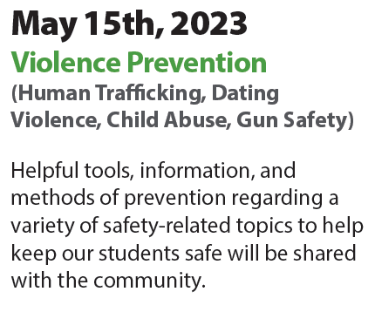


Upcoming Parent Webinars

Slide 21

Child Nutrition
Upcoming Event

Slide 22

Advocacy
Join Zoom Meeting
https://us02web.zoom.us/j/81358869004?pwd=RFd0alc5enA0QjBnbXk0RDQ5WTFSZz09

Slide 23

Fort Bend ISD
Observes
Autism Awareness Week
April 3-7, 2023

Slide 24


Mental Health America and Child Trends Webinar
March 28 @ 1p
Panel discussion: Educators helping youth develop mental health literacy & strategies to support students in gaining self-awareness and emotional regulation
Register today! https://chronicdisease.zoom.us/webinar/register/WN_ax6m--tmRBC8DDLOj_xmxw

Slide 25
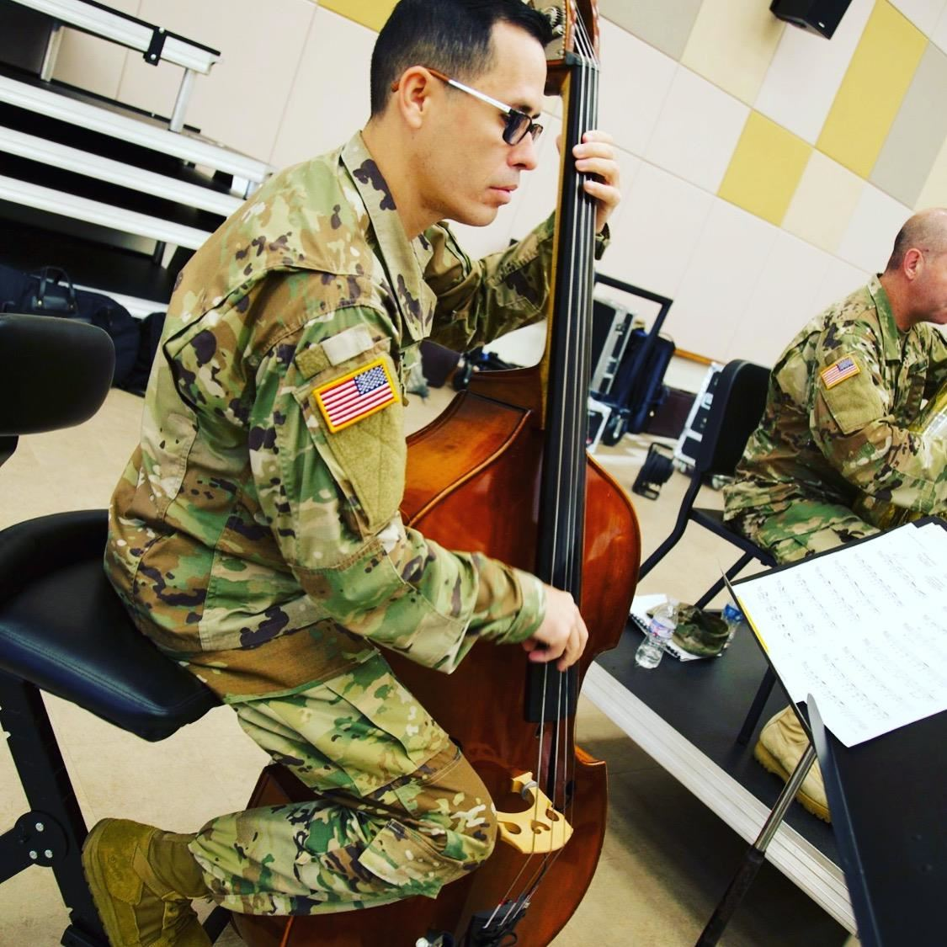
Congratulations to
Mr. Framy Diaz of
Ridgemont Elementary School for being named Elementary Principal of the Year

Slide 26
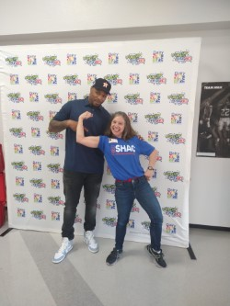
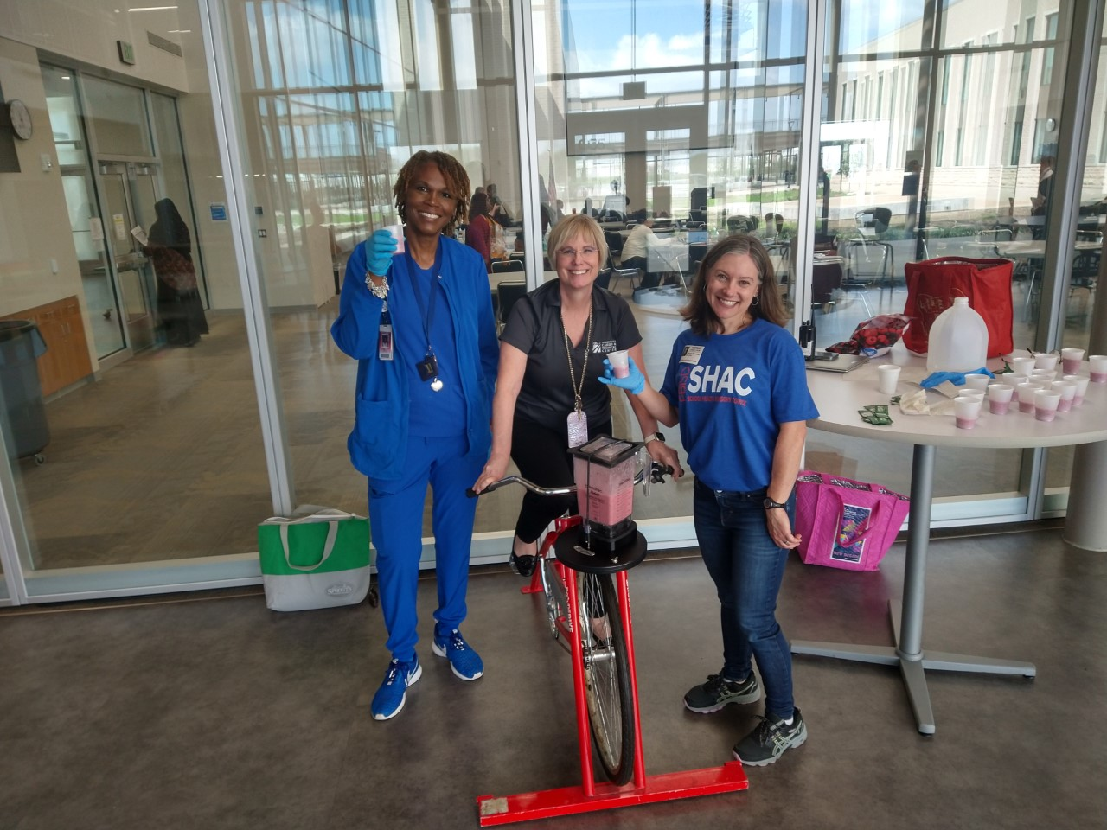
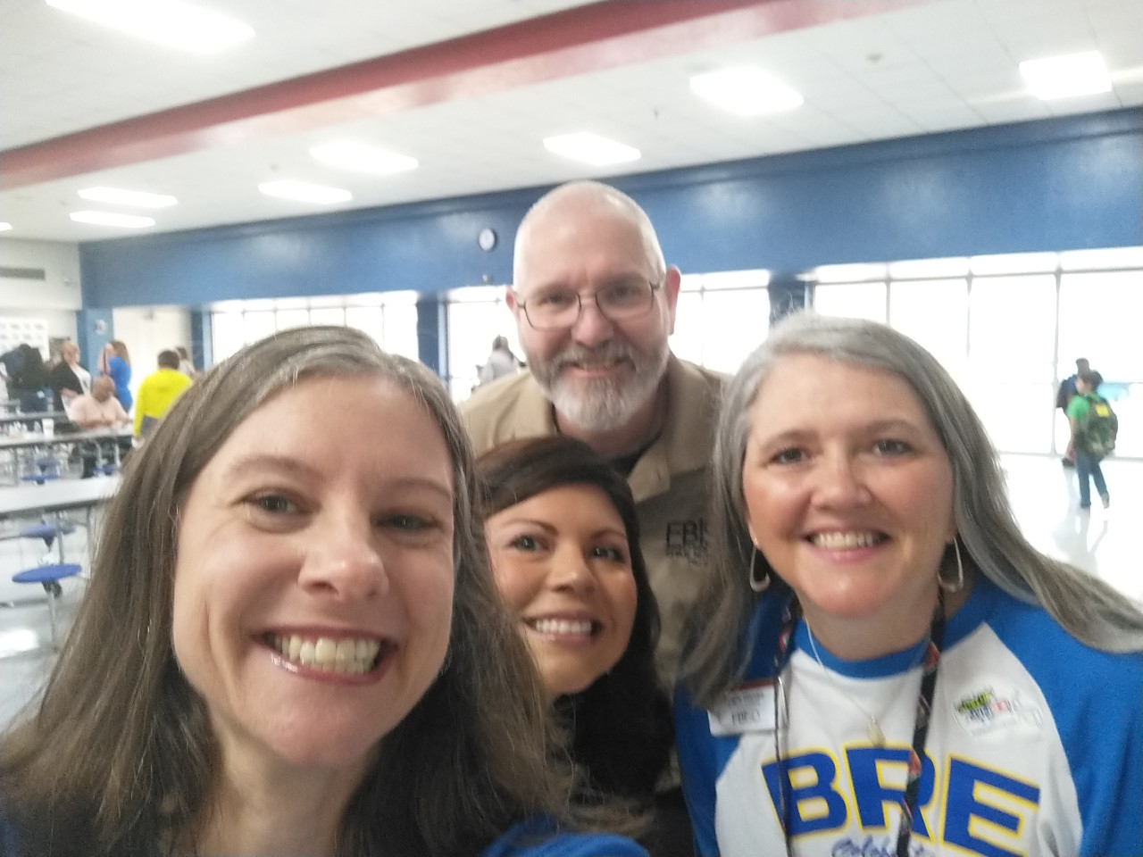
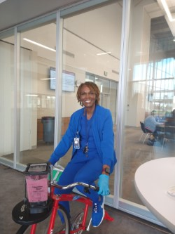

Fort Bend ISD Celebrates National Nutrition Month

Slide 27


Slide 28

Upcoming SHAC Meeting
April 19, 2023
12 pm – 2 pm
Fort Bend ISD Administration Building
Boardroom
16431 Lexington Blvd
Sugar Land, TX 77479

