Slide 1
SHAC Advocates!
General SHAC Meeting
Wednesday, April 19, 2023
Notes:
Presenter:
Time:
Strategy:
Materials:
Say:

Slide 2
Welcome & Wellness Moment
Allison Thummel
FBISD SHAC Chair

Slide 3
FBISD Bond presentation: How Does It Pertain to Wellness? Bryan Guinn FBISD Chief Financial Officer

Slide 4
2023 Bond Overview

Slide 5
Getting to Know…
Getting to Know the SHAC Advocacy Subcommittee: Leads & Members

Slide 6
ADVOCACY SUBCOMMITTEE LEADS
Rocaille Roberts – Lead/Chair: fortbendisdshacadvocacy@gmail.com
Jenna Ross – Parent Lead / Vice-Chair: jennagiarratano@hotmail.com
Coby Wilbanks – District Lead /Legal Counsel: coby.wilbanks@fortbendisd.com
Chassidy Olainu-Alade – District Lead / Civic Engagement: Chassidy.Jeanminette@fortbendisd.com

Slide 7
The Education Ecosystem in Texas & Legislative Update Dax Gonzalez, Division Director Texas Association of School Boards, Governmental Relations

Slide 32
Advocacy Committee: An Introduction & Resources Rocaille Roberts Advocacy Subcommittee Lead

Slide 33
ADVOCACY SUBCOMMITTEE GOALS
Goal 1: Engage with and inform the policy development process at FBISD following the passage of laws from the 87th Legislative Session/2021 special sessions, the 88th Legislative Session or federal laws that impact school wellness
Goal 2: Inform and learn from elected/appointed leaders and/or staff at the state level in the Texas Legislature, Texas Board of Education, Texas Education Agency and local level

Slide 34
ADVOCACY SUBCOMMITTEE GOALS
Goal 3: Inform and learn from Advocacy and/or Civic Engagement organizations
Goal 4: Engage the SEL/Student Wellness Coalitions, Student VOICES Advisory Network, the Communications Department (via Civic & Community Engagement), and Fort Bend Student Leadership 101/102 for voter registration, advocacy and other civic engagement opportunities

Slide 35
SHAC ADVOCACY RESOURCES
Michael and Susan Dell Center for Healthy Living Bill Tracker
Texas Legislature Online
The Legislative Process in Texas
Newsletter Course on the Texas Legislature
FBISD SHAC Advocacy Guidelines
Proposed Updates to the School Nutrition Standards (USDA)
Partnership for a Healthy Texas

Slide 36
Community Health Assessment Fort Bend County Health & Human Services Carrie Rai MA, MSW, LMSW Performance & Innovation Specialist

Slide 38
Community Health Assessment FORT BEND COUNTY HEALTH & HUMAN SERVICES
Carrie Rai MA, MSW, LMSW | Performance & Innovation Specialist

Slide 39
AGENDA
Fort Bend County Health & Human Services
Community Health Assessment
Community Health Improvement Plan
Next Steps

Slide 40
FBCHHS Mission
The mission of Fort Bend County Health & Human Services is to promote and protect the health and well-being of the residents of Fort Bend County through disease prevention and intervention, public health emergency preparedness and response, community engagement, and helping to assure the equitable provision of basic human needs.

Slide 41
FBCHHS Vision
Healthy neighbors living, learning, working, and playing together in healthy communities

Slide 42
2022
Fort Bend County
Health & Human Services
Community
Health
Assessment

Slide 43
CHA Process
Established Multi-Sector Committee
Met regularly from December 2021 to August 2022
Data
Secondary Data
Literature review of local Community Health Needs Assessments
CDC’s resource of frequently recommended health outcomes and determinants
Primary Data
25 key informant interviews
845 community surveys
Identified Community Health Needs
Notes:
7th CHA Committee meeting
3 sub committee meetings
Secondary data – CDC Wonder, Census, County Health Rankings, etc.

Slide 44
Data Metrics
Health Behaviors
Social & Community Factors
Health Care
Physical/Built Environment
Health Outcomes
Notes:
Health Care (Access & Quality)
Health Insurance Converge rates
Provider Rates
Hospital Utilization
Health Behaviours
Tobacco & Alcohol use
Physical activity
Nutrition
Seatbelt use
Immunizations & Screening
Prenatal Care
Social & Community Factors
Income
Poverty level
Educational attainment
Employment status
Homelessness
DV & Child Abuse
Violence & Crime
Social Capital & support
Physical/Build Environment
Air Quality
Water Quality
Housing
Food Access
Transportation
Mortality
Infant & Child Death rates
Injury related deaths
motor vehicle deaths
suicide
homicide
Morbidity
obesity
LBW
Cancer
Injury
Overall Health Status
STDs
TB
COVID
Mental Health
Diabetes

Slide 45
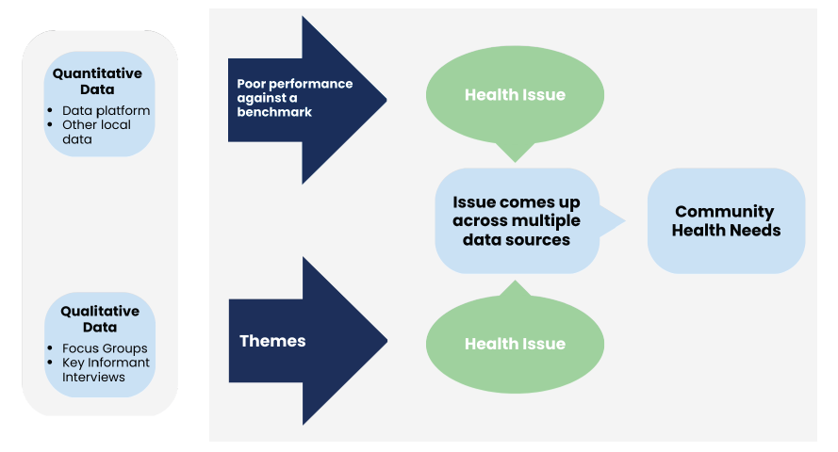
Identifying Community Health Priorities
Kaiser Permanente National Community Benefit, August 2015
Notes:
Benchmarks – Healthy People 2030 – Healthy people is an initiative of the US Department of Health and Huma Services that establishes national goals and measureable objectives with 10-year targets to guide evidence-based policies, programs, and other actions to improve the health and well-being of all Americans.

Slide 46
Community Health Findings

Slide 47
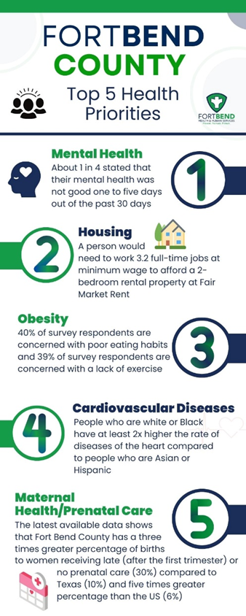
Prioritized Needs
Mental Health
Housing
Obesity
Heart Disease
Prenatal Care

Slide 48
Fort Bend County
Health & Human Services
Community Health
Improvement Plan

Slide 49
CHIP Process
Held five community input sessions
Presented CHA findings
Generated community solutions
Reoccurring themes are included in the plan

Slide 50
Goal: Improve mental health by increasing access to services and providing education
By 2026, increase the number of mental health providers serving FBC residents
Advocate and support legislation for mental health workforce investment
Increase quality student placement and internship opportunities
Expand the use of Peer Support Specialists
By 2025, decrease the number of poor mental health days per month reported by adults
Increase the use of telehealth
Increase mental health education within the community
Increase opportunities to provide education about mental health and stigma to children and adolescents
Increase the number of support groups
Improve system collaboration
Provide prevention and early intervention services and opportunities
Notes:
By 2026, increase the number of mental health providers serving FBC residents
Advocate and support legislation for mental health workforce investment, including student loan forgiveness, salary increases, and insurance reimbursement for other professionals providing services
Increase quality student placement and internship opportunities
Expand the use of Peer Support Specialists
By 2025, decrease the number of poor mental health days per month reported by adults
Increase the use of telehealth to improve access to health services
Increase mental health education within the community, particularly at places like churches, community centers, and schools
Increase opportunities to provide education about mental health and stigma to children and adolescents
Increase the number of support groups for family and friends of people living with mental health issues
Improve system collaboration through sharing resources and networking
Provide prevention and early intervention services and opportunities by training PCPs, educating teachers and parents, increasing mental health services in schools, and offering Mental Health First Aid courses

Slide 51
Goal: Ensure safe and affordable housing units are available for ownership and rent for the present and future residents of Fort Bend County
By 2026, reduce the proportion of households that spend more than 30% of income on housing
By 2026, reduce the percentage of renters who are housing cost burdened
Identify community member/organization to lead affordable housing efforts in Fort Bend County
Establish affordable housing coalition that creates & strengthens partnerships in order to:
Support the construction and preservation of affordable rental and ownership housing
Increase awareness and enforcement of fair housing laws
Consider affordable housing needs and goals when planning for major capital investment
Expand housing for special populations
Provide education including financial literacy, tenant's rights, and subsidized housing information
Expand the number and use of Tenant-Based Housing Vouchers
Advocate and support policy to raise the minimum wage to $15.00
Notes:
By 2026, reduce the proportion of households that spend more than 30% of income on housing
By 2026, reduce the percentage of renters who are housing cost burdened
Identify community member/organization to lead affordable housing efforts in Fort Bend County
Establish affordable housing coalition that creates & strengthens partnerships in order to:
Support the construction and preservation of affordable rental and ownership housing through land use/zoning policy, direct subsidies, financing and technical assistance
Increase awareness of fair housing issues and vigorously enforce fair housing laws
Consider affordable housing needs and goals when planning for major capital investment
Expand housing for special populations by setting aside units in new developments
Provide education including financial literacy, tenant's rights, and subsidized housing information
Expand the number and use of Tenant-Based Housing Vouchers
Advocate and support policy to raise the minimum wage to $15.00 and create living wage jobs

Slide 52
Goal: Improve health by decreasing obesity rates
By 2026, decrease the rate of adult obesity
Increase awareness about healthy eating and physical activity
Increase the number of health centers/clinics who make food and fitness prescriptions
By 2026, reduce the proportion of adults who do no physical activity in their free time
Increase opportunities for the community to be active
Partner and collaborate with Fort Bend County Parks & Recreation Department
Start early
Notes:
By 2026, decrease the rate of adult obesity
Increase awareness about healthy eating and physical activity in the community through events, such as nutrition classes, grocery store tours, and partnering with community centers and churches
Increase the number of health centers/clinics who make food and fitness prescriptions
By 2026, reduce the proportion of adults who do no physical activity in their free time
Increase opportunities for the community to be active by offering regular and consistent family events and after school activities
Partner and collaborate with Fort Bend County Parks & Recreation Department to offer outdoor events and programs
Start early by encouraging and supporting children and adolescents to participate in daily school physical education and sports as well as healthy eating

Slide 53
Goal: Improve cardiovascular health by increasing awareness and access
By 2026, reduce heart disease deaths
Increase awareness about healthy eating and physical activity
Provide education about how to access healthcare in the community
Provide education about the symptoms of and how to respond to a stroke
Increase the availability of behavioral counseling
By 2026, increase the proportion of adults who consume the recommended servings per day of fruits & vegetables
Provide early exposure to children about healthy foods
Increase access to food bank/panty locations and food delivery resources
Increase the number and use of community gardens
Notes:
By 2026, reduce heart disease deaths
Increase awareness about healthy eating and physical activity
Provide education about how to access healthcare in the community
Provide education about the symptoms of and how to respond to a stroke
Increase the availability of behavioral counseling to promote a healthy lifestyle in adults without cardiovascular risk factors
By 2026, increase the proportion of adults who consume the recommended servings per day of fruits & vegetables
Provide early exposure to children about healthy foods via nutrition education in schools and summer programs
Increase access to food bank/panty locations and food delivery resources, especially to areas identified as food deserts
Increase the number and use of community gardens

Slide 54
Goal: Prevent pregnancy complications and maternal deaths and improve women’s health before, during and after pregnancy
By 2026, increase the proportion of pregnant women who receive early prenatal care
By 2026, decrease the percentage of low birth-weight babies
Increase the number of locations of the Special Supplemental Nutrition Program for Women, Infants and Children (WIC) program
Increase awareness about the importance being healthy before and during pregnancy
Provide training to medical professionals about different cultural practices
Increase awareness about the benefits of doulas and midwives
Improve collaboration and service coordination
Advocate for Medicaid expansion
Notes:
By 2026, increase the proportion of pregnant women who receive early prenatal care
By 2026, decrease the percentage of low birth-weight babies
Increase the number of locations of the Special Supplemental Nutrition Program for Women, Infants and Children (WIC) program
Increase awareness in the community about the importance of taking steps to improve health before becoming pregnant and steps to take to improve the likelihood of having a healthy pregnancy
Provide training to medical professionals about different pregnancy, childbirth and postpartum care cultural practices
Increase awareness about the benefits of doulas and midwives
Improve collaboration and service coordination between doulas, midwives, and physicians
Advocate for Medicaid expansion, increased eligibility during and following a pregnancy, and coverage for doula services

Slide 55
Next Steps

Slide 56
Next Steps
FBCHHS is:
Developing a Strategic Plan
Working with community partners to implement the CHIP
SHAC can:
Read the CHA & CHIP
Adopt and engage in CHIP goals, objectives & strategies
Partner and collaborate with organizations that align with the CHIP

Slide 57
Contact:
Carrie Rai MA, MSW, LMSW
Performance & Innovation Specialist
email: Carrie.Rai@fortbendcountytx.gov

Slide 58
SHAC’s Take Action Project
Update on Prevention Support Materials
SHAC Roster
Update of SHAC’s Legislative Priorities
SHAC Updates

Slide 59
Brain Break “Laughter Yoga” Chassidy Olainu-Alade FBISD Coordinator of Community and Civic Engagement

Slide 60
Laughter Yoga

Slide 62
“Ha”maste
Notes:
Cell Phone Laughter
Ask your group members to pretend their mobile phone is ringing. Then ask them to put it to their ear and laugh as if they have heard a funny joke.
Tell them to walk around the room and laugh as they pretend to talk on the imaginary phone.

Slide 63
Electric Shock
Notes:
Cell Phone Laughter
Ask your group members to pretend their mobile phone is ringing. Then ask them to put it to their ear and laugh as if they have heard a funny joke.
Tell them to walk around the room and laugh as they pretend to talk on the imaginary phone.

Slide 64
Cell Phone
Notes:
Cell Phone Laughter
Ask your group members to pretend their mobile phone is ringing. Then ask them to put it to their ear and laugh as if they have heard a funny joke.
Tell them to walk around the room and laugh as they pretend to talk on the imaginary phone.

Slide 65
Drive Home

Slide 66
Approve Minutes
March 21, 2023
Cathy Hunter
FBISD SHAC Secretary

Slide 67
Celebrations & Announcements LaDonna Green FBISD Wellness, Health & Prevention Specialist

Slide 68
CND Celebrations
Toss It Your Way: April 4th
Students had the opportunity to submit their fresh and tasty pizza recipe for a chance to have their recipe featured on next school year’s menu.
^{Students were judged based on:}
^{Feasibility}
^{Creativity}
^{Presentation}
^{Taste}
Chopped Competition: April 11th
CTE & CND partnered to host the CTE Chopped Competition. CTE students had the opportunity to showcase their creativity as they created unique dishes jor the judges to score.

Slide 69
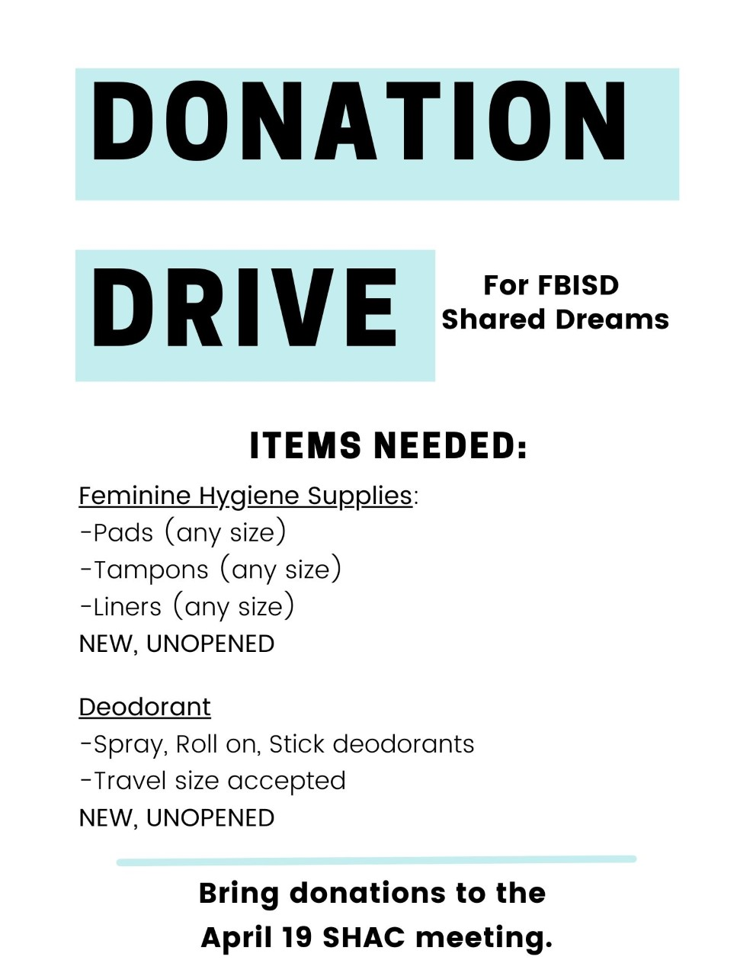
Donate to the FBISD Shared Dreams Feminine Hygiene Drive Today!

Slide 71
Blood Drive 4/20
There will be a
Blood Drive
on
April 20, 2023
at the
Fort Bend ISD Administration Building
16431 Lexington Blvd
Sugar Land TX, 77479
from
8 a.m. – 12 p.m.
To donate, go to the the link below
https://www.commitforlife.org/donor/schedules/drive_schedule/362255

Slide 73
FBISD Wellness Heroes
The SHAC WSCC Recognition Award was created to recognize campus groups, individual wellness champions and community partners who apply resources and knowledge to grow wellness on their campus, in the district, and in the community while further fostering the development of students to exemplify FBISD's Profile of a Graduate.
To nominate someone to be a Wellness Hero, click the link below and complete Google Form. Your favorite wellness champion could be one of FBISD’s Wellness Heroes.
2023 SHAC WSCC Recognition Form
Submissions are due by April 30th.

Slide 74
SHAC Shirts For Sale

Slide 75
DEA Drug Take Back Day
DEA Drug Take Back
April 22, 2023
10 am – 2 pm
Fort Bend ISD Administration Building
Parking Lot
16431 Lexington Blvd
Sugar Land, TX 77479

Slide 76
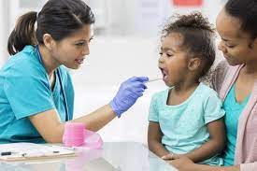
Nurse Appreciation Week
The School Health Services Department will be celebrating National Nurse Appreciation Week during our Monthly May meeting on May 9th.
The winners for the School Nurse of the Year will be announced during the meeting.
The department will appreciate any of the following:
Sponsors for Breakfast (Secondary RN) and Lunch (Elementary RNs and Secondary LVNs)
Gift Baskets: Self-Care Items, healthy snacks, etc.
Gift Cards: Coffee, scrubs, restaurants, etc.
Door Prizes: preferably items nurses can utilize in their clinics (Stethoscopes, coffee tumblers, first aid kits, etc.)
Please contact Maria Johnson (maria.johnson@fortbendisd.com), Sharyll Etuk (sharyll.etuk@fortbendisd.com) or Shumaila Ali (shumaila.ali@fortbendisd.com) if you would like to sponsor.

Slide 77
HB 3589
A bill was filed this session to move the school nutrition programs from the Texas Dept. of Agriculture (TDA) to the Texas Education Agency (TEA).
For more information on this bill, please visit:
https://capitol.texas.gov/tlodocs/88R/billtext/html/HB03589I.htm

Slide 78
Harvest of the Month

Slide 79
PET DAY at HIGHTOWER HS

Slide 80
Girls On the Run

Slide 81
Newest SHAC Members
Vanessa Gaona
Markita Harrell
Eugenia Peck
Ayesha Peck
Catalina Flores-Rau
A HUGE THANK YOU to our NEWEST members, and our continuing members! We need everyone’s help on our SHAC!

Slide 82
Advocacy Announcements

Slide 89
Subcommittees Convene
Health & PE
Nutrition
SEL
SHAC Action
Staff Wellness
Health & Safety
Advocacy
Everyone is encouraged to join one of these subcommittees

Slide 90
General SHAC Meeting
May 17, 2023
12 pm – 2 pm
Fort Bend ISD
Administration Building:
Board Room
16431 Lexington Blvd
Sugar Land, TX 77479
Join us for the last General SHAC meeting of this school year!
Upcoming SHAC Meeting

