Slide 1
FBISD Vaping Town Hall Meeting

Slide 2
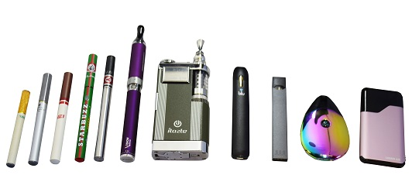
What is vaping?
Vaping is the act of inhaling and exhaling aerosol, often referred to as vapor, which is produced by an e-cigarette or similar device.

Slide 3
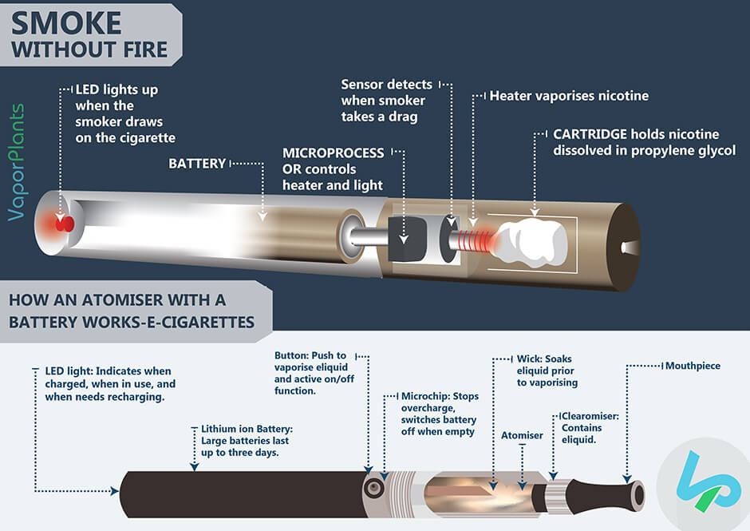
How does
a vape
or an
e-cigarette work?

Slide 4
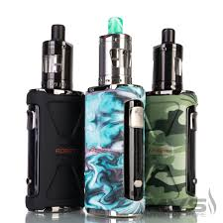
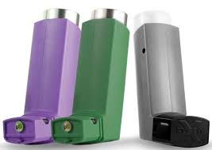
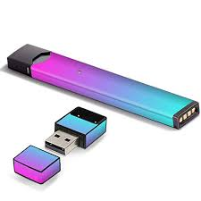
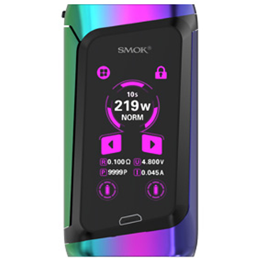
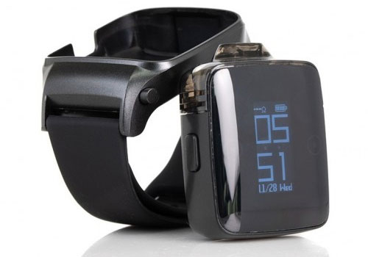
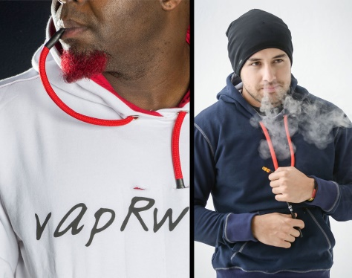
The New look of Nicotine addiction

Slide 5
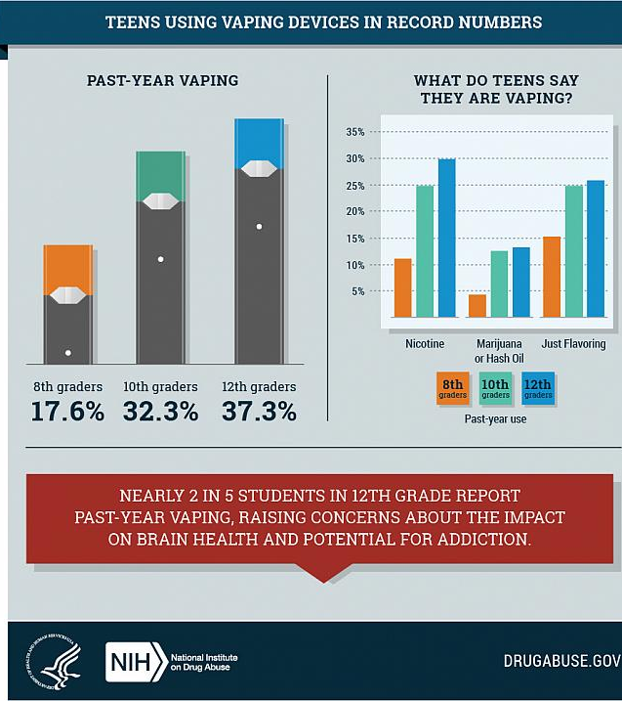
Vaping is on the rise and becoming an epidemic.

Slide 6
Nicotine is Nicotine.

Slide 7
One out of every 10 middle school students (10.5%) reported in 2019 that they used electronic cigarettes in the past 30 days
—an increase from 0.6% in 2011.
One out of every 4 high school students (27.5%) reported in 2019 that they used electronic cigarettes in the past 30 days
—an increase from 1.5% in 2011.
THC vaping among 12th graders increased from 9.5 percent in 2017 to 13.1 percent in 2018.
11.7% of high school seniors vape every day, suggesting that more users are becoming dependent on these products.
Statistics
Vaping has also significantly increased among eighth and 10th graders.
Males tend to vape more than females.
JUUL is the most common vape device used by teens.

Slide 8
As of now…
55 deaths related to vaping aged 17-75
2561 lung illnesses caused by vaping aged 13-75
The first death from a vaping-related illness was reported Aug. 23, 2019 in Illinois. At that time, federal and state officials were investigating almost 200 cases of the baffling sickness in 22 states, according to the CDC
As of Nov. 20, 2019, officials counted 2290 vaping related injuries
The Center for Disease Control (CDC) says nicotine dependence is the most common form of chemical dependence in the United States
Research shows that nicotine is just as addicting as Heroin

Slide 9
A special thanks to…
James Reese Career and Technical Center Health Science Practicum Students
James Reese Career and Technical Center Audio Video Production Students
James Reese Career and Technical Center Culinary Arts Students
Chefs Rich Popovic and Jennifer Cadengo
Mrs. Joey Dyrud-Lange
Ms. Kimberly Goodly
Mrs. Natalie Bostic, RN-JRCTC School Nurse
Fort Bend Community Prevention Coalition
UnitedHealthcare

Slide 10
And even more special thanks to…
Our Moderator:
Dr. Umair Shah, Harris County Public Health Executive Director
Our Panelists:
Sergeant Rafael Rincon, FBISD Police
Dr. Rizvan Quadri, FBISD Austin HS Principal
Steve Shiels, FBISD Director of Behavioral Health and Wellness
Mehul Mittal, FBISD Dulles HS Senior
Dr. Uzochukwu Odili, Apex Urgent Care Physician

Slide 12
Community partners working together for you and with you.
#PowerOfCommunity

