Slide 1
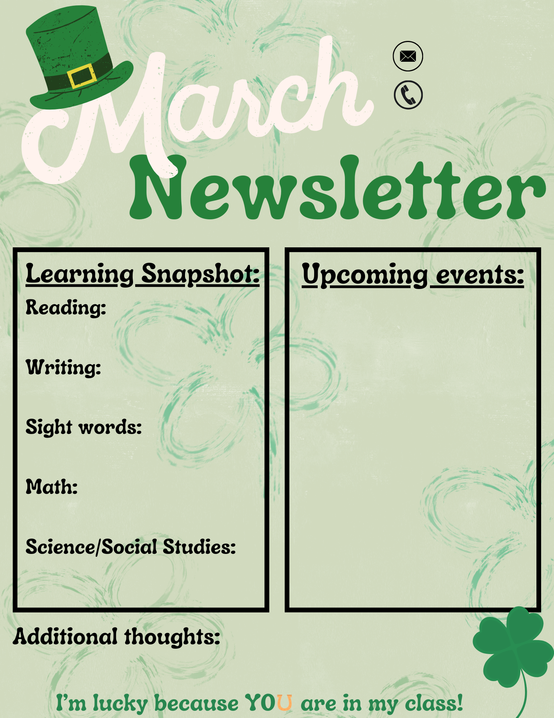
Mrs. Kirby
Kirby.jan@fortbendisd.gov
3/3/2025
3/3-3/7 Read across America week
3/7 Field Day
3/10-3/14 Spring Break
3/19 Boosterthon Kickoff
3/21 School Store
3/21 Family Game Night 6 pm-8pm
3/27 Boosterthon Run
Read across America Activities
Sentences
Telling time and graphing
State symbols.

