Slide 1


Elkins High School
Counselors & CCRA
SENIOR
MEETING
August 25- September 5

Slide 2

WHAT ARE YOUR POST-SECONDARY OPTIONS?
1
3
COLLEGE
TRADE SCHOOL
Two-year or four-year public/private institution
Institutions that provide specialized, hands-on training for specific careers
2
4
MILITARY
WORKFORCE
Speaking with a recruiter and taking the ASVAB will be a requirement for joining one of the branches. ASVAB will be offered once in the Fall and again in the Spring
For those interested in pursuing a career in a specific industry right out of high school
There is a place for everyone!

Slide 3

FREE & REDUCED LUNCH
-MORE THAN JUST A MEAL-
  Families can apply through the School Cafe App
  If you qualify for free/reduced lunch, your SAT, ACT, College Application fees, Art/Floral Design and NCAA fees will be waived. This can save hundreds!
  Email your counselor to request a fee waiver
  Remember... you can only have 2 SAT and ACT waivers total throughout high school

Slide 4

COLLEGE APPLICATION
PLATFORMS
  Common App (links with SchooLinks)
    commonapp.org
    20 Texas universities and more than 1000 others worldwide
  Apply Texas
    applytexas.org
    All Texas public and most Texas private colleges and universities
  Coalition Application
    coalitionforcollegeaccess.org
    Six Texas universities and more than 175 others nationally
  Common Black College Application
    commonblackcollegeapp.com
    More than 50 HBCUs on one application
  College- and University-specific websites
    Many schools have their own application process

Slide 5

FERPA WAIVER
What is the FERPA Waiver?
  Since FERPA is a complex law, we want to provide some key information before you respond to the FERPA waiver question.
  How does FERPA relate your college application? FERPA regulates the privacy of student education records, which could include your application to the college where you enroll. FERPA also gives you the right to review confidential letters of recommendation provided as part of that application after you enroll
  In the application, you’ll be asked if you want to waive the right to review confidential letters of recommendation, What should you know about this waiver? Waiving your right lets colleges know that you do not intend to read your recommendations, which helps reassure colleges that the letters are candid and truthful. Some recommenders may decline to write a letter for you if you do not waiver your rights. Check with your counselor or teachers to see if any of them follow such a policy

Slide 6
FERPA WAIVER
What is the FERPA Waiver?
  Students must complete the FERPA question on SchooLinks
  Counselors CANNOT complete any documents if this is not completed, which will hold up your application!

Slide 7

HOW MANY COLLEGES SHOULD I APPLY TO?
  At least 2 Safe schools- those that you meet all requirements and are almost certain that you will be accepted into
  At least 3 Target schools- those that your academic profile is competitive with that of admitted students
  At least 2 Reach/Dream schools- Those that are a stretch for you, Your grades, test scores and overall profile is lower than what the school lists as its student profile
Apply to schools that train you for your future career, not based upon the name of the school

Slide 8
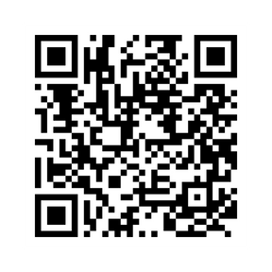
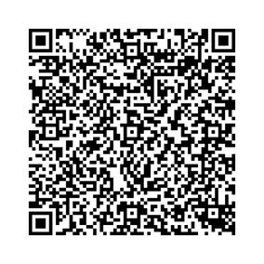
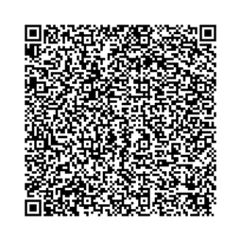
COLLEGE SEARCH RESOURCES
  College Board Big Future
  My Texas Future
  Overgrad

Slide 9



Which college admission process best suits you?
NON-RESTRICTIVE PLANS
NON-RESTRICTIVE PLANS
Regular Decision
Students submit an application by a specified date and receive a decision in a clearly stated period of time
Rolling Admission
Institutions reviews applications as they are submitted, and render admission decisions throughout the admission cycle until spots are filled
Early Action
Students apply early and receive a decision well in advance of the institution’s regular response date
Priority
This is the Early Action/Scholarship Deadline for in-state colleges & universities

Slide 10

Which college admission process best suits you?
RESTRICTIVE PLANS
NON-RESTRICTIVE PLANS
Early Decision
Students make a commitment to a first-choice institution where, if admitted, they must enroll. The application deadline and decision deadlines occur early. Commitment is BINDING.
Restrictive Early Action
Students apply to an institution of preference and receive a decision early. They may be restricted from applying Early Decision, Early Action, or Restrictive Early Action to other institutions. If offered enrollment, students have until May 1 to confirm

Slide 11

General College Application Deadlines
Application Type | Application Deadline
Early Action | October/November
Early Decision | October/November
Restrictive Early Action | October/November
Regular Decision | January/February
Rolling Admission | Varies

Slide 12
BLACKOUT DATES
1
3
OCTOBER 13-17
NOVEMBER 24-28
**There’s usually a big deadline on October 15th. Please be aware of this and submit ahead of time. No documents will be sent during this time
Thanksgiving Break-- No documents will be sent during this time
2
4
DECEMBER 22-JANUARY 2
MARCH 16-20
Christmas Break- No documents will be sent during this time
Spring Break-- No documents will be sent during this time

Slide 13

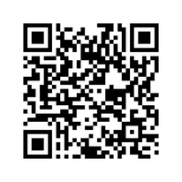
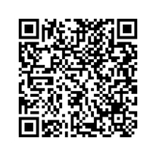
Should I take the SAT or ACT?
  We recommend that students take BOTH exams. Do not cram or rush, but prepare ahead of time.
  Free SAT Prep: Free ACT Prep:
  We recommend that students do not select the colleges that they want their scores sent to when registering for the tests. Instead, wait for your test scores and then select which school you want to send them to
  Students also have the choice to NOT send their scores, if a college they are applying to is test optional. It is the student’s responsibility to look at the college’s website to find our if a school is test optional.
  If your school is test optional and your test scores meet or are above the college’s average test scores- send your score!
  Many scholarships will ask for SAT/ACT scores
  Be sure to apply for accommodation if you get them in the classroom

Slide 14


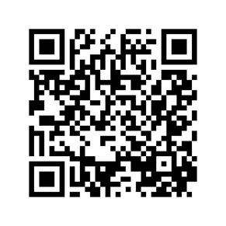
TEXAS COLLEGE BRIDGE
  Helping students prepare for college level coursework in Math and English
  A personalized, self-paced online program for non-college-ready students
  Courses must be completed by the end of the semester
Partnering Schools

Slide 15
TSIA
  What is the TSIA? It is a college readiness test that is required if the SAT or ACT do not meet the required score
  How do I know if I need to take the TSIA? If your SAT scores are at least 480 verbal and 530 math or your ACT scores are a 22 in math and a combined ELAR score of 40, then you are exempt! You can also have earned a C or higher in an English and Math Dual Credit course to be exempt
  What if I don’t take it? Colleges will require you to take a summer College Prep English or Math course for no credit. You cannot enroll in credit bearing courses until you pass the course or the TSIA
  Where do I take the TSIA? We offer it on campus- more information to follow

Slide 16
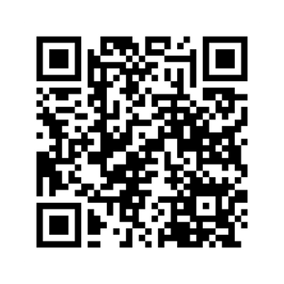
SCHOOLINKS
  College apps must be added to SchooLinks in order to request transcripts, rec letters and fee waivers
  Counselors complete and submit required documents through SchooLinks only AFTER the school, application AND application deadline has been added by the student
  Adding a college application to SchooLinks will automatically trigger a transcript request- no additional emails are necessary to request for a transcript to be sent
Adding Colleges and Requesting Transcripts Tutorial

Slide 17
Transcript Requests
  Many colleges will allow you to request additional documents from your student portal once you submit your applications
  The only way to have an official transcript sent is by adding the college to SchooLinks as seen in the tutorial video
  An “official transcript” means that it never goes to a student/parent. An official transcript is sent after the request from institution to institution
Online Registration
Interview
Announcement
Re-registration
Scholarship Handover

Slide 18
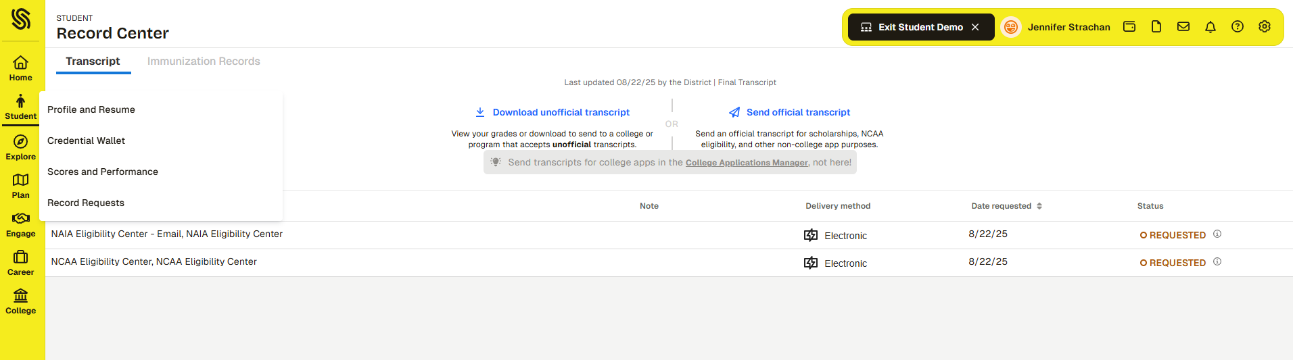
Transcripts for NCAA Clearinghouse & Scholarships
Re-registration
Scholarship Handover

Slide 19

RANK QUESTION
  When you are completing your information in SchooLinks, you will see a question asking if you would like to share your rank with your colleges, as it is no longer on the transcript- only GPA appears, not rank
  If you opt to send your rank, it will be sent to all colleges. There is no option to select individual schools
  Some colleges may ask you to submit your rank if you opt to share your rank. All students have a rank letter in their Skyward Portfolio tab in attachments. There will be the option to request this from your student portal once the application has been submitted. Some colleges will allow students to upload it themselves into their portals--- JUNE or SEPTEMBER RANK?
  If you do not wish to share rank, then no further action is needed. If you need assistance with deciding to share rank or not, please reach out to your counselor for advisement

Slide 20
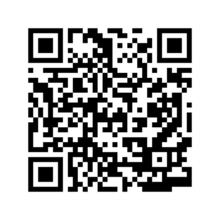
Requesting Letters of Recommendation
  Please allow teachers and counselors at least 2 weeks from your deadline to write your letter. We may have over 30 letters to write and want to do the best letters possible for our students
  Email your counselor and teacher your brag sheet- check list on next slide
  If schools do not want rec letters, do not submit them as they go into a junk file
Online Registration
Interview
Announcement
Re-registration
Scholarship Handover

Slide 21
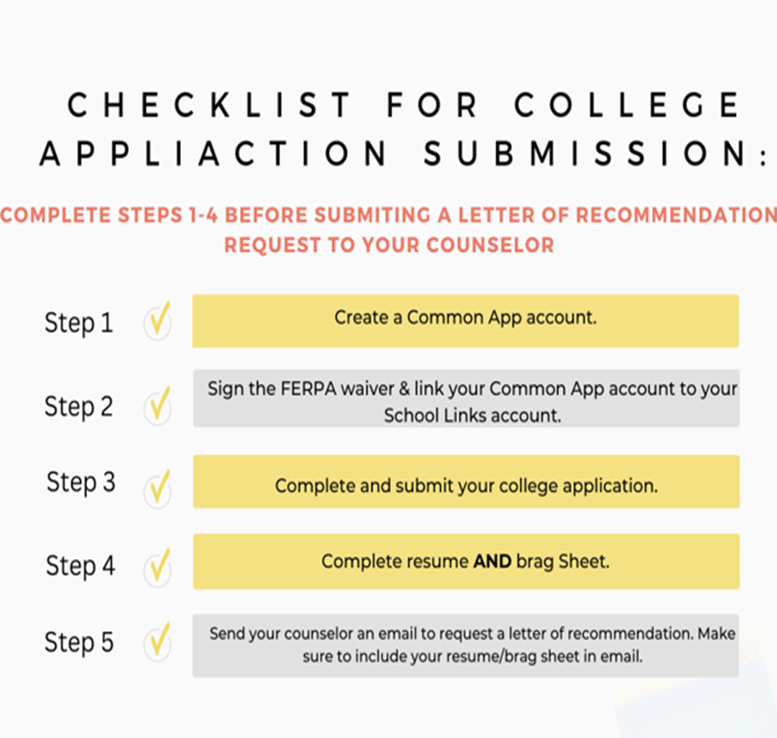
REC LETTER CHECKLIST

Slide 22

NCAA Clearinghouse
  Student Athletes being recruited to play Division I or Division II sports must register with the Clearinghouse and send their transcript: https://web3.ncaa.org/ecwr3/
    Things to remember:
      Check your account to see updates and tasks
      Be sure to add Elkins HS so we can upload your transcript
      Fee waivers are available for those students that qualify
Online Registration
Interview
Announcement
Re-registration
Scholarship Handover

Slide 23
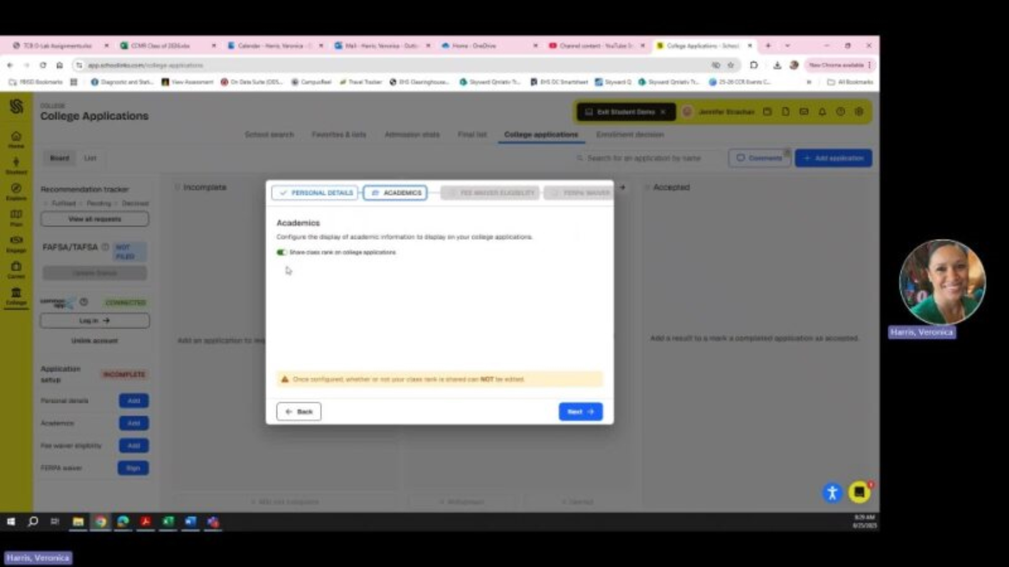
SchooLinks Setup
Adding a school in the College Application Manager automatically generates a transcript request

Slide 24
CCRA
  Scholarships
  FAFSA
  College Advising
  SchooLinks Assistance
  TSIA Testing in the Spring
  ASVAB Testing– November 12
  Everything college, career and military

Slide 25

988 CRISIS
LINE

