Slide 1

Today’s Goals
Success Criteria: Students will learn the Bobcat Way and ensure they are successful citizens at First Colony Middle School
Learning Intentions:
  I will be able to understand the meaning of “The Bobcat Way”
  I will understand what it means to stay safe on campus
  I will understand attendance protocols on campus
  I will understand before, during, and after school procedures
  I will know how to use my technology responsibly
  I will know how to dress appropriately for school

Slide 2
First Colony Middle School
REINVESTMENT PRESENTATION Spring 2025

Slide 3
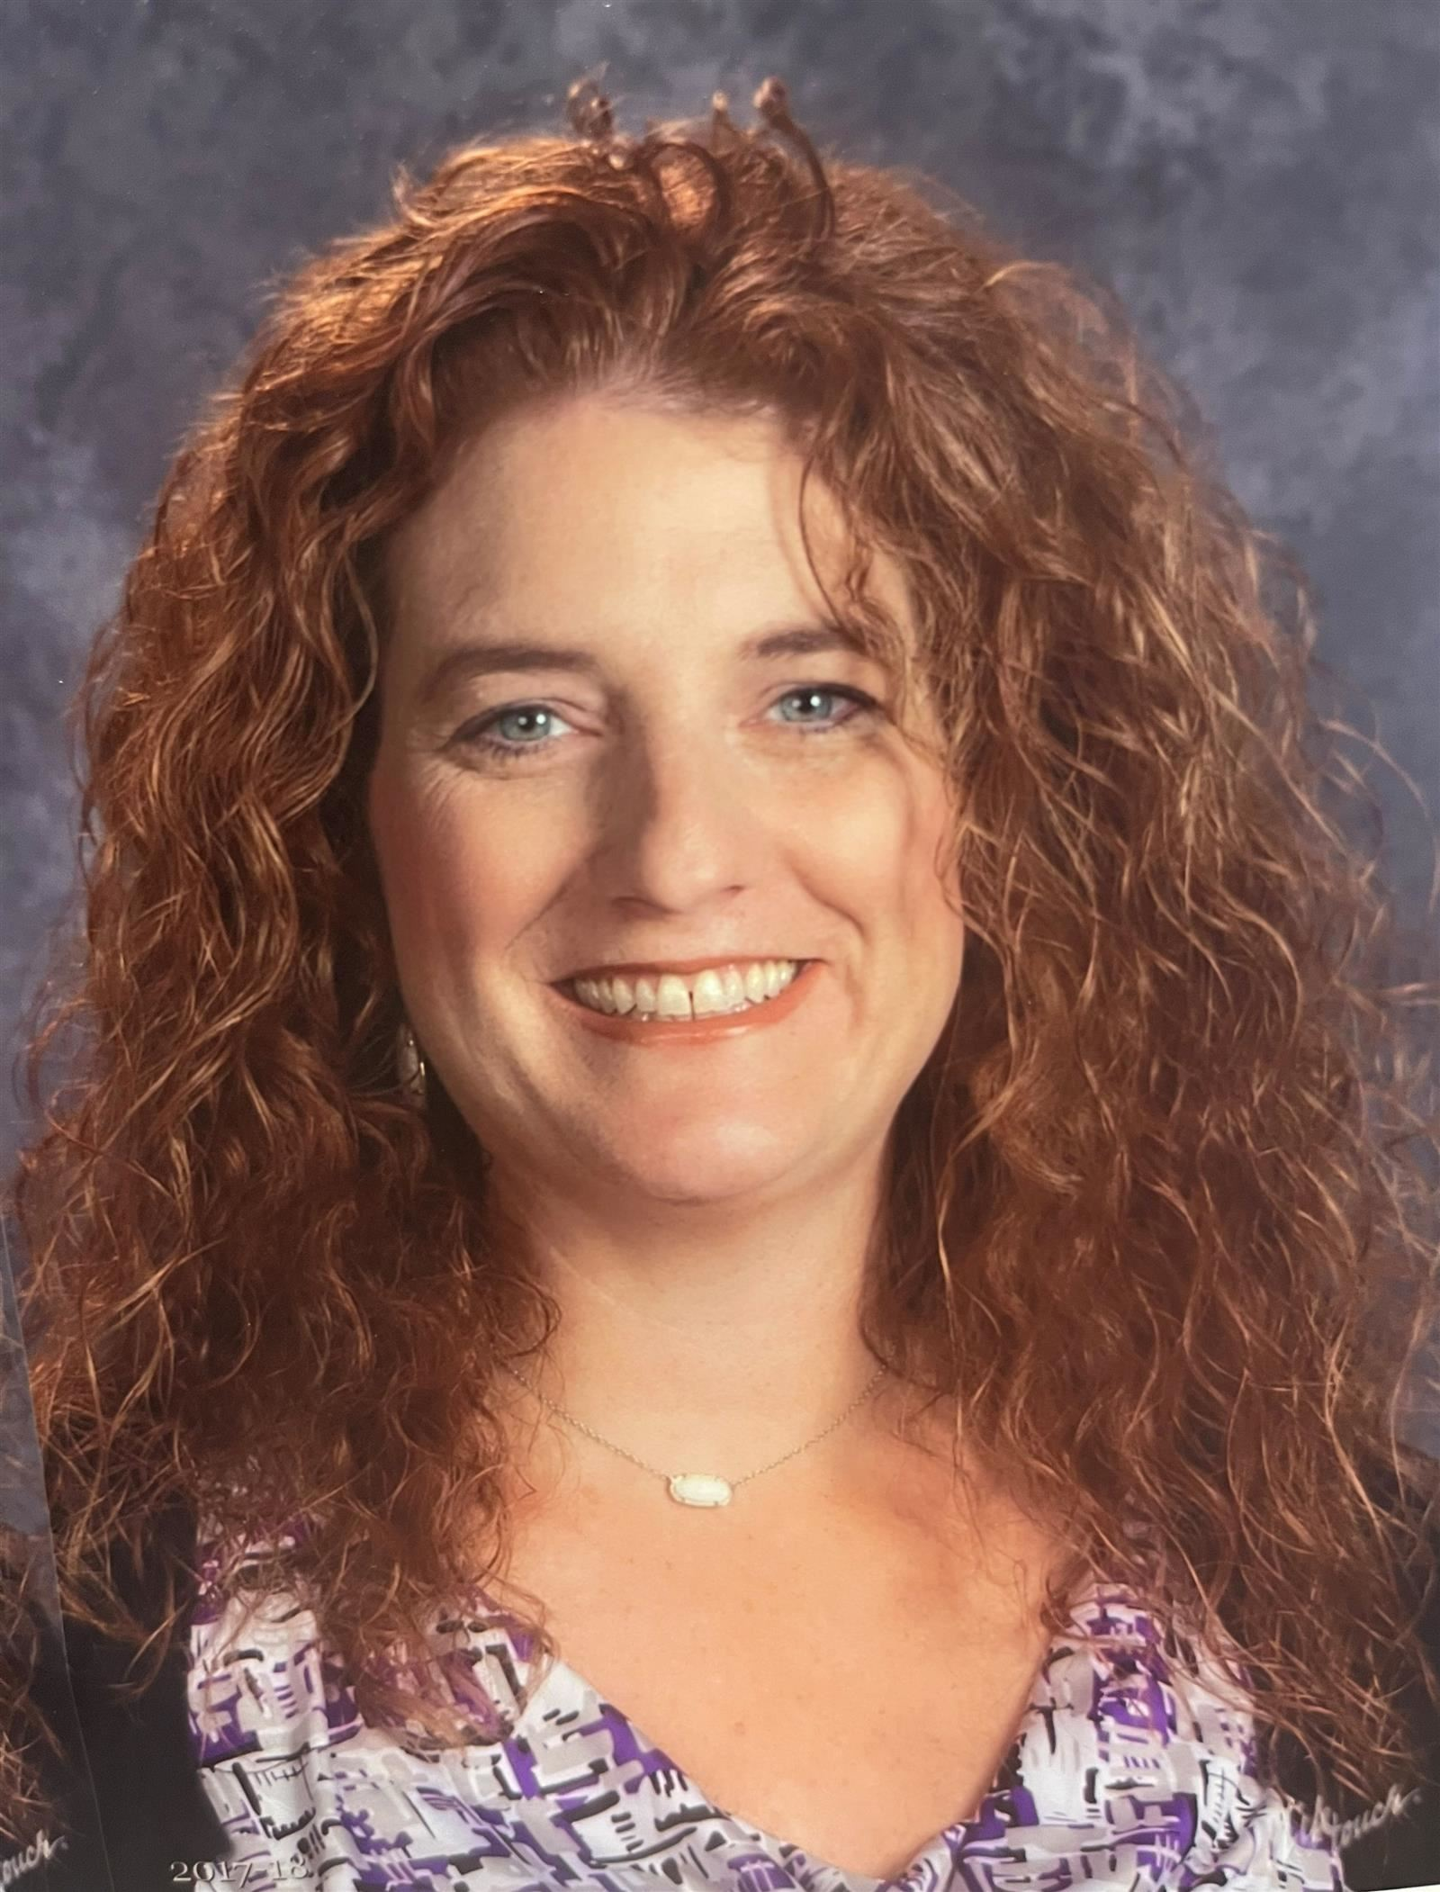
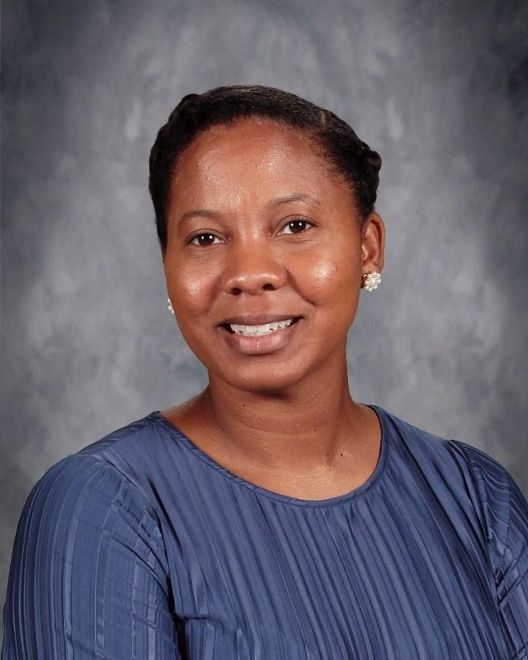
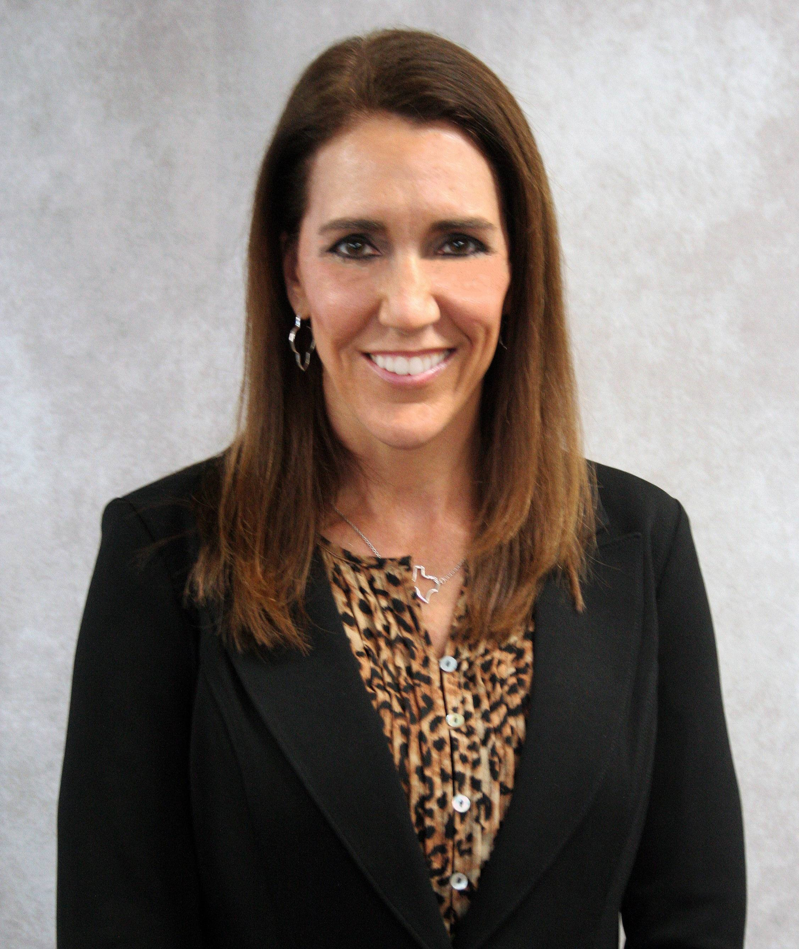
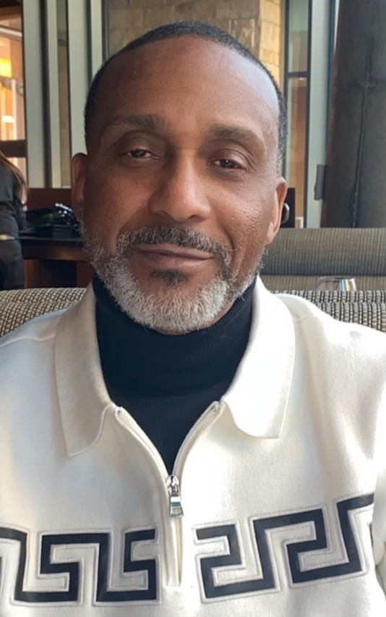
People You Need to Know
Ms. Petru
Ms. Richmond
Mrs. Lucas
Mr. Goodwin
Principal
8th Grade Associate Principal
7th Grade Assistant Principal
6th Grade Assistant Principal

Slide 4
Tardies and Hall Passes
Students who are late to class (after the bell rings) will receive a tardy. After 3 tardies, you will get a referral and have a consequence. Consistent tardies or misuse of restroom privileges may result in loss of hallway privileges
Students must follow the 10/10 rule: You cannot leave class the first or last ten minutes.
Tardy Sweeps occur frequently. Tardy sweeps are when randomly selected periods are checked for tardy students. If you are caught in one of these “sweeps” you will have to serve a PM detention.
If you are out in the hallway not during a passing period, you MUST have a hall pass.
  Different areas of the building are designated to different zones for the restroom. You need to stick with your area.

Slide 5
In the Hallways… The Bobcat Way
Be Respectful
Others’ space respected
Be on time to class
Conversation level 1 and school appropriate
Always walk on right side of hall
Tech not allowed between 8:50 – 4:10

Slide 6
Hallway Expectations
Be courteous of where you are going. Say excuse me. Always walk to the right side of the hallway.
Do not stop and group up in the middle of the hallways. You block the flow of traffic.
Do not run in the hallways. Horseplay (play fighting, dunking, etc.) are unacceptable. We walk at all times.
Personal displays of affection are not allowed on campus.

Slide 7
Before School Procedures
The building will open at 8:20 AM. 1st period starts at 8:50am.
Report to your grade level areas, have breakfast in the commons, or go for tutorials. You must stay in your holding area (you must stay with your tutorial teacher until 8:45am)
Technology is OKAY (no camera usage, school appropriate content, one earbud in at a time etc.)

Slide 8
Before School Procedures
If you eat breakfast, you must sit at one of the designated breakfast tables.
You may only sit at the breakfast tables if you PURCHASE breakfast from FCMS. Breakfast from home should be eaten at home.
You have 5 minutes once you sit down with your breakfast to finish.
Report immediately to your assigned holding area (6th & 7th grade to gym, 8th grade to other tables in Commons)

Slide 9
Turn and Talk with a Partner
What is new about the before school procedures?
Can you sit at the breakfast tables if you bring breakfast from home?

Slide 10
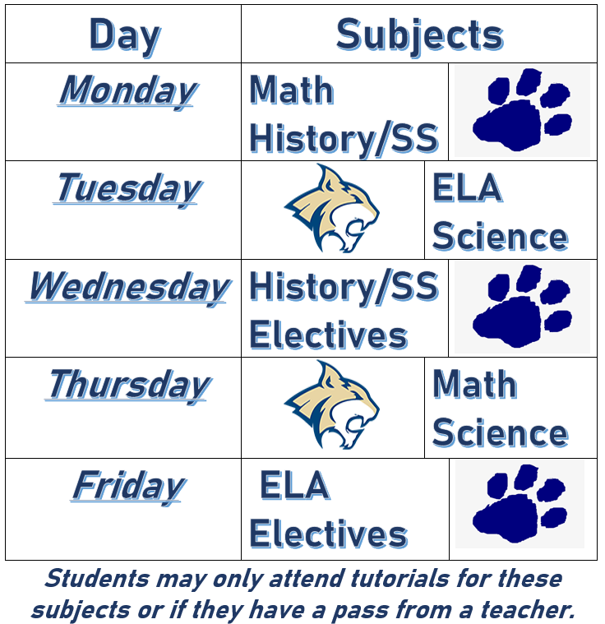

Tutorials
Once you’re in tutorials, you MUST stay in that teacher’s room until dismissal.

Slide 11
Morning Tutorials
You must report to tutorials on-time in order to get a tutorials pass to be upstairs.
You MUST have a pass from the teacher on duty by the Commons stairs in order to go to ANY tutorial including science and electives that are downstairs.
No Pass=No Tutorial
If you are caught in the hallway without a tutorials pass before school, you will receive a consequence.

Slide 12
Turn and Talk with a Partner
Who has to have a pass in order to go to any tutorial whether upstairs or downstairs?
Where do you get a tutorials pass?

Slide 13
Lunch Procedures
Enter the commons and get seated quickly. You may not save seats for anyone.
Wait until your table is released to the lunch line.
  If you need to use the microwave, go after your table is called.
  You may only go through one line. Make sure you have money with you or in your account.
  If one line is too long, it may be closed. In that case, you need to make a different selection.

Slide 14
Lunch Procedures
Do not share food
You have about 30 minutes for lunch. We want you to visit and enjoy your friends, but you also need to eat in a timely manner.
Wait until your table is called for dismissal. At that time, clean up all trash and put it in the garbage can. Be sure to walk all the way around the three pillars.
Restrooms are closed during dismissal.
Do not take any food or drinks out of the commons.

Slide 15
Lunch Procedures
On tech days, you are only allowed to use your District issued laptop.
You must be on school-appropriate material, including games.
Games that feature weapons, violence, etc. are not school-appropriate.

Slide 16
Turn and Talk with a Partner
What kinds of websites/games are you allowed to be on during Lunch Tech Days?

Slide 17
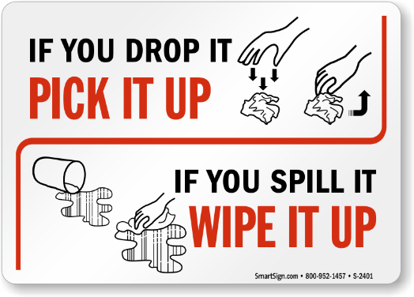
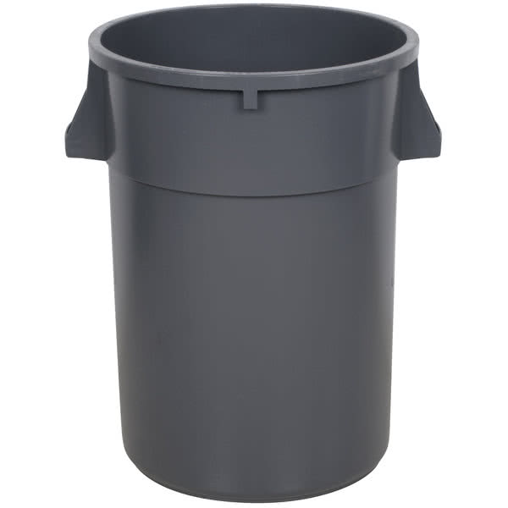

Cafeteria Expectations
Raise your hand if you need assistance, restroom, etc.
Keep your area clean by disposing of trash properly. You will wait until an adult comes to dismiss your table to throw trash away
Do not take any food or drink items out of the cafeteria (only water may leave if in containers that can be closed/sealed.

Slide 18
After School Procedures
When the dismissal bell rings, bus riders report to the bus ramp and board your bus as soon as possible. You need to check the board for the location of your bus.
Car riders exit through the doors closest to their ride. The front door is your best option.
Walkers and bike riders exit through bus ramp doors. You MUST be off campus by 4:20pm or their will be discipline consequences.
Bus Riders have 5-7 minutes to load the buses
No loitering (hanging out) after school is dismissed MUST go directly home.
You must head directly to your after school club/organization and will not be allowed reentry into to building. You have 5 minutes to get to your extra curricular activity.

Slide 19
Turn and Talk with a Partner
If you are a biker/walker, what is new about the after school procedures?

Slide 20
Digital Citizenship
Students are expected to follow all the guidelines in the digital citizenship policy.
Students are expected to know that technology use is not private and is monitored frequently by the district, this includes your Outlook email usage
Violation of computer use policy will result in disciplinary action, loss of access, and responsibility for costs associated with repair/replacement.
Remember that anything you post on social media could become a problem at school if it disrupts our educational environment.

Slide 21
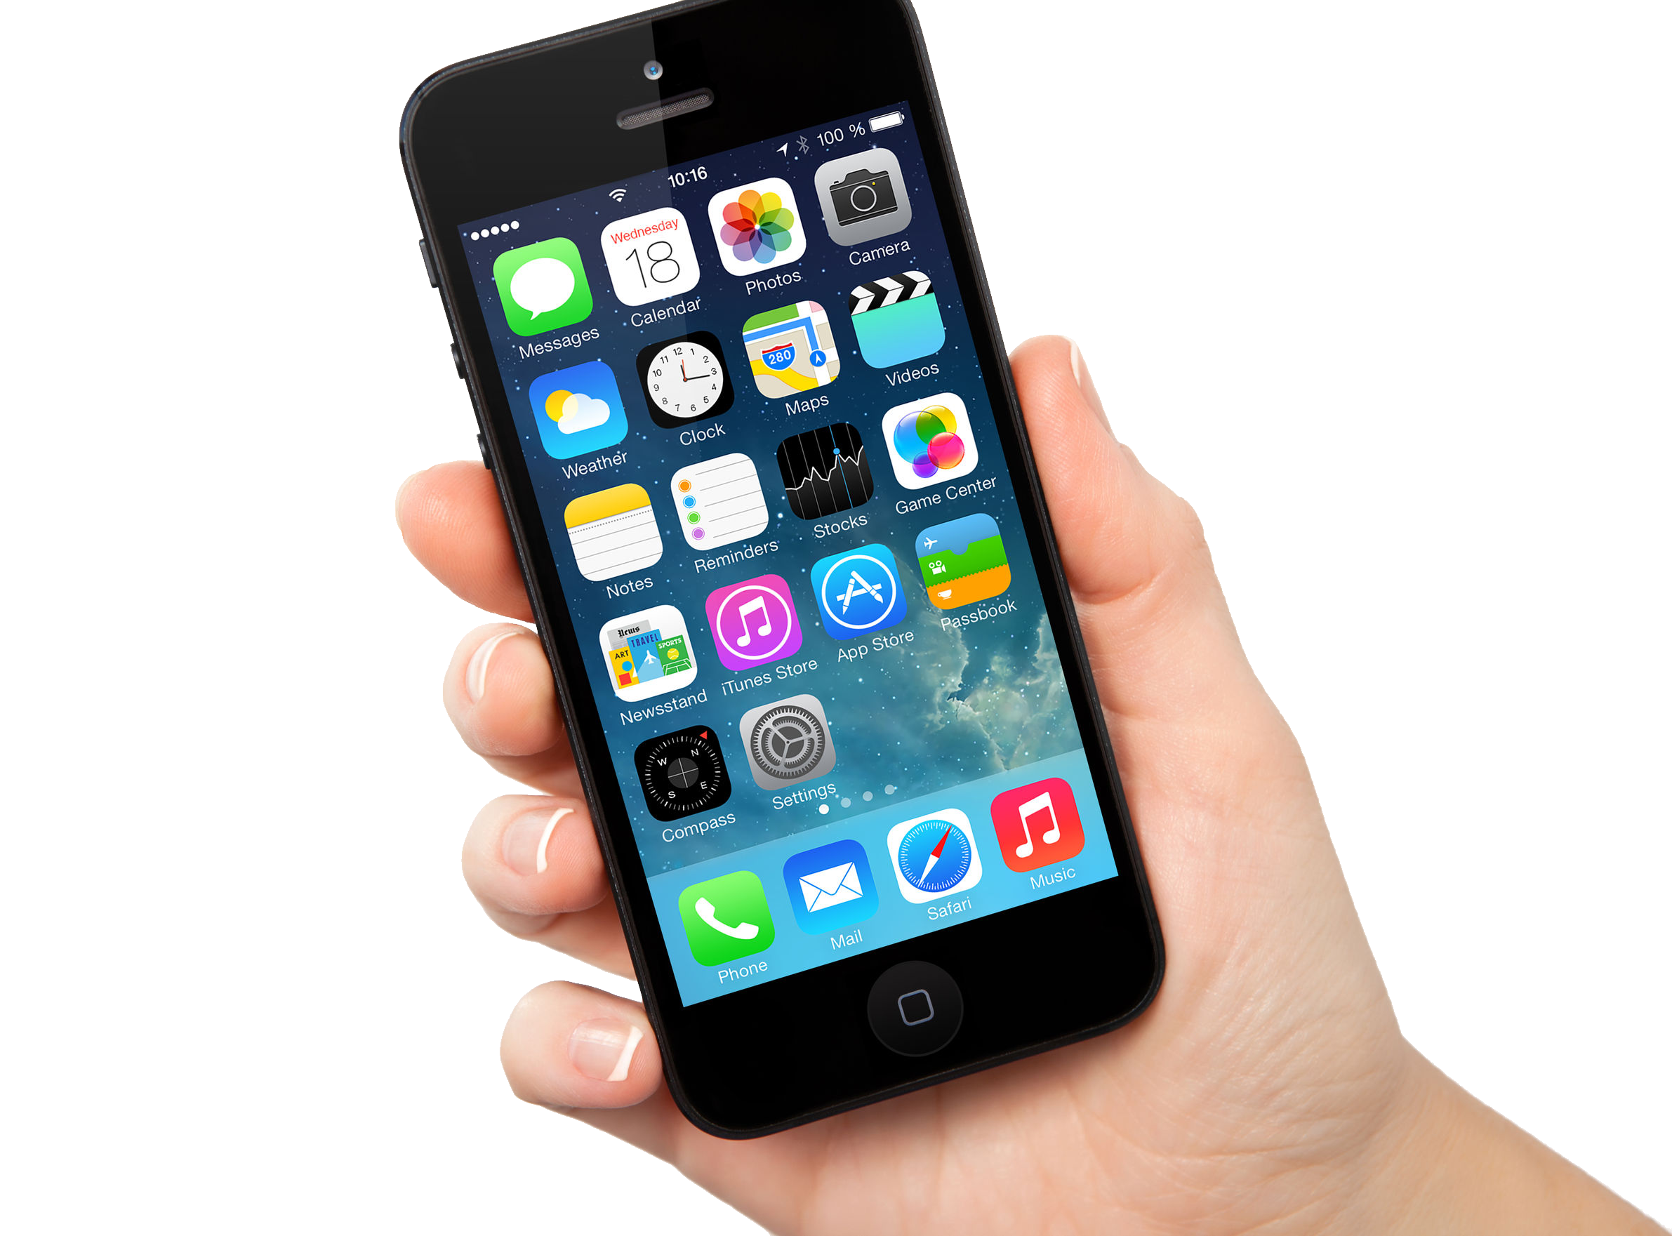
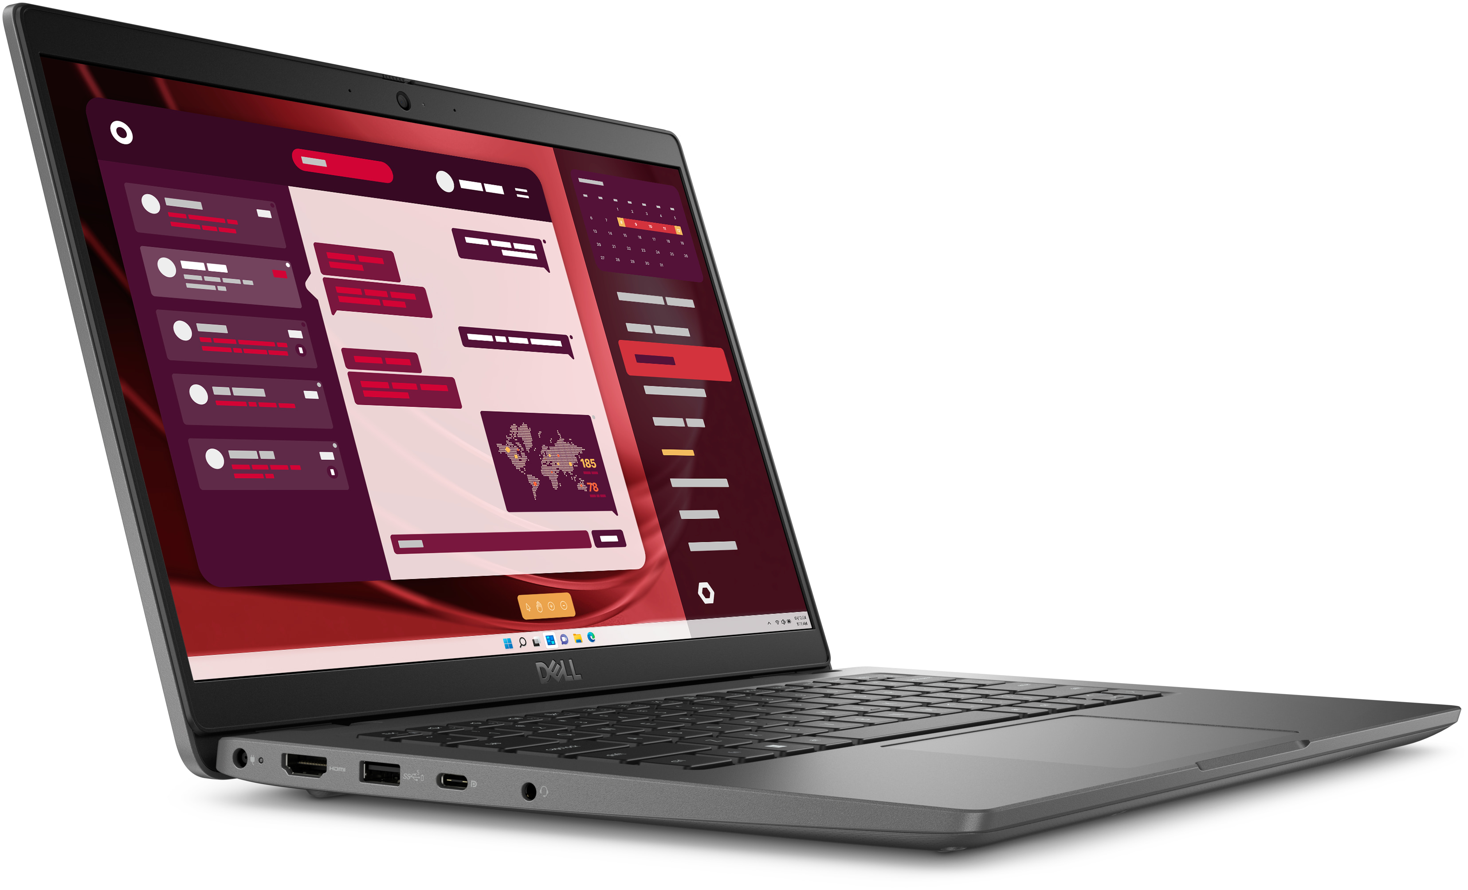
Technology Use for the School Year
Upon arrival, students will be allowed to use their cell phones until being dismissed from their grade level areas in the morning.
Cell phones, and headphones/earbuds will be put in locker before first period and remain there until 4:10 dismissal.
Smart watch devices will be prohibited in testing environments.
Students should not have their phones or headphones on them at any time during the school day, from 8:50 – 4:10.
Students need to bring their laptop and charger to class DAILY. Students can only use the district provided laptop in class.

Slide 22
We are not responsible…
We are not responsible for lost or stolen items. PLEASE do not leave your belongings outside in the hallway or out of your locker!!
You must also lock up your bicycles.

Slide 23
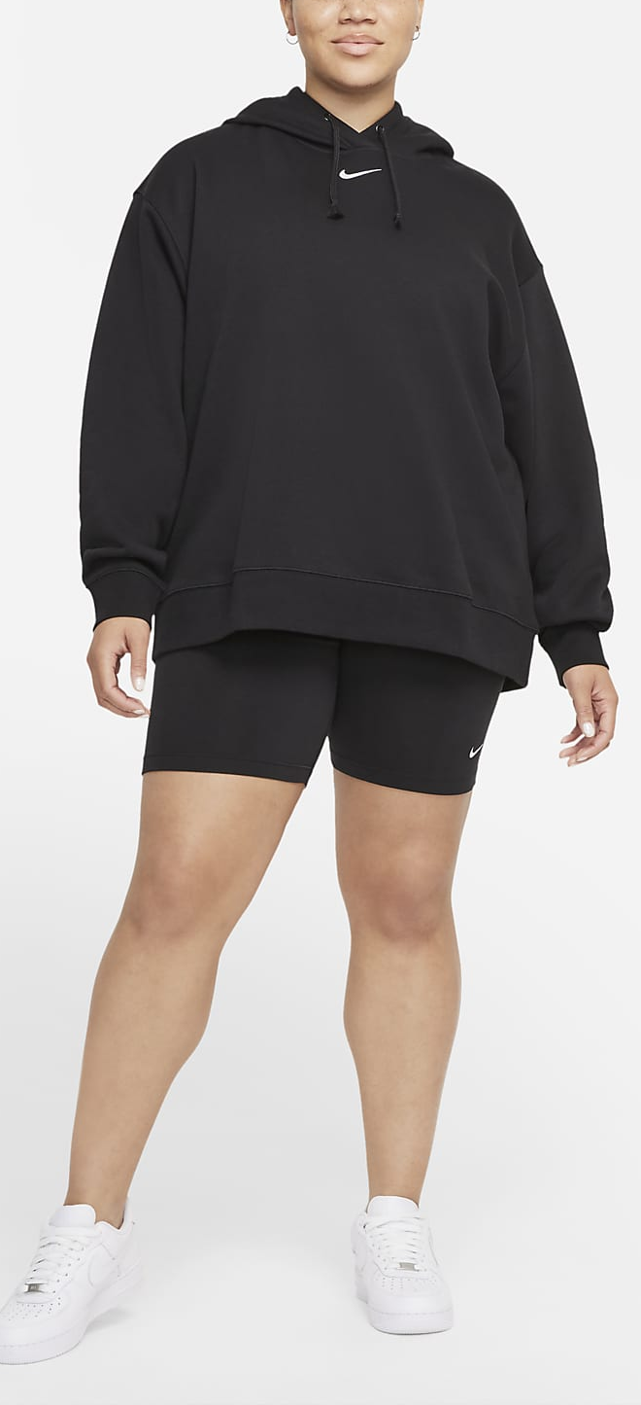
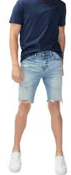
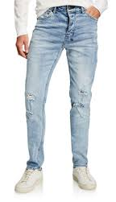
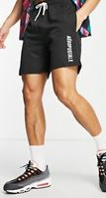
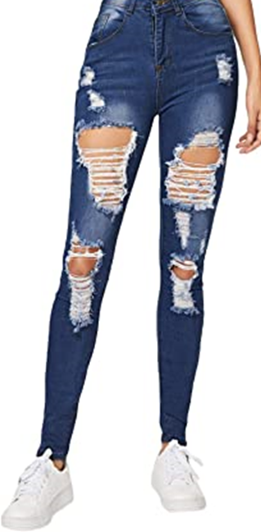
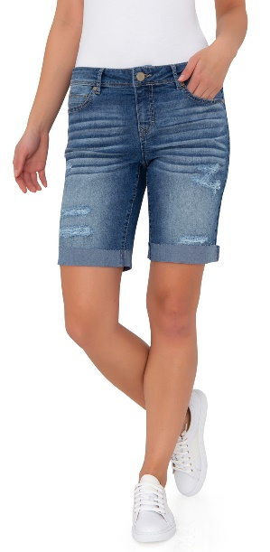
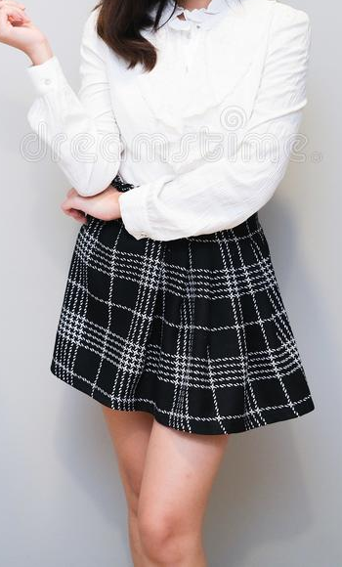
Dress Code
Pants/jeans/shorts must be worn at the hip and must cover undergarments.
Shorts & skirts must be at midthigh.
Pants that are torn or have holes in them must not have any undergarments showing

Slide 24






Dress Code
Shirts must touch belt line, with no revealing undergarments or midriff, while sitting or standing, all the way around
Shirts may not have words/images relating to alcohol, tobacco, weapons, drugs or anything profane, violent, offensive or insults to others.

Slide 25


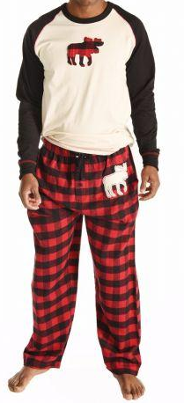
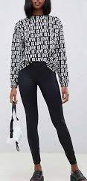
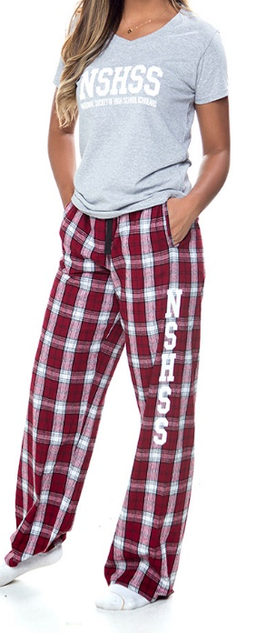
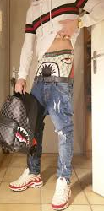
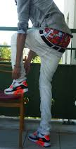
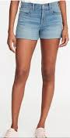
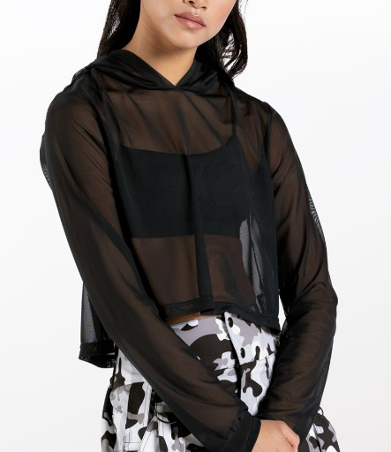
Dress Code
No pajama wear, unless it is a designated spirit day
No tights/leggings unless accompanied with a shirt that covers the posterior
Revealing clothing of any type is prohibited
No see-through material
Oversized pants/shorts that sag and worn below the waist are inappropriate. Pants/jeans/shorts must be worn at the hip and must cover undergarments

Slide 26
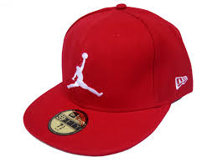
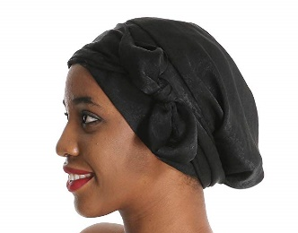
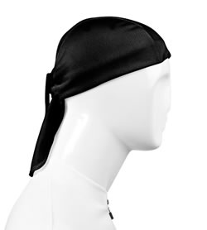

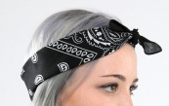
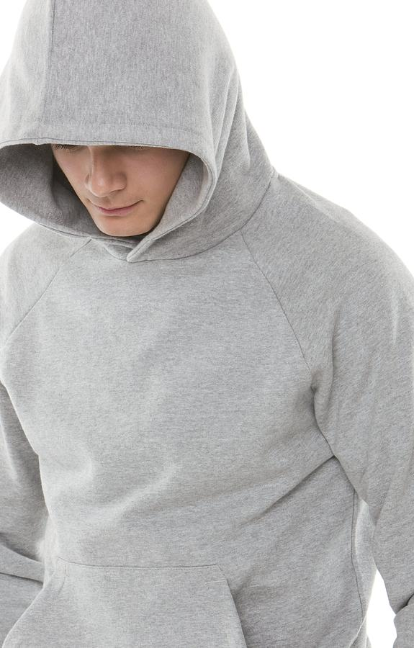
Dress Code
Attire that is distracting or causes a disturbance or identifies a student as part of an unauthorized group is prohibited (bandanas, shoelaces, chains, t-shirts, etc.)
No hats/caps/doo-rags/wave caps/bandanas/ hoods/bonnets worn inside the building.
A hat MAY be worn on a designated spirit day or as a purchased PBIS Reward

Slide 27

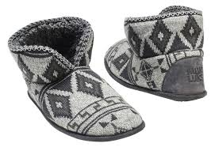
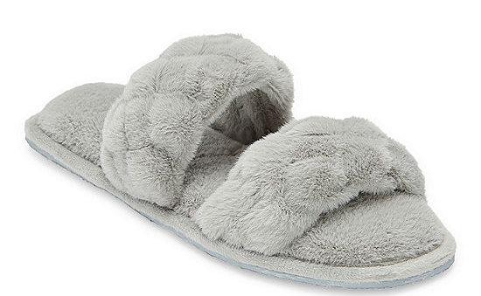
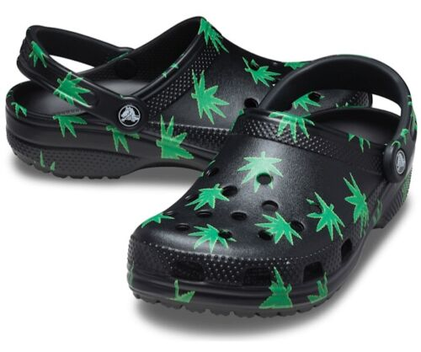
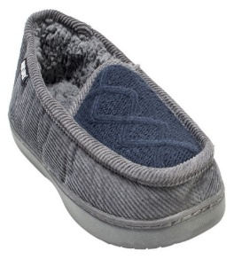
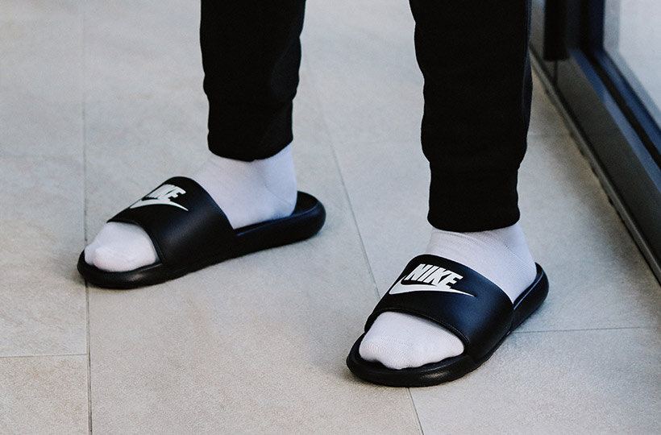
Dress Code
Appropriate shoes must be worn for student safety.
House shoes and slippers are not allowed.

Slide 28
Student ID Expectations
IDs must be worn on campus at all times (before/after school activities as well), with the exception of PE.
Damaging IDs will result in a $5 fee and referral. Damaging your ID includes drawing on it, breaking it, putting stickers on it, etc.
Students shouldn’t swap IDs with any other students. Doing so is not following our safety protocol on campus.
If you forgot your ID for the day, you need to get a temporary one. You get 3 warnings before you have to pay a fee and receive a referral.

Slide 29

Security
Officer Hoang is our campus police officer.
His office is located in the hallway behind the AP office (back science hallway)
You are responsible for your own belongings. Please do not leave your stuff lying around.
Security cameras are in place for your safety and the school’s safety.

Slide 30

Being a Bobcat
You are expected to follow the FBISD Student Code of Conduct at all times.
Demonstrate courtesy and respect to all students, staff, teachers, and other volunteers.
Get to class on time and be prepared with appropriate materials.
We expect your behavior at school activities to be the same behavior we expect at school. This includes athletic events and other extra curricular events.

Slide 31
Turn and Talk with a Partner
Why do you believe that following school expectations/rules is important?

Slide 32

Make it a Great Day Bobcats!

