Slide 1
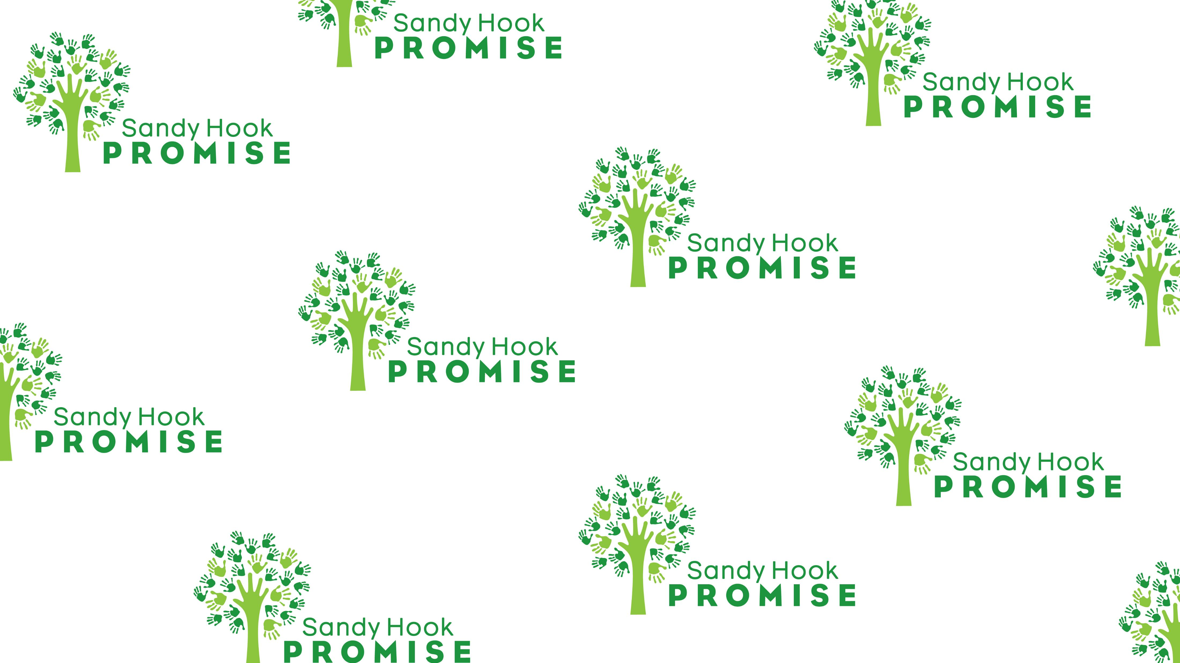
Switch to the Accessible Version of Box ›
Start With Hello_Grades 6-12_Updated 2020.pptx
Sign up
Log in
1
Start With Hello
Sponsored by: Sandy Hook Promise

Slide 2

Reach out to your friends and to classmates EVERYDAY to make them feel valued, respected and accepted.
Notes:
While Start with Hello is certainly about reaching out and helping friends and classmates
who may be lonely or socially isolated, it is also just as much about reaching out to
your friends and to classmates EVERYDAY to make them feel
valued, respected and accepted.

Slide 3
Review: Why is Start With Hello important?
Loneliness and social isolation are all to common for students
70% of adolescents experience loneliness.
When we feel lonely or socially isolated, we need positive relationships in our life...just like we need to eat when we are hungry; or need to drink when we are thirsty.
Notes:
Let’s review a few things from yesterday. Why is Start With Hello important?
Loneliness and social isolation are all to common for students
70% of adolescents experience loneliness.
When we feel lonely or socially isolated, we need positive relationships in our life...
just like we need to eat when we are hungry; or need to drink when we are thirsty.

Slide 4
REMEMBER OUR GOALS THIS WEEK:
*To understand the concepts of loneliness and social isolation.
*To learn the tools that will help you create a socially inclusive school community that combats loneliness and social isolation.
A socially inclusive community is where all students feel valued, respected and accepted.
Notes:
REMEMBER OUR GOALS THIS WEEK:
*To understand the concepts of loneliness and social isolation.
*To learn the tools that will help you create a socially inclusive school community
that combats loneliness and social isolation.
A socially inclusive community is where all students feel valued,
respected and accepted.

Slide 5
Reach out: BE BRAVE
You have to be BRAVE to reach out and do something.
We often think about helping someone…but it takes bravery to actually help.
We have to have self-awareness and social awareness!
Notes:
I’m going to review some of the signs to be aware of when your friends and
classmates may be lonely or socially isolated.
These include:
Spending long periods of time alone
Not having friends; and
Frequently avoiding social situations
You have to be BRAVE to reach out and do something.
We often think about helping someone…but it takes bravery to actually help.

Slide 6

Reach out: BE BRAVE
Brave is defined as: “To have or show physical, emotional or moral strength in the face of difficulty, danger or fear.”
When you’re brave, you do something that is hard for you.
A brave space is one in which we take risks, doing so with care and compassion.
This Photo by Unknown Author is licensed under CC BY-NC
Notes:
Brave is defined as: “To have or show physical, emotional or moral
strength in the face of difficulty, danger or fear.”
When you’re brave, you do something that is hard for you.
A brave space is one in which we take risks, doing so with care and compassion.

Slide 7
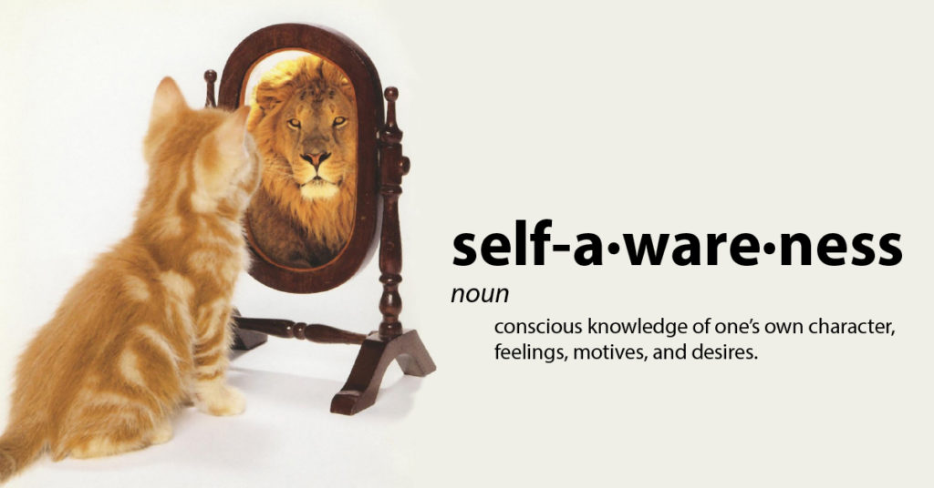
DEFINE- Self-awareness:
The ability to accurately recognize one’s own emotions, thoughts, and values and how they influence behavior.
Notes:
DEFINE- Self-awareness:
The ability to accurately recognize one’s own emotions, thoughts,
and values and how they influence behavior.

Slide 8
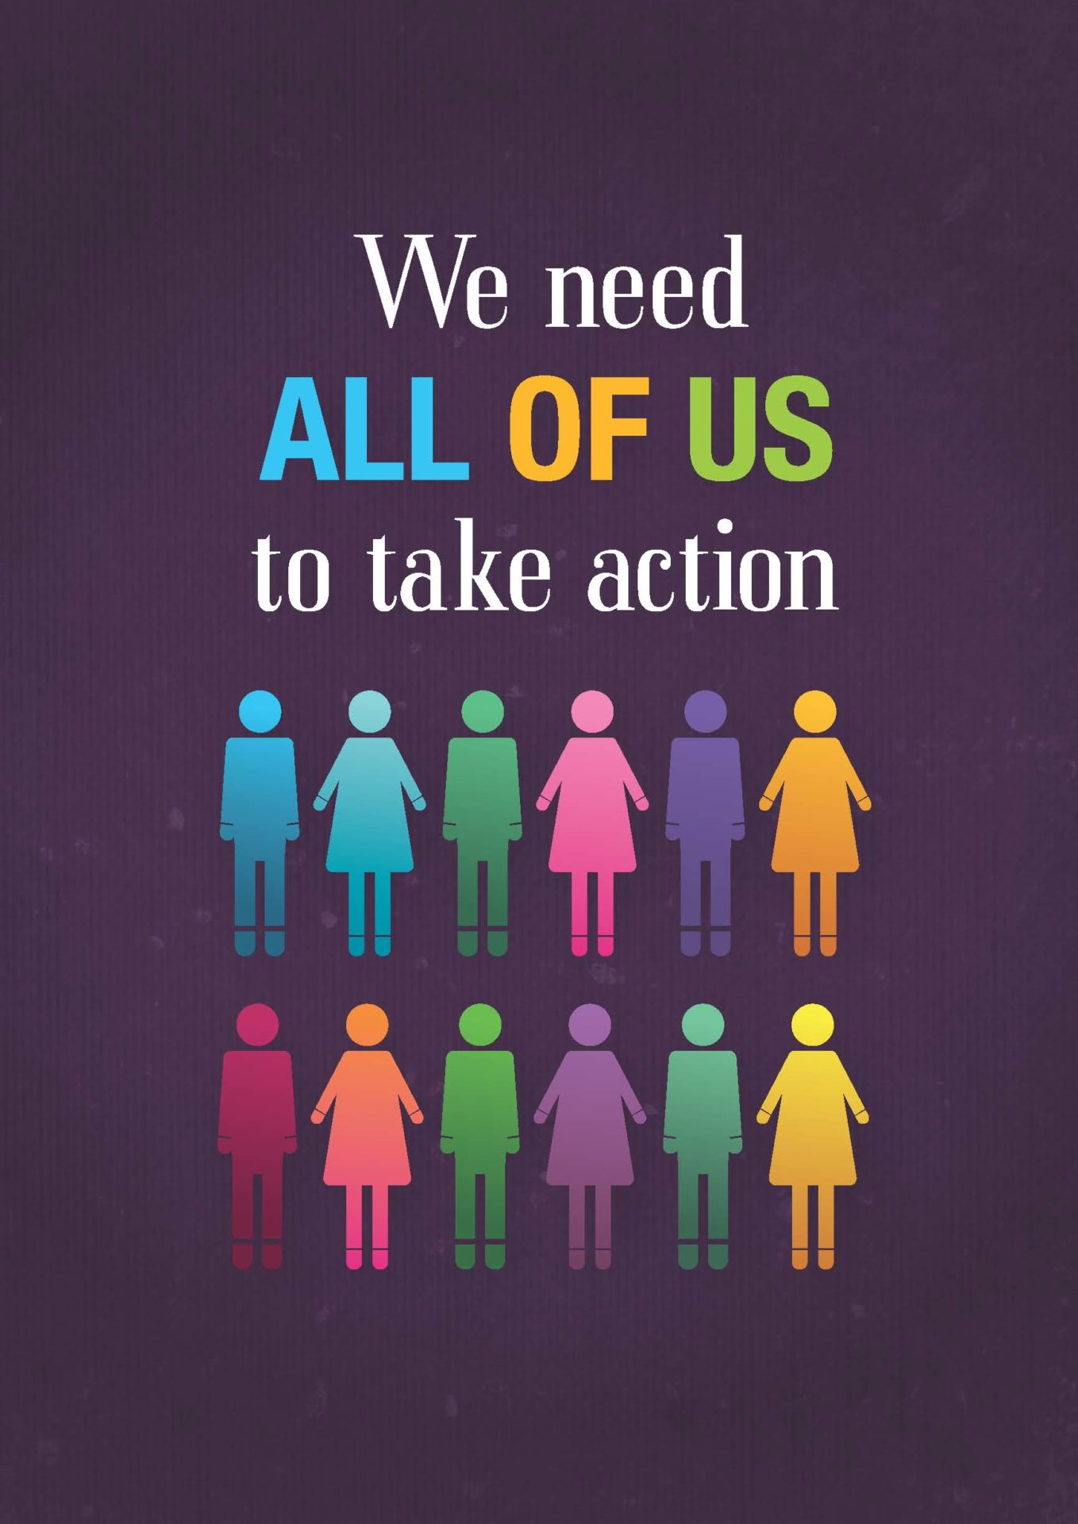
DEFINE- Social awareness:
The ability to take the
perspective of and empathize
with others, including those
from diverse backgrounds
and cultures.
This Photo by Unknown Author is licensed under CC BY-NC-ND
Notes:
DEFINE- Social awareness:
The ability to take the perspective of and empathize with others,
including those from diverse backgrounds and cultures.
Let’s take a few minutes to get up and get moving and find out more
about each other. Let’s take 5 minutes to play Buddy BINGO.

Slide 9
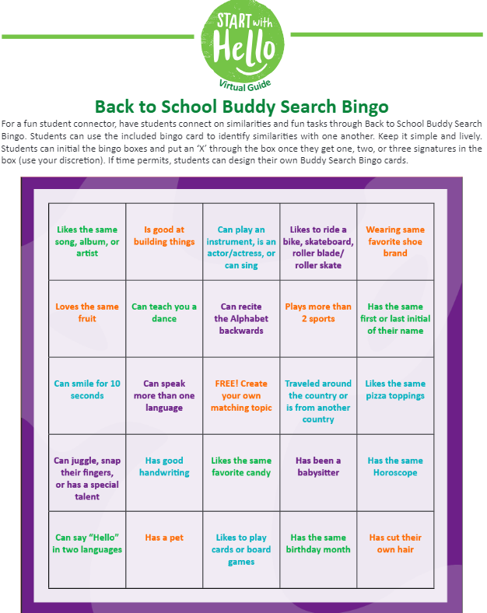
BUDDY BINGO
Instructions:
Take 5 minutes to walk around and TALK to other students in your class.
ASK them questions to find out about them. Have them SIGN their name in a box! Try to fill out your whole page!
Notes:
Let’s play BUDDY BINGO!
Instructions:
Take 5 minutes to walk around and TALK to other students in your class.
ASK them questions to find out about them. Have them
SIGN their name in a box! Try to fill out your whole page!

Slide 10
BUDDY BINGO
Instructions:
Take 5 minutes to walk around and TALK to other students in your class.
ASK them questions to find out about them. Have them SIGN their name in a box! Try to fill out your whole page!
Notes:
What is something you learned about someone else in the room?
[allow several students to share]
WHY is it important to get to know other students?
When we SEE…speak…and get to know others…we are a stronger Bobcat community!

Slide 11
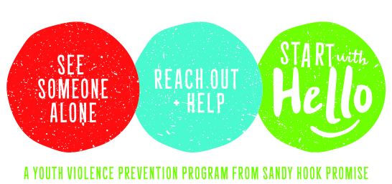
Thanks for your active participation!
Have a seat and we will continue…

Slide 12
How easy is it to start with Hello?
View video on next slide.

Slide 13
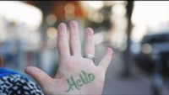
“Just Say Hello” Video from Oprah

Slide 14

See Someone
Alone
Reach Out
And Help
Start With Hello
Notes:
There are three simple steps to create this more socially inclusive community.
Step 1: See Someone Alone
Step 2: Reach Out and Help
Step 3: Start With Hello

Slide 15
Cliques
Unspoken social rules
Our identity
Notes:
Let’s review from yesterday… Why can it be difficult to reach out and
help someone else?
One reason is that there are cliques and unspoken social rules in
middle and high school that tell you it may not be ok to help someone.
These cliques and unspoken social rules are invisible boundaries
that might make you feel unsure about reaching out to
someone you don’t typically socialize with.
Also, our personal identity is at stake. Sometimes we worry about how
it might make us look or how it might affect our social status
if we reach out and help.

Slide 16
Fear of rejection
Fear of others laughing
We don’t know how
Notes:
Another reason is the fear of rejection. We may be thinking
"What if they don't like me?“ or
"What if my instinct is wrong and they want to be left alone?"
We may be nervous others will laugh at us or we just may not
know how to reach out and help.
We simply haven’t yet learned the strategies.

Slide 17
From Bystanding to Supporting:
Do you just stand by?
View video on next slide:
Notes:
Let’s check out a video about being a bystander…
and why so often we don’t reach out to help.
View video on next slide:

Slide 18

Video link if needed: https://youtu.be/Wy6eUTLzcU4?si=ZTjCmLdHd7beSYYF

Slide 19
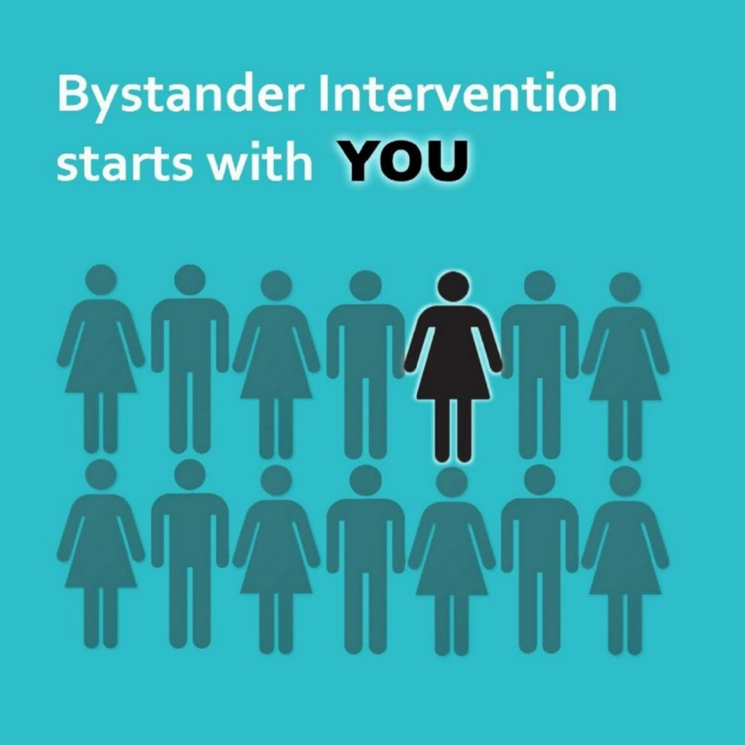
THE BYSTANDER EFFECT
What do you think about the bystander effect?
Do you think it is easier to help others when there are not other people around? Why/why not?
What is something YOU can do about it?
Notes:
Think about how this video and this concept of the bystander effect
relates to helping others in bullying situations and when someone feels left out…
What do you think about the bystander effect?
Do you think it is easier to help others when there are not other
eople around? Why/why not?
What is something YOU can do about it?

Slide 20
Decreasing their anxiety
Increasing their self-esteem
Increasing their success in school
Simply brightening their day
Notes:
Though it can be challenging to reach out and help,
it’s important to know that the benefits to reaching out
and helping others.
These benefits include:
Decreasing their anxiety
Increasing their self esteem
Increasing their success in school
Simply brightening their day

Slide 21
Increasing your confidence
Increasing your problem-solving skills ​
Increasing your ability to empathize​
Let’s view a quick video about empathy.
Notes:
There are also benefits you. For instance, helping others can lead to:
Increasing your confidence, since you’re doing
something that may be out of your comfort zone
Increasing your problem-solving skills, because you’ll be
thinking of the best ways to reach out and help ; and
Increasing your ability to empathize and understand
the feelings of others who may be different from you
Next, let’s view a video about empathy.

Slide 22

If needed-video link: https://youtu.be/fFqIZP4Yb64?si=EVxKE__FyXKtRLot

Slide 23
INTENTIONAL ACTS OF RESPECT:
When you show EMPATHY, you show RESPECT
Respect can mean many things to many people
Tthe Oxford Dictionary defines it as “the consideration for the feelings, wishes, rights or traditions of others.”
What does respect look like here at FCMS?
How can we respect others?
Notes:
When you show EMPATHY, you show RESPECT
Respect can mean many things to many people
The Oxford Dictionary defines it as “the consideration for
the feelings, wishes, rights or traditions of others.”
What does respect look like here at FCMS?
How can we respect others?

Slide 24
LET’S MOVE AND MIX!
Option 1:
Act it Out Skits
Use the next 2 slides
4 Groups
Act out scenarios provided
Option 2:
Yes/No/Maybe
Skip the next 2 slides to activity
Split room into Yes/No/Maybe sides
Students move to area they agree with

Slide 25
Let’s Act: Role Play/Skits
Respect Role Play: What would you do if you saw this happen? *Scenarios on next slide
Assign students to work in 4 groups to act out the following skits/scenarios.
Show the WRONG WAY to handle the situation and then the RIGHT WAY so that they demonstrate respect, empathy, and appropriate social behavior.

Slide 26
Let’s Act: Role Play/Skits
You walk onto the bus and ask two different students if you can sit with them. They both say “no” and slide over to the far end of the seat so you don’t even have a chance to sit down.
You and your friend are having a nice time eating pizza and telling stories at lunch. Another student walks up to your table and asks to sit with you. You are ready to say “sure,” but your friend says “no, this seat is taken.” You know that’s a lie.
You raised your hand at least three times to answer the teacher’s questions about how to solve a math problem. But you couldn’t believe it, the teacher never called on you or even looked your way!
A student walked past your desk during free time as you were drawing a picture in your journal. She paused, laughed, and scribbled all over your picture.

Slide 27
Let’s GET MOVING! Yes-No-Maybe Activity
Instructions:
Designate one side of the room as “Yes,” the opposite side as “No,” and the center as “Maybe.”
Students: Pay attention to the statement. Move to the side/space in the room that corresponds with how they feel about the statements read.
Variation (less movement): Ask students to write the words separately (YES-NO-MAYBE) on 3 index cards or scrap paper and when prompts are read aloud, students hold up the card that applies to the scenario. Or, use a thumbs-up, thumbs-down, or sideways thumb to share their opinions.

Slide 28
Let’s GET MOVING Again! Yes-No-Maybe Activity
“I can speak 2 or more languages.”
“I love spicy foods.”
“In my free time I’m riding my bike.”
“I make really good chocolate chip cookies.”
“I babysit my younger sister/brother/cousin at least once a week.”
“I’m a huge Marvel fan”
“I love wearing slides to school.”
“I enjoy fishing.”
“Last Halloween I dressed up as a superhero.”
“I eat ranch dressing on pizza.”

Slide 29
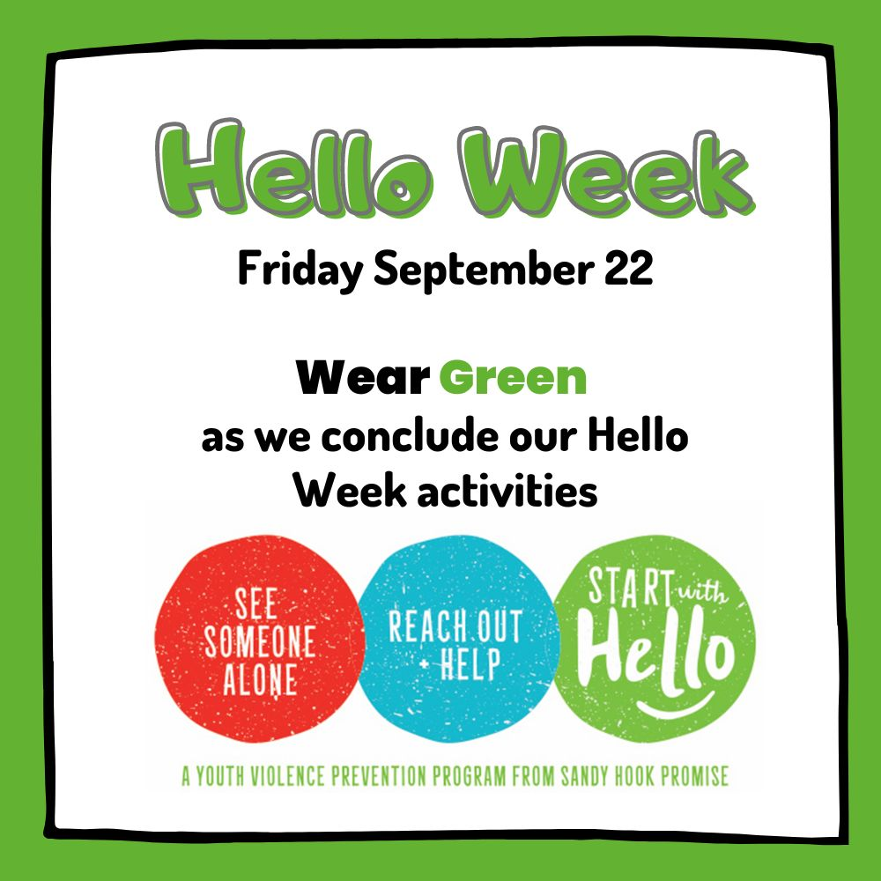
Start With Hello:
Remember to wear GREEN on Friday!
Closing activities:
1.Video on next slide!
2.Make a small poster about Start With Hello and tape it in the hallway by your classroom door.
Notes:
Wear GREEN on Friday…it is the color of the Sandy Hook Promise program
because it is the school color of Sandy Hook Elementary school.
Go GREEN all over Friday!
Have extra time? Play the video on the next slide about
how we treat others…or make a poster about what you
learned this week and post it outside classroom door.

Slide 30

If needed-video link:https://youtu.be/mTsvSAItPqA?si=L6D5OLEQGYdvVSLY

Slide 31
Create a “Start With Hello” Poster or small flyers on computer or scratch paper to post outside of classroom.
Send pictures to Tracy.Kelly@fortbendisd.com and Dawne.Sanders@fortbendisd.com
Notes:
EXTRA Activity:

Slide 32
To review:
Your promise chain link from yesterday!
How can we accept and show respect to our fellow classmates/teachers/family? Etc.
Respect looks different depending on who you’re interacting with and where you are at the time.
Treating others with respect helps build a stronger community.
Notes:
[Presenter Outro]
[Example: Thank you so much for taking the time to learn about ways to c
reate a closer and more inclusive school and community.
Because we know that both loneliness and social isolation can lead to some pretty bad stuff,
I hope this program has made you feel empowered to reach out and make a
difference in one of your friend’s or classmates lives!
Who knows, you may just find your new best friend!”
Okay, here we are. The end of my journey and the beginning of yours.
It was a joy to educate you on how to make a difference in your school community.
Thank you for listening and paying attention! And remember, to always Start with Hello].

Slide 33

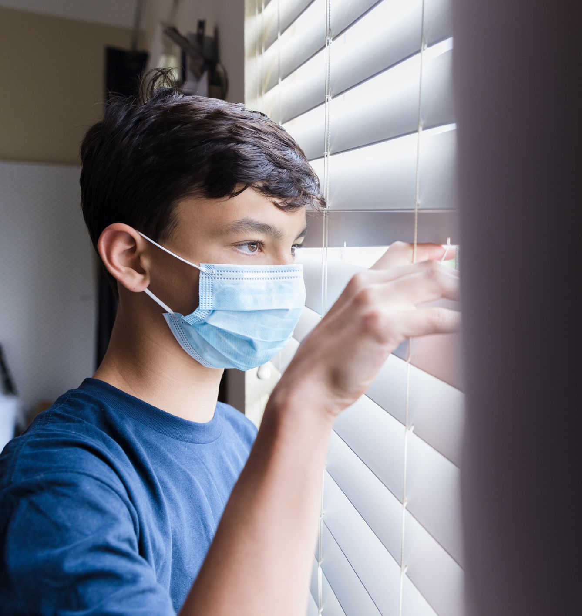
Review: Social Isolation
When someone does not have frequent or any social interactions with their peers-they do not have close friends.
Notes:
For example, they are often alone after school or at lunch, and alone on the weekends.
They may be alone because their peers discourage them from sitting at their table at lunch or exclude them from hanging out after school.

Slide 34
Review: Social Isolation
It is a perceived or real feeling that you don’t fit in, that you don’t belong, or that you have been left out.
The separation may be the result of a rejection from others, or from the person’s own withdrawal from others.
Notes:
It is a perceived or real feeling that you don’t fit in, that you don’t belong, or that you have been left out.
The separation may be the result of a rejection from others, or from the person’s own withdrawal from others.
Social isolation can happen in person or online.
People who are socially isolated may prefer to be alone, may avoid human interaction or keep to themselves, and/or may be anxious or uncomfortable around others.

Slide 35
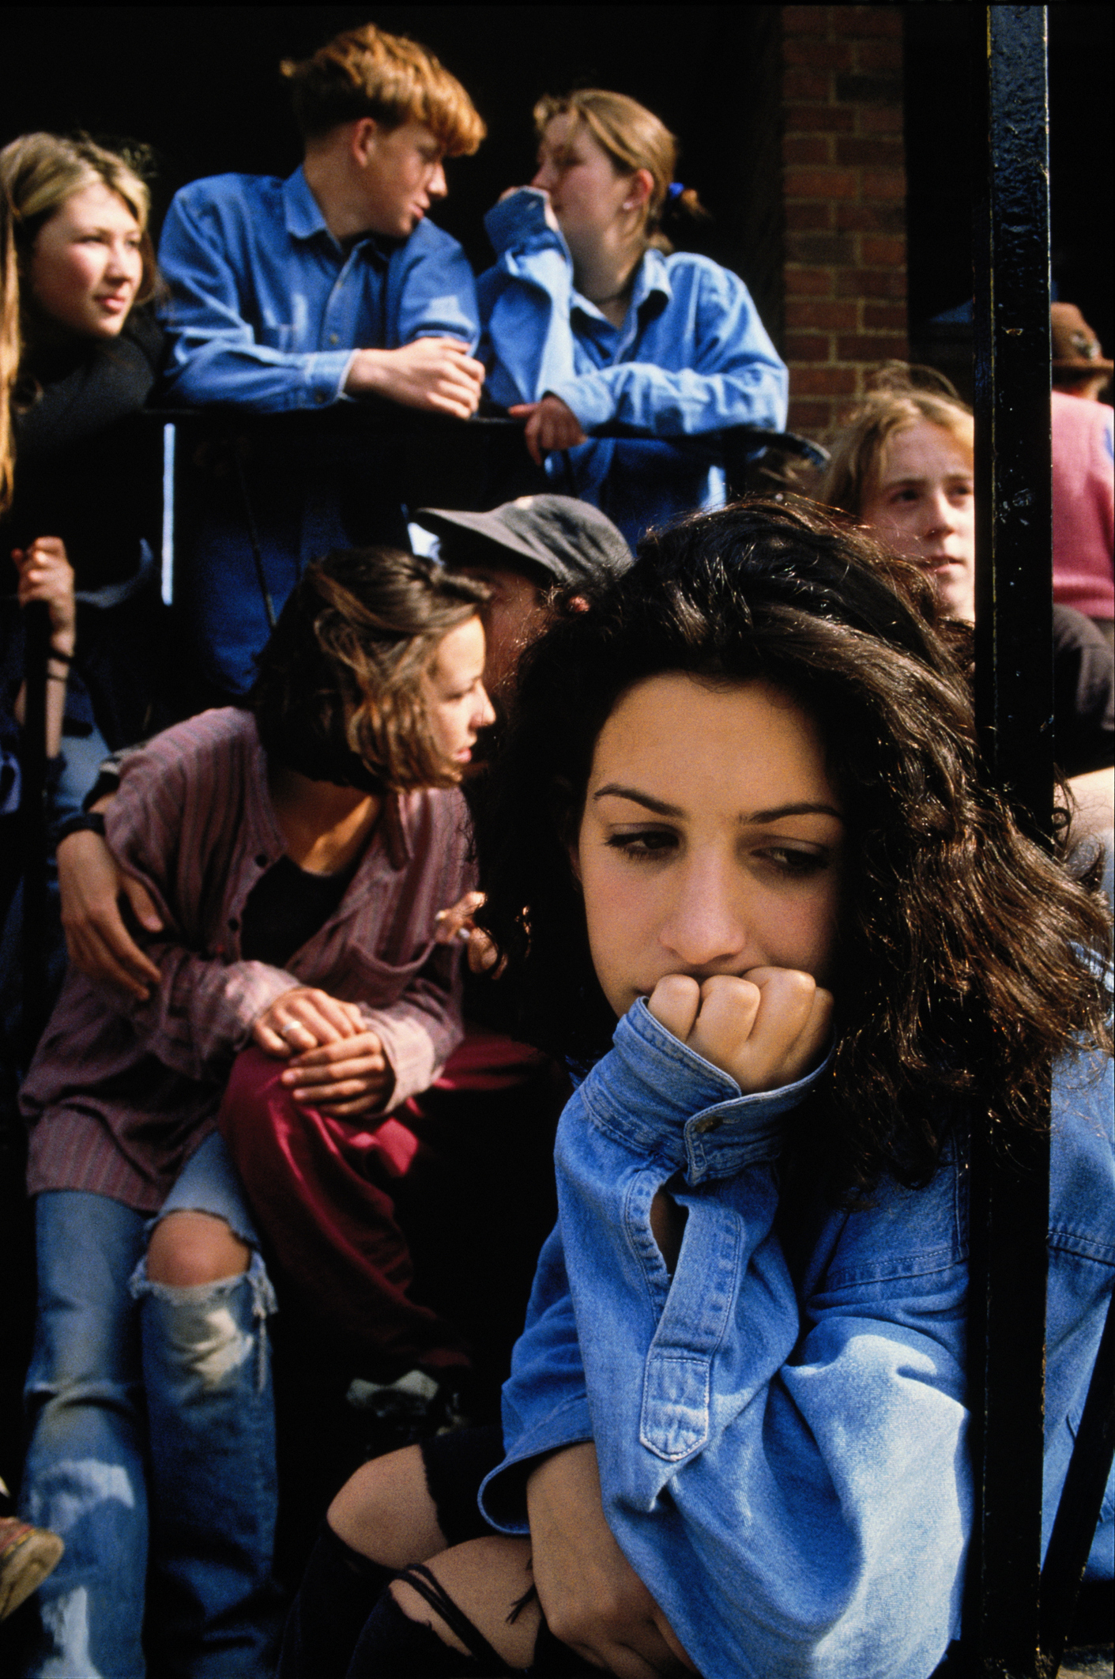
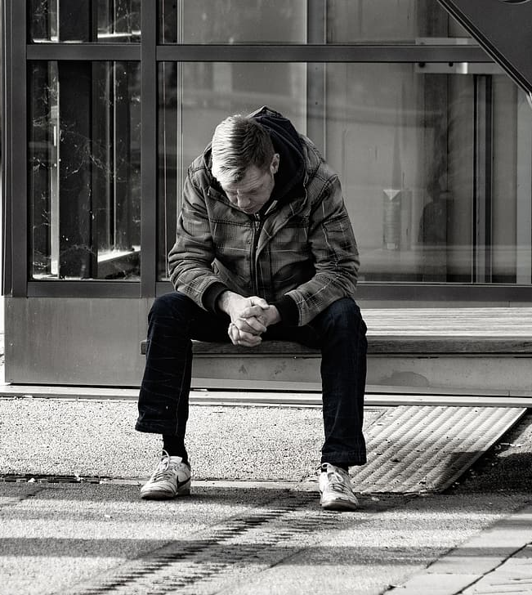
Review-Loneliness
Loneliness is a feeling.
It is when there is a difference between what someone WANTS in a social relationship and what is HAPPENING in the social relationship.
Because loneliness is a feeling, being physically alone is not always necessary to experience loneliness.

Slide 36
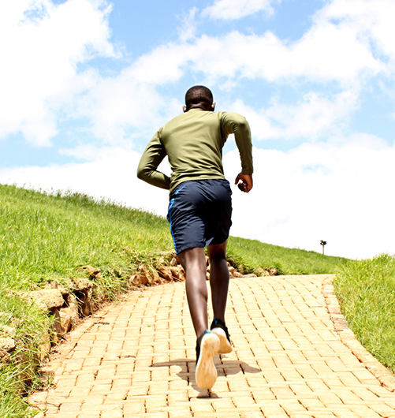
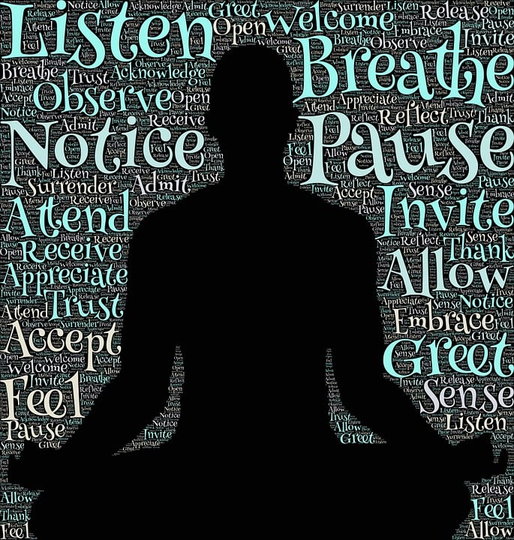
Review-Healthy Alone Time
I know some of you may be thinking “sometimes I want to be alone” and that is totally OK!
Let’s clarify: being alone doesn't always mean someone is lonely or socially isolated.
Notes:
Sometimes we choose to be alone because it helps us relax or recharge our batteries; be more creative; more productive...or sometimes we just need to be away from people.
This is healthy alone time. ​

Slide 37
Healthy Alone Time
Healthy Alone Time is when you choose to be alone to clear your mind, take a break from “socializing,” give time to focus on and recharge yourself, and/or work through problems or possibilities without any outside influence.
In short, healthy alone time is a positive choice.

Slide 38
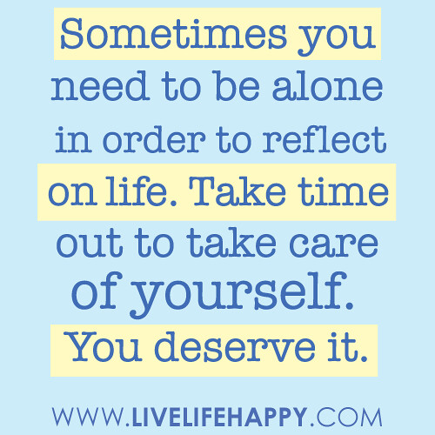
Review: Healthy Alone Time
Some examples of Healthy Alone Time include:​
  Reading a book​
  Watching tv, movies, etc.​
  Playing video game​s
  Listening to music
  Going for a walk
  Playing guitar
Personally, when you have alone time, what do you like to do?
This Photo by Unknown Author is licensed under CC BY-SA-NC
Notes:
Read slide and ASK QUESTION…allow students to answer.
Personally, when you have alone time, what do you like to do?

Slide 39
Let’s GET MOVING! Yes-No-Maybe Activity
Instructions:
Designate one side of the room as “Yes,” the opposite side as “No,” and the center as “Maybe.”
Students: Pay attention to the statement. Move to the side/space in the room that corresponds with how you feel about the statements read.
Variation (less movement): Ask students to write the words separately (YES-NO-MAYBE) on 3 index cards or scrap paper and when prompts are read aloud, students hold up the card that applies to the scenario.

Slide 40
Let’s GET MOVING! Yes-No-Maybe Activity
If someone spends a lot of time alone, they must feel lonely most of the time. (Discuss)
Someone can have many close friends and still deal with social isolation/feel lonely. (Discuss)

Slide 41
Let’s GET MOVING! Yes-No-Maybe Activity
Even healthy alone time can have negative consequences. (Discuss)
When I feel lonely, it makes me uncomfortable. (Discuss)

Slide 42
Let’s GET MOVING! Yes-No-Maybe Activity
I can tell when my friends or classmates are feeling lonely.
Spending time on social media helps me feel less lonely.

Slide 43
Discussion Activity:
Turn & Talk or large group:
What are examples of times when or reasons why you might want to be alone, and what do you do during your healthy alone time?
How can you tell when your alone time may be starting to become less healthy?
What might lead someone to feel socially isolated, and how might we know they feel that way?
How can we make sure that people who prefer to be alone don’t become socially isolated?

