Slide 1
Meadows Elementary Gifted Services
September 20, 2022
Notes:
Presenter:
Time:
Strategy:
Materials:
Say:

Slide 2
Meet our GT Teachers (Elementary)
1st Grade – Mrs. Safieh
3rd Grade – Mrs. Gregg
4th Grade – Mrs. Jones
5th Grade – Mr. Champ
Notes:
Elementary - Enter GT teachers' names (duplicate if necessary)
Secondary Only – Delete this slide

Slide 3
Fort Bend ISD Gifted and Talented
Areas Served
FBISD Gifted and Talented Student
English Language Arts
Mathematics
Social Studies
Science
Students are currently identified and served in the 4 core areas.
Notes:
Your child is identified in either Math and Science, ELA and SS, or all areas. Your child’s teacher in these subject areas will provide differentiation according to your child’s needs.

Slide 4
Differentiation is…
“… a teacher’s response to a gifted learner’s needs.” (Carol Ann Tomlinson)
“… customizing instruction so every gifted learner experiences continuous learning.” (Bertie Kingore)
Notes:
Read the quotes from GT experts.

Slide 5
How do we Differentiate?
2P’s | 2 C’s | 2 F’s
Pre-assessment | Choice | Feedback
Perky Pace | Challenge | Flexibility
Gentry, M. (2014). Total School Cluster Grouping and Differentiation: A Comprehensive Research Plan for Raising Student Achievement and Improving Teacher Practices (pp 100 – 105)
Notes:
Pre-assessment
Pre-assessment helps teachers reduce unnecessary practice. What students already know is highly correlated to what they will learn in the future (Marzano 2004). These pre-assessments can be formal (pre-tests) or informal (quick writes and surveys). Teachers also assess for any affective needs (self-efficacy, motivation, social skills).
Perky Pace
Perky Pace means teaching the required content at a rate that keeps the student’s attention and does not linger unnecessarily on basic content. There are times when a gifted learner will need extended time on a particular content area.
Choice
Choice refers to how the participates in learning or displaying mastery of the content. This builds leadership and creativity in students.
Challenge
Ensures that student engages in activities that are meaningful and appropriately difficult. Kanesvsky (2011) refers to this as deferential differentiation; allowing students to make choices while ensuring the academic standards are met in a complex and more in-depth way.
Feedback
The greatest impact a teacher can have on students success on independent self-selected tasks is providing prompt and customized feedback.
Flexibility
Teachers do not rely on assumptions of gifted learners. Respectful differentiation is sensitive to culture, gender, age, and ability level.

Slide 6
How do we Differentiate?
Notes:
Sophisticated Learning Products
Visit www.texaspsp.org Explain GT Project at your campus
Acceleration:
Presentation posted at www.fortbendisd.com/gifted

Slide 7
GT Services for Elementary Students includes ...
Elementary (K-5)
Cluster Grouping with differentiated instruction in core content areas (ELA, SS, Math, Science)
Notes:
Currently students in elementary are cluster grouped with a GT trained teacher where instruction is differentiated to meet their needs.

Slide 8
Cluster Grouping
Gifted and Talented students are ensured opportunities to work together as a group, work with other students, and work independently during the school day as well as the entire school year.
GT students are placed together for instruction in the appropriate content area(s) for which they have been identified in cluster grouping.
Teachers are trained to adapt curriculum and instruction for their gifted learners.
Notes:
Differentiating the pace of learning for GT students provides an opportunity for them to learn at a pace commensurate with their abilities in order to maintain their interest and provide a developmentally appropriate level of challenge. Acceleration practices involving pacing include continuous progress, curricular compacting, and subject-matter acceleration.

Slide 9
GT Initiatives
Notes:
TPSP applies to all campuses. Delete slides 13 – 18 for GT Learning Plan and Innovation Hour if these initiatives are not on your campus.

Slide 10
GT Learning Plan
Notes:
Only share if you are a GT Learning Plan campus.

Slide 11
GT Learning Plan ( 1st Year)
GT Learning Plans will be implemented in grades
1st-5th (Elementary)
6th (Middle School)
9th (High School)
Notes:
Hide this slide if you are a Year 2 or more GT Learning Plan Campus

Slide 12
GT Learning Plan
The GT Learning Plan (GTLP) is a written record of gifted and talented programming utilized with each gifted child. and provides opportunities for students to develop academic and affective (social and emotional) goals.
The GTLP provides opportunities for students to develop academic and affective (social and emotional) goals that are monitored by the teacher and student.
Notes:
COGS may add an additional slide with upcoming dates/timeline

Slide 13
Gifted and Talented Learning Plan: SMART Goals
SMART goals describe the specific and measurable programming emphasis for annual learning and growth
The areas selected as priorities for SMART goals are monitored through ongoing assessment.
SMART Goals are linked to specific instructional strategies.
Planning guide for making instructional decisions about materials, programming options and assessments for gifted students based upon strengths, interests, and social-emotional needs.
Notes:
The GT Learning Plan will be completed in Skyward by the teacher and available to parents through Family Access in Skyward.

Slide 14
Goal Setting Timeline
August 22-September 22
GTLP Goal Development and Initial Conference window
September 12-16
Elementary GTLP Goals Draft Due
September 19-26:
Parent Goal review/input: A GTLP collaboration/discussion opportunity
September 26-September 30
Elementary and Secondary (grades 1-12) GTLP finalized with Parent Signature Due
Parents digital signature submitted through the Family Access Parent Portal in Skyward
October 3-6
Parents use Family Access to Sign GT Learning Plan
October 6
GT Learning Plan Signing Day (Final)
Notes:
Share how parents are going to be made aware of/provide input on student’s goals (parent-teacher conferences, phone, email, or hard document

Slide 15
Texas Performance Standards Project

Slide 16
Texas Performance Standards Project
The Texas Performance Standards Project (TPSP) provides GT students with an opportunity to share their in-depth knowledge of a topic of interest.
The TPSP is a required classroom learning experience for students in 1st-7th grade. Participation in TPSP in 8th - 12th grade is recommended.
Notes:
COGS may add an additional slide with upcoming dates/timeline set by campus/teachers.

Slide 17
Additional Information

Slide 18
Acceleration Options in Fort Bend ISD
Curriculum Compacting
Partial Acceleration, by Content
Self-Paced Instruction
Credit by Exam
Advanced Placement
Dual Credit
Collegiate Enrichment Courses
Visit www.fortbendisd.com/gifted
for the full presentation on Acceleration Options in FBISD
Notes:
Visit www.fortbendisd.com/gifted for the full presentation on Acceleration Options in FBISD
Curriculum Compacting
A classroom strategy that makes adjustments to the curriculum
Adjustments include fewer introductory and/or on-level activities
Replaces on-level activities with rigorous content
May not result in advanced grade placement
Partial Acceleration, by Content
A school based practice that offers students higher level content
Physically moves to a higher level classroom for part of the day; or
Provides higher-level curricular materials within their own classroom.
Opportunities through talent searches and summer programs for gifted
Self-Paced Instruction
Gives students control over pacing and content decisions
Uses online platforms such as
Think Through Math,
Khan Academy
iStation
Reputable online courses (fees may apply)
Enhanced though campus implementation of TPSP/Project Based Learning

Slide 19
Additional Opportunities for your GT Child
Middle School Gifted and Talented Academy
Gifted and Talented Mentorship (12th Grade Students)
Notes:
GT Academy
Housed at Quail Valley MS for GT students in grades 6-8
Students are admitted as incoming 6th graders through a lottery system
Instruction is designed to enhance self-awareness, self-efficacy, problem solving and the learning of critical and creative thinking skills that empower students
Students not attending the GT Academy receive GT services at their zoned campus.
Students are served in the four core plus Spanish at the GTA. All other classes are embedded with zoned students.
There are two lotteries. The first provides seats to gifted students who have cognitive abilities scores in the 97th percentile. A second lottery with all other GT identified students is run once the first process has been completed.
GT Mentorship
An innovative course that serves exceptionally gifted and motivated students through an evening course and placement with a mentor in a particular field of research.
Students explore complex thought, expand critical thinking, consider novel problem solving strategies and engage in original research and project development while working alongside a professional mentor.
Students may apply for this program in their 10th or 11th grade year for participation the following year.
Highly rigorous and competitive application process. Students must have already begun looking into a particular field of research and are able to commit to taking an off period at the end of the, as well as have transportation to drive themselves to the Education Complex for evening classes and to their mentorship site.

Slide 20
GT Parent Advisory Committee (PAC)
Who is the PAC?
The Gifted and Talented Parent Advisory Committee is comprised of parents in Fort Bend ISD who support the GT program offered by Fort Bend ISD. The PAC is a committed group of parents who provide feedback related to Gifted and Talented programming.
How do I volunteer?
Scan the QR Code below and complete the PAC Interest Form today. Each campus is allowed up to three parents to serve on the PAC.
Notes:
Take a moment to inform parents about the Parent Advisory Committee (PAC). If your campus do not have a PAC representative ask parents to consider to joining the PAC and completing the PAC Interest Form. I will upload the list of current PAC representatives in Schoology for your reference.

Slide 21
Parent Resources
SENG –Supporting Emotional Needs of Gifted
www.sengifted.org
NAGC –National Association of Gifted Children
www.nagc.org
TAGT –Texas Association for the Gifted and Talented
www.txgifted.org
PACE –Parents for Academic Excellence
www.pacefortbend.org
Notes:
Here is a list of resources for parents of gifted students.

Slide 22
Parent Resources
https://www.davidsongifted.org/
http://cty.jhu.edu/
www.giftedandtalented.com
https://www.destinationimagination.org/

Slide 23
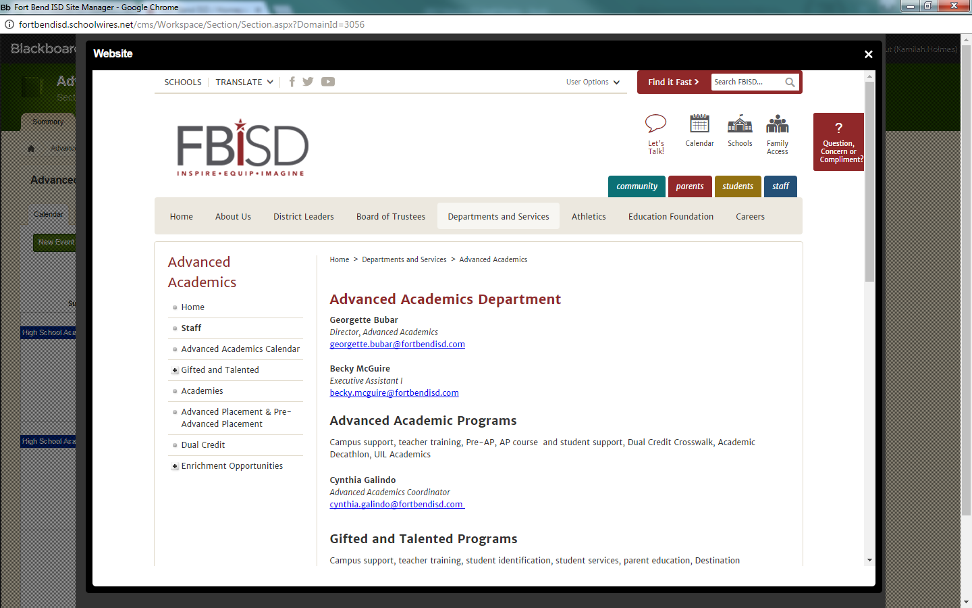
Contact Us!
281-634-4720
GT Counselor
Shalyn.Clay@fortbendisd.com
GT Administrator
Ruth.Riha@fortbendisd.com
GT Champion of Gifted Services
Carrie.Gregg@fortbendisd.com
GT Parent Liaison
wenpen76@gmail.com
Notes:
Customize this information with your campus contacts.

