Slide 1
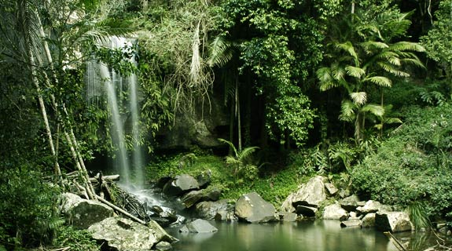
Climate Regions, Biomes and Tropical Climates
By: Ashley Pham and Mariana Bengochea

Slide 2
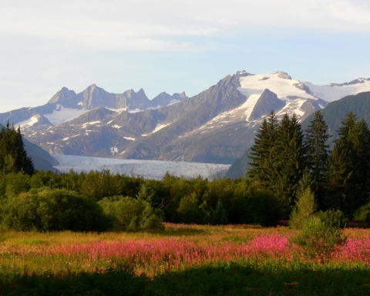
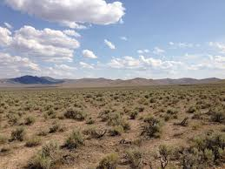
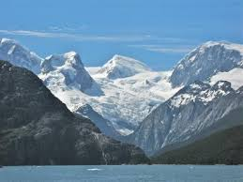
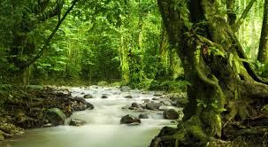
Climate Regions
Four Climate Zones: tropical, dry, mid latitude, and high latitude.
Elaborate with different biomes.
Climate similarities results in similar biome.

Slide 3
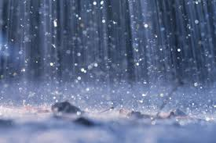
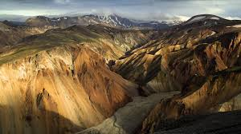
Biomes
Affected by two factors: climate and terrain.
Climate: influenced by precipitation and temperature.
Terrain: influenced by distribution of land masses, ocean basins, topography of continents.

Slide 4
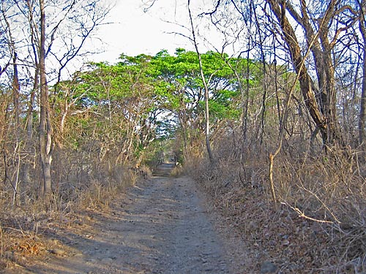
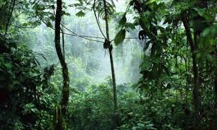
Tropical Climates
Wet or dry climates
Found in or near low latitudes (the Tropics)
Found in South America, the Caribbean, Asia, and Africa

Slide 5
Sources
http://www.google.com/imgres?imgurl=https://seasianrainforests.wikispaces.com/file/view/rainforest.jpg/301390276/rainforest.jpg&imgrefurl=https://seasianrainforests.wikispaces.com/&h=320&w=575&tbnid=s0e0jPGnQLC33M:&docid=fGM5UpmOumRn2M&ei=EZ8AVu62BIKyggTT64uAAw&tbm=isch&ved=0CDMQMygBMAFqFQoTCK6DqdmvicgCFQKZgAod0_UCMA
http://www.google.com/imgres?imgurl=http://easyscienceforkids.com/wp-content/uploads/2014/02/Science-for-Kids-Website-on-Dry-Climate-Image-of-a-Dry-Climate-Region.jpg&imgrefurl=http://easyscienceforkids.com/all-about-dry-climates/&h=2448&w=3264&tbnid=vzvVEAYyKptHgM:&docid=iXmaVQFfokCxMM&ei=Z6AAVrKJIMnPgwSjtY24CA&tbm=isch&ved=0CDIQMygAMABqFQoTCPLYzvywicgCFcnngAodo1oDhw
http://www.google.com/imgres?imgurl=http://www.klccconventioncentre.com/images/articles/img_climate.jpg&imgrefurl=http://www.klccconventioncentre.com/Malaysia-@-Climate.aspx&h=413&w=751&tbnid=dojTAk7EikxgAM:&docid=yrMDksrkhq6EaM&ei=36AAVsnnDci6ggSvl4yoBQ&tbm=isch&ved=0CDEQMygAMABqFQoTCInT2LWxicgCFUidgAodrwsDVQ
http://www.google.com/imgres?imgurl=http://img.ezinemark.com/imagemanager2/files/30002494/2010/07/2010-07-12-16-00-08-1-the-climate-in-juneau-is-a-mid-latitude-oceanic-cl.jpeg&imgrefurl=http://travel.ezinemark.com/beautiful-sceneries-of-juneau-in-alaska-773653723fcf.html&h=384&w=480&tbnid=zIsHk_PcLawUaM:&docid=ZN17eO_7V9OmjM&ei=P6EAVuH9CcuVNryqo_AO&tbm=isch&ved=0CDMQMygCMAJqFQoTCKGZuOOxicgCFcuKDQodPNUI7g
http://www.google.com/imgres?imgurl=http://cdn.phys.org/newman/gfx/news/hires/glaciershelp.jpg&imgrefurl=http://phys.org/news/2010-09-glaciers-high-latitude-mountains-taller.html&h=300&w=400&tbnid=_NwZMbFC-1qu9M:&docid=s1CI4RBJwLnqQM&ei=paEAVvDdFsyrgwTuo46gDw&tbm=isch&ved=0CC4QMygAMABqFQoTCLDElpSyicgCFczVgAod7pED9A
http://www.google.com/imgres?imgurl=http://d2x3wmakafwqf5.cloudfront.net/wordpress/wp-content/blogs.dir/104/files/2014/04/heavy-rainfall.jpg&imgrefurl=http://www.am980.ca/2015/04/08/rainfall-warning-in-effect-for-london/&h=1066&w=1600&tbnid=lmLUDkmN1IPeYM:&docid=Az91ANYMJGmFWM&ei=EqIAVqqiIoyYgwSrtSk&tbm=isch&ved=0CDEQMygAMABqFQoTCKrznsiyicgCFQzMgAodq1oKAA
http://www.google.com/imgres?imgurl=http://www.twincitiesholistichealth.com/wp-content/uploads/2015/02/terrain.jpg&imgrefurl=http://www.twincitiesholistichealth.com/terrain-medicine/microbiome-and-global-dysbiosis/&h=1080&w=1920&tbnid=f2MwuHjSDJE6mM:&docid=Fvc01cM91cE13M&ei=X6IAVpH5BsSoNuTNnPAP&tbm=isch&ved=0CDEQMygAMABqFQoTCNGk3-yyicgCFUSUDQod5CYH_g
http://www.google.com/imgres?imgurl=http://www.marietta.edu/~biol/biomes/images/tropseas/a80_cr_0239.jpg&imgrefurl=http://www.marietta.edu/~biol/biomes/tropdry.htm&h=375&w=500&tbnid=3YzFQ8y6Zc-wuM:&docid=Eq507fE9LZC77M&ei=tqIAVq_5DYmrggTti6qACA&tbm=isch&ved=0CB0QMygBMAFqFQoTCK-spJazicgCFYmVgAod7YUKgA
http://www.google.com/imgres?imgurl=http://static.wixstatic.com/media/1ee798_b14ad209e65add2f70351935a8e26678.jpg_512&imgrefurl=http://marclineberger.wix.com/tropical-wet-climate%23!page-3&h=276&w=460&tbnid=cXS-_9A92ZXHIM:&docid=IrMd9hwdb4FN2M&ei=eqMAVv-zMsergwTtiqXQCA&tbm=isch&ved=0CB8QMygDMANqFQoTCP_Yg_SzicgCFcfVgAodbUUJig

